Slide 1
Notes:
Lobbying on parliament hill

Slide 2
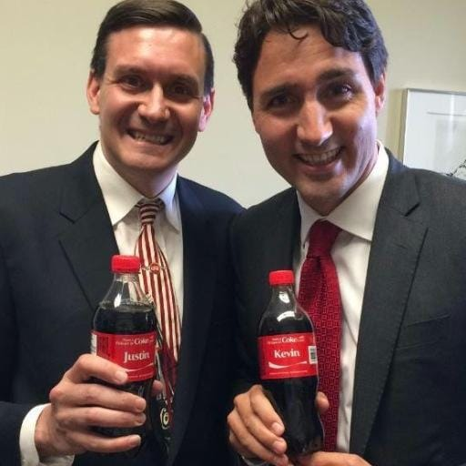
Kevin Bosch Managing Partner Sandstone Group
19 years on Parliament, working for 3 Prime Ministers, and 7 Liberal Party Leaders
7 years in government relations and advocacy
A regular on the Hill Times Top 100 Lobbyists in Canada
Represented clients in a wide range of industries, including agriculture, technology, health, finance, environment, infrastructure, manufacturing, energy, defence, transportation, telecommunications and the charitable sector

Slide 3
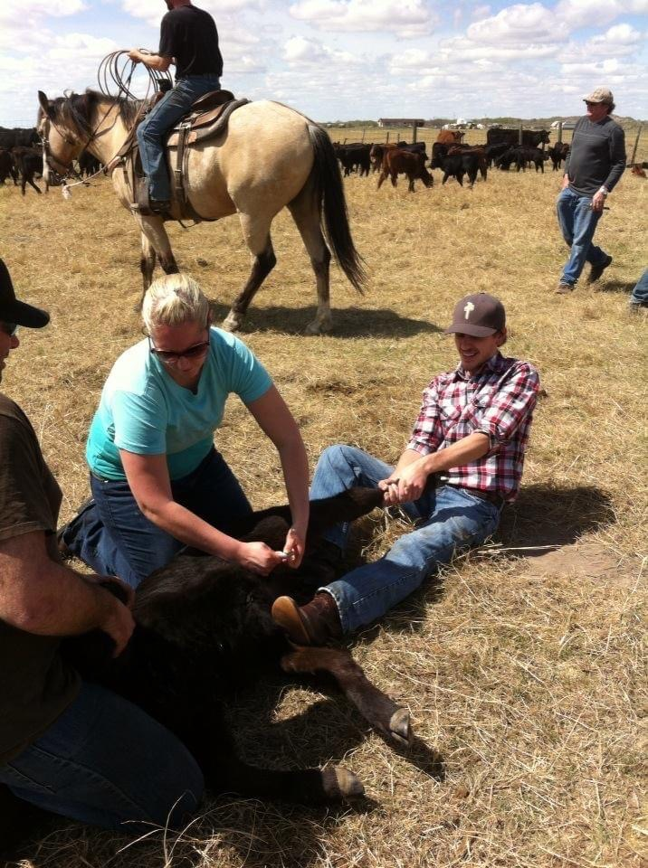
The Bosch Ranch

Slide 4
Build a Solid Strategy
First, identify what success looks like. What is achievable? What is realistic?
Measure twice, cut once. Develop your strategy before you engage;
Map out your stakeholders. Who is responsible for your issues? Who is going to care? Who are your potential supporters and champions

Slide 5
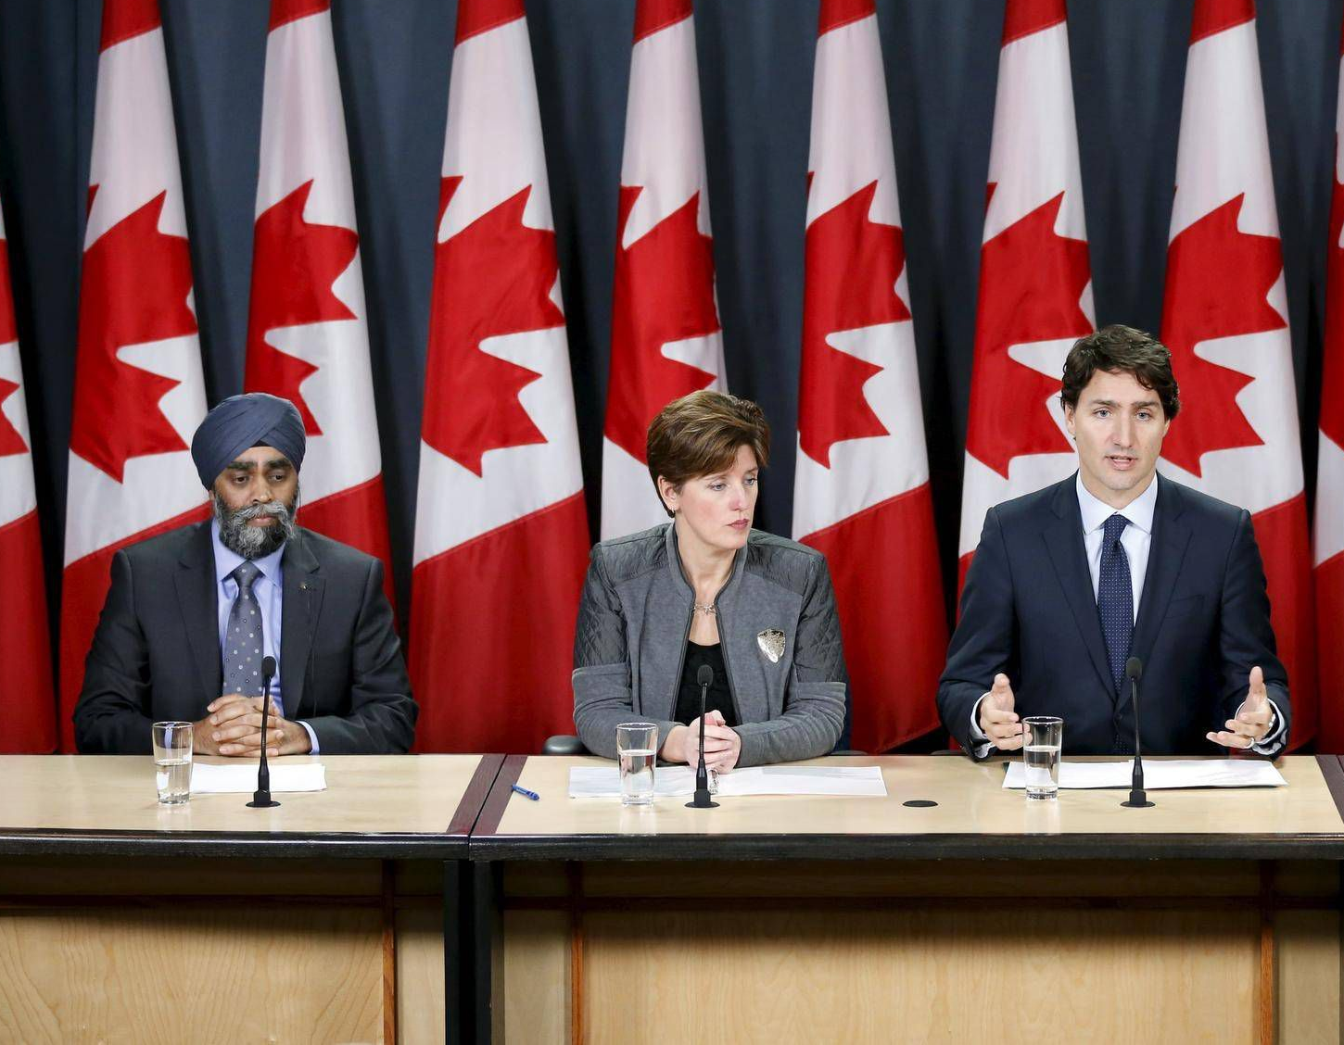
Clearly Communicate Your Message
Craft a compelling narrative
Always have a clear ask, that can be explained in a few short sentences
Create a concise deck and leave-behind documents
Use data effectively (polling, surveys, statistics, studies, credible third-party evidence)
Don’t downplay your expertise. Nobody in government knows your business better than you

Slide 6
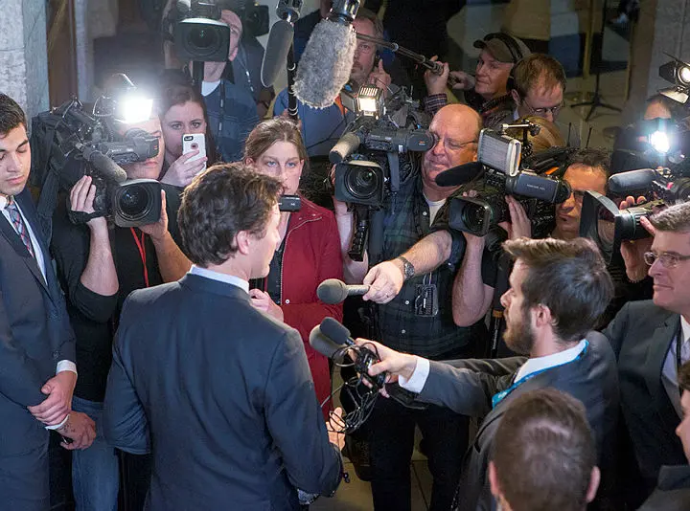
Media & Social Media
Government Relations (GR) through Public Relations (PR)
Use the media and social media to lay the groundwork for your issues
Create media stories or social media campaigns before you do your outreach
Media can light a fire under a disengaged government

Slide 7
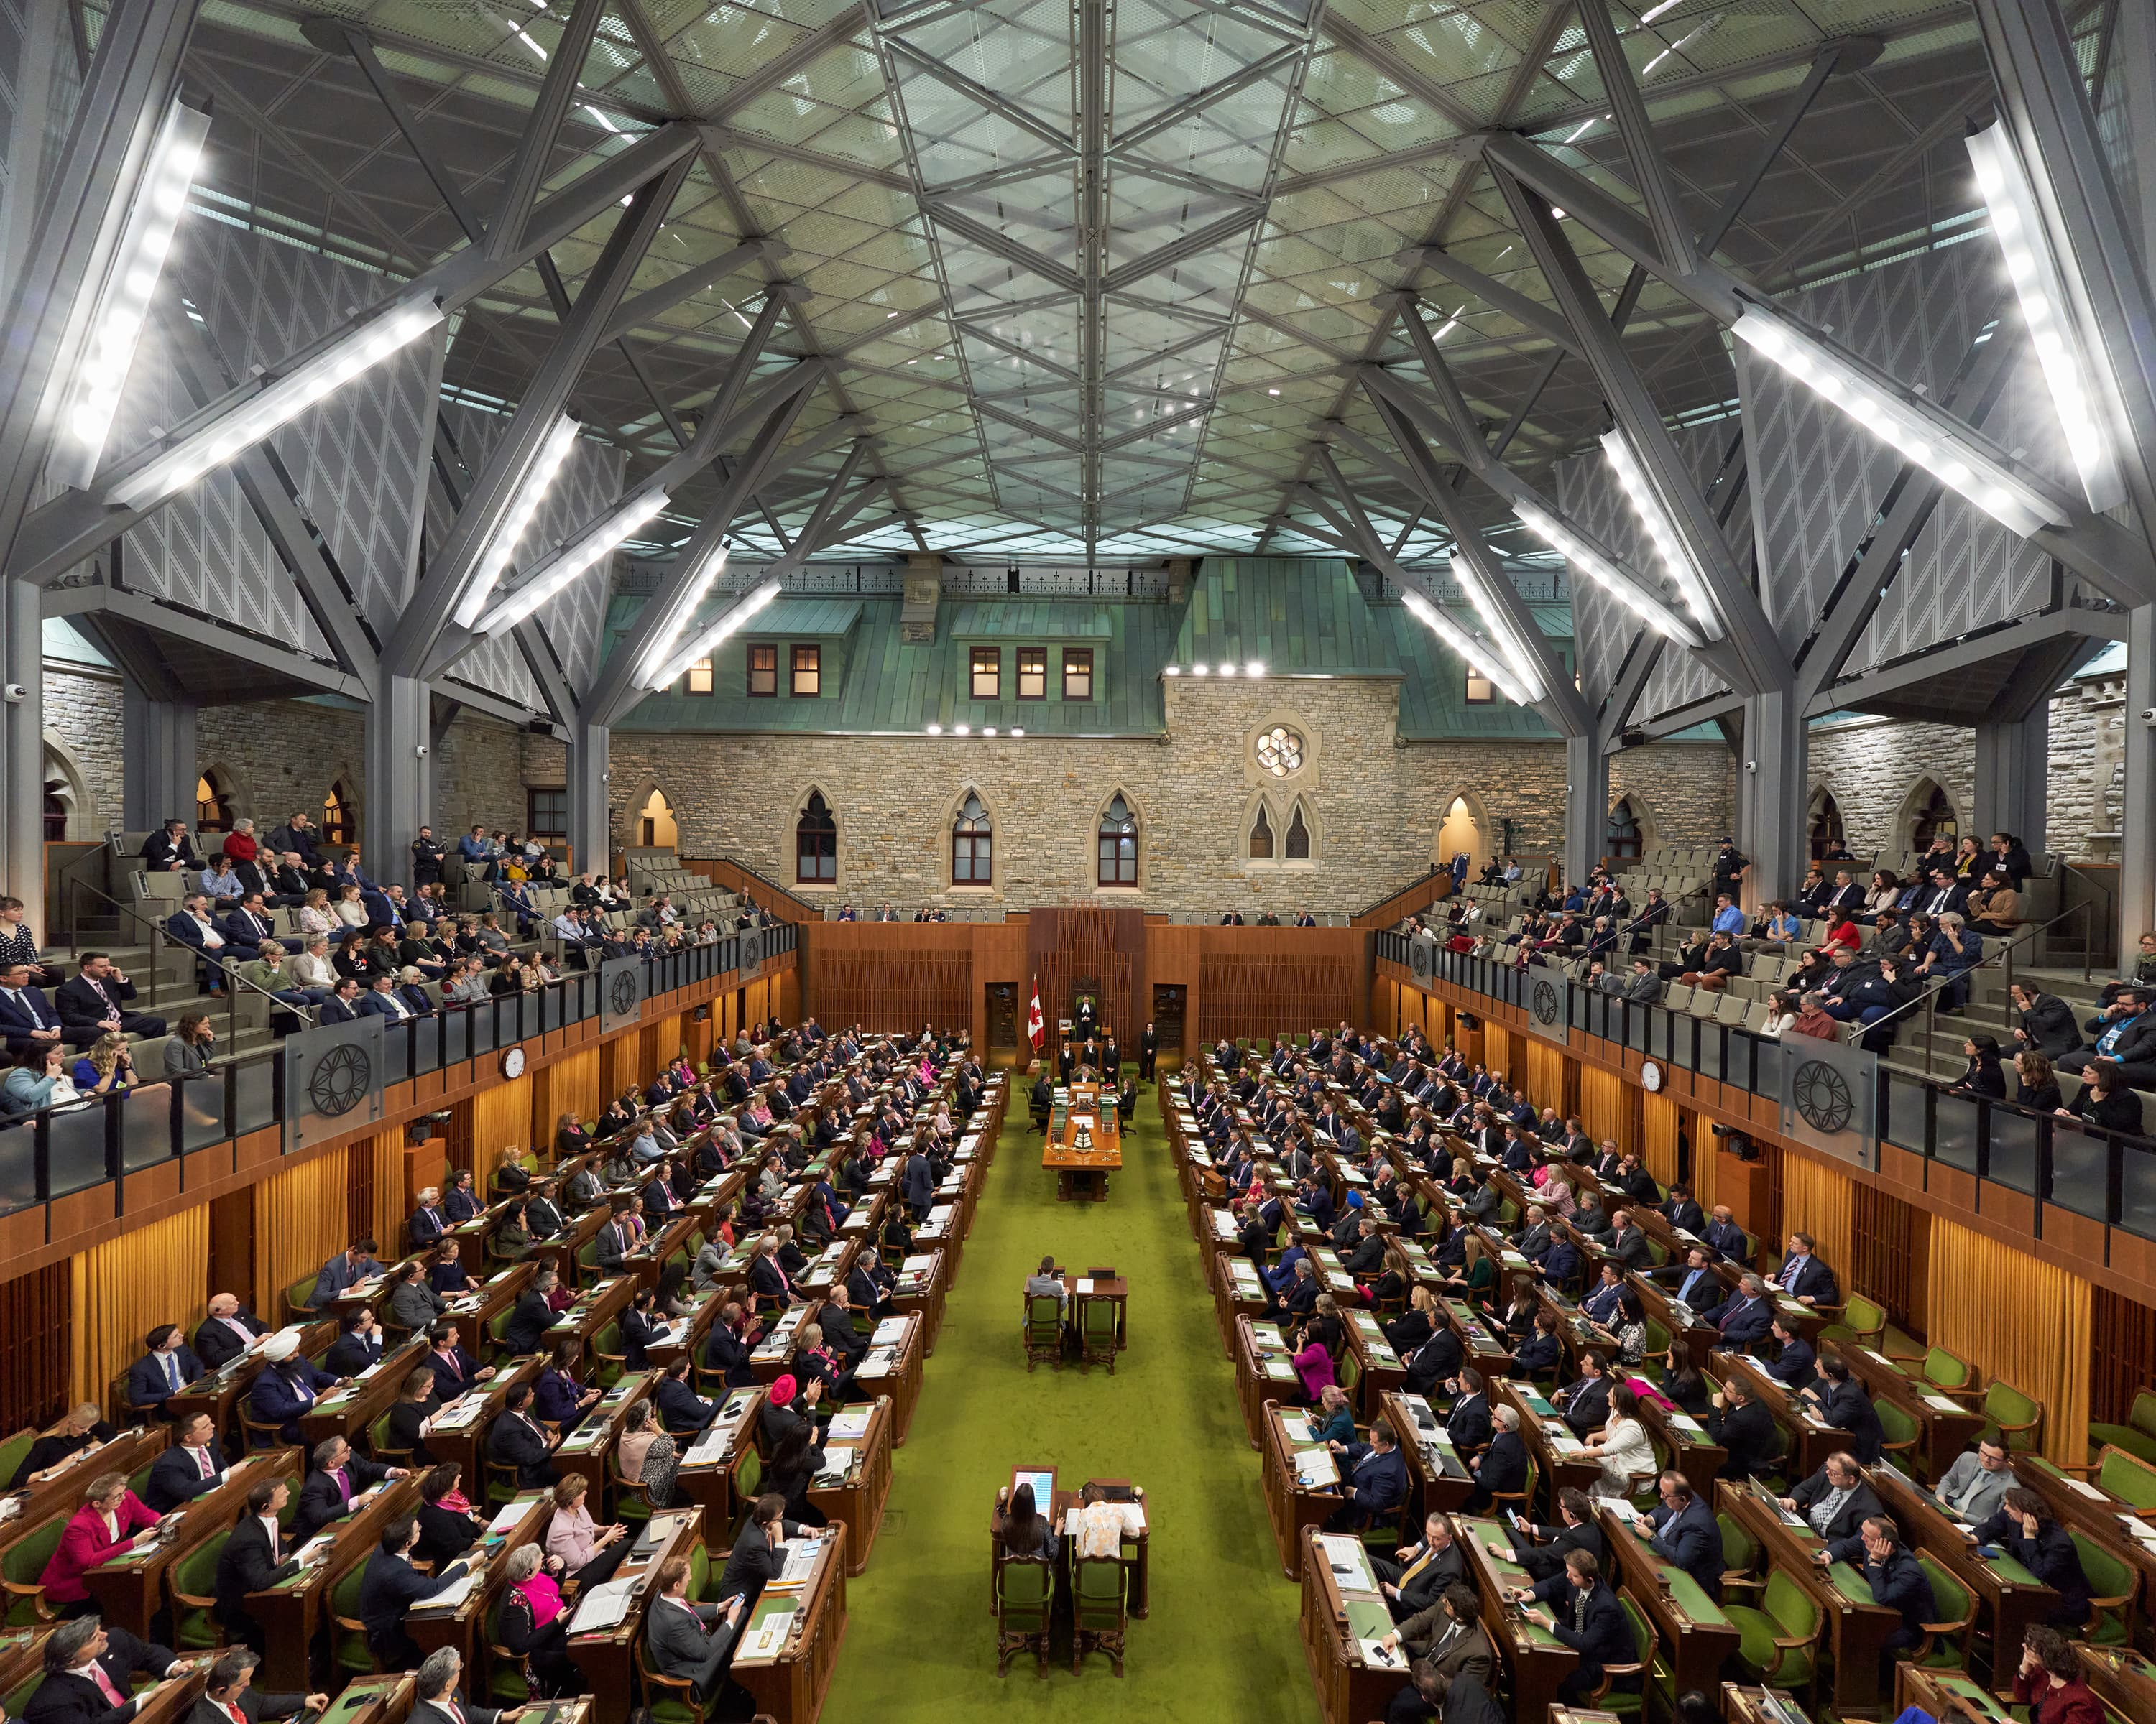
Build Your Champions
Activate your allies and turn your supporters into champions who will advocate on your behalf
In Ottawa, MPs and Senators are the best lobbyists
Use other Ministers to advance your issues with their cabinet colleagues
Don’t overlook the opposition, but be careful in how you utilize them

Slide 8
Showcase Your Best Assets
Creative advocacy is effective advocacy;
Highlight your unique offering
Use your members and employees. All politics is local
The most effective spokespeople are real people and real people are voters
Ottawa is full of suits, so bring a farmer, a rancher, or a beekeeper

Slide 9
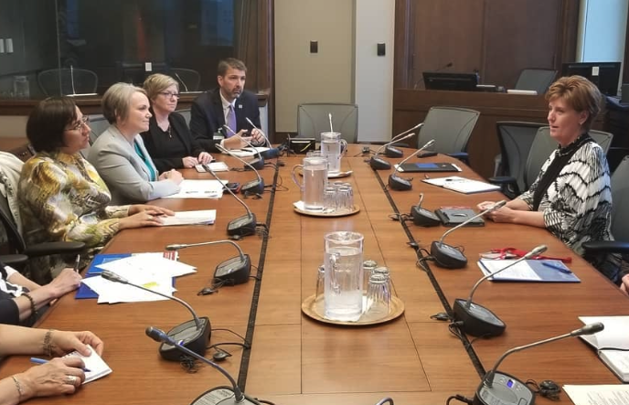
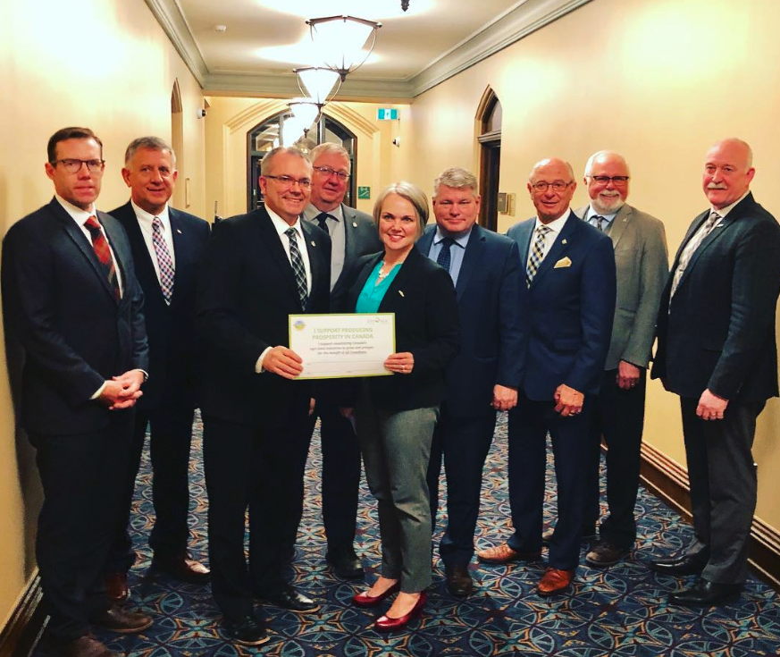
Follow-up
Each meeting is the beginning of a relationship
Keep the conversation going, and don’t hesitate to re-engage
You don’t always need something ‘new’ when you engage
Politicians often look for places to visit, and tour
Government will turn to stakeholders they know when they need support or industry opinion

Slide 10
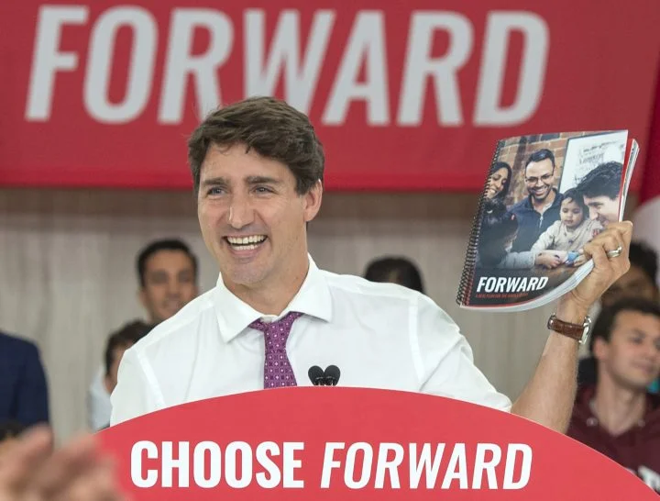
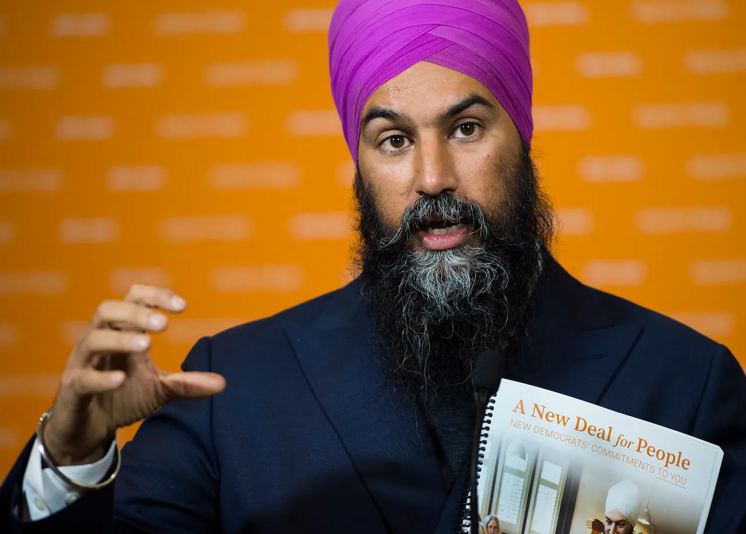
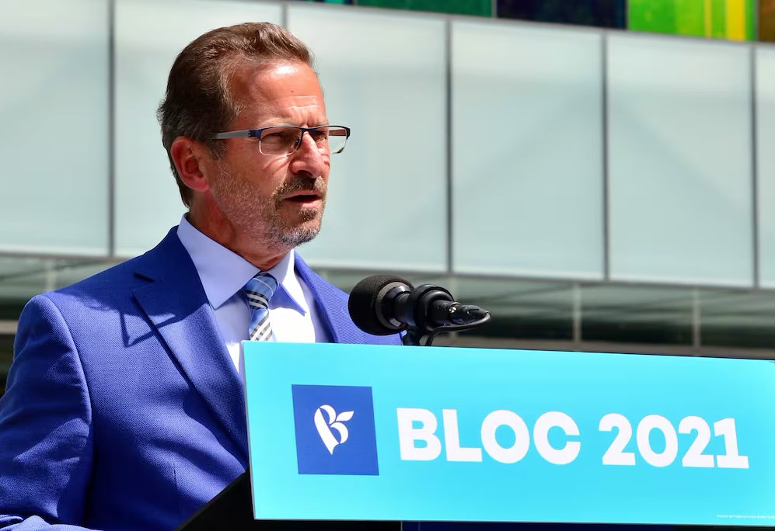
Influence Party Platforms
Platform writing periods start long before the writ
Effective organizations work to get their issues included in each party’s platform
Showcase how your priorities align with theirs
Never go all-in on one party. You might have significant disagreement, but common ground can be found with every party
The government will often match platform promises of the opposition

Slide 11
Persistence
If you find yourself stuck, or that your advocacy has hit a wall… go around it
Use the political side to activate the bureaucracy and clear roadblocks
Remember policy change is not achieved in one meeting

Slide 12
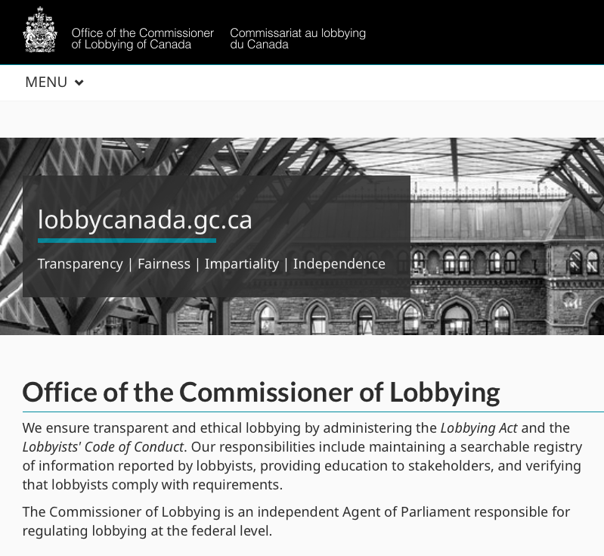
Know the Rules & Follow Them
Lobbyist Registrations (Federal and Provincial)
Lobbyist Communications reports
Rules governing hospitality (gifts, receptions, dinners)

Slide 13
Kevin Bosch Managing Partner Sandstone Group Kevin@SandstoneGroup.ca 613-791-5618 www.SandstoneGroup.ca

