Slide 2
Government decision making from the perspective of...
1.
The key players
2.
The processes
3.
The timing considerations

Slide 3
Government decision-making
The key players

Slide 4
The Prime Minister and PMO
The Prime Minister
The Prime Minister (PM) is the central decision-making actor
The PM has several roles: Member of Parliament, head of political party, head of government and Chair of Cabinet
The Prime Minister's Office
Made up of “exempt staff” that are not public servants
Performs several key functions to support the PM and Government including:
Providing advice to the PM
Developing and advancing the Government's policy agenda
Coordinating communications
Working with other Ministers' Offices

Slide 5
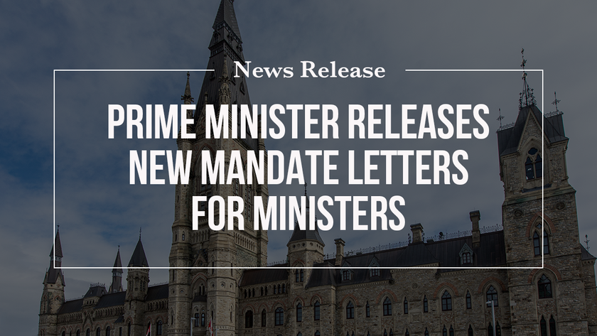
Ministers and their offices
Ministers serve many roles:
Represent constituency as a Member of Parliament
Member of government caucus
Member of Cabinet responsible for a portfolio
Ministers are appointed by the PM and their "to-do" list is assigned in a mandate letter
The Minister is supported by exempt staff who offer political advice
The Minister is also supported by the public service who provide neutral, evidence-based advice and implement the Government's agenda
Most influential Ministers are:
Minister of Finance responsible for the Budget and reviews all funding proposal before providing recommendations to the PM
President of the Treasury Board reviews and approves Treasury Board submissions

Slide 6
Cabinet: "the what" of decision-making
Accountable to Parliament
Cabinet performs several critical functions and is the "executive" decision-making body of Government
Cabinet committees do the initial "vetting" of policy proposals, before making a recommendation to Cabinet for final decision
Cabinet Committees have their own members and areas of responsibility including, for example:
Cabinet Committee on Agenda, Results and Communications
Cabinet Committee on Operations
Cabinet Committee on Economy, Inclusion and Climate “A”
Task Force on Services to Canadians
Chaired by the PM
Decision document is a Memorandum to Cabinet
Principle of Cabinet solidarity:
Inside: speak freely and disagree
Outside: speak with one voice

Slide 7
Oversees human resources for the Public Service and sets government-wide standards and policies
Treasury Board: the "how"
of decision-making
PS Employer and Management Board
Treasury Board focuses on the "how" of government decision-making. Their job is to ensure that a plan is in place to achieve the objectives of the new initiative
Reviews spending plans to ensure they are aligned with government priorities and providing value for money
Expenditure Manager
Consists of 6 Ministers
Committee of Council
Reviews and approves all regulatory policies and orders-in-council
Chair: The Hon. Mona Fortier
Vice-Chair: The Hon. Diane Lebouthillier
Members
The Hon. Chrystia Freeland
The Hon. Ahmed D. Hussen
The Hon. Joyce Murray
The Hon. Seamus O’Regan Jr.
Decision tool: Treasury Board Submission
A Treasury Board Submission is the decision-making document seeking authorities to implement a new program

Slide 8
Central Agencies
The "Central Agencies" are important players in the Government decision-making process
Policy (the "what")
Money (the "how much")
Implementation (the "how")
The Prime Minister's department
Secretary to Committees and Cabinet
Provides leadership and challenge function on government policy
Develops mandate letters
Coordinates horizontal initiatives
Steward of the fiscal framework
Examines new requests for funding, and makes recommendations to the Minister of Finance
Produces the Budget
Supports the Treasury Board
Reviews and challenges TB submissions
Monitors results
Performs analysis on proposed regulations

Slide 9
Government decision-making
The processes

Slide 10
Where do decisions come from
Government decisions are influenced by multiple different forces some of which are planned and others develop in response to external events or ideas
Mandate letters
Platform commitments
Speech from the Throne
Responsive - Planned
The public service
The Budget
Domestic and international events
Stakeholders
Canadians
The Government will start by authorizing "planned" priorities, but when new initiatives arise there is a gap in "authorities" and a new decision is required...

Slide 11
Four types of "authorities" are needed to make a new decision
The Minister has authority to make decisions within certain limits (e.g., day-to-day operations, procurements, etc.)
Anything beyond requires new "authorities" i.e., decisions from the PM, Cabinet, Treasury Board and/or Parliament
Policy authority
Funding authority
Implementation authority
Parliamentary authority

Slide 12
Policy authority or "policy cover"
Decision tool: Memorandum to Cabinet (MC)
Decision vehicle: Cabinet or the Prime Minister
Lead: Privy Council Office, with support from sponsoring Department
Key questions that drive the decision:
Does the proposal align with Government priorities and/or agenda?
Is this a new policy or program or change to an existing policy or program?
What is the gap or problem this proposal is trying to address?
What is the economic impact?
Does the proposal require legislation?
Does the proposal require new funding?

Slide 13
Funding authority i.e., obtaining a "source of funds"
Decision tool: Funding Proposal
Decision vehicle: The Budget or the Minister of Finance and the Prime Minister
Lead: Department of Finance, with support from sponsoring Department
Key questions that drive the decision:
Why is new funding required vs. using existing funding?
Are the proposed costs scalable?
How did you come up with your cost estimates?
What data do you have to support your rationale?

Slide 14
Implementation authority
Decision tool: Treasury Board Submission
Decision vehicle: The Treasury Board
Lead: Treasury Board Secretariat, with support from sponsoring Department
Key questions that drive the decision:
What is the detailed plan to implement the proposal?
How will you measure the impact of the proposal?
What are the risks associated with the proposal? How do you plan to mitigate those risks?

Slide 15
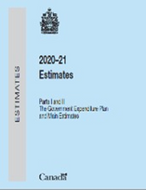
Parliament provides final authority to release funds
Decision tool: The Estimates
Decision vehicle: The Supply Bill, which becomes the Appropriation Act when passed
The Financial Administration Act states that the Government needs Parliament’s authority in order to make payments.
Authority is provided through the Appropriation Act which provides authority for one fiscal year (two years for CRA and CBSA). The authority provided is called a voted authority.
Lead: Department of Finance and Treasury Board Secretariat
Key processes that challenge the decision:
Debate in the House of Commons
Study at Committee
The Senate
Supply is the process by which Government obtains Parliament’s authority through appropriation acts

Slide 16
The "normal" path from idea to implementation...
1. Policy Idea
2. MC development
3. Cabinet Committee
4. Full Cabinet
8. Treasury Board Submission
7. Budget
6. Approval by the Minister of Finance and PM
5. Funding Letter (if new funding required)
9. Treasury Board Approval
10. Estimates prepared as part of Supply Bill
11. Appropriation Act passed by Parliament
12. Departments can spend money on new initiative

Slide 17
That's great, but how does this help me shape policy...?

Slide 18
Government decision-making
The timing considerations

Slide 19
The standard Government decision-making timeline
(September) Finance solicits Budget ideas from Departments
(late-October) Deadline for Departments to submit Budget proposals
(October to February) Department of Finance Pre-Budget Consultation open to public & Finance Committee (FINA) Pre-Budget Consultations (Mar 2021 / Oct 2022)
(March-April) Federal Budget
(October-November)
Fall Economic Statement
(December) Tabling of final Supplementary Estimates
(by March 1st) Main Estimates Tabled
(October) Tabling of Fall Supplementary Estimates
(April to June) Tabling of Spring Supplementary Estimates
(September) Tabling of Public Accounts

Slide 20
The best time to have an impact on government decisions...
Before proposals are sent to Finance
During pre-budget consultations & direct to Minister and Finance
Before budget is "locked down" but after themes and priorities are set
(September) Finance solicits Budget ideas from Departments
(late-October) Deadline for Departments to submit Budget proposals
(October to February) Department of Finance Pre-Budget Consultation open to public & Finance Committee (FINA) Pre-Budget Consultations (Mar 2022 / Oct 2023)
(March-April) Federal Budget
(September) Tabling of Public Accounts
(October) Tabling of Fall Supplementary Estimates
(October-November)
Fall Economic Statement
(December) Tabling of final Supplementary Estimates
(by March 1st) Main Estimates Tabled
(April to June) Tabling of Spring Supplementary Estimates

Slide 21
Also, important to remember that the "process" is not set in stone
Off-cycle funding decisions
For time-sensitive or unexpected decisions, Ministers can seek an "off- cycle" funding decision from the Minister of Finance and Prime Minister
These decisions can happen any time during the year
Mandate letter commitments
Items can drop off the list, although it is very challenging since 2015 when they started to be made public
Privy Council Office tracked completion of mandate letter commitments through Results and Delivery Unit up until 2019
Ad hoc policy announcements
Can disrupt the normal decision-making process e.g., announcement can precede authorities, but still need to check all the boxes

Slide 22
Summary and key conclusions
ALL new decisions, even if they do not require new funding, MUST obtain the necessary authorities (even when a decision falls "off-cycle")
Understanding the decision-making process helps guide how and who to intervene with
Your timing matters - knowing when to intervene will improve your chances of success – early intervention is key (the earlier the better!)

