Slide 1
EDI as a Strategic Imperative Presentation to the CFA March 6, 2023
Notes:
M

Slide 2
Mary Larson | Partner – Consulting, Business Strategy Leader
Mary is a Partner in MNP’s Montreal Office and National Strategy Practice Leader -- as well as leading the Firm’s ESG and EDI Practices.
She helps CEOs and S-Suite executives clarify and build alignment around their strategies, strengthen leadership capacity, and embed cultures that foster outstanding execution.
Mary has worked with clients across North and South America, Europe and Asia; more recent engagements include the Business Development Bank of Canada, Export Development Canada, the Canadian Canola Growers’ Association, the government of Alberta, Magna International, McGill University, Brock University, Drs. Manitoba, the Institute for Corporate Directors and Waterfront Toronto, as well as several municipalities.
Through global strategic senior executive roles at leading international companies and partnerships in top-tier consulting firms, Mary has built relevant skills in strategy, sustainability, and organizational culture. She led the global transformation team at McDonald’s, directed technology commercialization at Alcan, and led Strategy and Government Affairs at a noted Canadian food manufacturer and distributor.
Her commitment to sustainability over two decades led to a national leadership role in ESG (Environment, Social and Governance), with a particular focus on the “Social”.

Slide 3
What is it?
Awareness demands strategies and action
Moving beyond business case … to moral case … to the right question:
Where do we start?

Slide 4
Does the Inside Match the Outside?
The workforce should look like the community
In Canada, groups formerly known as minorities may reach majority status by 2044
48% of Generation Z are racial or ethnic minorities
CCDI 2022
People call it the EDI Journey because it begins with one step
Eschew tokenism
Build a strategy – actions and measures

Slide 5
Where are we?
In 2021, Canadian agriculture and agri-business was a $140Bn business with ~280K employees
Traditionally under-represented groups:
Women
Indigenous Peoples
Newcomers
Disabled People
Racialized Persons
LGBTQ+ People

Slide 6
Where are we?
The total number of farm operators declined from 294K in 2011 to 262K in 2021, a decline of 10.7%
CAGR %
(1.1%)
Women represented 30.4% of farm operators in 2021, up from 27.4% in 2011 -- but the number of women has declined slightly
1.1 %
The percentage of Indigenous farm operators was 1.9% in 2016 -- slightly less than 5000 individuals
(3.8%)
Immigrant farm operators represented ~9% of farm operators in 2016, but their share seems to be falling
Statistics Canada. Table 32-10-0230-01 Characteristics of farm operators, Census of Agriculture historical data

Slide 7
Context
Where are we coming from?
Indigenous Peoples
Structural Indigenous exclusion
Disabled People
Lack of funding structures
Women
Narratives about the place of “Women on the farm”
People of Colour
Discrimination and purposeful exclusion
Newcomers
Racialization and a short-term focus on filling labour gaps
LGBTQ+ People
Heteronormative assumptions

Slide 8
Further Pressures
Persistent Labour Shortages
Need to attract under-represented groups
Mainstream Discussions about Equity and Diversity
Pressures governments, industry groups and consumers to consider EDI
Global and Domestic Supply Chain Influence
Forces reporting and proof of compliance with the “S” of ESG
Desire for an Equitable and Sustainable Food System
Raises questions about how workers are treated and compensated

Slide 9
What now?
Awareness demands strategies and action
Moving beyond business case … to moral case … to the right question…
Where do we start?

Slide 10
Moving Past What We Call It
Goal: Define what equity looks like and what actions are appropriate
Build on what we are getting right and find the path to human equity
EDIB – Equity, Diversity, Inclusion & Belonging
EDIR – Equity, Diversity, Inclusion & Reconciliation
DEI – Diversity, Equity & Inclusion
IDEA – Inclusion, Diversity, Equity & Accessibility
IDEA – Inclusion, Diversity, Equity & Anti-Racism

Slide 11
Many Organizations are Tackling EDI— in the US and Canada

Slide 12
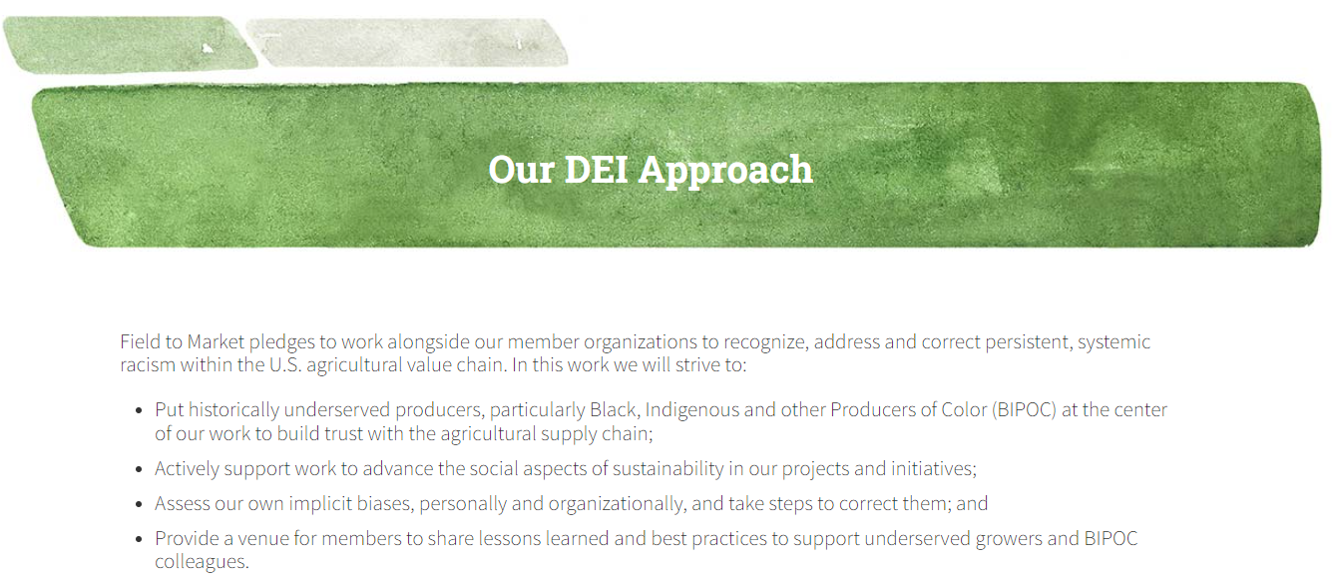
An Example

Slide 13
DEI is a Strategic Matter What is your organization’s purpose and role? What does your organization look like? What can you influence? What difference can you make? Can you measure that difference?

Slide 14
Demographic Census: A Snapshot of the Current State
Gender Identity
Allows people to self-identify in various ways
Adheres to Employment Equity Act guidelines
Makes it possible to determine any underrepresentation of members of Equity Deserving Groups
Ethnicity
Sexual Orientation
Demographic Collection
Racialized Persons
Persons with Disabilities
Indigenous Persons

Slide 15
Can serve multiple objective
Getting the data you need is entirely possible – using a range of questions that will help Brock University to create meaningful actions.
Diversity
An important source of reliable evidence
Highlights how well actions are engaging and supporting people from diverse backgrounds
Equity
Highlights who is part of the community and who is NOT represented
Supports intersectionality
Inclusion
Helps eliminate barriers by revealing them
Just being asked to self- identify increases engagement

Slide 16
Defining how you can make a difference
Purpose
What is the major issue or challenge that your organization is uniquely positioned to tackle?
Strategy
What are the things that your organizations will do to address this set of challenges?
Reach/ Influence
What is your sphere of influence? Policy? Advocacy? Education? How much can you achieve?

Slide 17
Consider Internal and External Opportunities
Structural
EDI barriers embedded in institutions and systems
Incentives to drive significant change
Role in EDI advocacy? Partnerships to address barriers ?
Who “does the work”?
Cultural
Resistance to change and unconscious bias
Leadership culture: What is said and how people act
Processes and internal systems that embed discrimination
Wherever business takes you MNP.ca
4

Slide 18
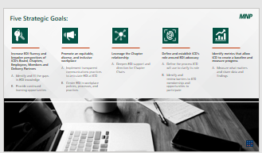
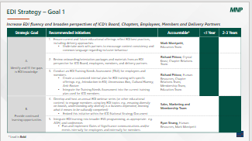
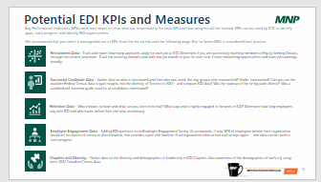
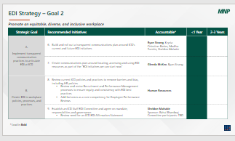
Strategic Plan Summary
Sample
Example of Success Measures
Sample
Sample
Sample

Slide 19
EDI in Canadian Agriculture: What Will Drive Change?
Recognize the impact of trends
Identify barriers to equity and diversity
Engage with under-represented groups to devise solutions
Pinpoint what your organization can do
Develop a coherent EDI strategy…directly linked to your organizational strategy
Commit to action
Measure results

Slide 20
Questions?

