Slide 1
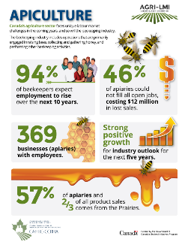
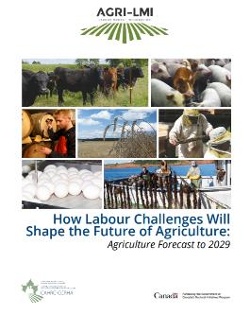
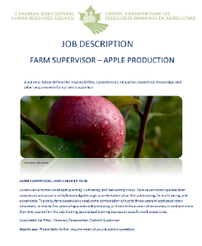
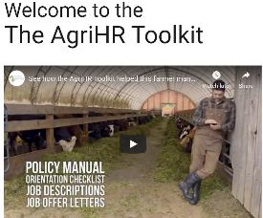
Canadian Agricultural HR Council
Who are we
National, non-profit organization
Focused on addressing Human Resource issues facing agricultural businesses across Canada
Led by industry stakeholders
Centre for Research on Agricultural Labour Market Information
Access Point for Customizable Solutions related to HR Mgmt and Training

Slide 2
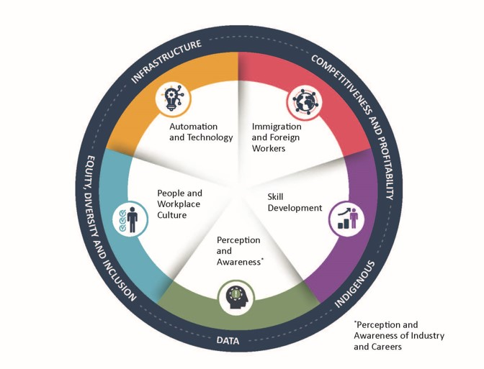
National Workforce Strategy for Agriculture and Food & Beverage Manufacturing

Slide 4
Engaging Indigenous Agriculture Producers and Stakeholders
Held an Indigenous Agriculture session at CFA’s Summer 2022 meeting
Sharing Circles series – currently underway
Equity, Diversity and Inclusion in Agriculture
Secretariat and Steering Committee Member, Canadian Agri-Food EDI Working Group
NWSP EDI Working Group has completed work related to NWSP
Preparing a more formal delivery program of tools, training and support for industry (e.g. training, webinars, guides, on-line community)
Notes:
Debra

