Slide 1
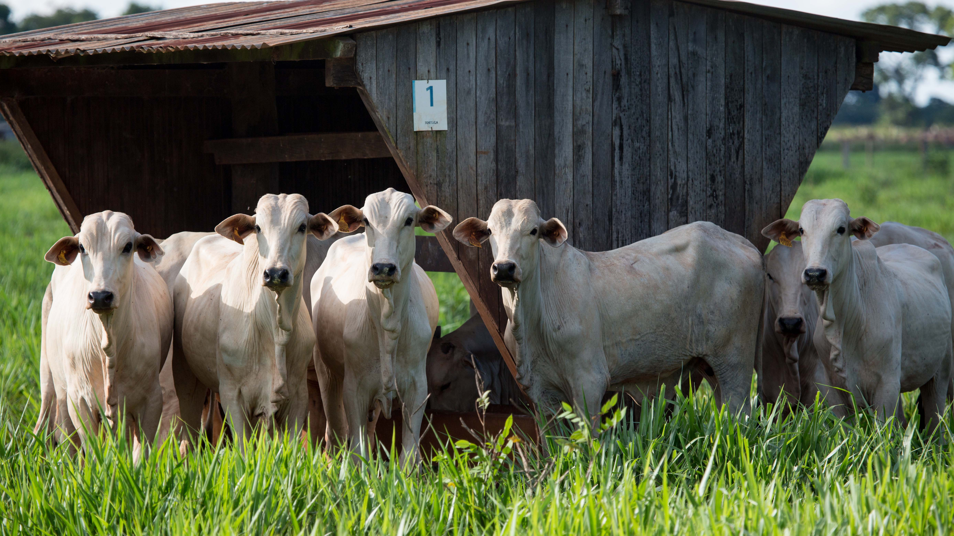

Reducing methane emissions from agriculture
Bovaer® a proven solution
2022 CFA Annual General Meeting
March 2nd, 2022
Finding sustainable solutions in uncertain times
Maik Kindermann, Head R&D Clean Cow, Inventor Bovaer®
maik.kindermann@dsm.com

Slide 2
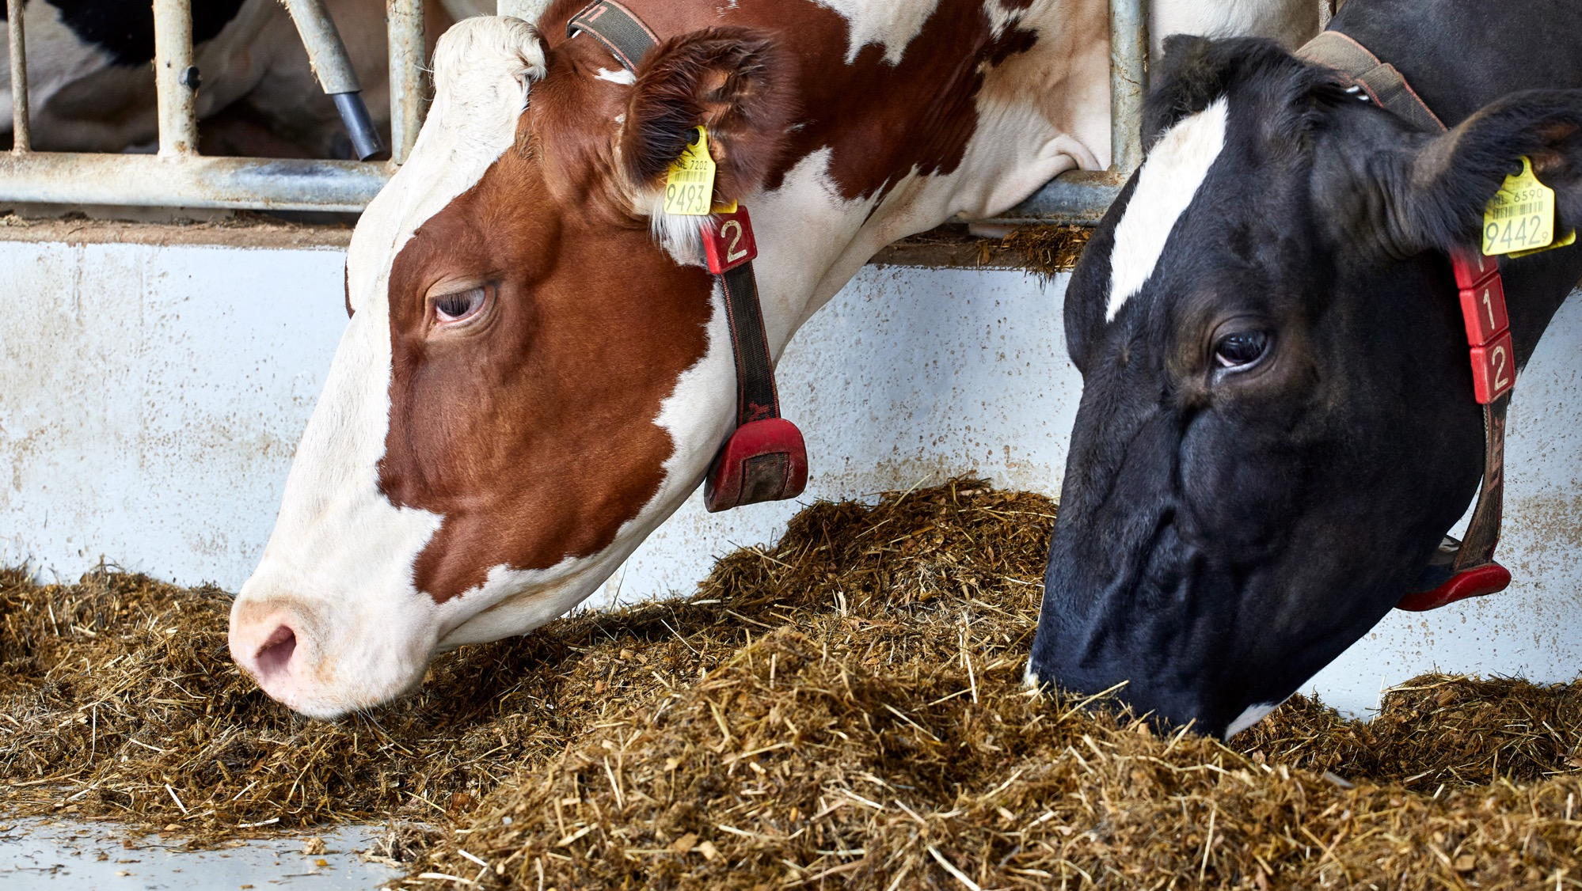


+
Air
Bov (ine)

Slide 3
Cows make methane
It’s not their fault. Methane is a byproduct of digesting the tough, fibrous food they eat. And it’s released into the air burp by burp.
Methane traps heat
Like carbon dioxide (CO₂), methane is a greenhouse gas. Its warming effect is shorter lived, but much more potent than CO₂. So eliminating it begins to pay off right away.
Bovaer® reduces methane
teaspoon daily
in a cow’s feed
less methane produced
takes effect immediately
proven safe for consumers, for cows, and good for our planet
How it works
In a cow’s stomach, microbes help food break down. This releases hydrogen and carbon dioxide. An enzyme combines these gases to form methane. Bovaer® is a feed additive that suppresses the enzyme, so less methane gets generated.

Slide 4



Bovaer® saves 1 ton of CO₂ equivalent per cow every year, thereby creating a step-change improvement in sustainability
Feeding Bovaer® to…
…3 cows is like taking
1 family-sized car off the road.
…1 million cows is like
planting a forest of
45 million trees.
…1 cow saves the equivalent of
127.000 smartphone charges.

