Slide 1
A BETTER WAY

Slide 2
Introducing:

Slide 3
What We Do
Triple Green Products manufactures and installs industry leading equipment into the agricultural, institutional, municipal, commercial, and industrial sectors.
Focusing on sustainable, biomass fueled, renewable energy and the environmentally conscious handling and recycling of organic waste materials, we have built a reputation for supplying proven long-lasting solutions.
One of our core products is the BioDryAir Grain Drying system that utilizes various biomass materials as fuel for combustion to generate heat energy.
Notes:
How presentation will benefit audience: Adult learners are more interested in a subject if they know how or why it is important to them.
Presenter’s level of expertise in the subject: Briefly state your credentials in this area, or explain why participants should listen to you.

Slide 4
Who Are We?
TGP’s solutions are unique in that we have been the industry standard for long lasting reliability, providing clean energy solutions and cost savings for over 20 years.
We are committed to ensuring that our clients have reliable equipment and energy sources now and into the future.
TGP is backed by a highly qualified and competent team.
Notes:
How presentation will benefit audience: Adult learners are more interested in a subject if they know how or why it is important to them.
Presenter’s level of expertise in the subject: Briefly state your credentials in this area, or explain why participants should listen to you.

Slide 5
Our Mission
To remain North America’s leading clean and renewable energy provider by manufacturing and distributing the most reliable, efficient and carbon neutral clean energy products on the market. We are committed to social responsibility and provide cutting edge renewable energy solutions that utilize solid bio-fuels to provide alternative solutions, at a fraction of current industry costs.
Notes:
How presentation will benefit audience: Adult learners are more interested in a subject if they know how or why it is important to them.
Presenter’s level of expertise in the subject: Briefly state your credentials in this area, or explain why participants should listen to you.

Slide 6
Biomass Energy Explained
A clean renewable energy.
Better than renewable, it is an energy that can be fueled with agriculture waste or other organics.
Combusts cleanly.
Meets carbon emission thresholds.
Notes:
How presentation will benefit audience: Adult learners are more interested in a subject if they know how or why it is important to them.
Presenter’s level of expertise in the subject: Briefly state your credentials in this area, or explain why participants should listen to you.

Slide 7
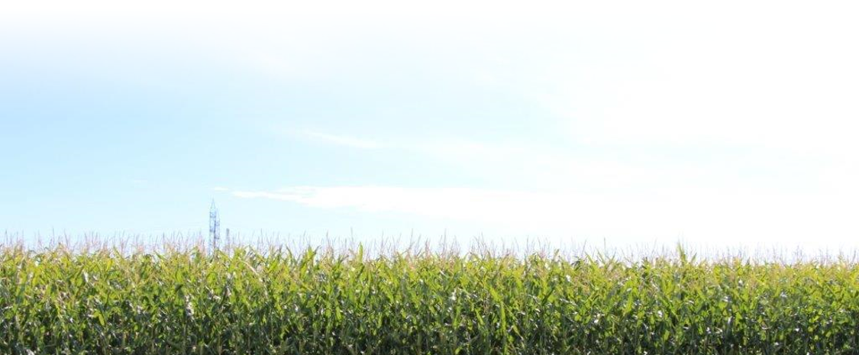
Grain Drying
Drying grain can be one of the most energy-intensive operations on the farm.
Significant cost to farming operation even before considering the carbon tax impact.

Slide 8
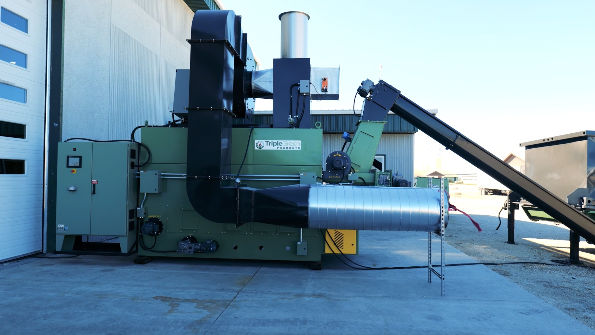
Notes:
How presentation will benefit audience: Adult learners are more interested in a subject if they know how or why it is important to them.
Presenter’s level of expertise in the subject: Briefly state your credentials in this area, or explain why participants should listen to you.

Slide 9
The Solution
The solution is the state-of-the-art, carbon neutral BioDryAir system that utilizes solid bio-fuels to provide heat to a conventional grain dryer at a fraction of current fossil fuel costs (even natural gas).
Significantly reduced energy costs realized immediately, netting increased profits/cost savings
Reduce carbon profile significantly with a BioDryAir system, reaping greater benefits from a tax standpoint and garnering a reputation for a commitment to a greener environment
Implement without rebuilding your existing infrastructure
Notes:
How presentation will benefit audience: Adult learners are more interested in a subject if they know how or why it is important to them.
Presenter’s level of expertise in the subject: Briefly state your credentials in this area, or explain why participants should listen to you.

Slide 10
BioDryAir systems use biomass fuel combustion to generate renewable heat energy.
Energy costs are currently a significant line item for any enterprise and are going to continue to rise as fossil fuel choices become more volatile and controversial.
Carbon impact/carbon tax/carbon regulations are current realities. Sustainable biomass fueled heating is Carbon Neutral.
BioDryAir has been used in industrial mining applications for over 10 years drying various products
Notes:
How presentation will benefit audience: Adult learners are more interested in a subject if they know how or why it is important to them.
Presenter’s level of expertise in the subject: Briefly state your credentials in this area, or explain why participants should listen to you.

Slide 11
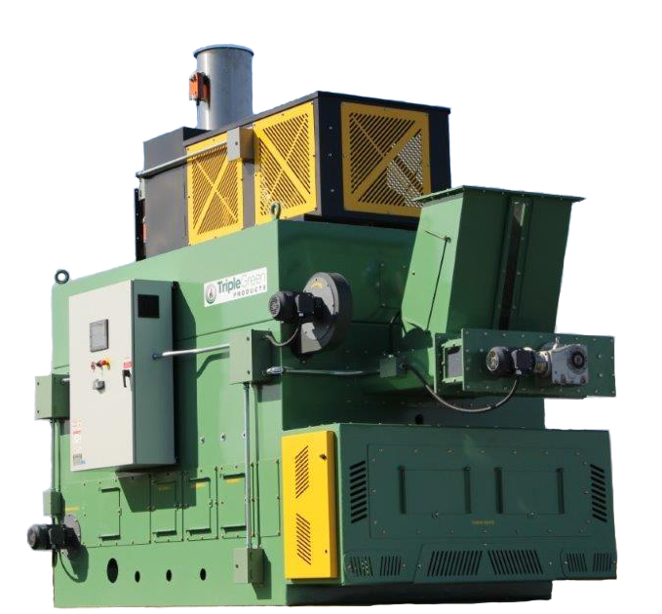
The Benefits of a TGP BioDryAir
Each model is turn-key and able to integrate with existing conventional grain dryers
TGP systems feature unique benefits exceeding all current emission standards. Features include:
High Efficiency Biomass Combustion
Compatible with existing grain dryers
Fully Automated Control System w/Touch Screen Monitor
Smartphone Connectivity
Notes:
How presentation will benefit audience: Adult learners are more interested in a subject if they know how or why it is important to them.
Presenter’s level of expertise in the subject: Briefly state your credentials in this area, or explain why participants should listen to you.

Slide 12
Based on a Saskatchewan farm of 9,160 acres, drying 568,400 bushels
Using BDA-1654

Slide 13
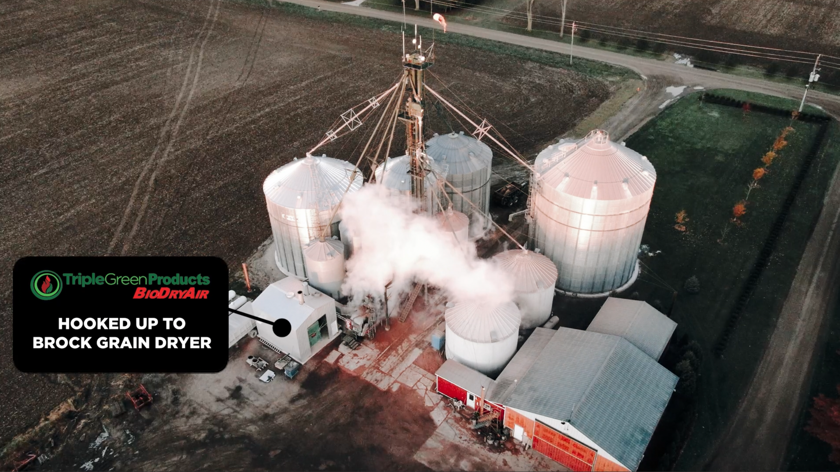
Notes:
How presentation will benefit audience: Adult learners are more interested in a subject if they know how or why it is important to them.
Presenter’s level of expertise in the subject: Briefly state your credentials in this area, or explain why participants should listen to you.

Slide 14
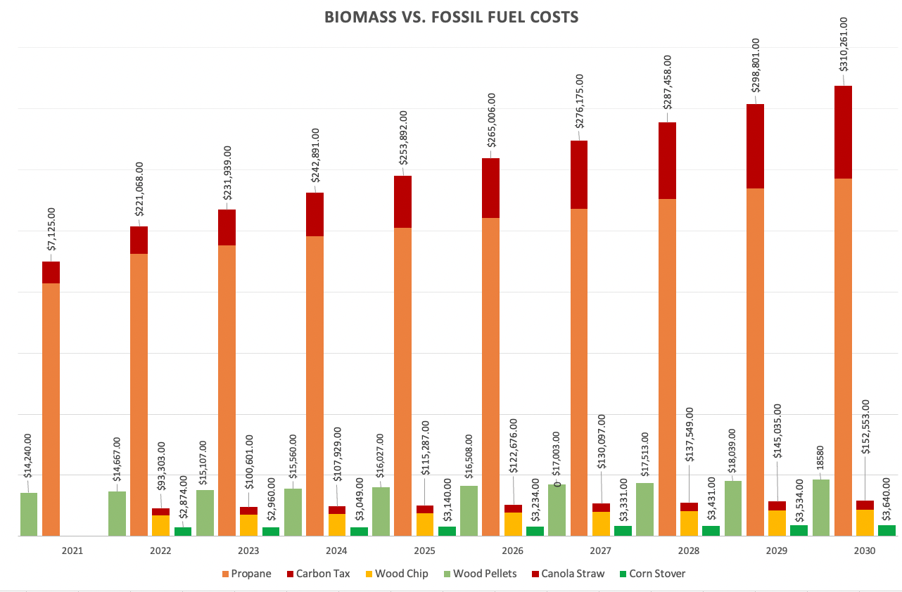
Based on an Ontario farm of 1,150 acres, drying 252,530 bushels – starting at a moisture level off 33% and drying to a 15.5% moisture
Using BioDryAir

Slide 15
Based on a Saskatchewan farm of 9,160 acres, drying 568,400 bushels
Using BDA-1654

Slide 16
Our Dealer Network Spans from Coast to Coast
Notes:
How presentation will benefit audience: Adult learners are more interested in a subject if they know how or why it is important to them.
Presenter’s level of expertise in the subject: Briefly state your credentials in this area, or explain why participants should listen to you.

Slide 17
Triple Green Products …A Better Way
A Carbon Neutral solution.
With a Sustainable, increasingly abundant biomass fuel sources.
That is Environmentally Friendly.
Enjoy Fuel Cost Savings from 30% - 80% - even compared to natural gas.
Notes:
How presentation will benefit audience: Adult learners are more interested in a subject if they know how or why it is important to them.
Presenter’s level of expertise in the subject: Briefly state your credentials in this area, or explain why participants should listen to you.

Slide 18
Why Choose Triple Green Products?
TGP’s products are manufactured using latest automation tech, and attention to the details.
Our products are proven, in service for over 20 years, with proven installations throughout North America
We provide a carbon neutral option – with carbon pricing and taxing concerns, our systems are the logical answer.
Our equipment is proudly manufactured in Canada, so parts and service are readily available.
We at Triple Green Products believe that if a product is made better, it lasts longer and therefore costs less. This makes our products the most economical solution.
We really do offer -
“A Better Way”!
Notes:
How presentation will benefit audience: Adult learners are more interested in a subject if they know how or why it is important to them.
Presenter’s level of expertise in the subject: Briefly state your credentials in this area, or explain why participants should listen to you.

Slide 19
Contact Us
Triple Green Products
Box 119 – R.R. #1
Morris, Manitoba
R0G 1K0 Canada
Office: 1.204.746.6333
Toll Free: 1.855.373.2378
info@triplegreenproducts.com
www.triplegreenproducts.com
Notes:
How presentation will benefit audience: Adult learners are more interested in a subject if they know how or why it is important to them.
Presenter’s level of expertise in the subject: Briefly state your credentials in this area, or explain why participants should listen to you.

Slide 20
A BETTER WAY

