Slide 1
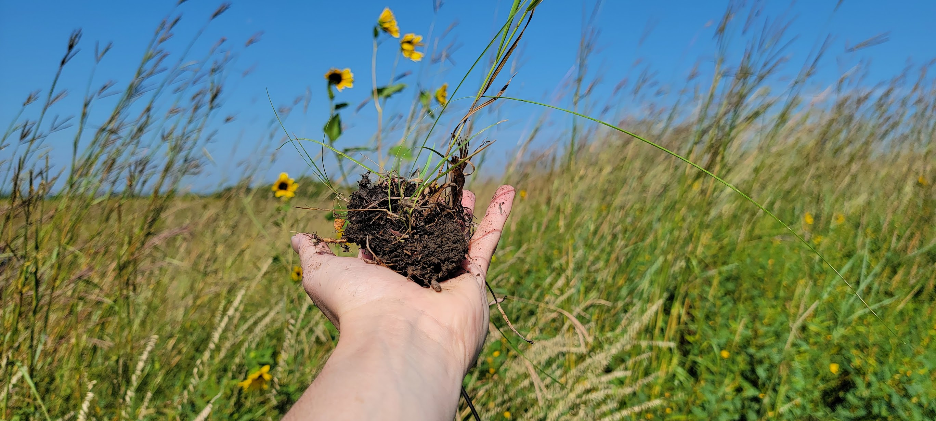
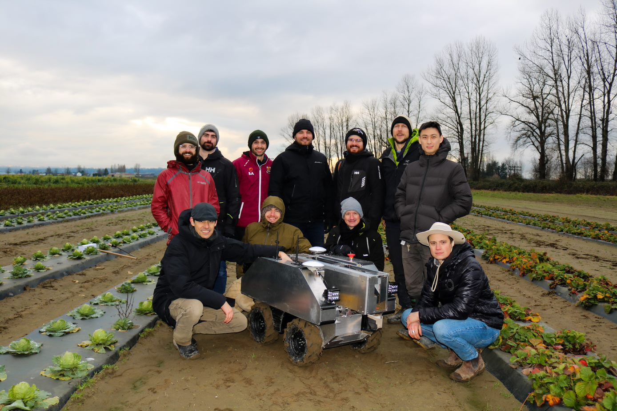
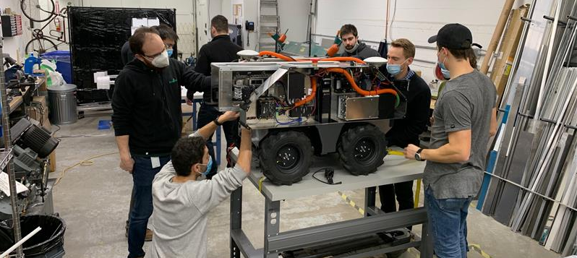
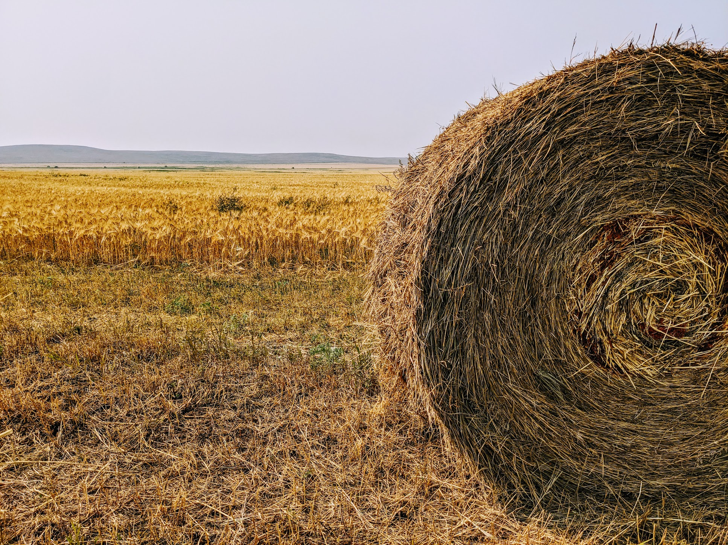
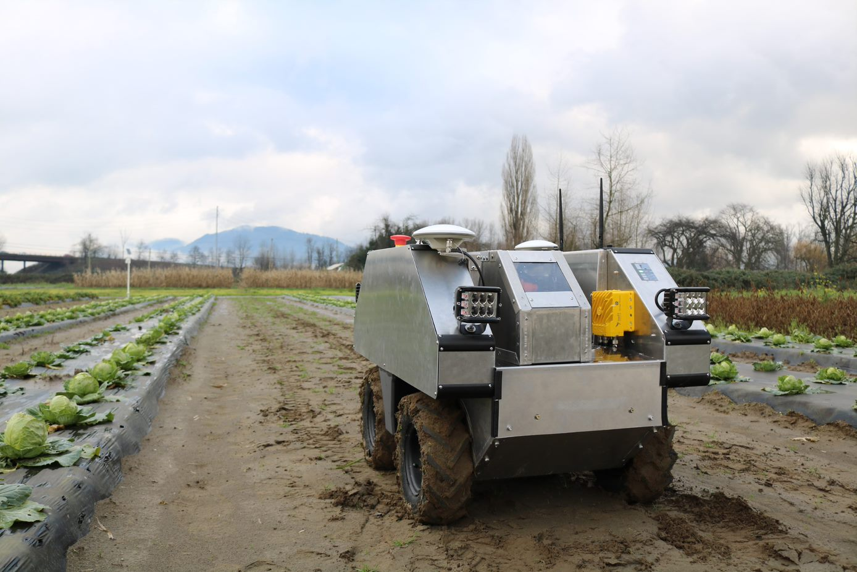
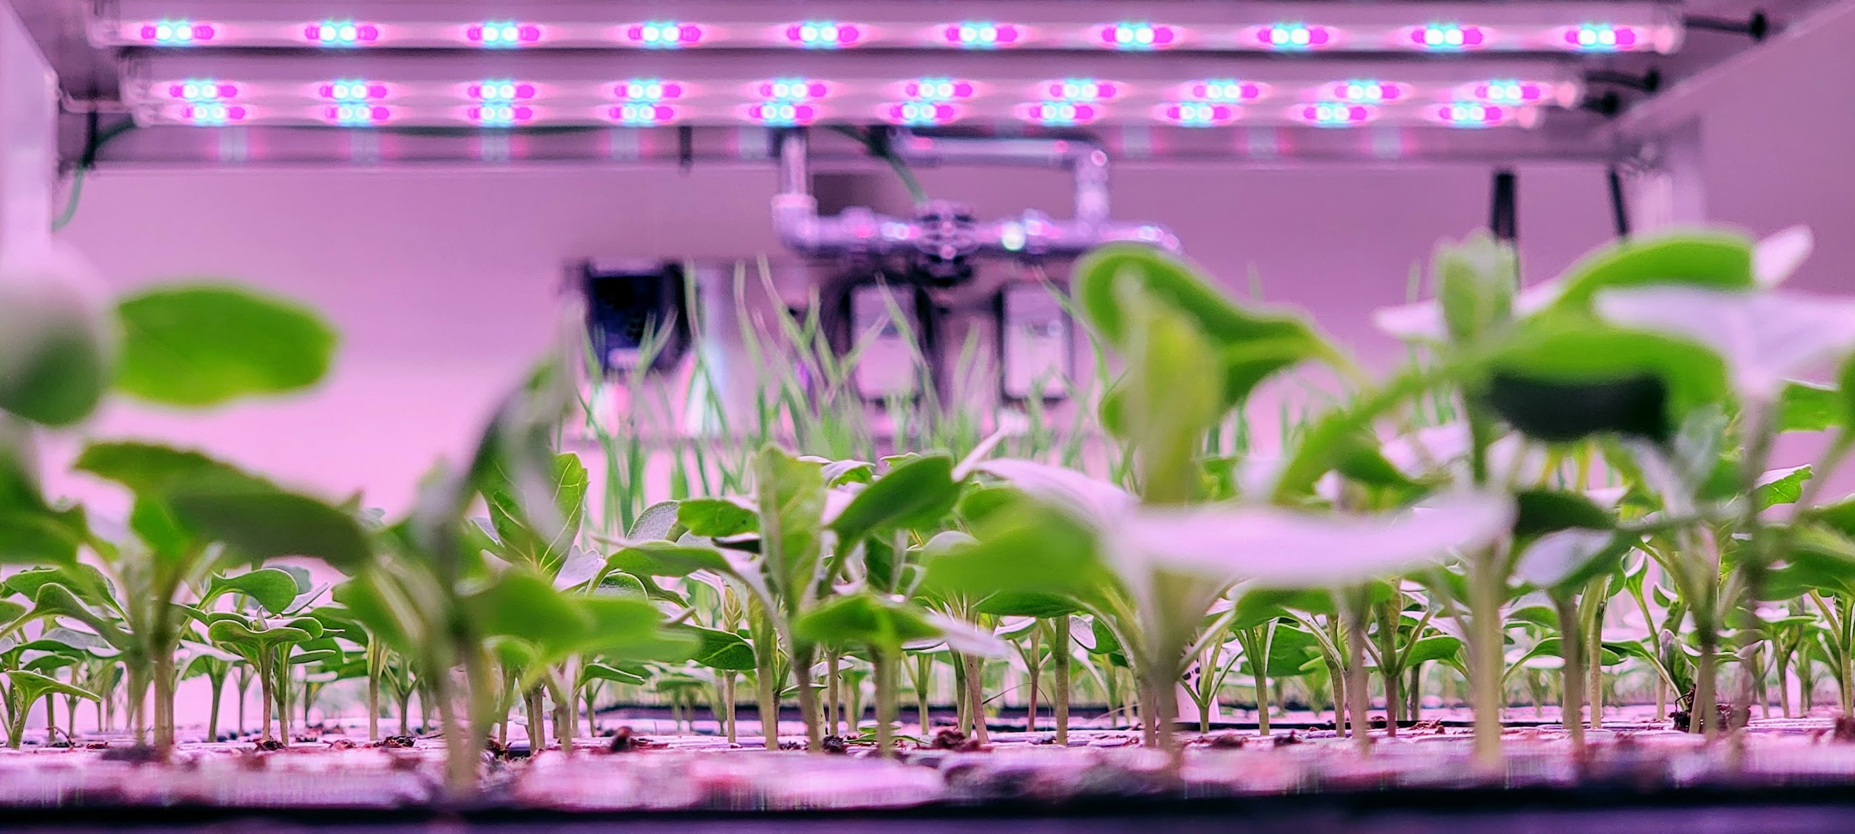
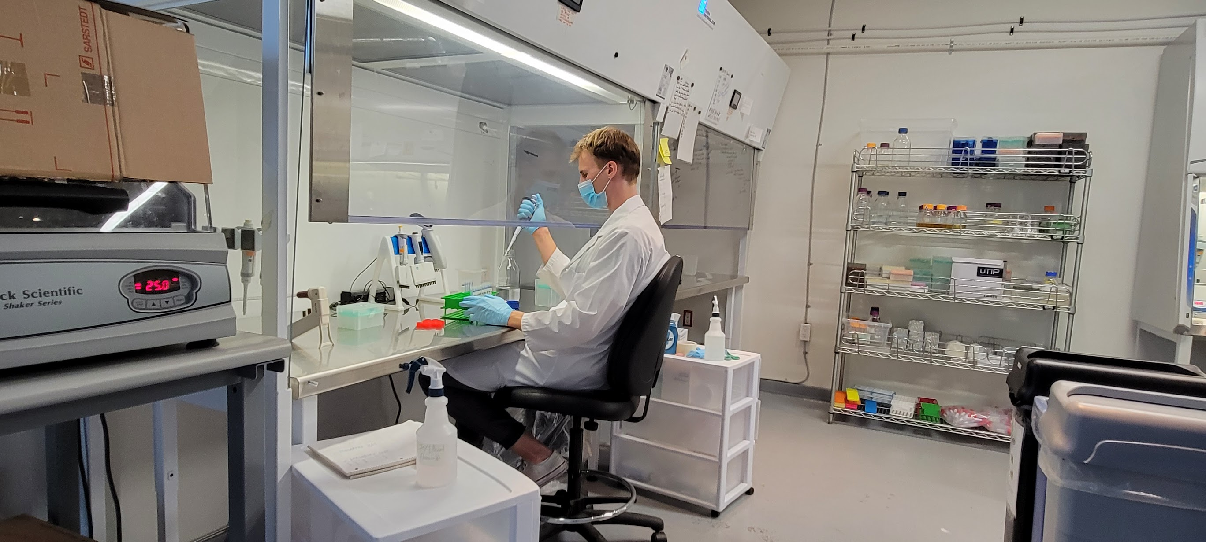
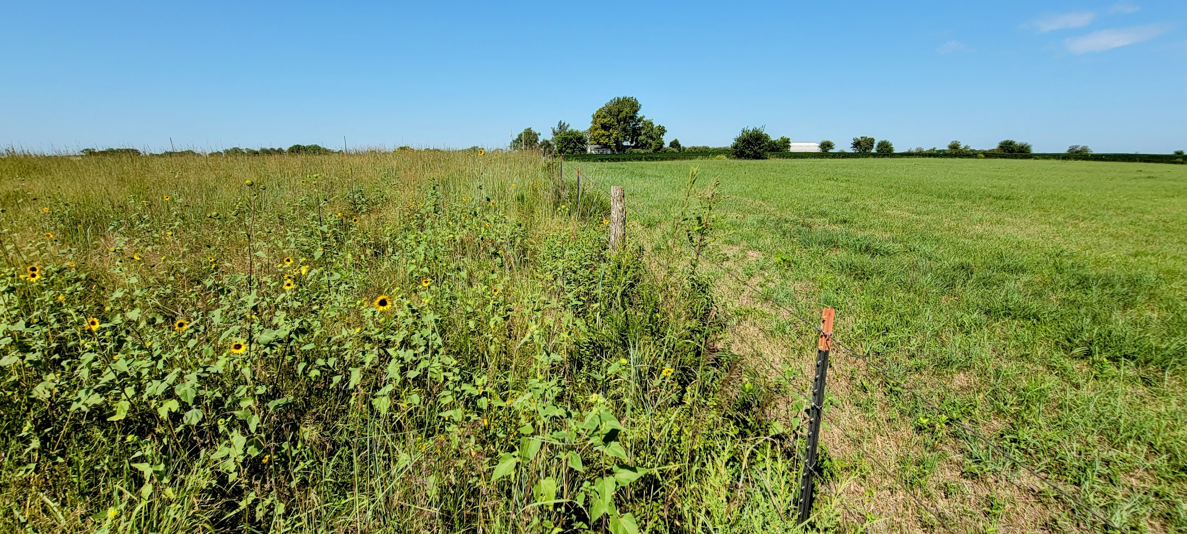
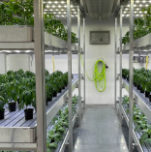
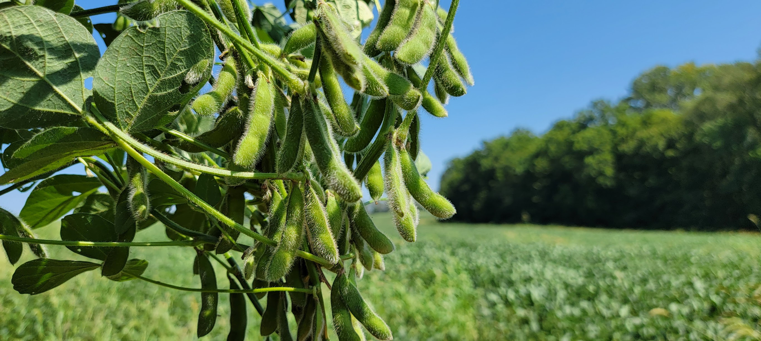
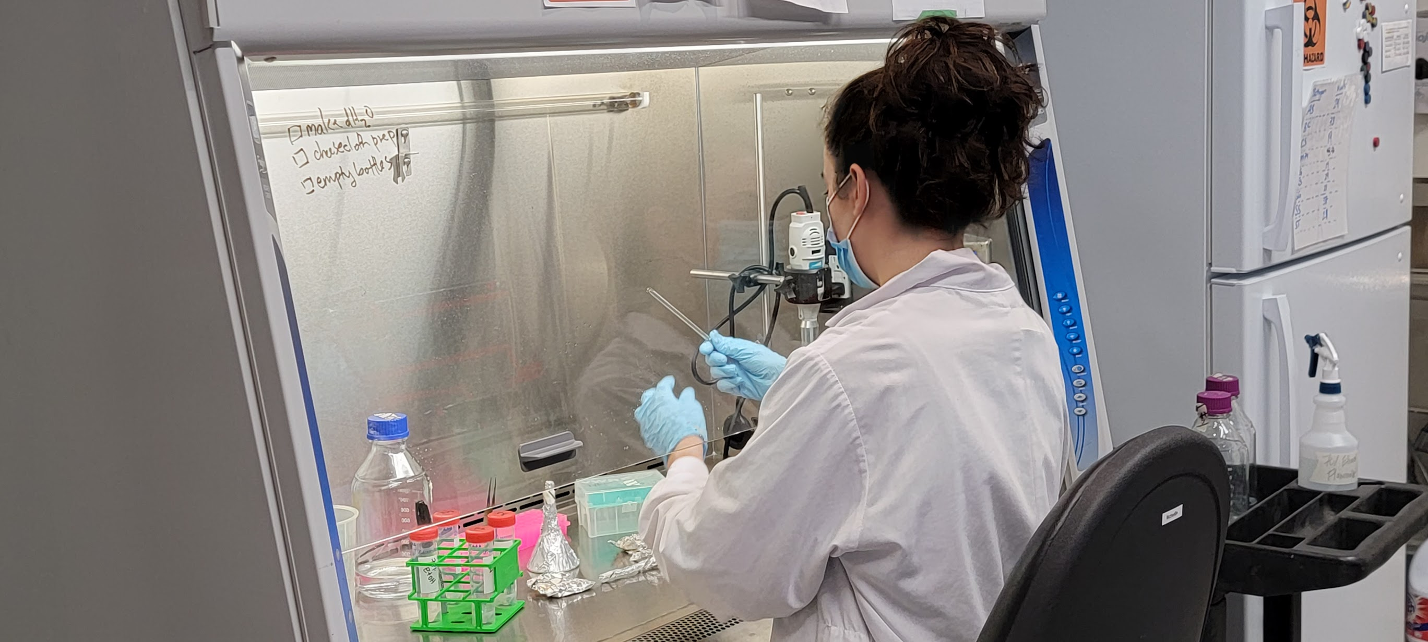

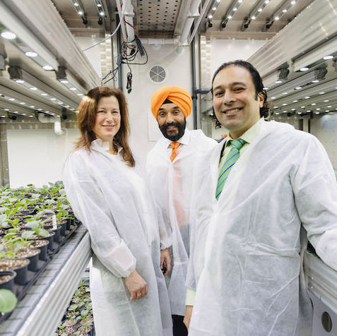
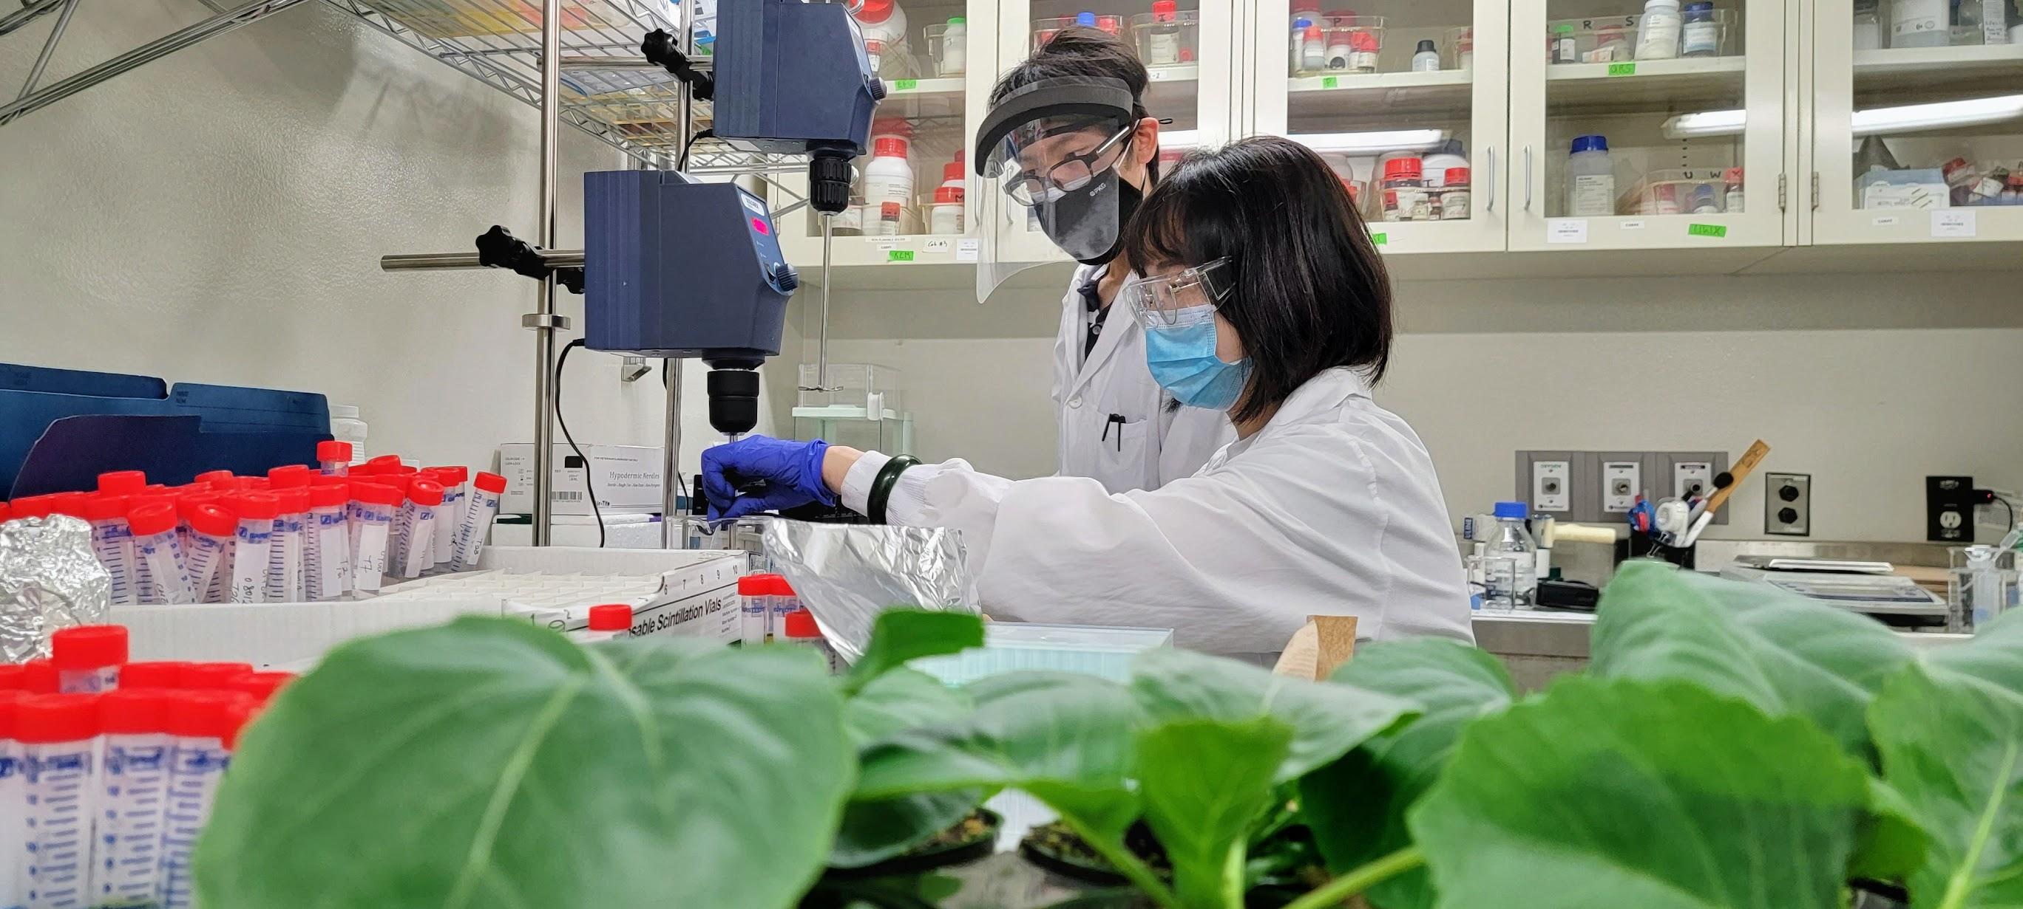
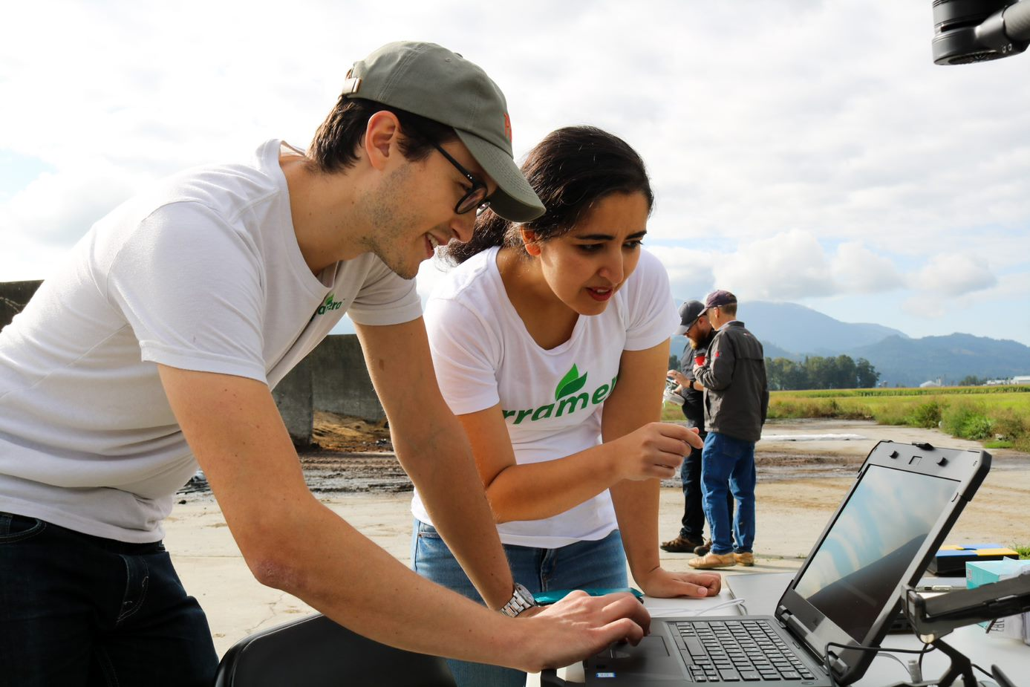
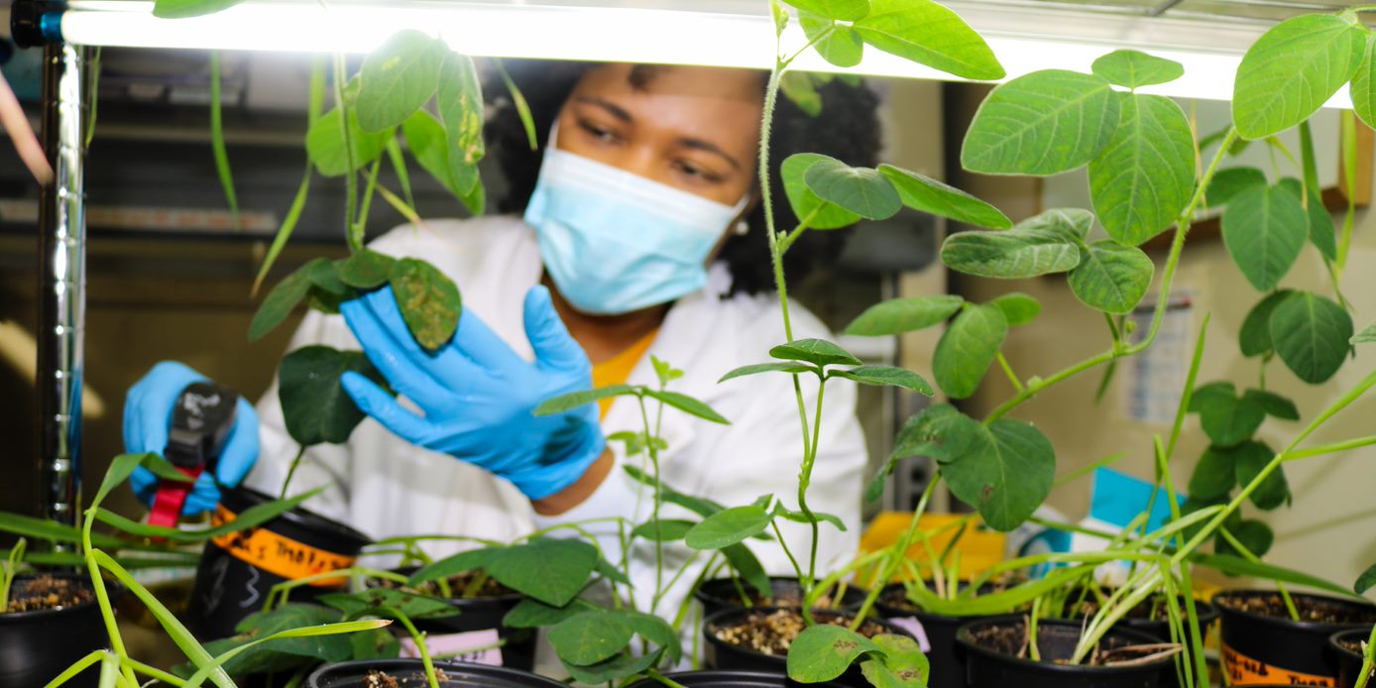
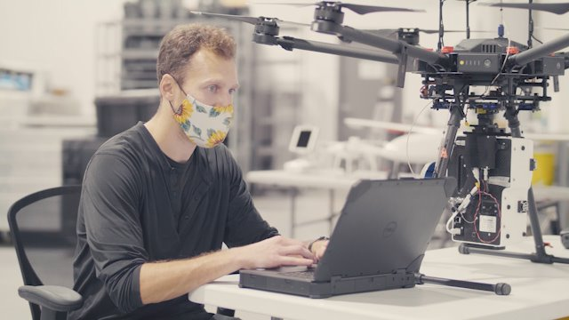
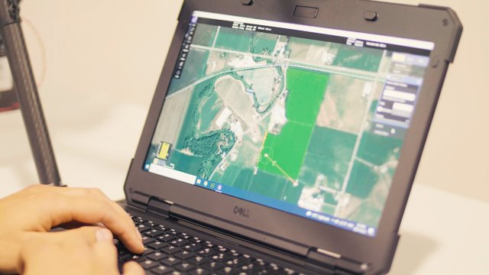
Karn Manhas,
Founder & CEO, Terramera

Slide 2
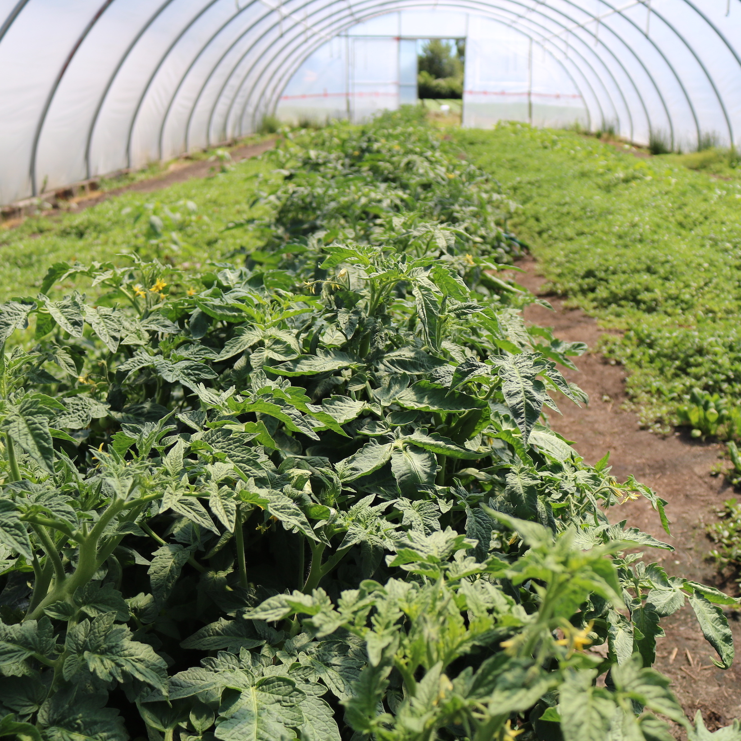
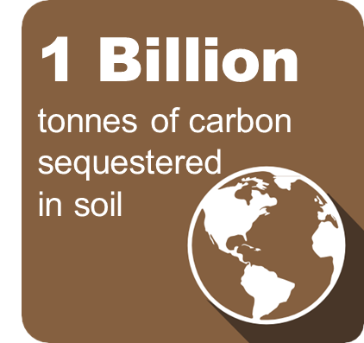
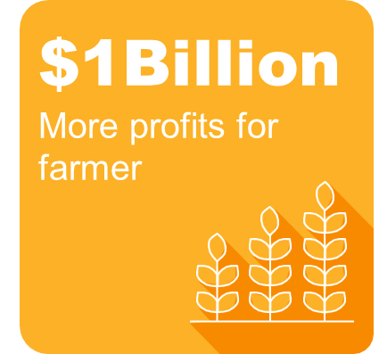
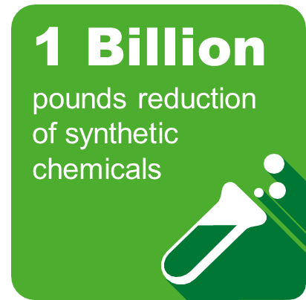
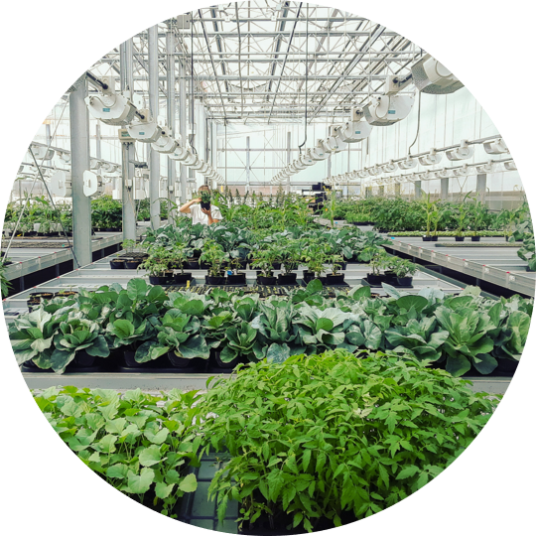



┃ “Our Earth”
“How can we use technology to unlock the intelligence in nature to ensure an earth that thrives and provides for everyone?“
$100m+ private funding
Our 2030 BHAGs
260+ patents
120+ team from 35 countries
Our Ultimate Vision
Rich, Healthy Soils
Rich, Healthy Farmers
Rich, Healthy Planet
Founded 2010 in BC

Slide 3




Why is Terramera Focusing on Soil Health?
Improving Soil Health is a multi-billion-dollar opportunity for Canadian Agriculture.
  Higher farmer profitability & land value
  Sequester carbon and mitigate climate change
  Improved farm resilience & food security
  Cleaner water and fewer chemicals
  More Nutritious Food
  Better food means better human and animal health

Slide 4
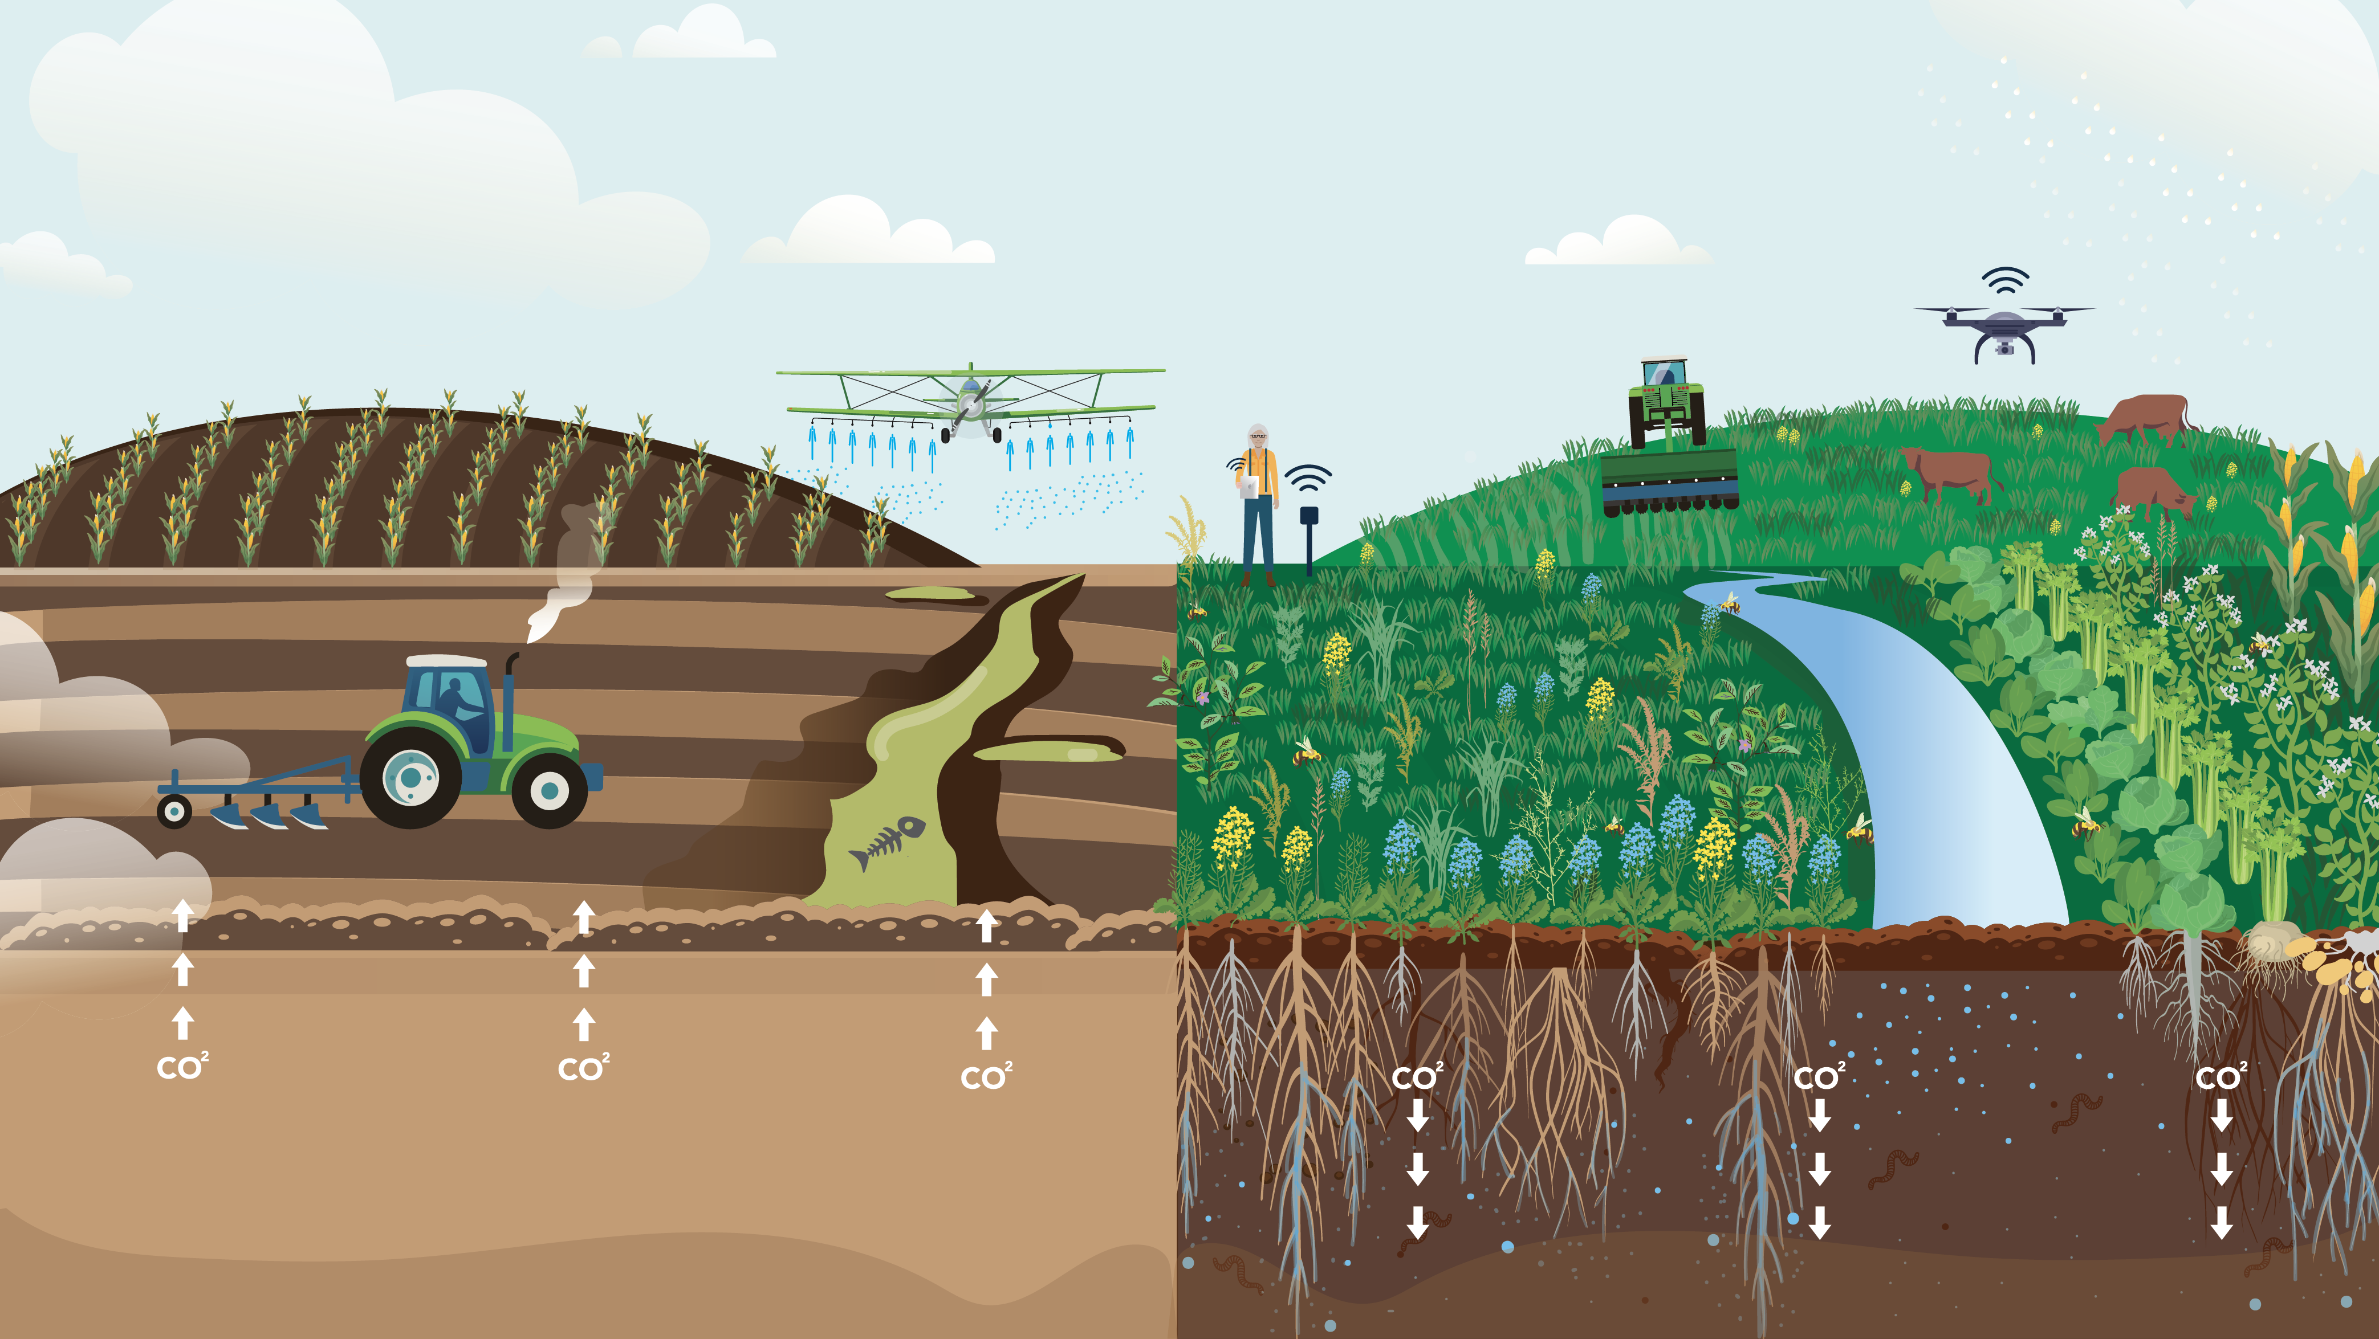
Terramera is Powering a Soil Health Revolution
The Carbon Problem:
'Conventional' farming today
The Economic Solution:
Regenerative Soil-Health farming

Slide 5
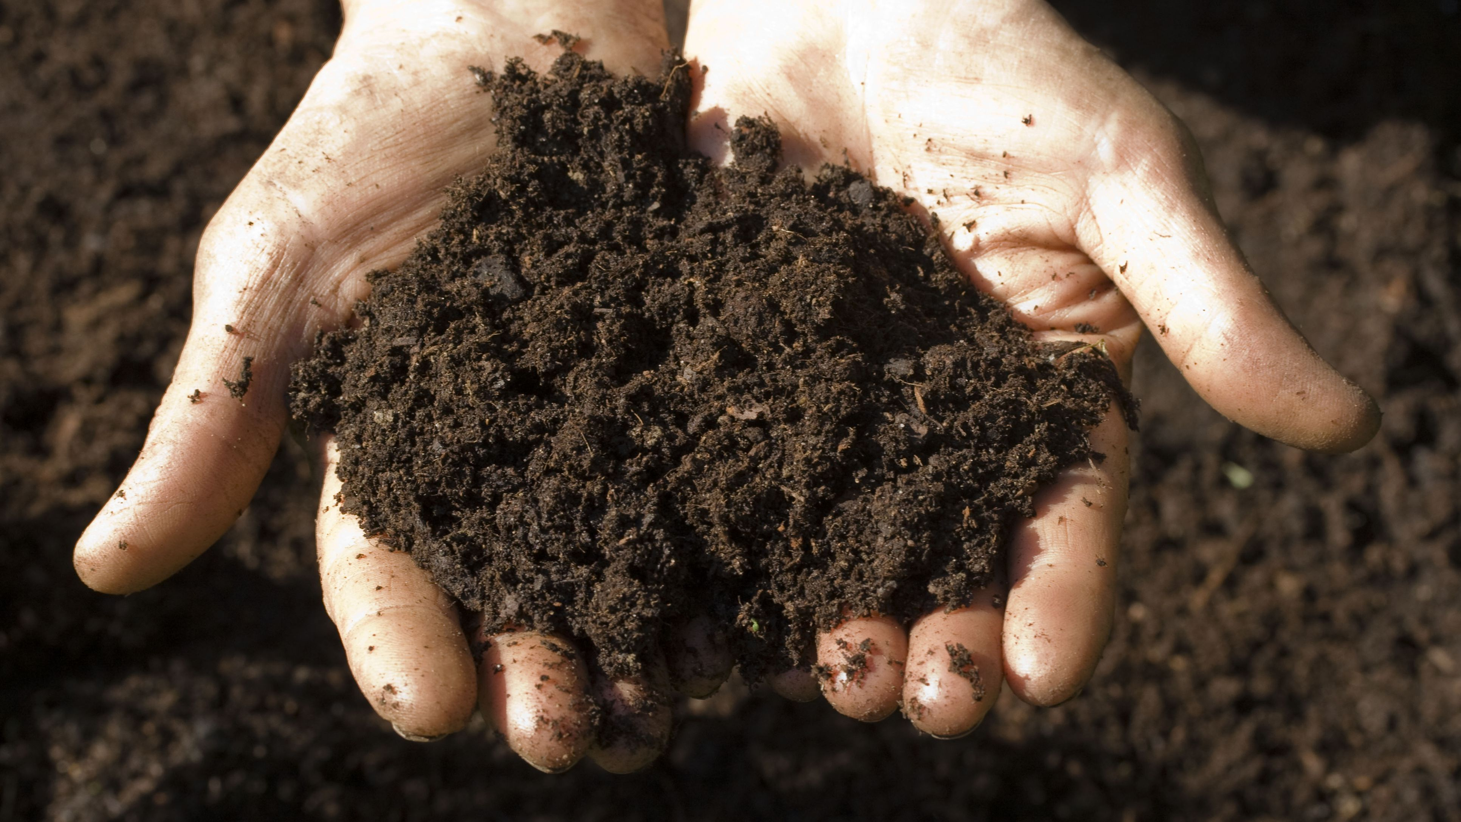
Quantifying soil carbon is expensive and
Uncertain, but doesn’t have to be
WE CAN UNLOCK THIS VALUE AND CREATE A NEW SIGNIFICANT MARKET
Terramera has developed technology that can cheaply and accurately quantify soil carbon, and health indicators including N, P, K, Ec, Ph.
We are improving economics & incentives for farmers to increase soil carbon so that:
  Carbon credit prices can align with buyer budgets.
  Farmers can be more profitable.
  Farmers will have more info on how their practices impact soil health.
Measuring and verifying soil carbon is cost prohibitive, labour intensive, and often unreliable.

Slide 6
At $20-25 per tonne, Carbon Credits provide Producers with around $5-15 per acre.
Intelligent Agriculture
Carbon credits are just a small part of the economic value created for farmers
Producer Profit from transition to Regenerative
Increasing soil health and carbon can increase farm profits by over $100* per acre.
Potential Carbon credit
*Ohio Ecological Food and Farm Association
Notes:
While there is a big opportunity in carbon credits, scaling the profitable transition to regenerative is a much bigger prospect that will provide closer term revenue and, in fact, help us get to carbon credits faster.

Slide 7

Soil Carbon Sequestration Process
Sunlight + CO2
Photosynthesis
Energy for Plants
Excess Carbon
Pushed into soil via roots
​
Microbes Use & Convert
Stable Carbon in Soil
regenerative
practices
Organic Carbon (POM) accumulates
Carbon cycle
High-carbon soil holds more water, nutrients, higher fertility. Over time, POM converts to more permanent C (MAOM)
Plants absorb Carbon Dioxide
Plants form carbohydrates using Carbon dioxide and water from the soil
Carbon enters the soil carbon pool through leaf litter, roots, and soil microorganisms

Slide 8
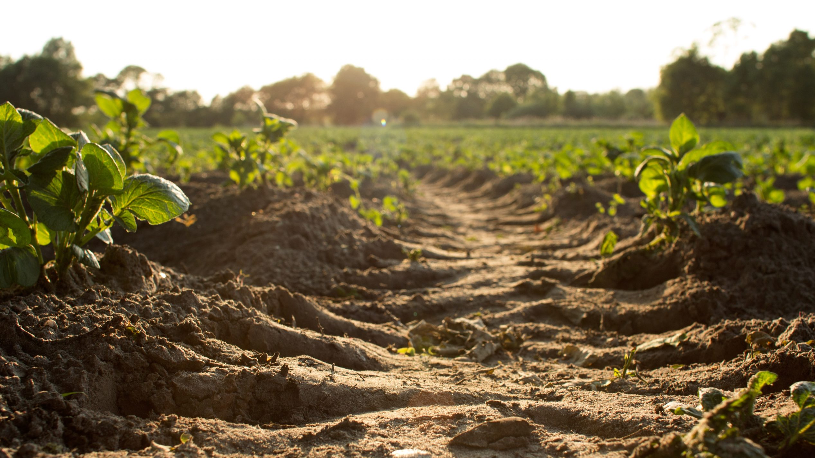

Increasing Soil Carbon Creates Positive Feedback Cycles
Less carbon in the air
Climate change reduced
Less water required for crops > less soil erosion > less carbon released
MORE CARBON IN THE SOIL
Healthier soil adds more carbon
Less Nitrous oxide emitted
Soil health not depleted by fertilizer
Less fertilizer required
CONFIDENTIAL © 2022 Terramera | Terramera.com

Slide 9
How Might We Scale Regenerative Agriculture?
Better
Regenerative
Regenerative
Forage

Slide 10
Automated Soil Sampling
What’s happening below the surface
One Machine does the work of 6-9 workers
Collect samples at various Depth to create soil profiles in 4D
Measure N, P, K, Ec, Ph, Moisture, Temperature in Real Time
Measures VIS and SWIR spectrum used to Estimates Carbon concentration, Carbon Stocks and Bulk-density
Capture crop residue, soil structure and color information
Future steps: Add Measurement of POM, MAOM, Nutrients, and an extended sets of Soil parameters.
Cost per sampling location decrease over time as you sample more

Slide 11
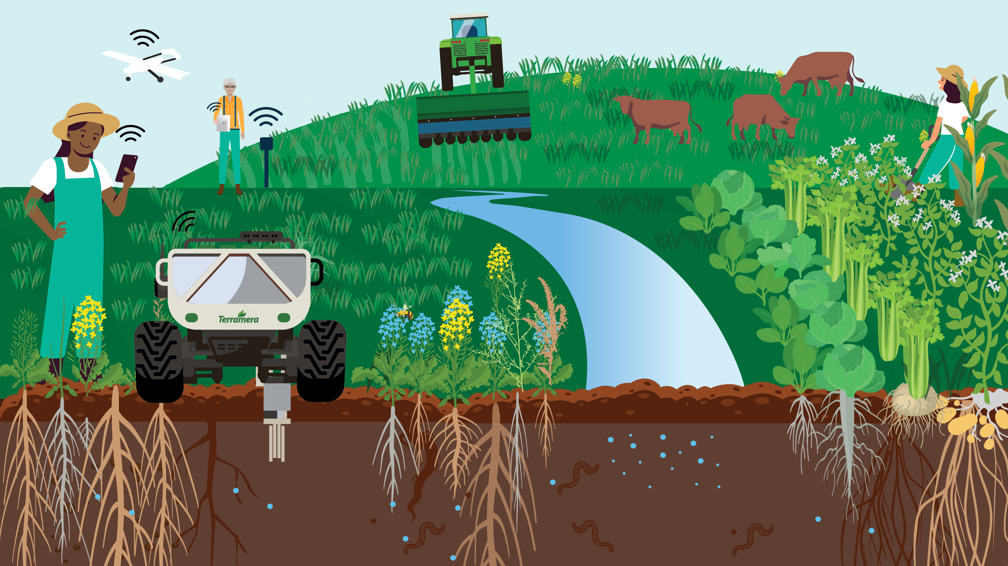
C
Carbon
POM
MAOM
Particulate Organic Matter
Mineral-Associated Organic Matter

Slide 12
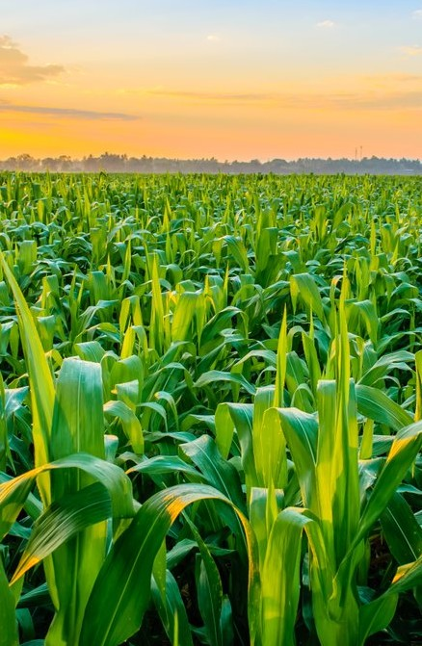

Technology Empowering Producers
Regenerative
By focusing on OUTCOMES, rather than prescriptive processes or practices, Terramera’s technology allows farmers to decide what’s best to do on their land and be rewarded for their actual results.
Organic
Conventional
Technology Empowering Farmers
“What’s good is what’s good for the land.”
– Aldo Leopold
TERRAMERA CONFIDENTIAL © 2022

Slide 13
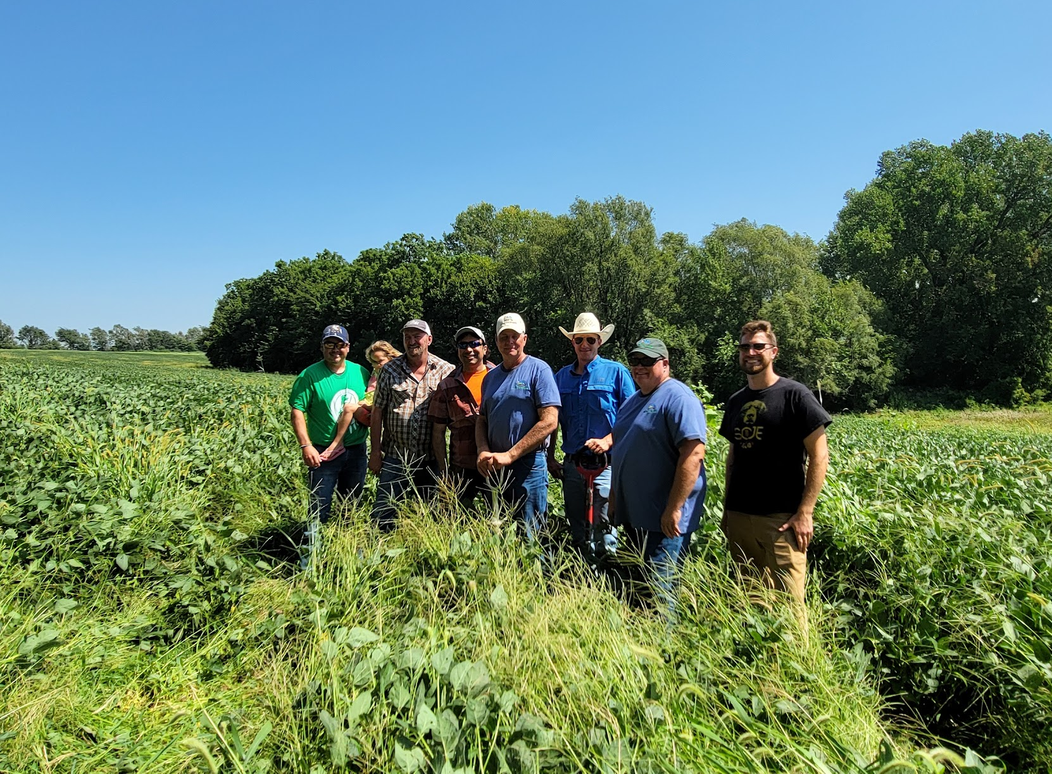
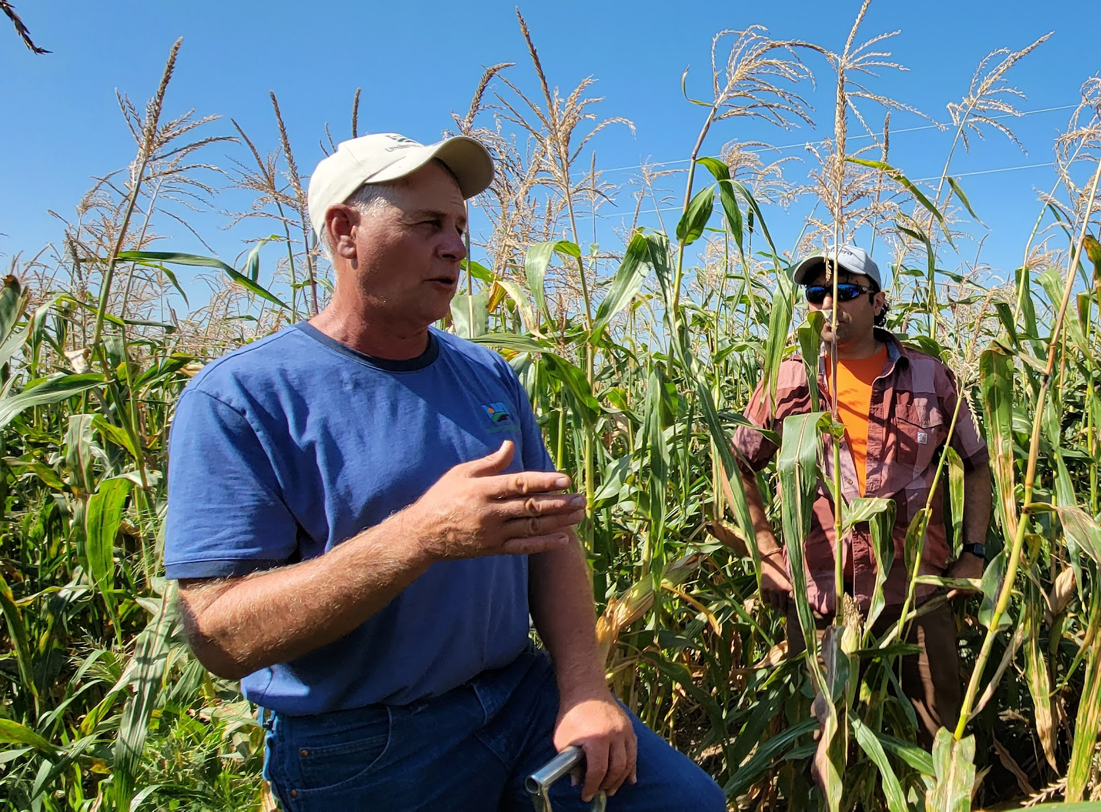
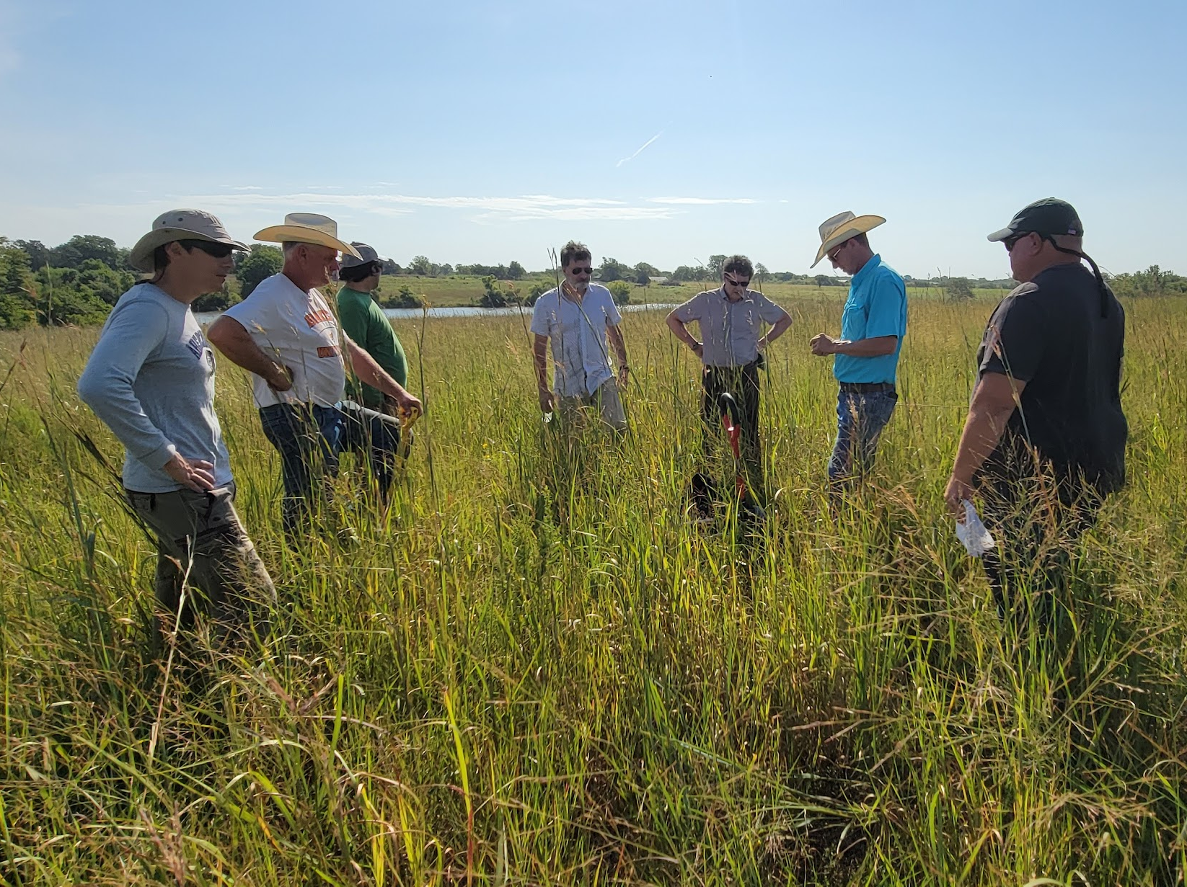
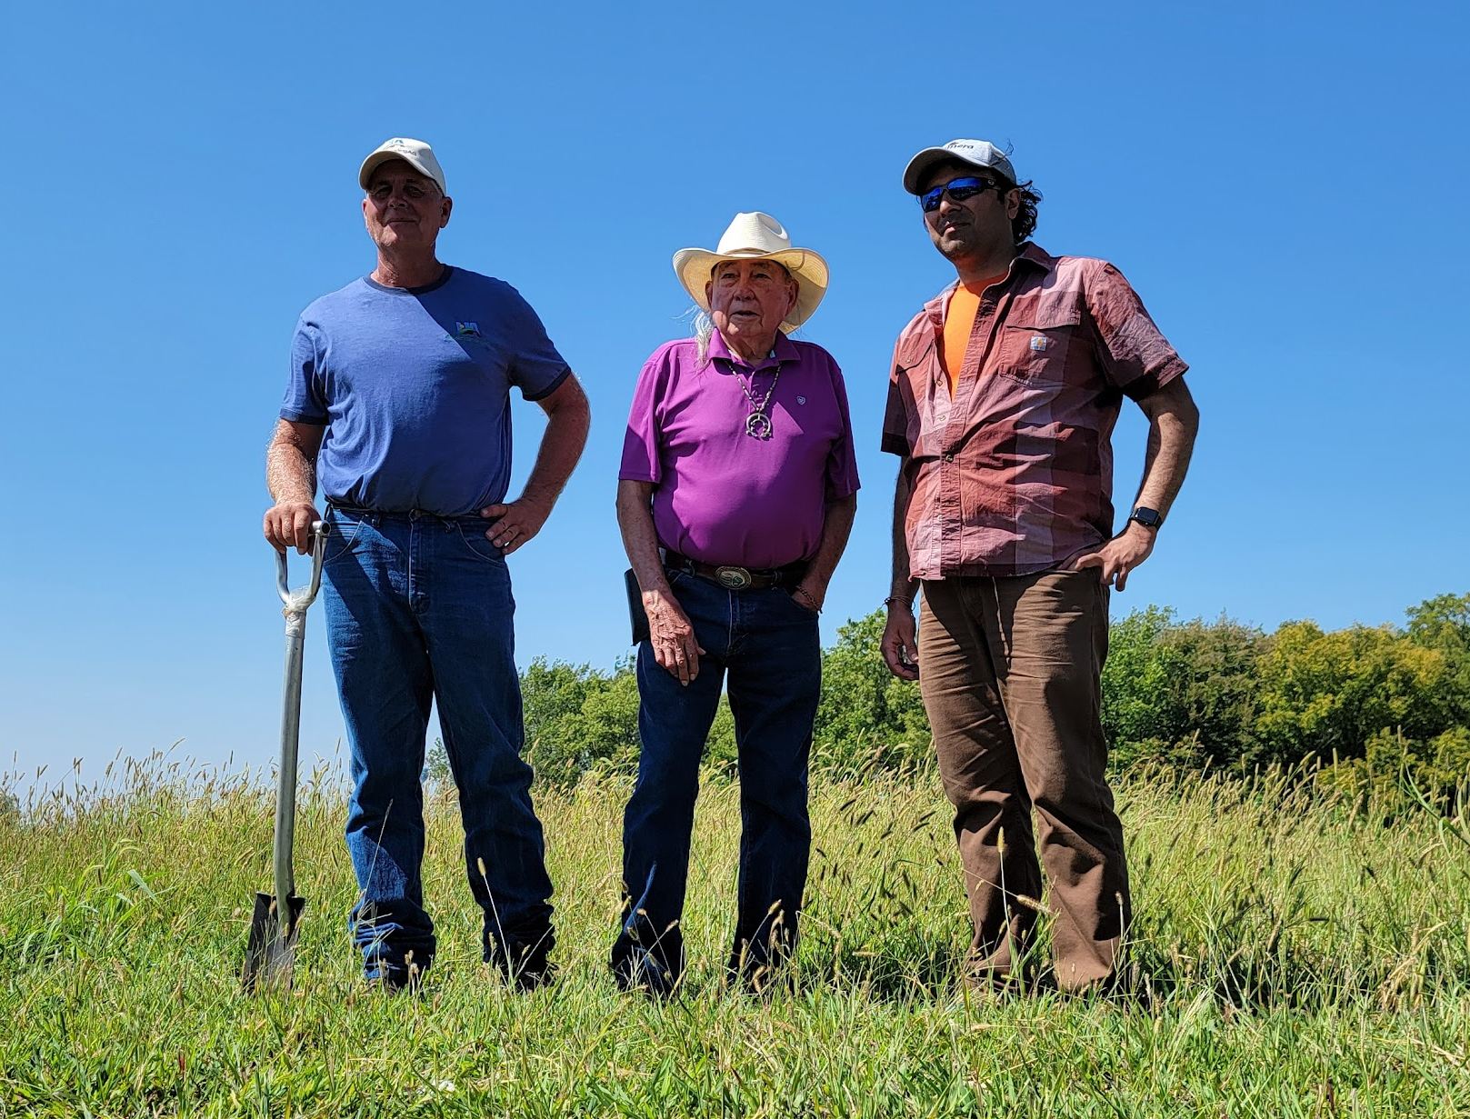
Regenerative annual cropping could reduce or sequester 14.5–22 gigatons of CO2 by 2050 (Project Drawdown)
Regenerative Agriculture can sequester more than 100%
of current annual CO2 emissions (Rodale)
Agriculture, Forestry and Land Use accounts for 18% of greenhouse gas emissions
According to Statistics Canada, in 2019 farmer’s net incomes dropped by 45.1% on average
Regenerative practices have been found to boost farmer profitability by up to
78%
Danone, Maple Leaf Foods and McCain have both committed to fully transition their supply chain to Regenerative Agriculture within this decade
Nestle has committed $1.4bn committed to support 500,000 growers to transition to Regenerative Agriculture by 2025
General Mills will advance regenerative agriculture on 1 million acres of farmland by 2030.

Slide 14
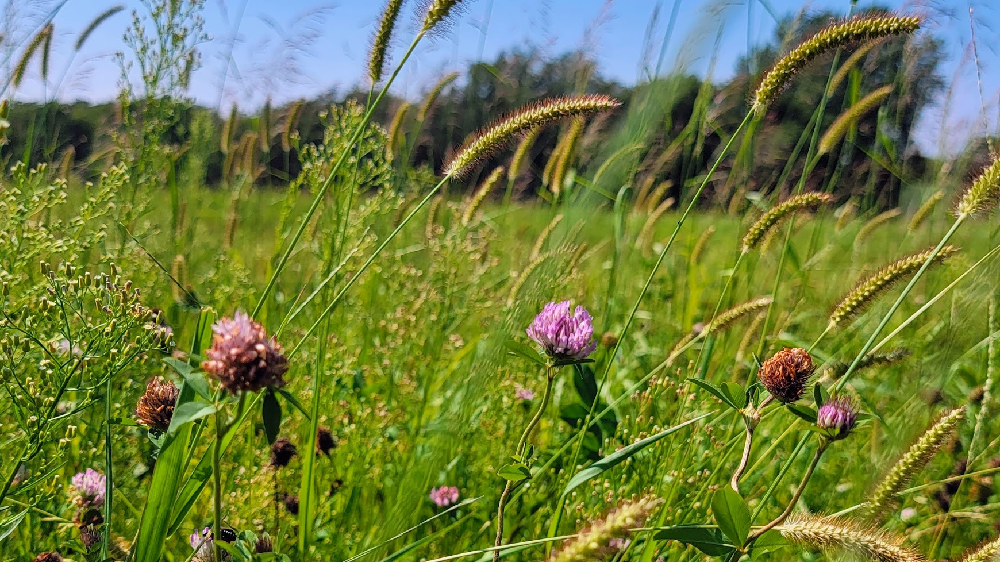
Thank you!

Slide 15

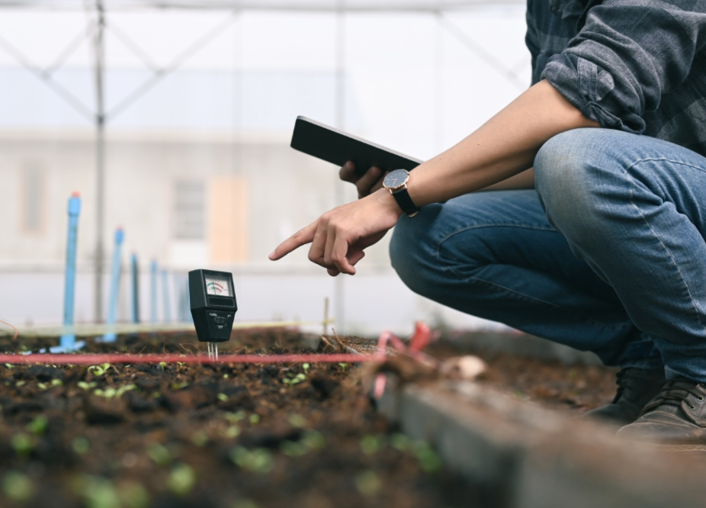
Quantifying soil carbon accurately, economically and reliably
Our low-cost soil carbon quantification technology accurately measures soil carbon and can detect carbon permanence.
Advanced measurement
  Measures both mineral associated and particulate organic matter over time to prove carbon permanence
Regenerative farming outcomes
  Precise measurement demonstrates how farming practices increase soil carbon and achieve carbon permanence
Confidence in carbon markets
  Supports carbon markets by ensuring farmers paid for the actual carbon they sequester, and governments and investors are confident in the carbon offsets they buy

Slide 16
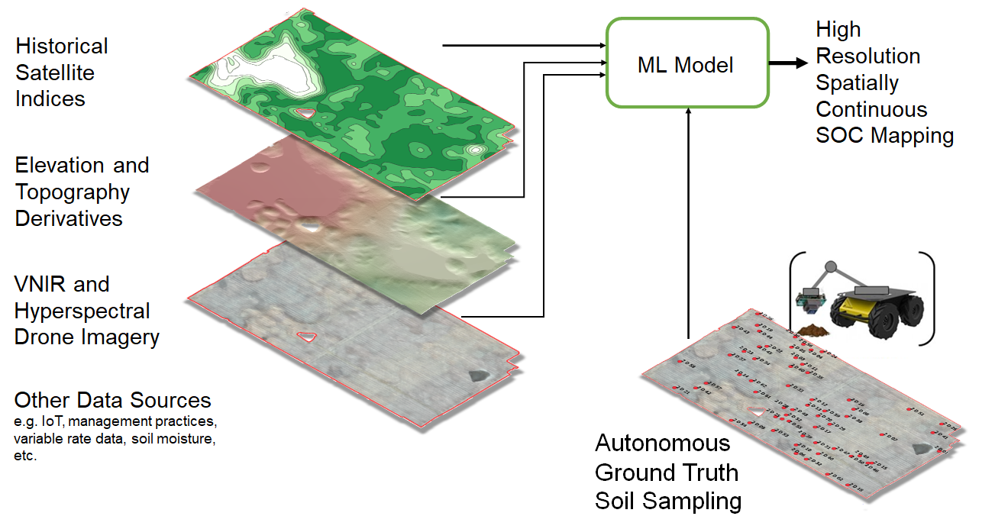
Predictive modelling is key to scaling soil sampling & soil carbon credits
Currently estimate soil carbon with direct measurement or predictive biogeochemical modeling.
Terramera digital soil carbon mapping solution
Machine Learning Model
Direct measurement is too expensive to scale. Biogeochemical modelling is not accurate enough for soil carbon markets.
Terramera uses combination of techniques – predictive biochemical modelling using remote sensing & ground-truth direct measurement to generate an accurate, cheaper solution that can scale.
Ground-truth soil sample data from the field

Slide 17
The future of agriculture needs to be outcomes based
When outcomes are hard to measure, we rely on processes to achieve standards. For example, in organic farming rules have been established that follows a product from farm to retail.
Process-based measurement leads problems experienced in organic farming today:
Significant time and expense to create, understand, follow and audit the process. Costs passed on to consumer at a significant premium.
Without regular audits, it’s possible to ‘cheat’ & circumvent the process.
Rather than optimizing for outcomes, focus is on optimizing the process.
Terramera is creating technologies to enable outcome-based measurement:
Time, effort & expense is saved
It’s impossible to cheat/ circumvent the process
The industry optimizes for outcomes – what consumers care about!

