Slide 1
Canada’s Grocery Sector at a Glance
Total grocery retail: $103.8 billion/yr.
Total Grocery Stores in Canada:
13,400
Independents
6,900 (51%)
CFIG member retail: $12.8 billion
( Source: 2015 Economic Impact Study)

Slide 2
Independent Sector – BOTTOM LINE Impact on Economy
( Source: 2015 Economic Impact Study)

Slide 3
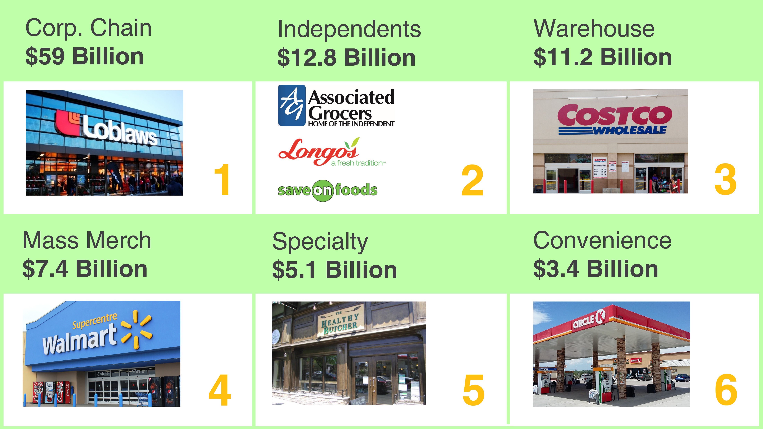
Estimated Grocery Retail ($ Billions)
( Sources: 2018 Canadian Grocer’s Who’s Who; 2015 Economic Impact Study)

