Slide 1
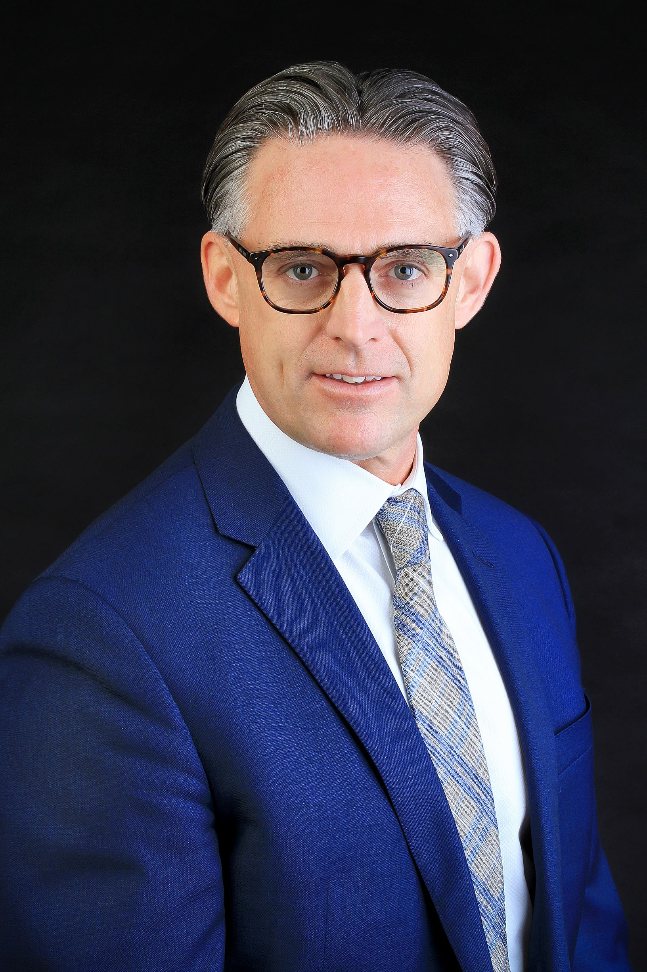
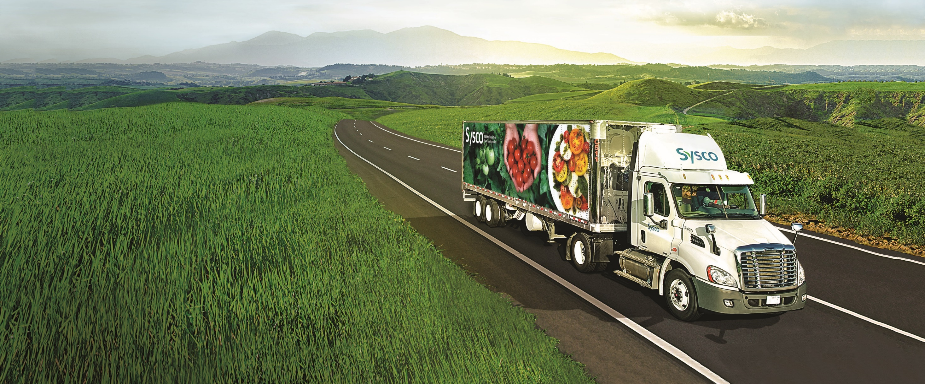
Randy White, President
Sysco Canada

Slide 2
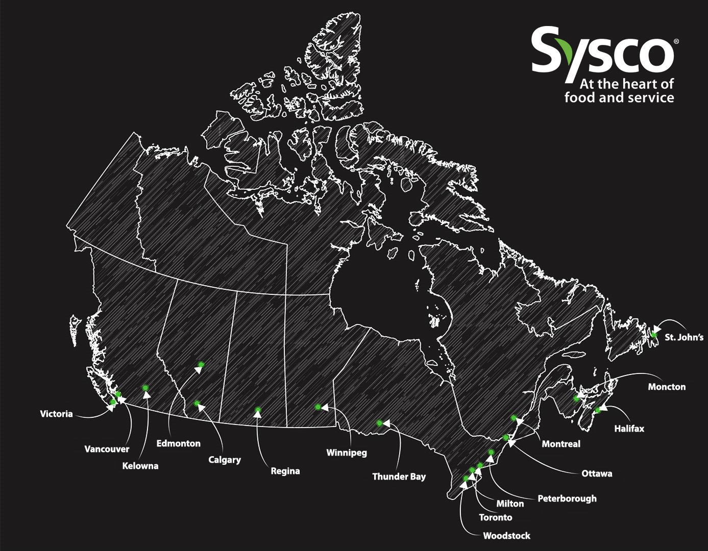
the VISION we live by To be our customers’ most valued and trusted business partner
SYSCO CANADA COAST TO COAST​
Notes:
Sarah

Slide 3
SYSCO CANADA
Customer Base
47,783
unique SKUs
4,654
Sysco Brand SKUs
Local Operators
Restaurants
Hospitality
Seasonal Recreation
Retail
Indigenous
National Chains & Franchises
Healthcare & Senior Living
Foodservice Management
Restaurants
Hospitality
Travel & Leisure
3,795
employees
17
physical sites
600
trucks
19,342,000
Miles Driven

Slide 4
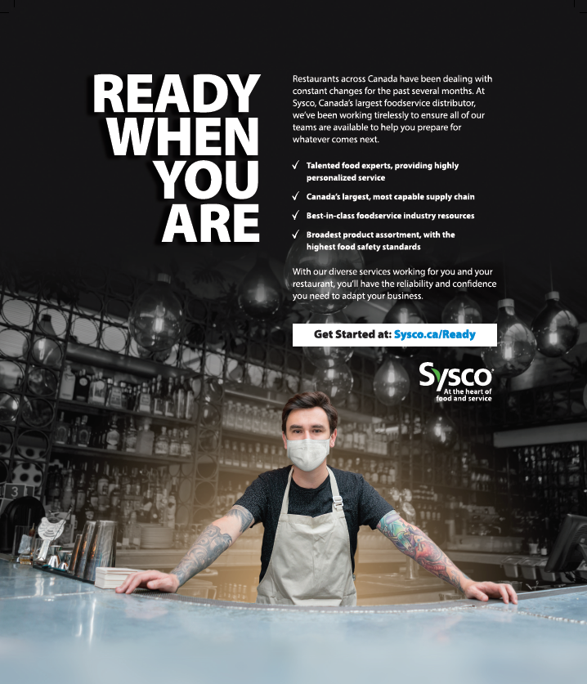
LEADING THE FOODSERVICE INDUSTRY
Talented food experts, providing highly personalized service
Canada’s largest, most capable supply chain
Best-in-class foodservice industry resources and customer technology
Broadest product assortment, with the highest food safety standards

Slide 5
ADVERSITY HIT.

Slide 6
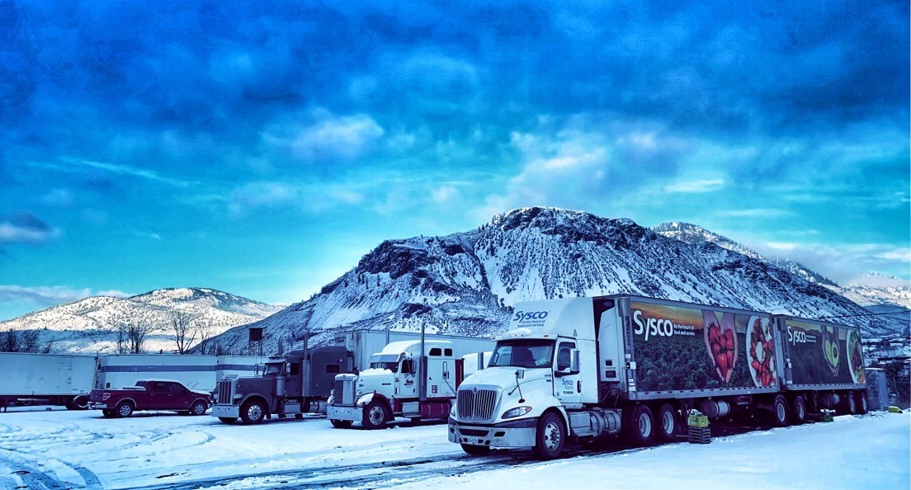
We stepped up & forward
into the marketplace

Slide 7
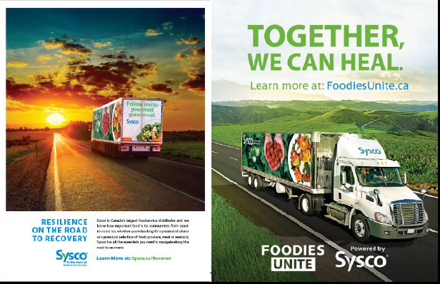
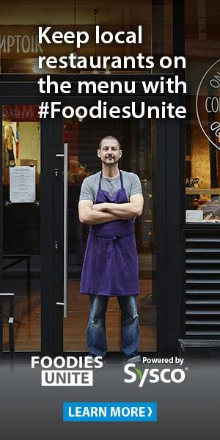
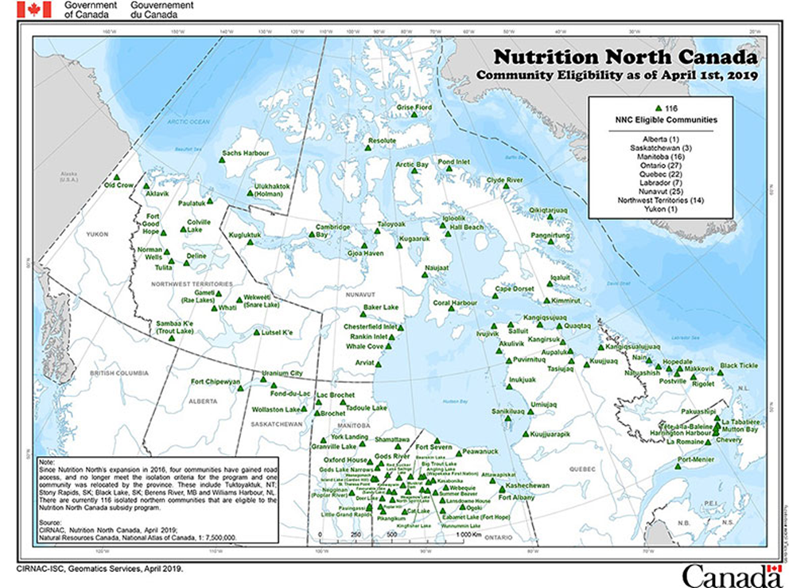
Heal our industry
Help Our Customers Nourish Our Communities
During the pandemic, Sysco donated over 6M+ meals to Canadians in need.
Notes:
WE’RE NOT SITTING BACK- WE’RE STEPPING UP NOW
Remove snap back montage and only have snapback

Slide 8
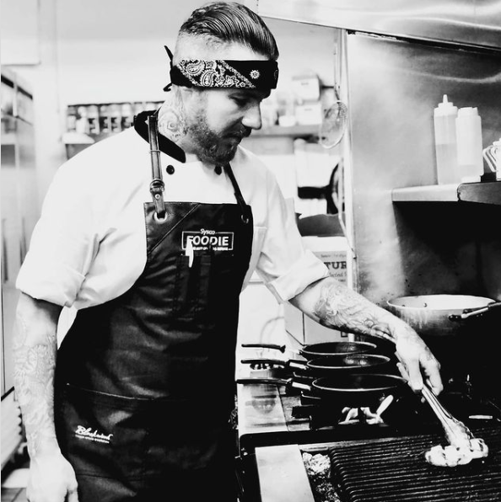
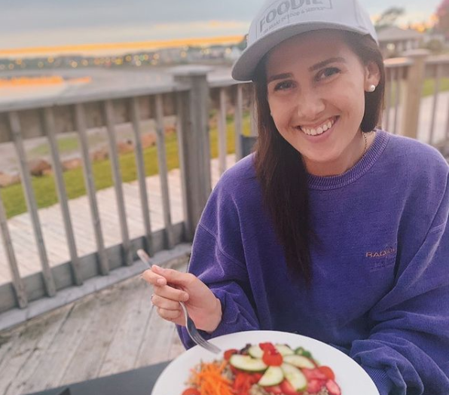
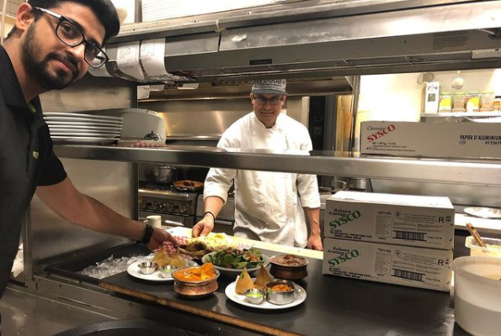
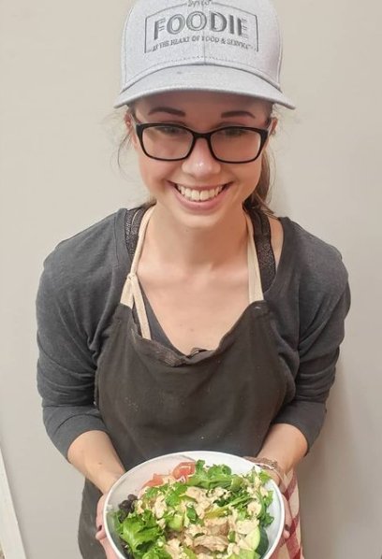
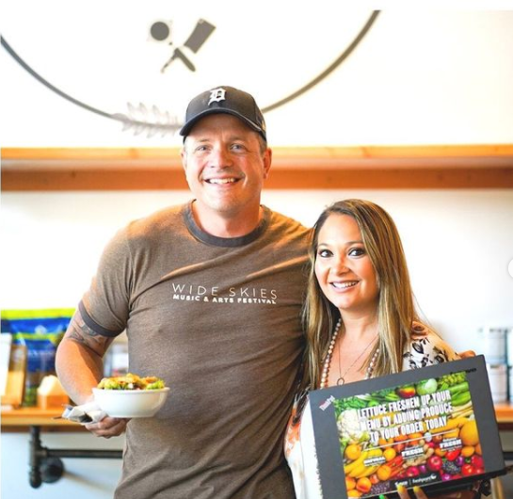
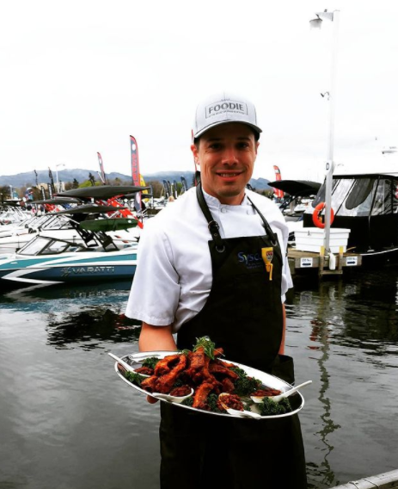
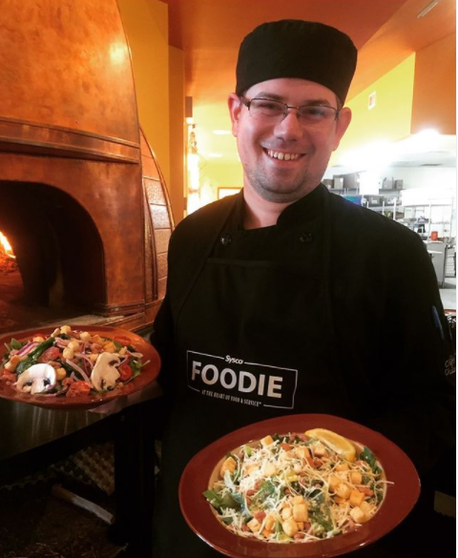
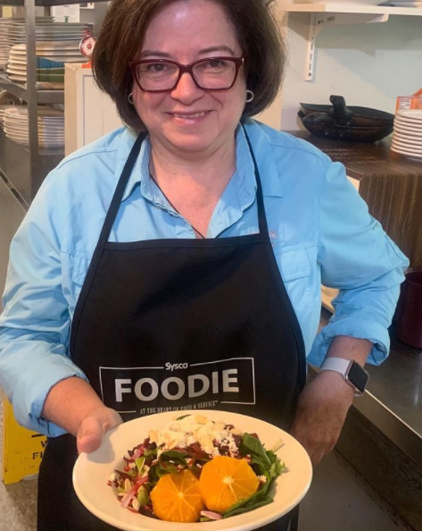
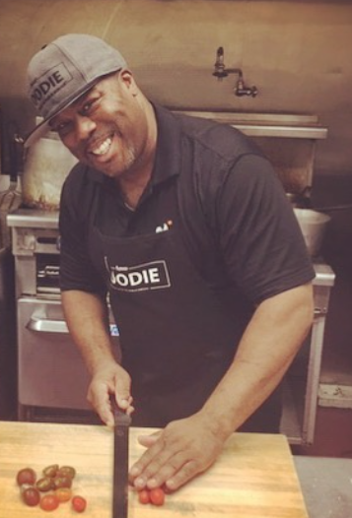
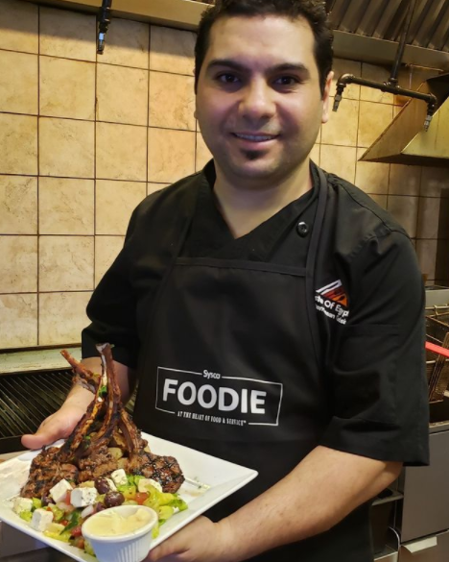
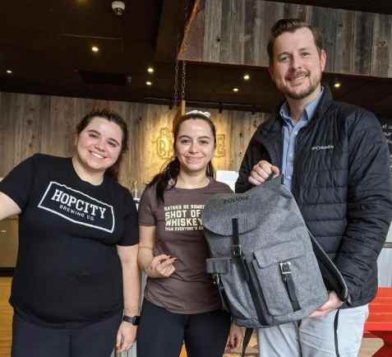
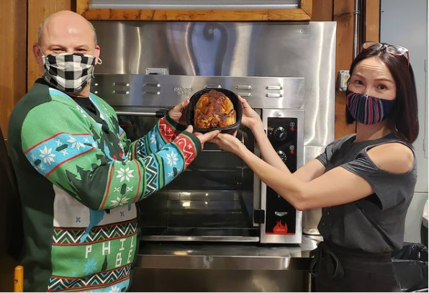
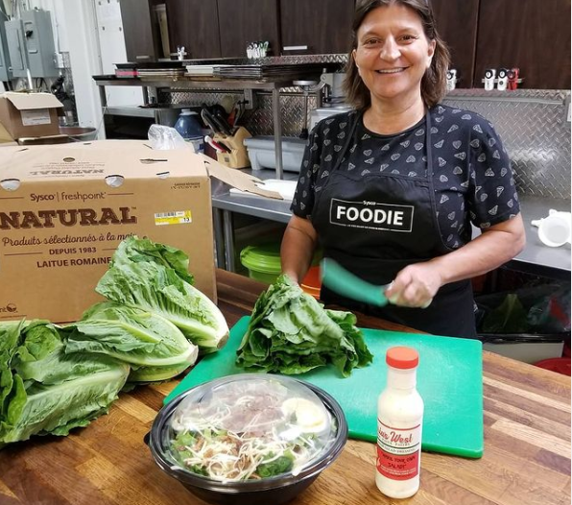
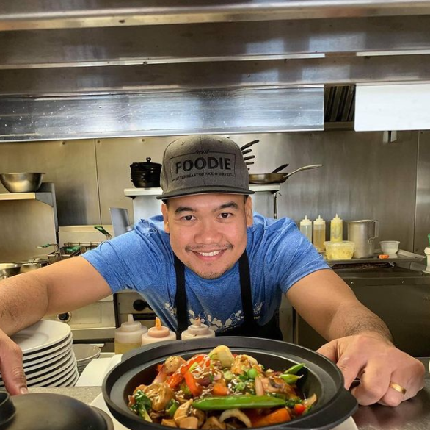
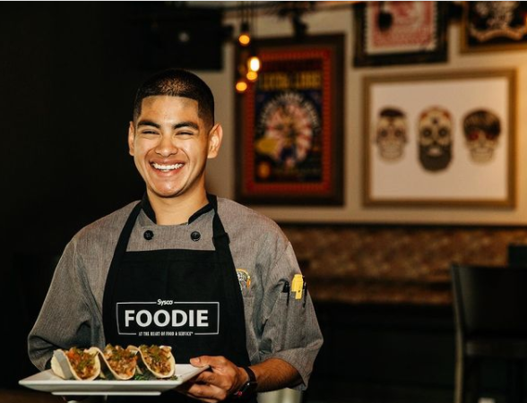
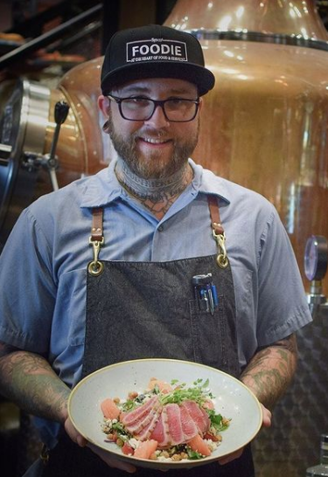
CONSUMER SHIFTS
NEW CHANNELS

Slide 9
EMERGING TRENDS
SOURCING

Slide 10
TOGETHER
WE CAN…
TRANSFORM
LEAD
GROW

