Slide 1
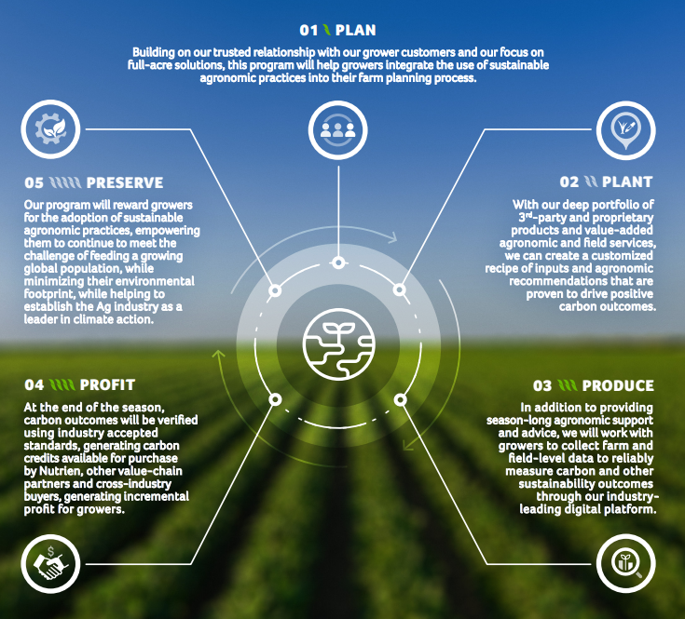
Nutrien‘s Carbon Program
Pilot phase launched in 2021 in the US and Canada
Working together with farmers to understand and develop agriculture’s carbon market opportunity.
Nutrien is building on existing protocols and working more broadly with collaborative groups to refine and shape protocols for agriculture.
Leveraging our digital tools for growers, adding the data and evidence needed for monitoring, reporting and verification.
Notes:
Targeting

Slide 2
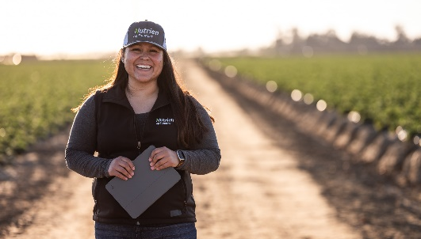
Nutrien’s Differentiated End-to-End Carbon Program We Have Assembled the Critical & Unique Building Blocks to Deliver Sustainability Outcomes at Scale
Trust-based planning with growers
Grower specific carbon recipe
On-farm agronomy support and advice
Streamlined data collection & easy validation
One stop monetization
Building on Nutrien’s trusted advisor relationship and long-term partnerships with growers
Part of our full acre farm planning focus to help growers sustainably increase ROI
Proprietary Nutrien “recipe” of practices and inputs from industry leading suppliers and our suite of proprietary products
Digitized crop planning, leveraging field data and soil sampling to establish baseline
Year-round agronomic support, from application services to in-season guidance on crop management
Variable rate prescriptions and custom fertilizer blends, continuing Nutrien’s 4R excellence
Digital platform to seamlessly collect data at the farm and field levels
Validation of emissions reductions, with agronomic modeling and in-field data points (e.g. soil sampling)
Grower payout, with Nutrien managing every aspect of carbon credit sales with its partners
Carbon credit management integrated with Nutrien’s digital platform
November 30, 2020
Source: Nutrien

Slide 3
The Goal is High Quality Carbon Offsets
Whether the aim is to participate in a compliance-based carbon market, a voluntary market or a supply chain initiative, high quality carbon offsets will follow a core set of principles.
Principles:
Real – based on a credible baseline and quantified using a conservative, public and peer reviewed method
Additional – beyond business as usual
Permanent – any net reversals must be accounted for and replaced
Verified – 3rd party review of monitoring, data and evidence in reporting
Registered – have a clear ownership and tracking to avoid double counting
Challenges for agriculture:
A high data burden for validation, verification, reporting and monitoring.
There is a high cost of measurement and high variability in biological systems that leads to uncertainty.
There is significant discounting of emission reductions and sequestration to deal with issues of non-permanence or reversibility and uncertainty.
Digitization and easy implementation with farmers is lacking.
Payments for carbon to farmers are relatively low.

