Slide 1
Innovative Policy Options for the Future of BRM Programing
Dave Sept
Golden Spruce Nurseries
Langley, BC

Slide 2
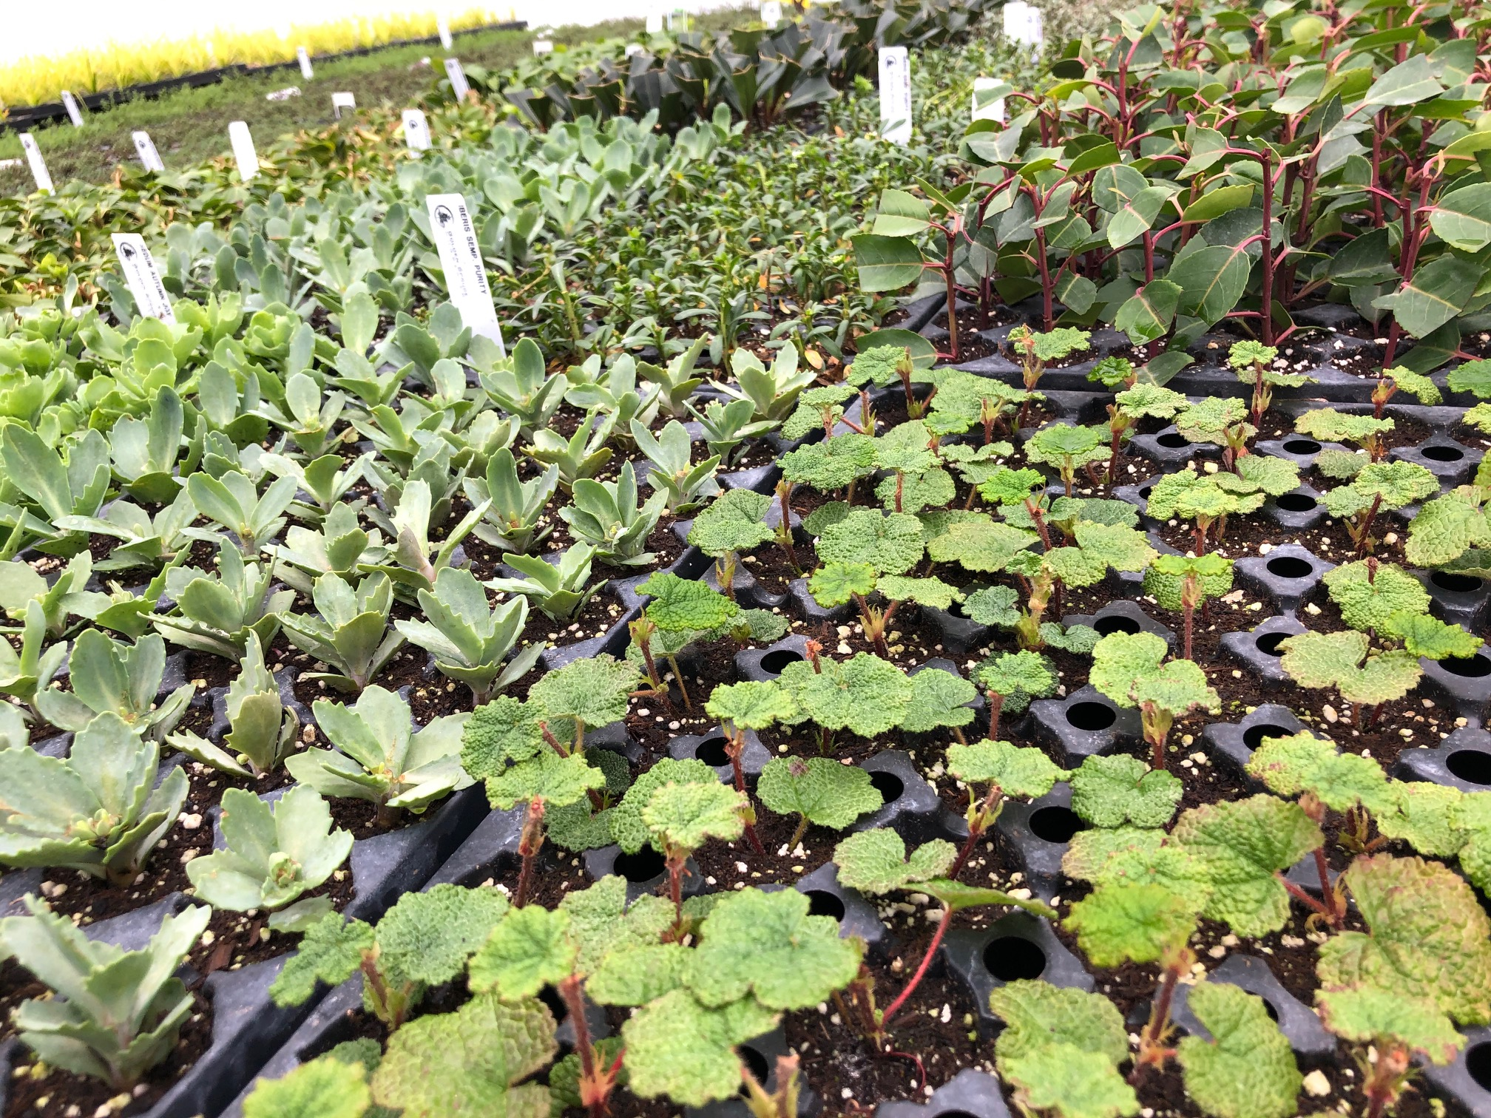

Slide 3
About Golden Spruce
No crop insurance available
Use Advance Payment Program – Delivered by Ag Credit Corp for our sector
AgriStability
AgriInvest
Budgets and forecast
Hiring policy
Marketing
Gross sales 2019 $2.6M

Slide 4
What does BRM mean to me?
Being a producer (owner/manager) who is:
ENGAGED
Actively participating in all aspects of risk management
2. EDUCATED
Informed and up to date on market conditions, labour issues, available BRM programs, opportunities for growth and profit
3. EFFECTIVE
Make timely, merit based decisions. Plan for the best and prepare for the worst

Slide 5
Engaged, Educated and Effective
Acknowledge that all business carries risk, farming even more so
Understand that it is the responsibility of the producer to maximize profits and mitigate risks
Be PROACTIVE in assessing risk - AgriShield
Consult professionals & peers to gain knowledge and understanding
Manage to your fullest capacity the things that are under your control
BRM programs should be designed to allow good farmers to take good risks and support innovation

Slide 6
What I can control – Producer Responsibility
Production
yields and capacity
Financial planning
Budgeting; trends in pricing, FX, social and environmental
Cost/Benefit analysis
Financial literacy - Cash books, Understand your balance sheet and income statement
Labour
Yes you can!
Marketing/Community engagement/Industry engagement

Slide 7
What I can Influence – Government Support
Weather
Flood, hail, frost, fire, earthquake etc.
Global market conditions
Geopolitical issues
Bumper crops
Trade disputes
Economy – Supply/Demand
Institutional Risk – What is the new BRM going to do/not do?
Human risk – health of producers - COVID

Slide 8
How to change BRM Programing
God grant us the serenity to accept the things we cannot change,
the courage to change the things we can, and the wisdom to know the difference.
Should we change the current funding levels in BRM, or just accept it?
What is possible to change?
Are producers, associations and FPT actually courageous enough to effect change?

Slide 9
AgriStability
Main Issues:
Terminology
Timeliness
Predictability
Equity
Coverage
Main Benefits:
Coverage based on YOUR farm
Historical vs forward looking
Will protect against long term trends

Slide 10
AgriStability
Timeliness is an issue that is easily addressed. It really is mostly a producer created problem.
Predictability can be improved within the administration of Agristablity. This is within the purview of FPT.
Coverage: It may be too much of a challenge to move above 70% trigger, however BC has enhanced the support payments to 80%
Can FPT reach an agreement on this? Where will the funds come from?

Slide 11
Equity – How can we all share the money?
BRM programing aims to treat all farms equally, however:
Not equitable between commodities
Not equitable within the same commodity from producer to producer
Reasons for inequality:
Crop insurance
Reference Margin limits
Allowable expenses – family farms, automation etc.
Supply management
Regional issues – cost of land
I think there is a need to see if shifting some protection from production losses to market losses is appropriate

Slide 12
BRM improvements for the Future
I feel AgriStability is still the best model forward – it does need improvement
Connect with producers and empower them to get educated in their business
Shift the service model to be more proactive in explaining how to use the program, how it will respond to various levels of loss. Farmers need to know at what loss level they will trigger a payment. Knowing their reference margin doesn’t really do that.
Remove RMLs and make the program more equitable for mechanized farms and those who use significant family labour.
Improve program accuracy of structural change adjustments
Re-evaluate how market inventory is treated. Unrealized gains and losses have an undue impact on payments.
Evaluate the if shifting some funding protection from production losses to market losses can make support more equitable for all producers

