Slide 1
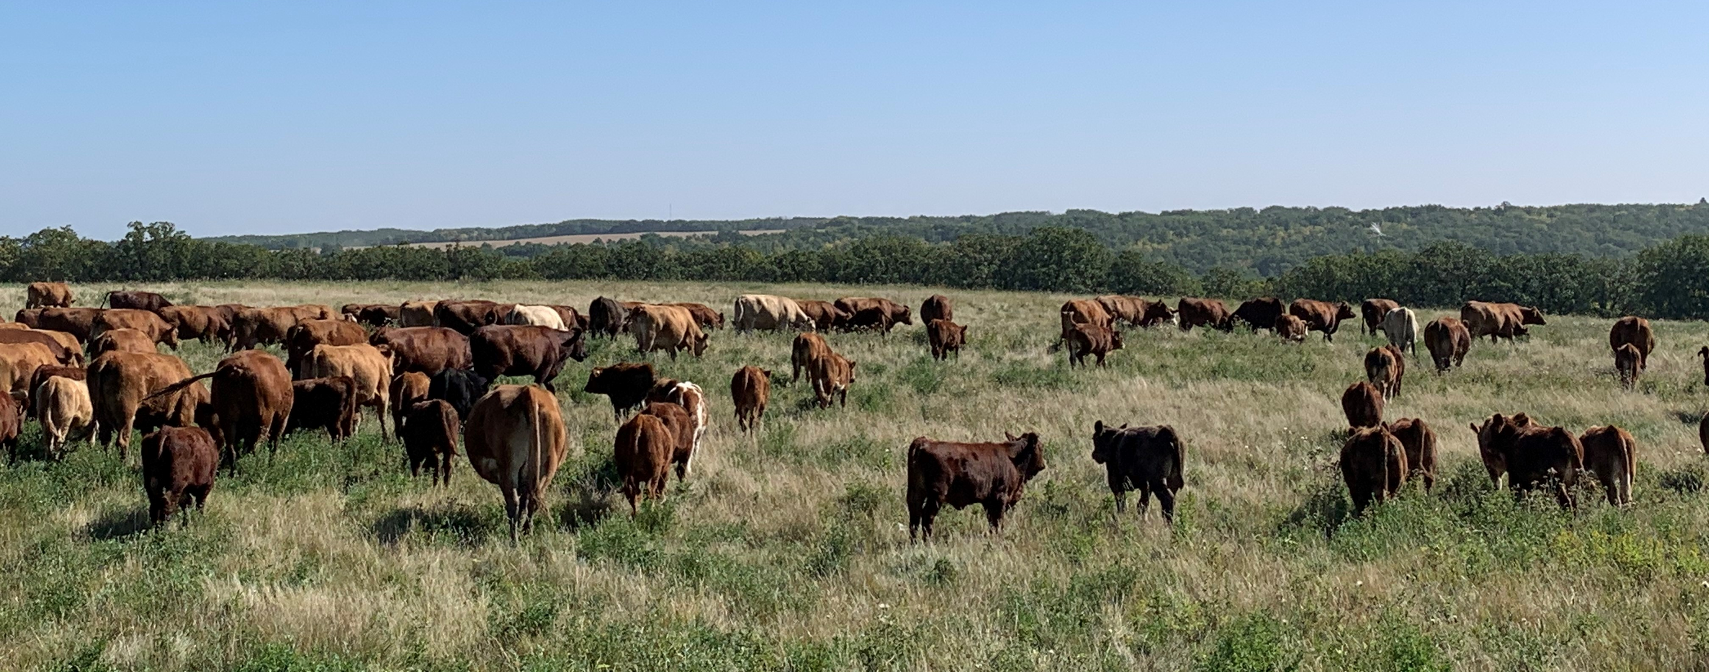

Tyler Fulton
Birtle, Manitoba
Email: tyfulton@hotmail.com
Twitter: @etyfulton

Slide 2
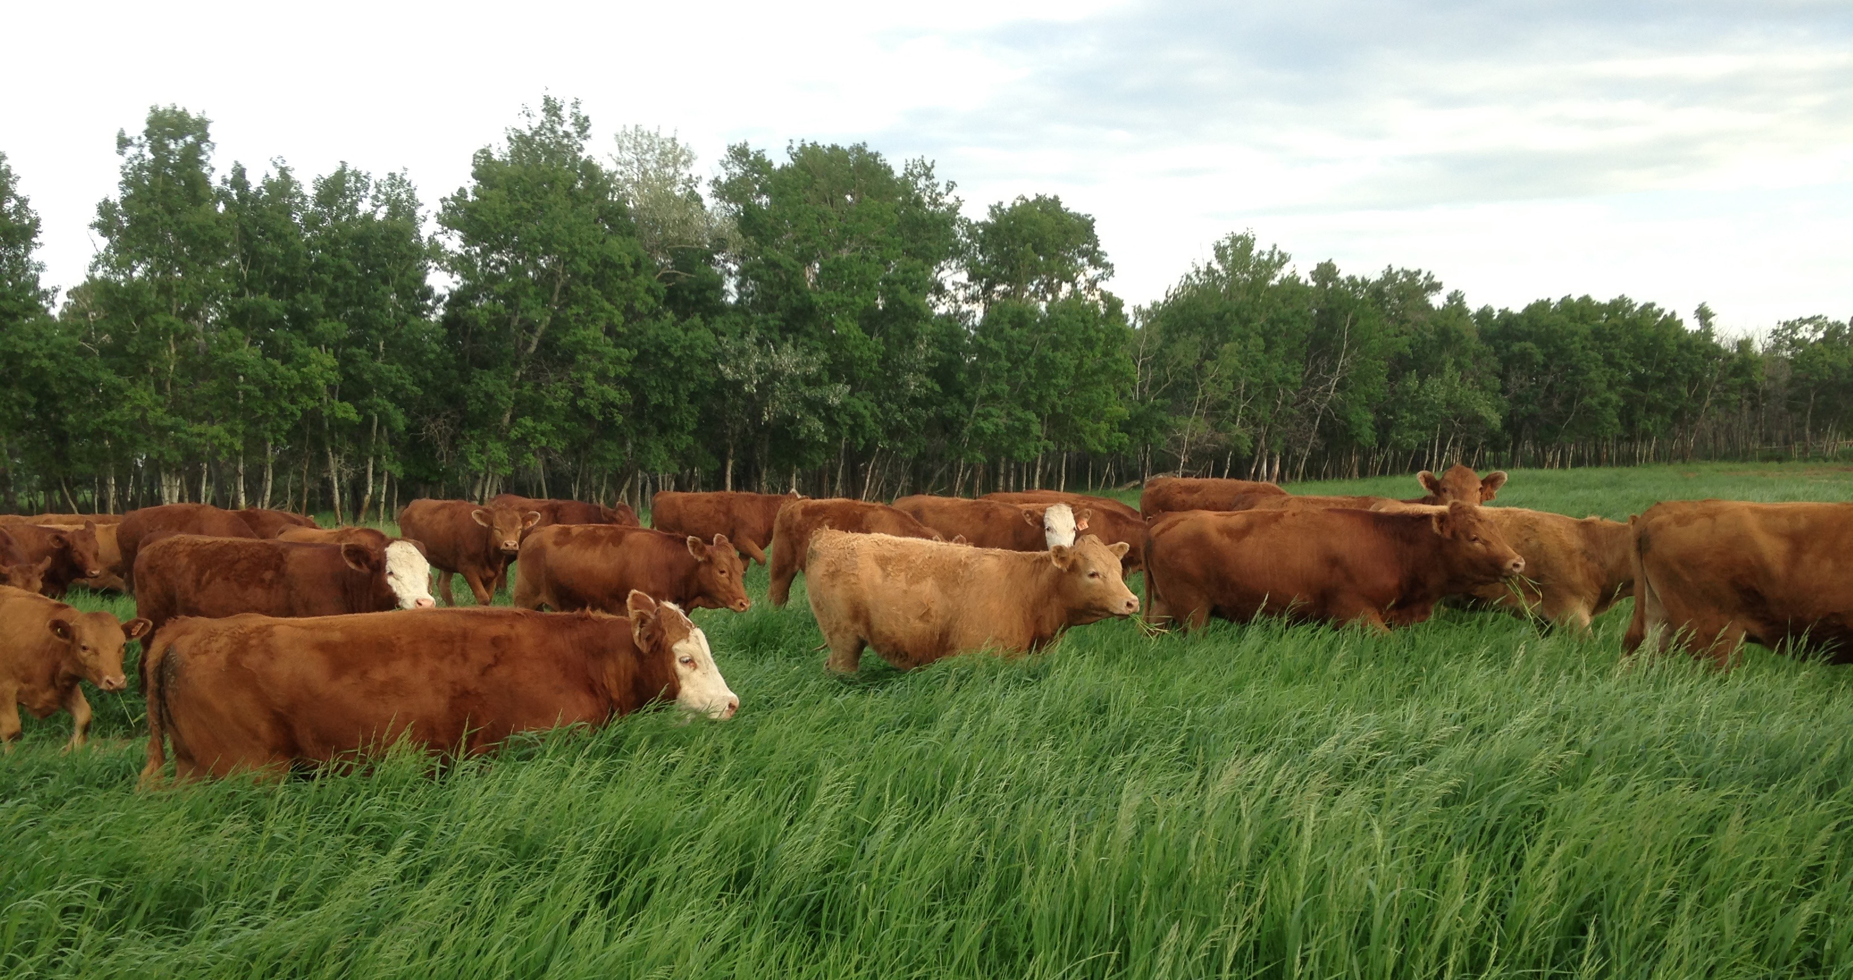
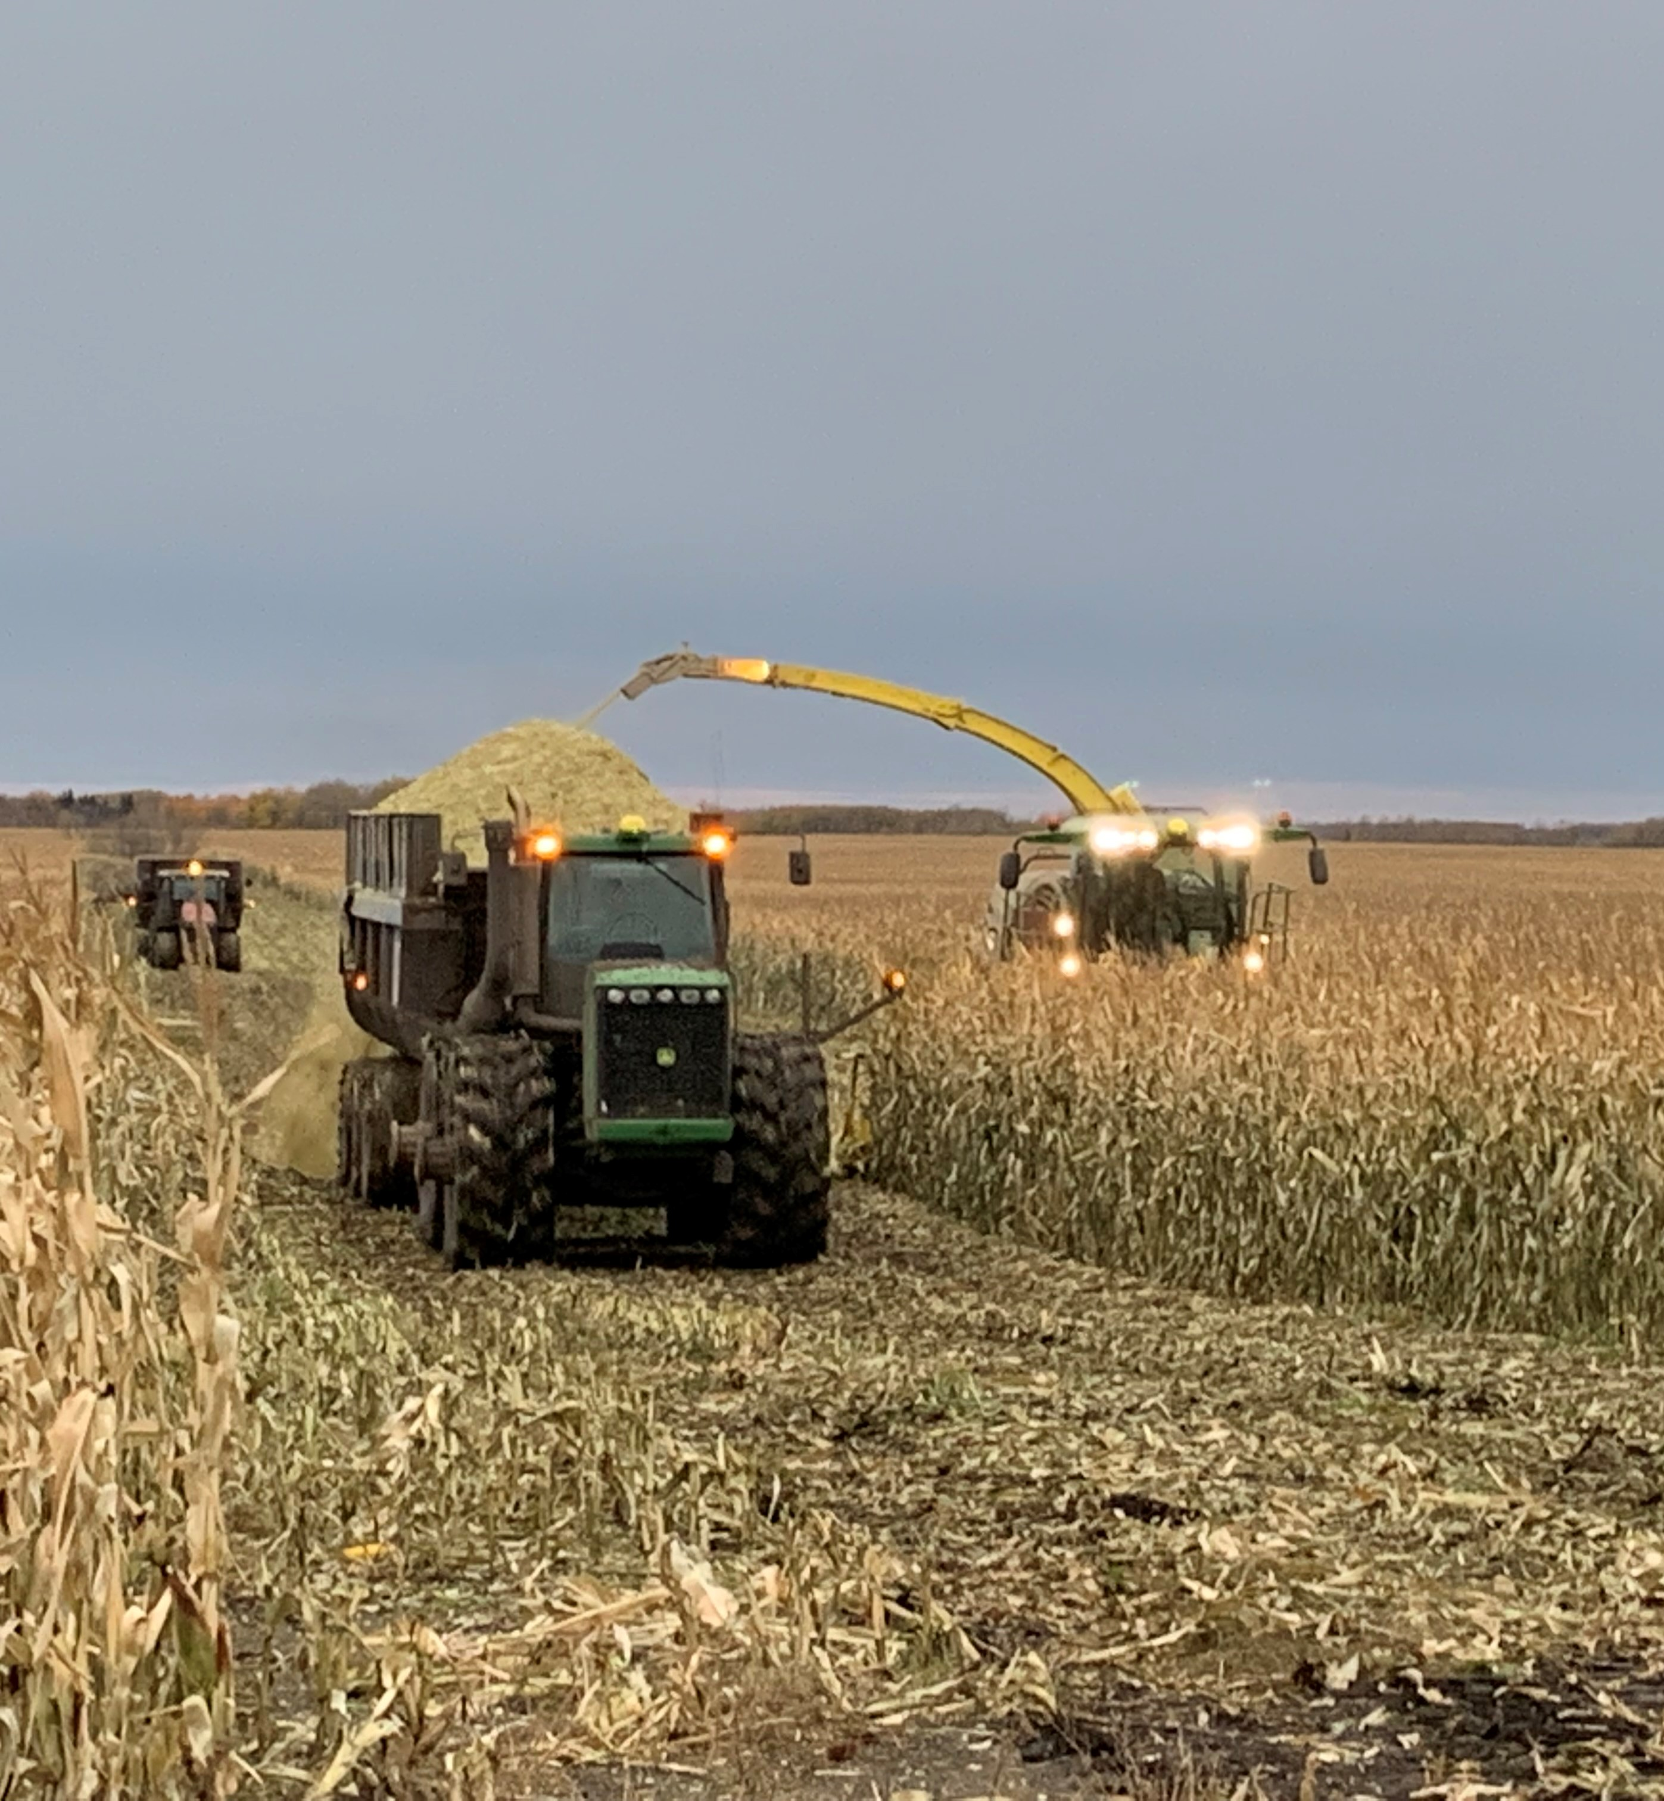
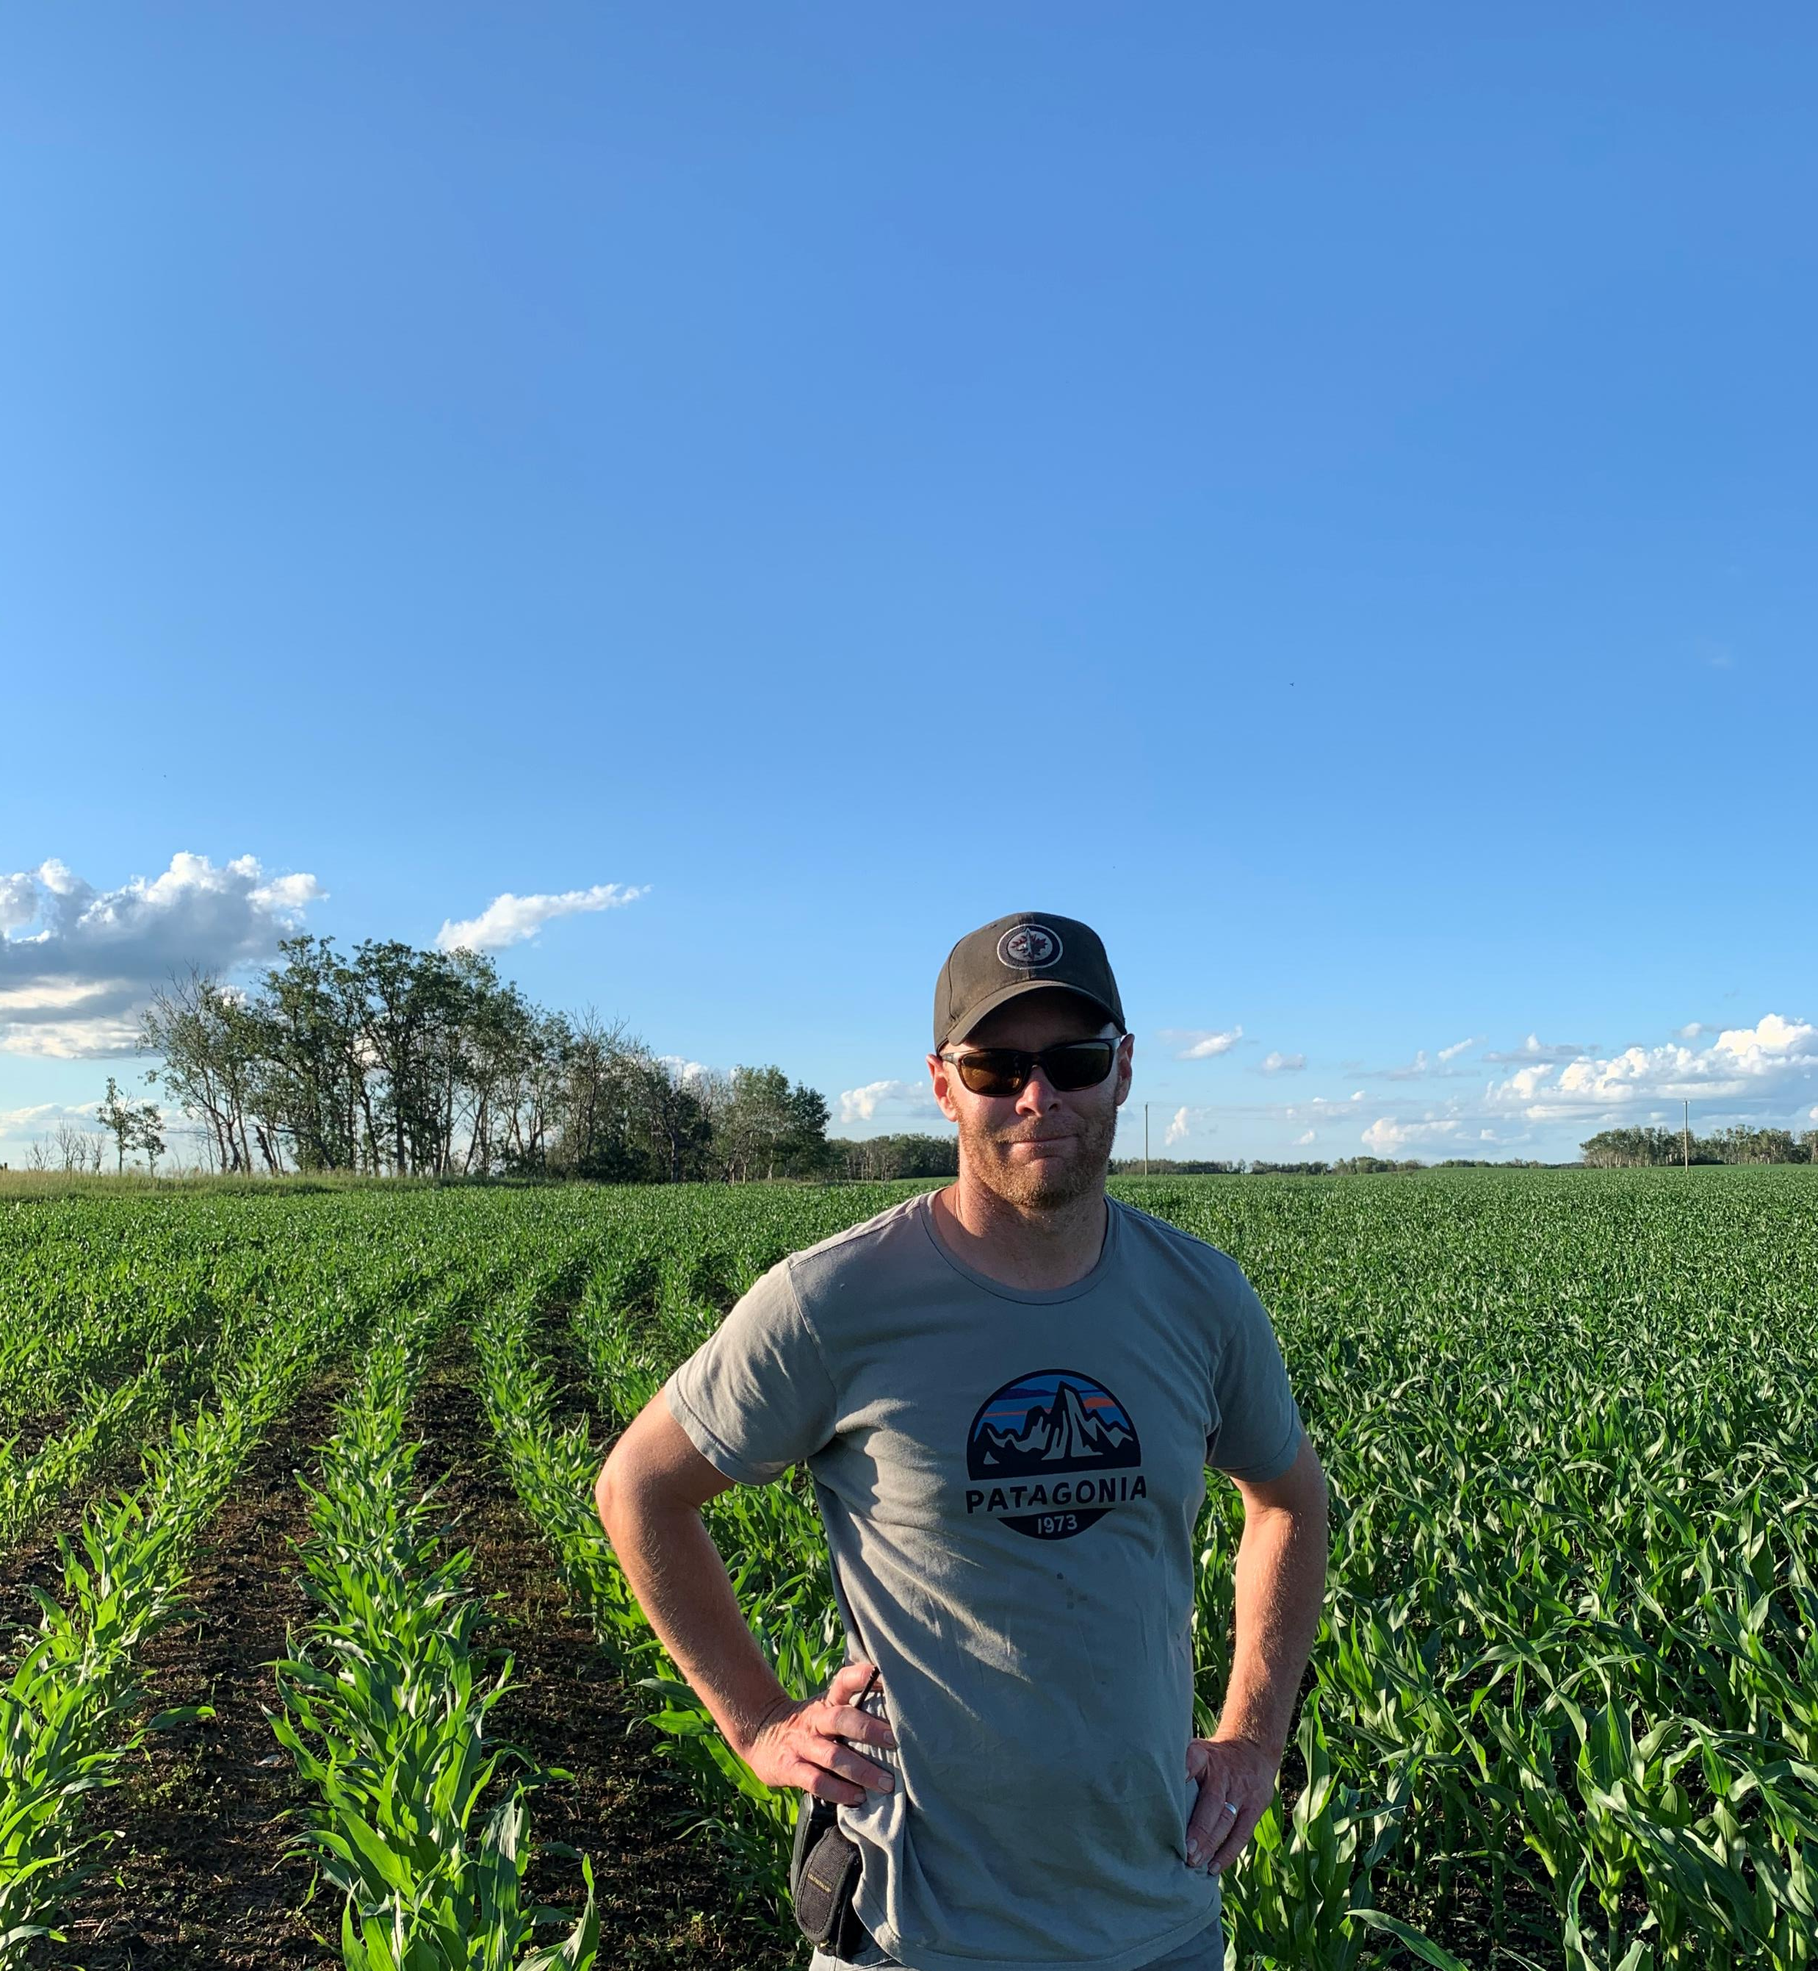
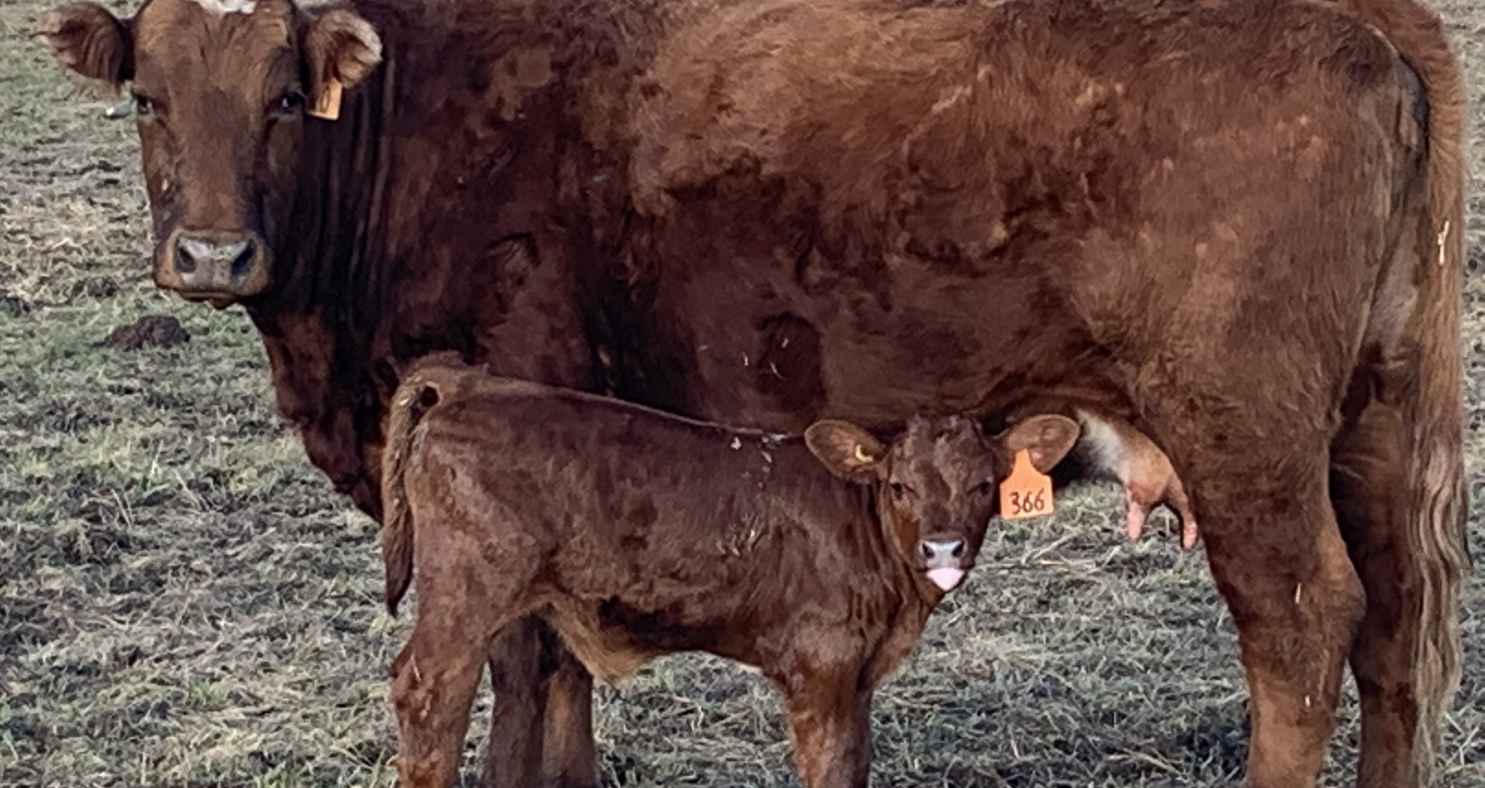
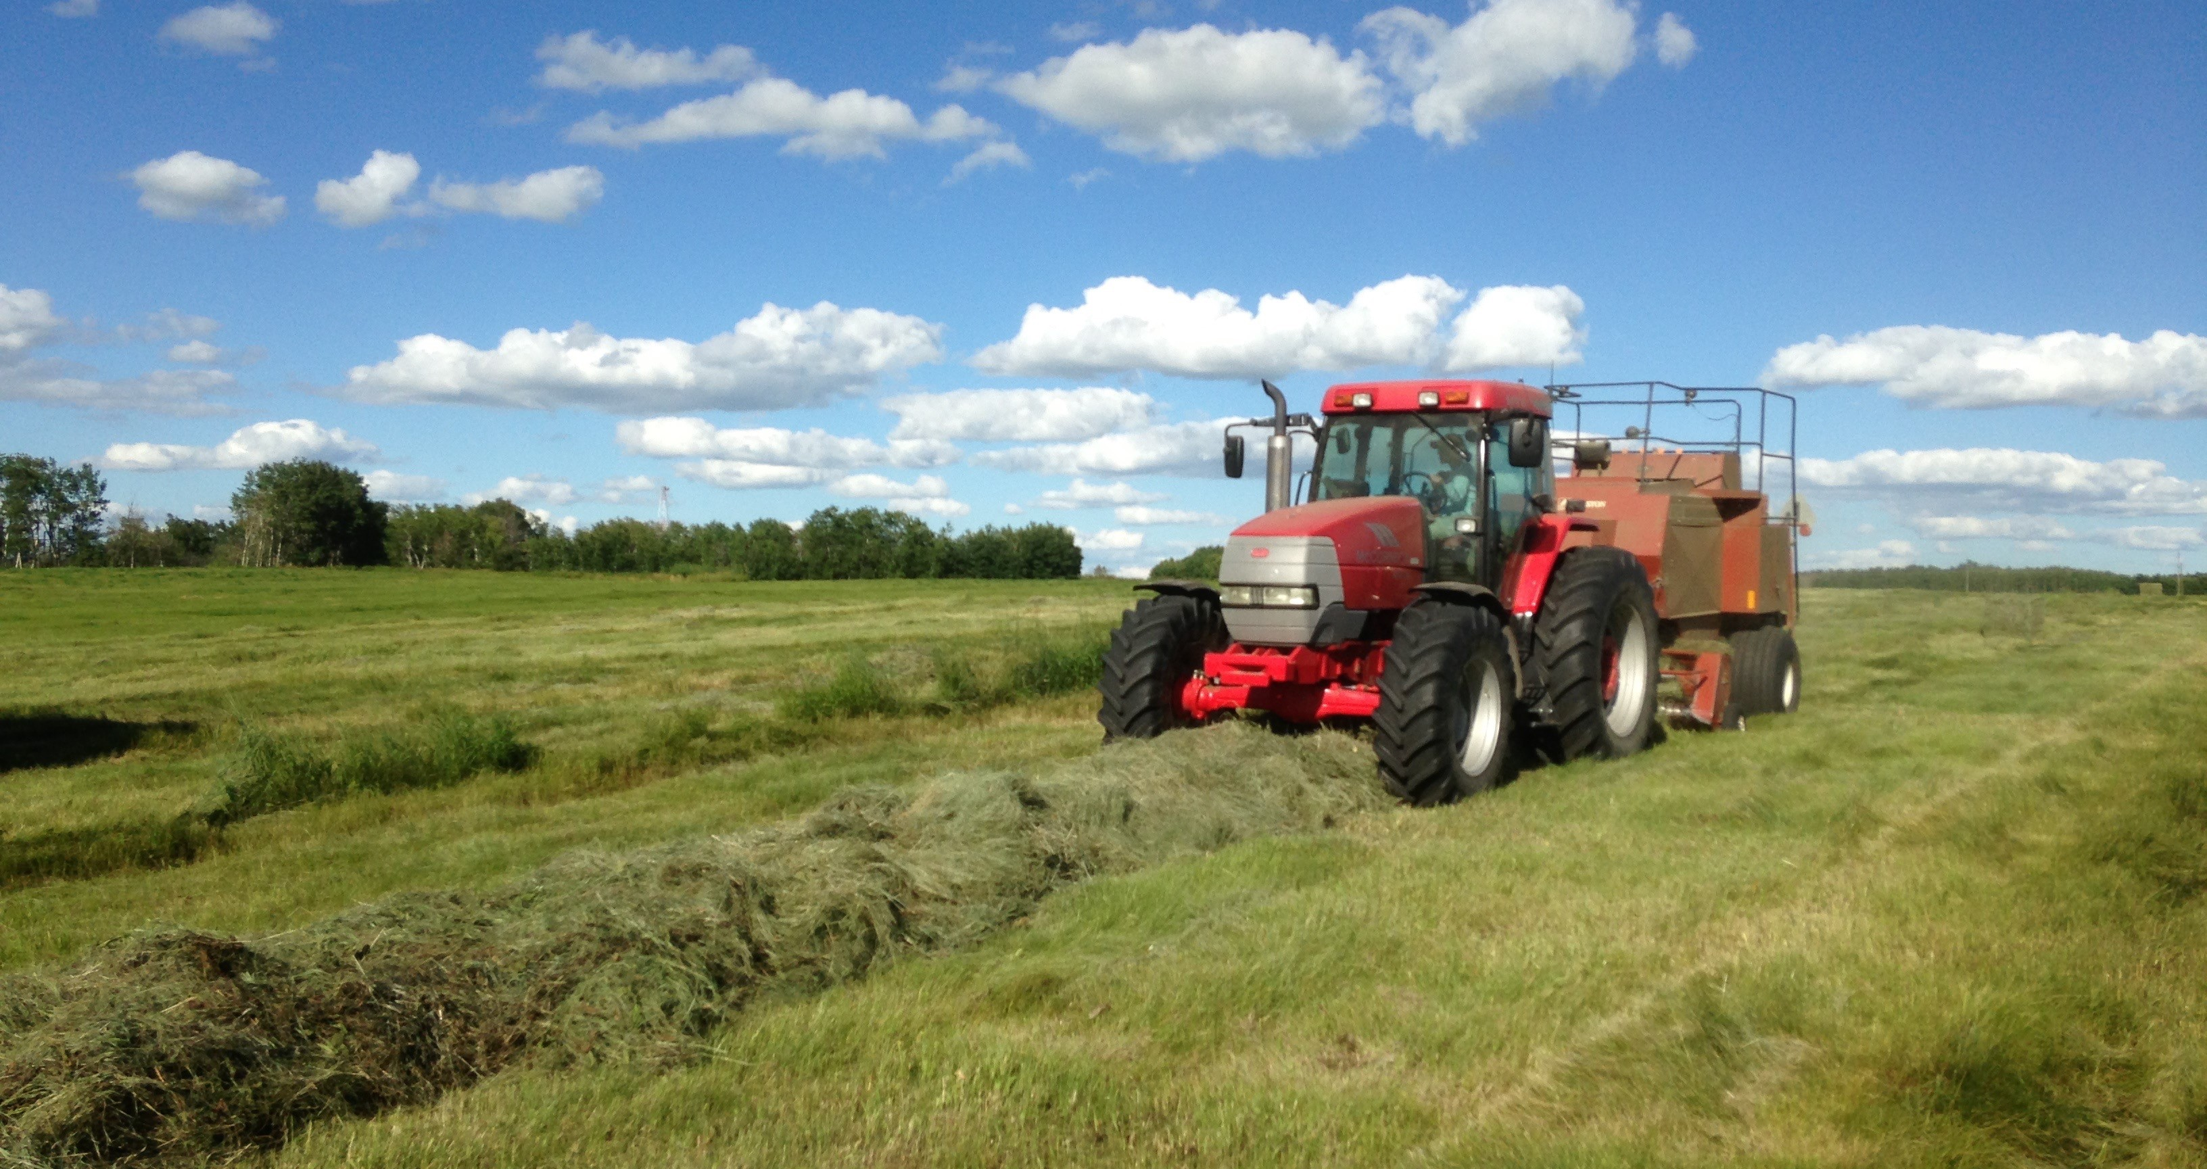
Our Farm – Birtle, Manitoba

Slide 3
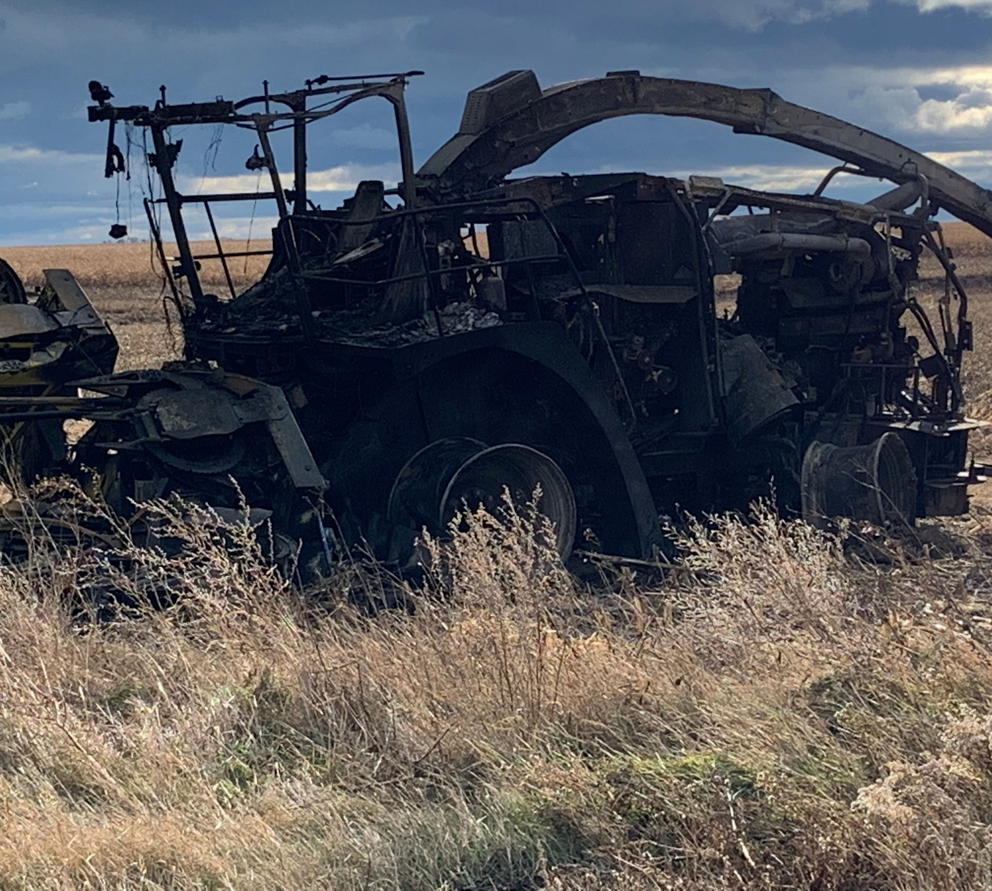
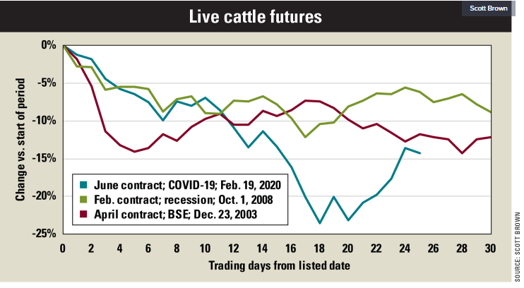
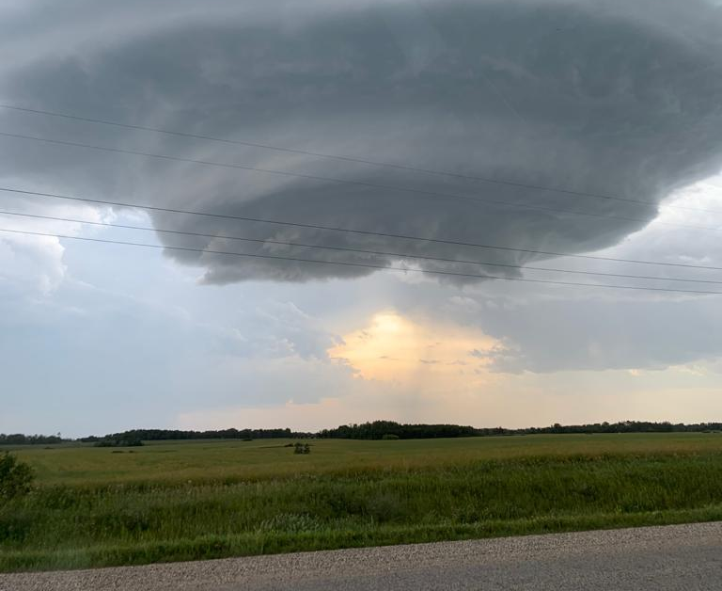
Farming is a risky business, but it’s rarely just one thing that causes failure.

Slide 4
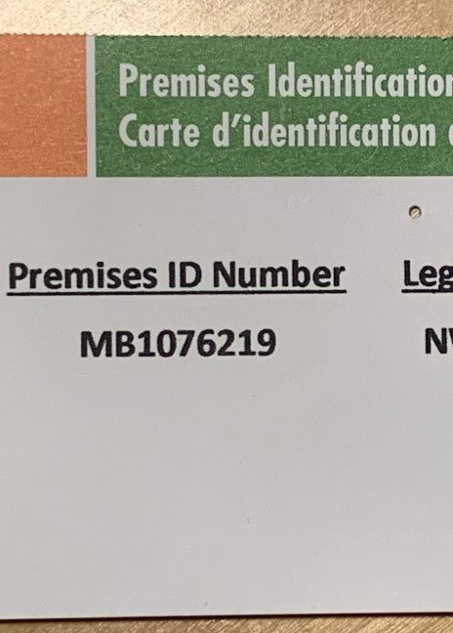
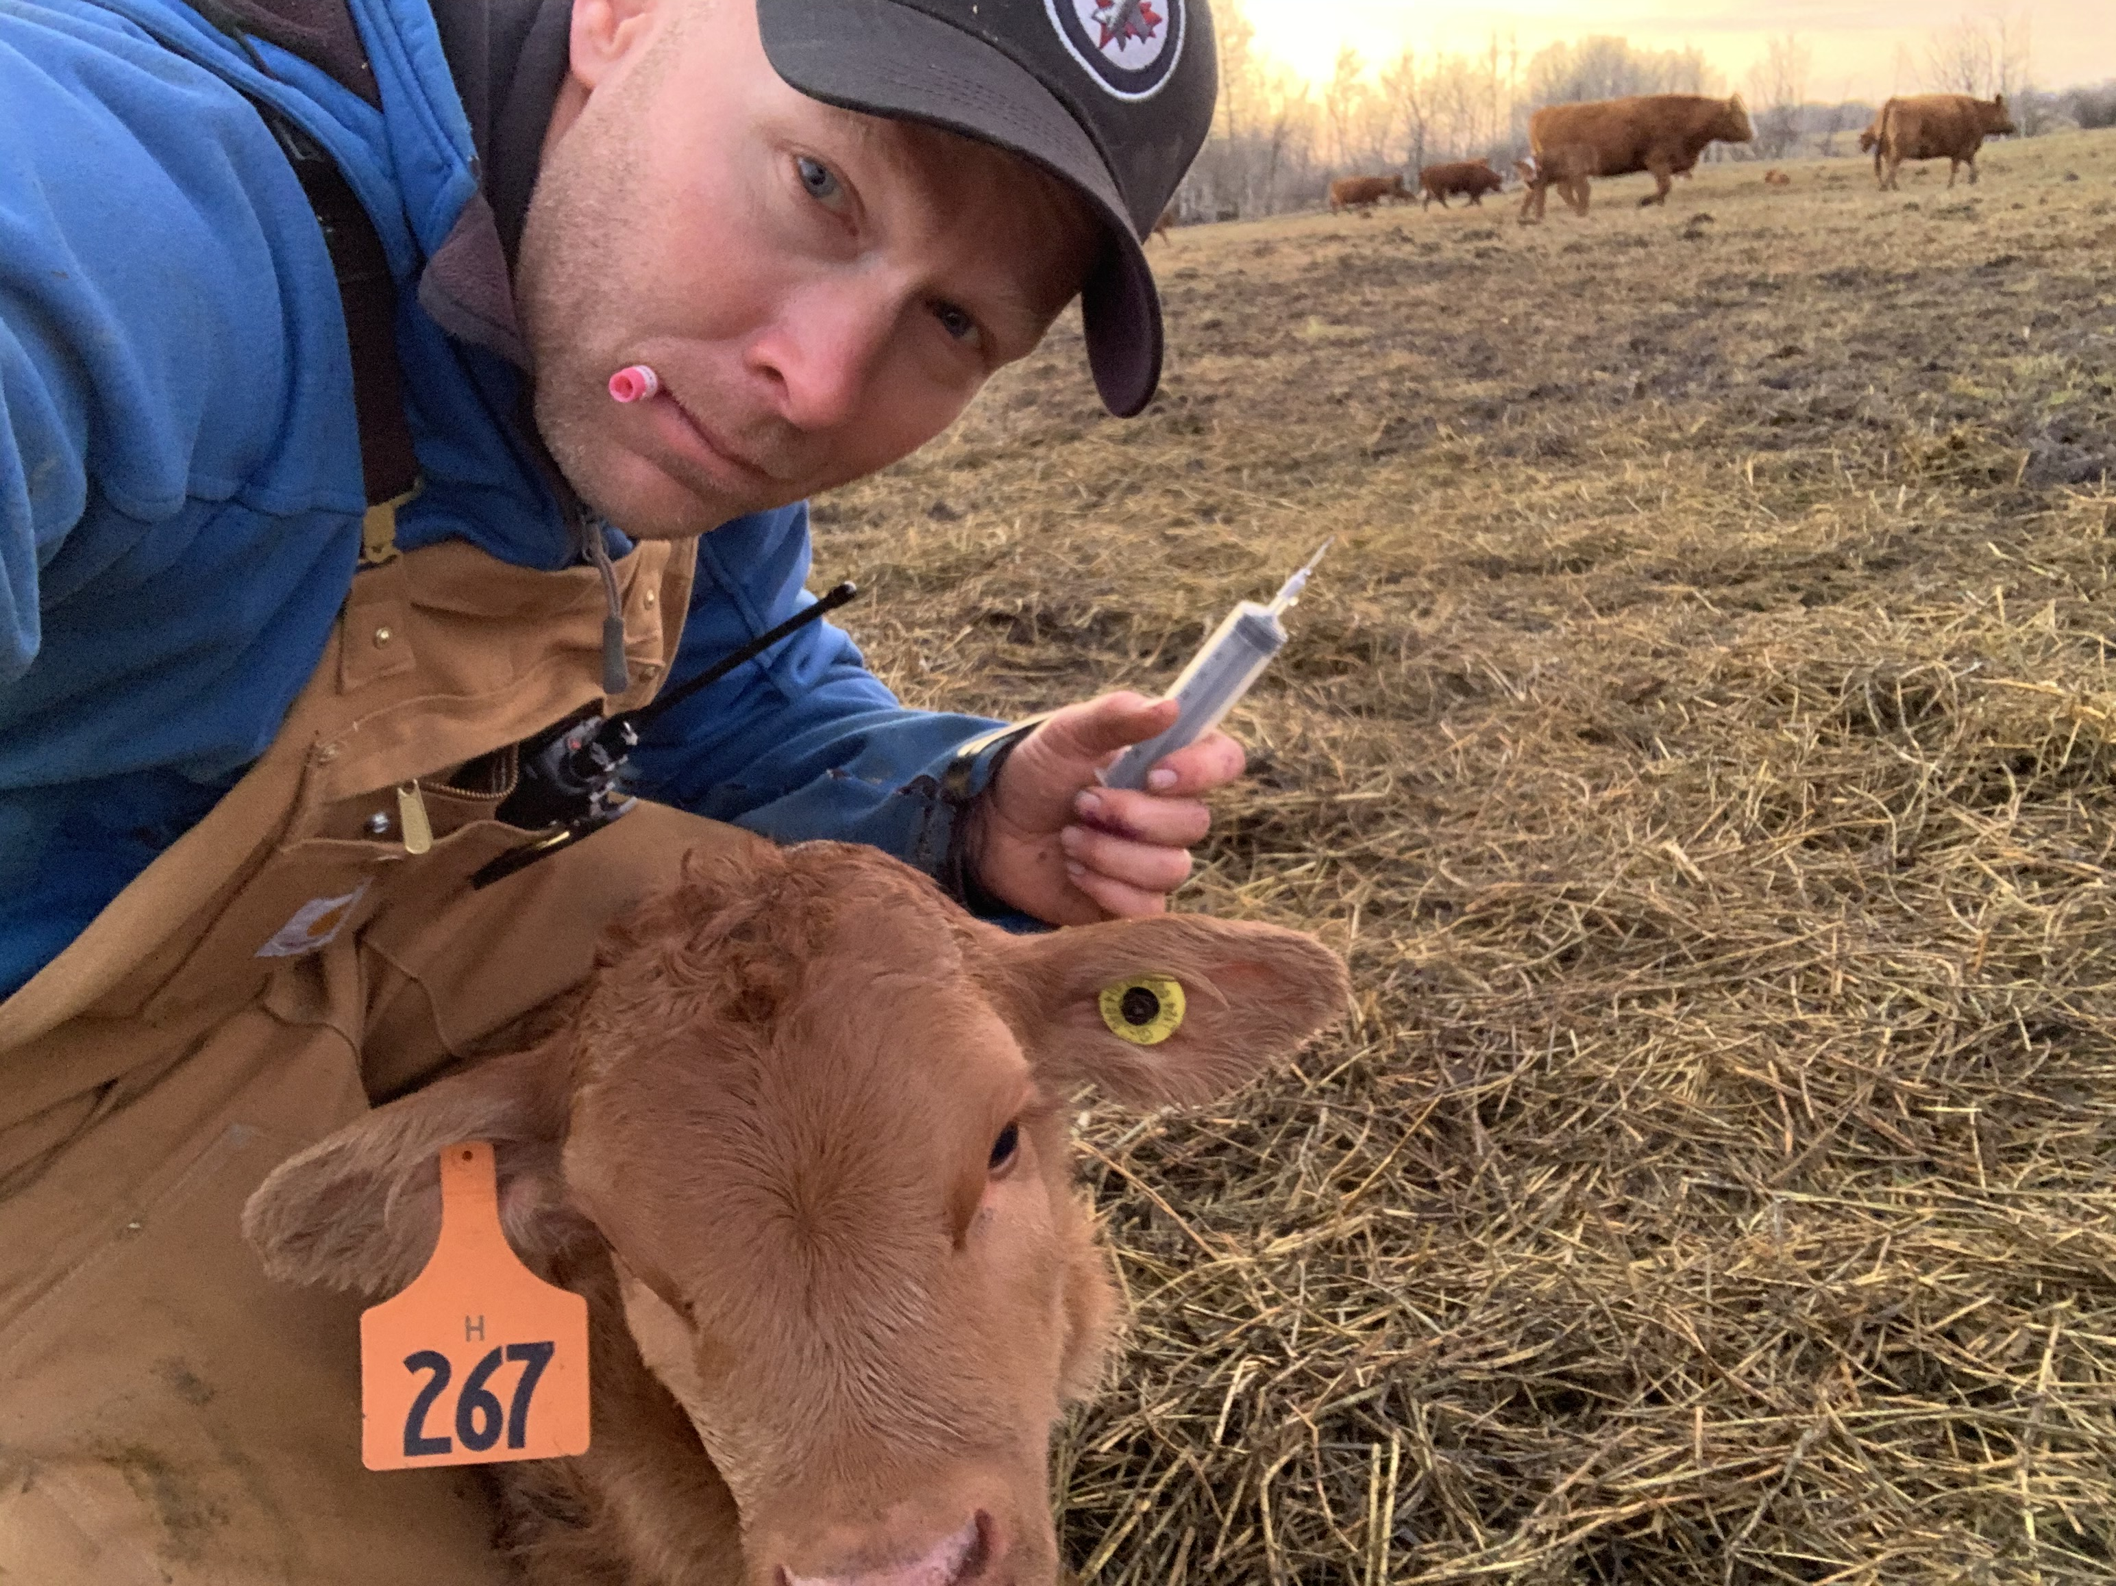
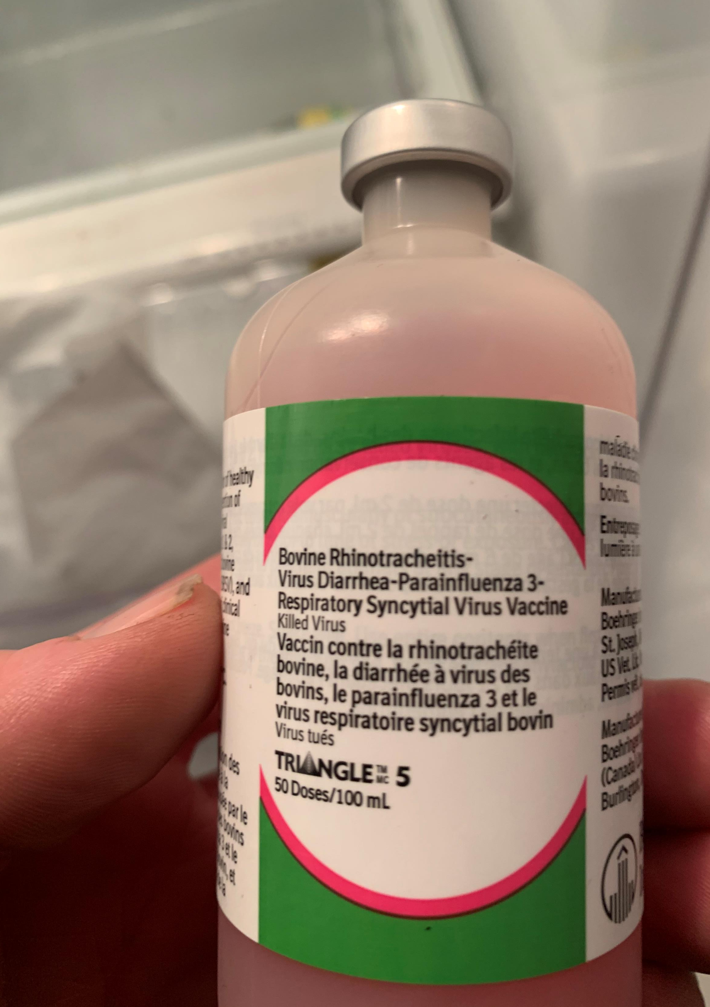
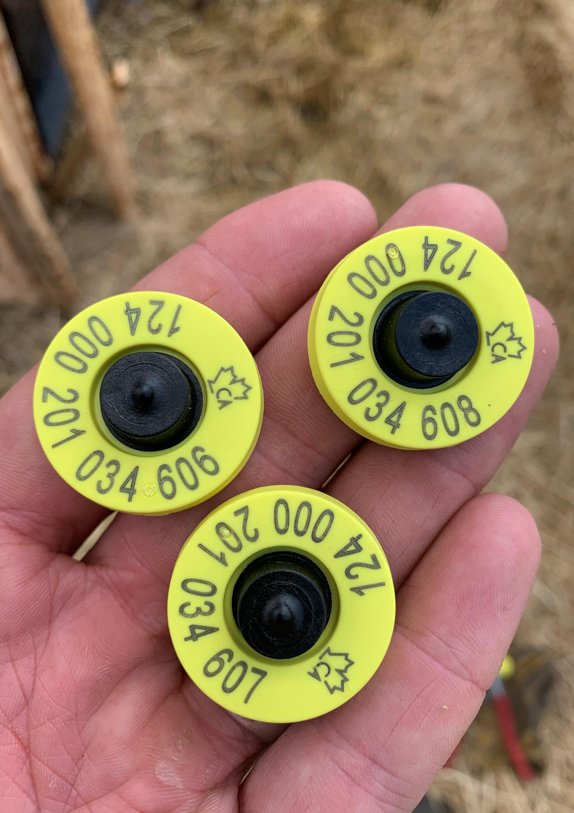
On-Farm Risk Management

Slide 5
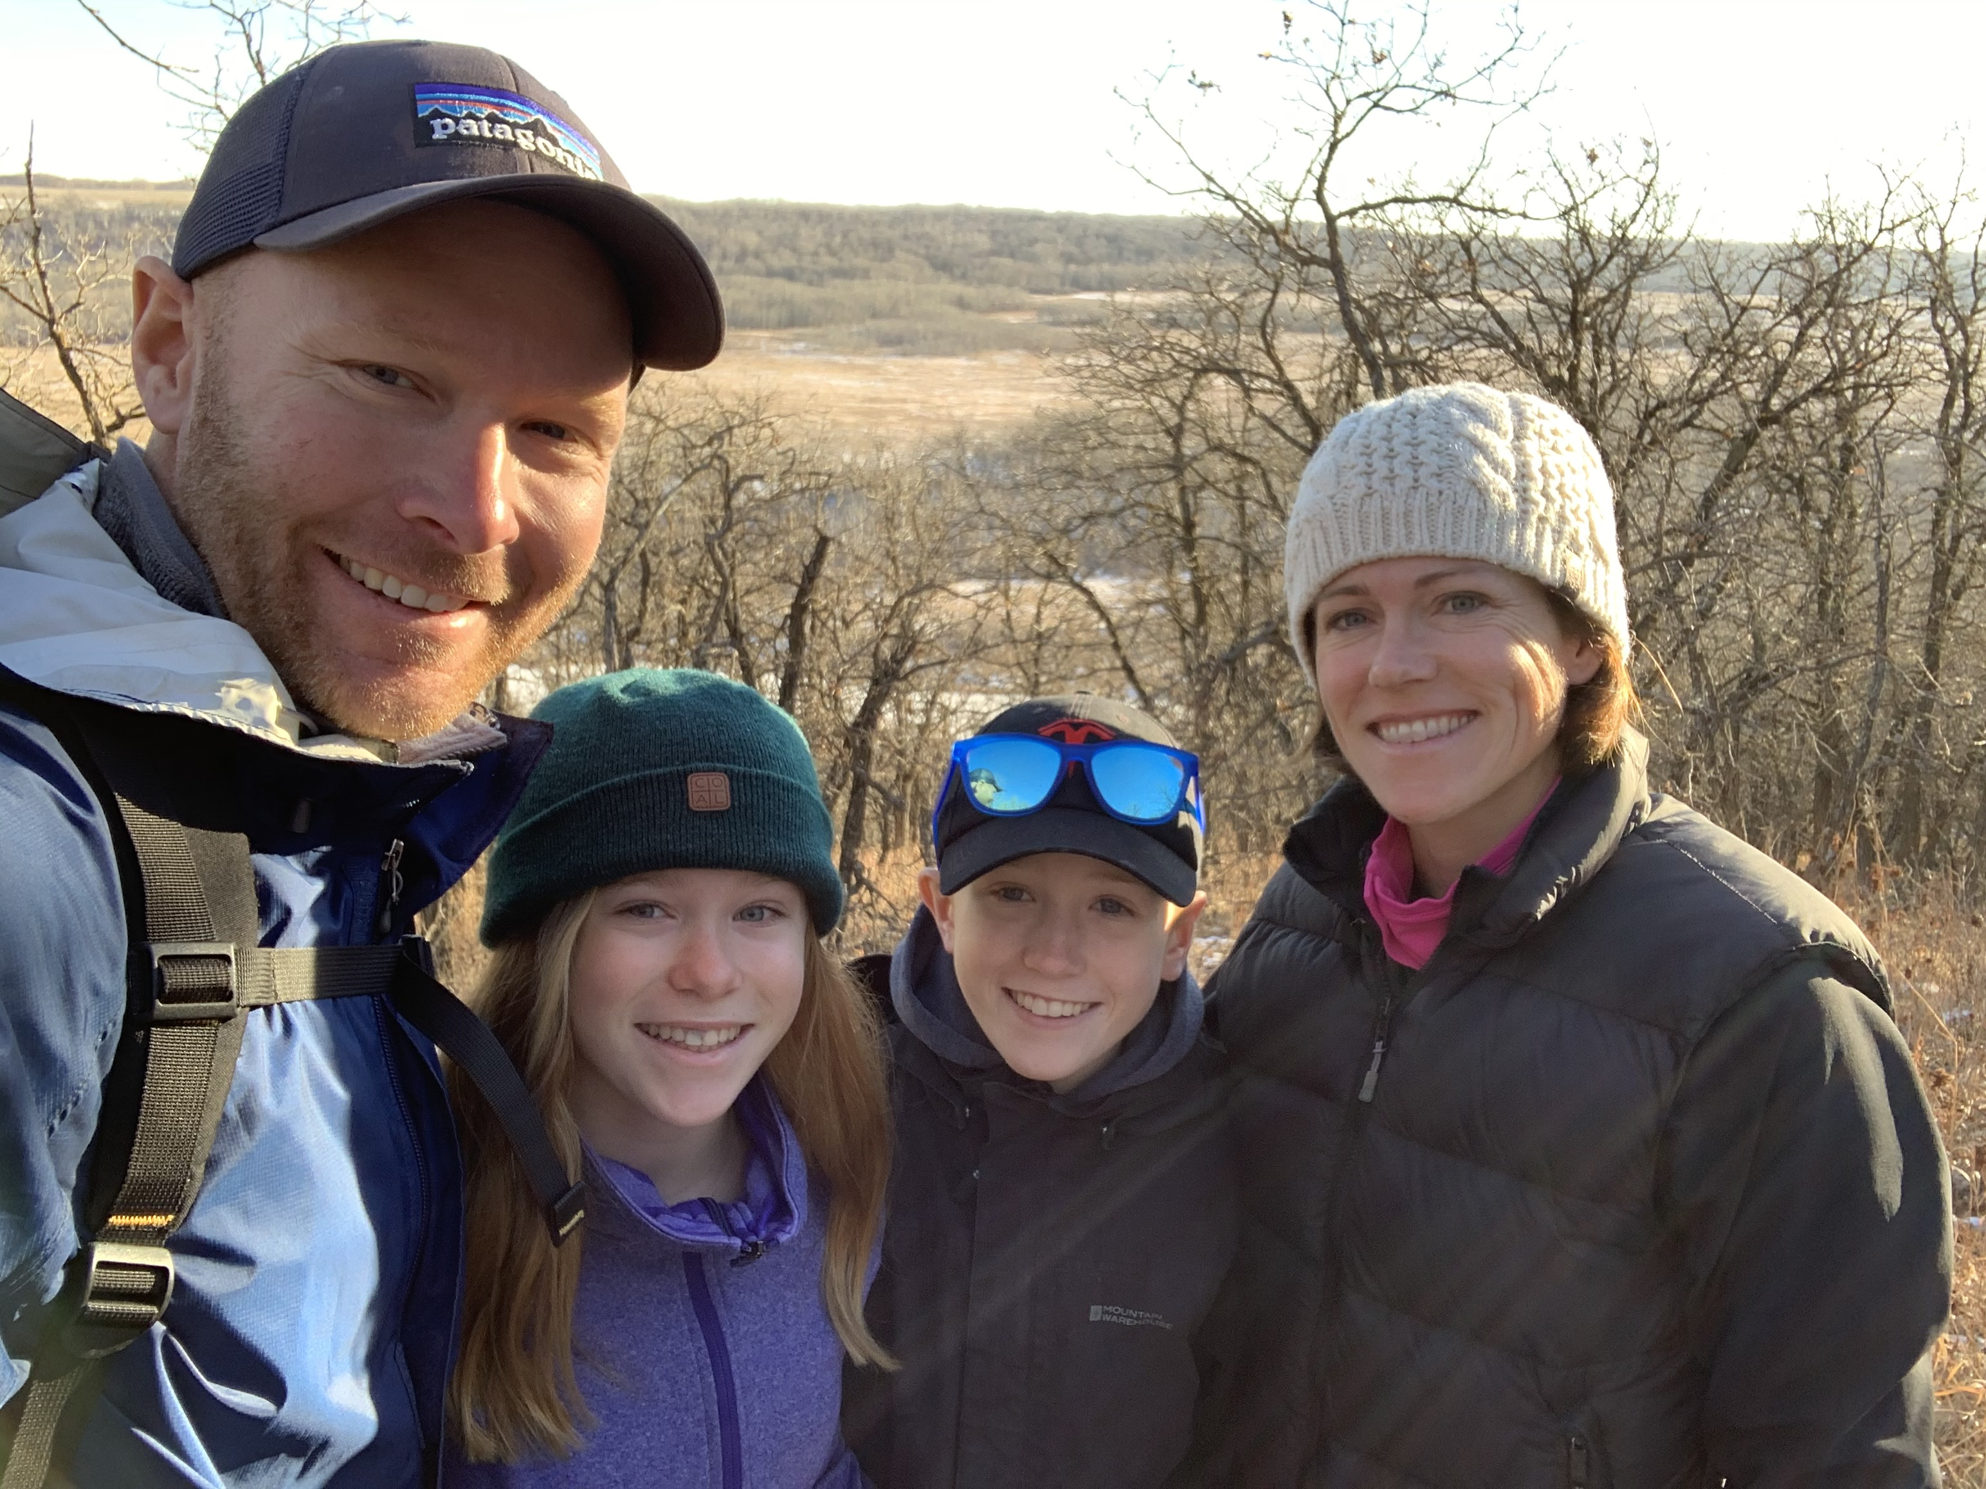
Considerations for future BRM Programs
Government supports Industry-Led programs
Equitable – ensure it across all of Agriculture
Modify AgriInvest to focus on Risk Management related outcomes
Design programs to be complementary so that farmers can manage their risk in segments

Slide 6
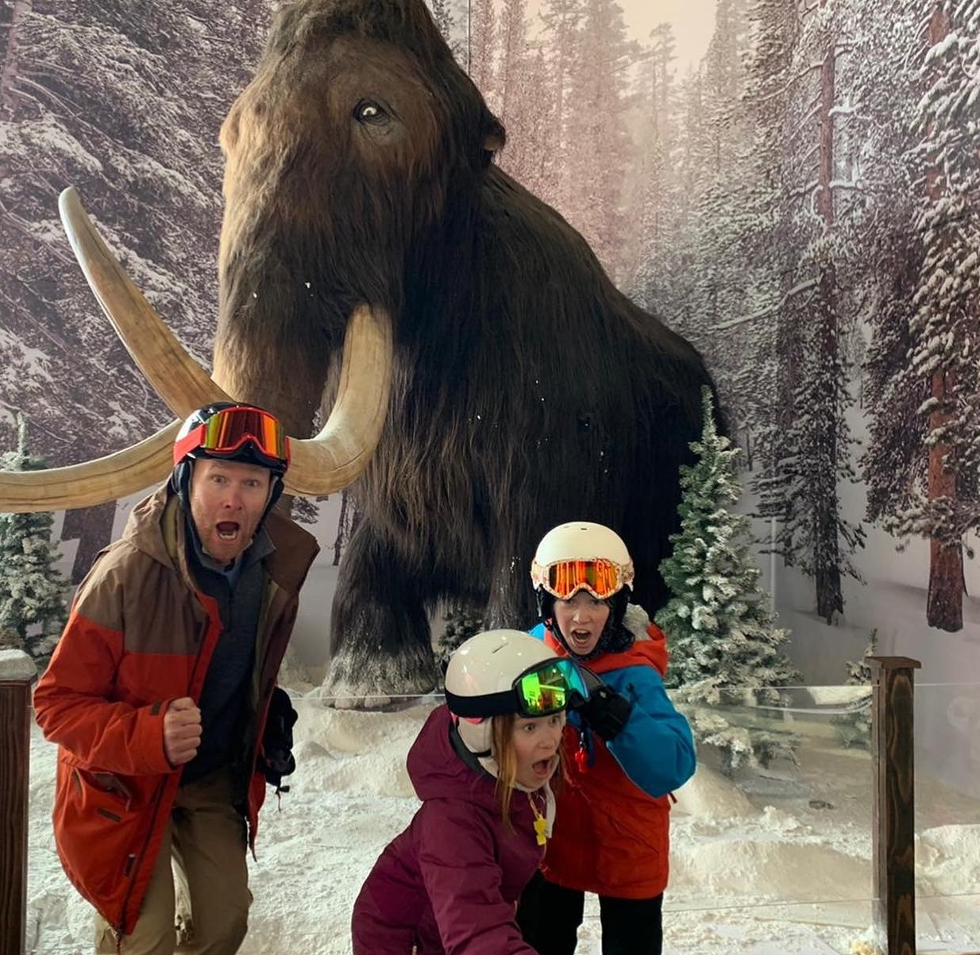
…because you never know!

