Slide 1
Business Risk Management
CFA AGM Discussion Panel
February 24, 2021

Slide 2
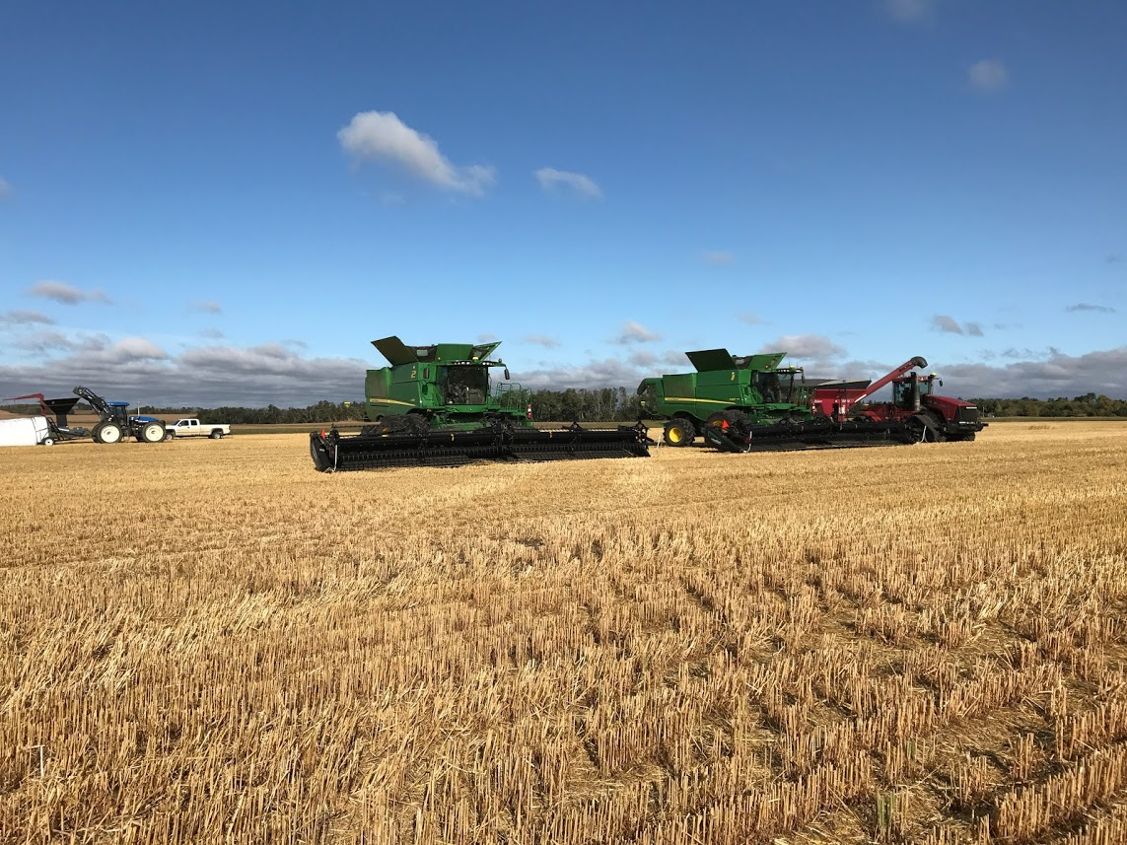
Stuart Person, CPA, CA
Senior Vice President, Agriculture Director, Crop Services
780.451.4406 1.800.661.7778 stuart.person@mnp.ca

Slide 3
Themes
BRM – current status
Challenges
The path forward!

Slide 4
Continued Misunderstandings?
The program(s) is (are) broken
They lack timeliness and predictability
They don’t work for my farm
Is the existence of these programs in a similar form for the last 25 or so years inconsistent with the criticism?

Slide 5
Financial Fluency
Business Risk Management Planning
All stakeholders would benefit from improvement here
Do you think education around the programs themselves, as well as business acumen, is important?
Is it even possible for the governments and industry to create self-revealing programs?
Education?

Slide 6
How much support should producers expect from governments, vs other providers of insurance?
The role of governments?

Slide 7
Effective approach?
If the approach was to incorporate the following 4 areas, would that increase the likelihood that requested changes to BRM would be actionable by governments in a more timely basis?
Acknowledgement of what exists
Clarity on the asks
Nuances of various sectors vs common unified goals
Demonstration that range of government role and responsibility have been considered

Slide 8
Farms are outgrowing the programs?
Farms keep growing in size
Vast majority are family farms
Payment caps are an issue for larger operations
Should we be concerned about protecting Canadian Ag production?
If so, should this concern be reflected in proposals for scalable programming?

Slide 9
What next?
Foundations are in place to build on
Proposed changes are good, and should be accepted
More change needed in 2023
Work to be done to get prepared

Slide 10
Thank You!

