Slide 1

International Trade Landscape in Dissarray:
A Canadian Perspective
Al Mussell

Slide 2
Foreign Policy Space
Long term issues- US/China 2001-; US/WTO DSU 2009-
US Sec 232 + 301 tariffs; China retaliation Spring/summer 2018
USMCA/CUSMA;
US-Japan
US-China; US anti-currency manipulation rules
End of WTO Appeals panel process
US MFP Support Aug 2018; May 2019
2017 US withdrawal from TPP; tougher US approach on trade
China-Canada tensions
Macro-economic policy environment
Exceptionally low interest rates
Exceptionally high debt levels
Macro-economic policy unable to stimulate economies

Slide 3
Recent Trade Arrangements;
Some Causes for Concern
US-Japan
Ostensibly grants US access to Japan agri-food market as they had in TPP, making up for lost time, under threat of US auto tariffs
US-China
More to come- US-EU; US-India (?), UK-EU, escalation in US bound tariff rates
Commits China to purchases of US farm products- for 2 yrs
Managed trade arrangements. Consistency with Most Favoured Nation?
But who will challenge this? How?
Some relief of Chinese non-tariff barriers
US market access on beef (cow beef (?)), packaged foods

Slide 4
Erosion of WTO
US concerns
US Action
WTO appeals panel now gone; provisional measures agreed by some countries
WTO appeal panels overreach
Concerns with applications of precedent
WTO measures ineffective at addressing issues with China
Filibuster appointment of WTO appeals panelists
Prospective action to block WTO budget
Use of Section 232 and 301 duties to undermine agreement on subsidies and countervailing measures
MFP payments undermine ag support caps
China is not prepared to change its economic development model

Slide 5
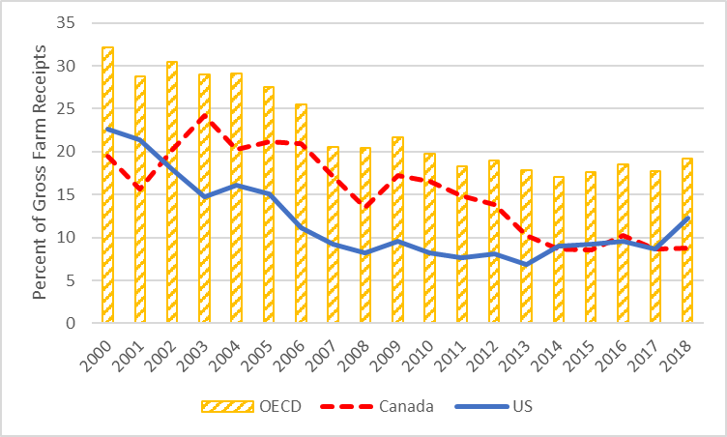
Producer Support; OECD Countries
Source: OECD

Slide 6
African Swine Fever in East Asia and
Protein Market Disruption
Conceptual problem- how to fathom the magnitude?
Meat protein price inflation spreading globally; will last for years
Sharp price swings- up, and down
Food security crisis in Asia; potential concerns for North America as well
Canada as a pork exporter: incredible opportunities; stunning risks
Dire need for a robust international trading system to bridge the gap

Slide 7
And Now…
Covid-19
≈ 70,000 cases; ≈1700 deaths
Tens of millions locked down
Greatly extended New Year’s holiday
H5N1 Hi-Path AI: Hubei, Hunan provinces. Only mass poultry deaths (so far)
What impact on economic activity/growth? China stimulus response?
Extreme logistical challenges
Complicates/kicks forward/dampens ASF-meat crisis
Additional challenges facing China
Plague of locusts bearing down on rice crops (?)

Slide 8
What Worries for Canada?
Managed trade
Canada as a secondary supplier of farm and food products. Backfill supplier for US
Erosion of rules-based trade
Canada lacks the weight to press market access in an export-oriented agenda
Weakened basis of rules from which to defend ourselves
Reversal of discipline on domestic support
Canada lacks the treasury to match larger countries
Arbitrage pricing
Will we be able to sell in export vs. domestic at approximately the same (freight adj) price?
Canada has a narrow set of farm products; almost all are affected by subsidies of others
Farm products used as the preferred weapon for retaliation
Will Canada be able to use US futures market as reliable price reference?
Past experience with adverse effects- ↑ surpluses ↓farm prices
What points of leverage for Canada?

Slide 9
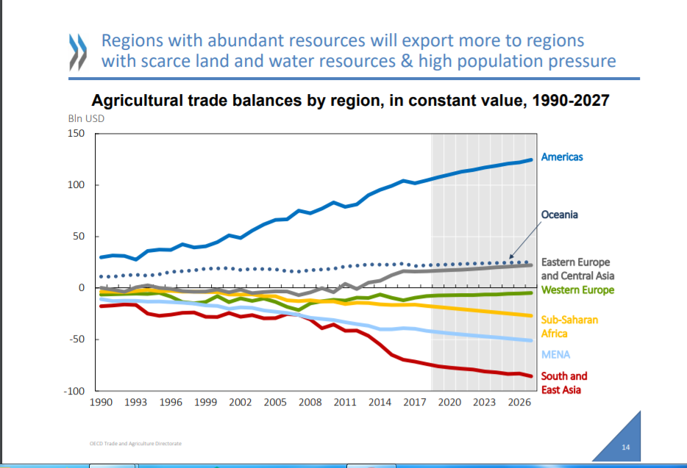


Notes:
So where do we go from here?
Development of a soft power strategy based food & energy
OECD last summer described a slowing growth world where the Americas and Oceania & lesser degree Europe & Central Asia make up the food deficit in Asia, MENA and Sub-Saharan Africa
Far deeper understanding of our strengths and weaknesses, risks and opportunities
Far deeper understanding of China and Asia in general
Begin playing chess rather than whack-a-mol

Slide 10

Thank you

