Slide 1
5G: Enabling
smart agriculture
Shawn Sparling
02-2020

Slide 2


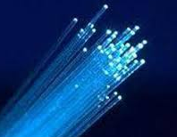














GLOBAL CAPABILITIES
NOKIA
EUR 119 Billion Invested in R&D over 20 Years
Mobile Networks | Fixed Networks | IP & Optical Networks | Enterprise Networks | Nokia Software | Global Services | Nokia Bell Labs
37,500+ R&D PROFESSIONAL
WE CREATE THE TECHNOLOGY THAT CONNECTS THE WORLD
2
Confidential & Proprietary

Slide 3

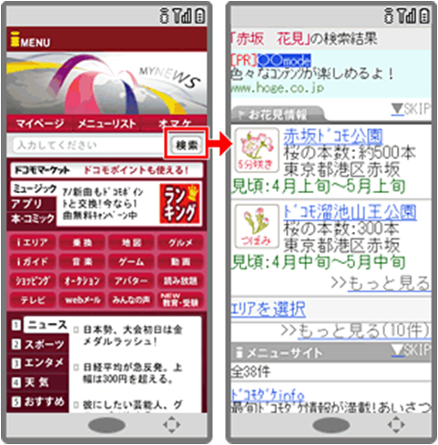
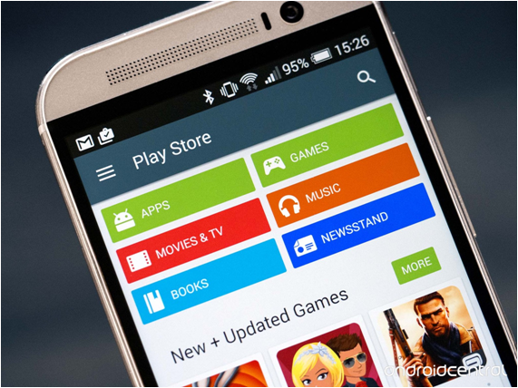
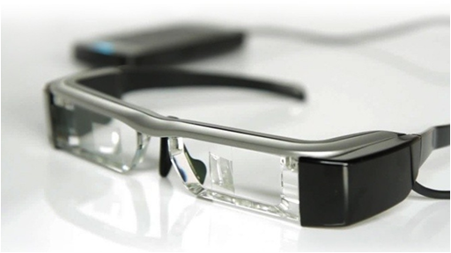
What does 2G, 3G, 4G mean for users?
Small wireless data
  1993 SMS
  1997 Snake
Wide-area wireless networking
  1999 i-mode
  2003 3G data cards
  2005 Nokia N70
Mobile internet
  2007 iPhone
  2008 App stores
  2010 Netflix’s mobile client
  2011 Facebook’s Messenger for Mobile
Immersive, pervasive networking
  2018 Virtual and augmented reality
  2020 Critical machine coms for industry automation
2G
3G
4G
5G
The evolution of network & device capabilities deepen user engagement & expectations

Slide 4



New user demands – with extremely diverse requirements
>10 Gbps
peak data rates
Capacity
100 Mbps
whenever needed
Devices
Smart Factories
Latency
Connectivity
<1 ms
radio latency
1,000,000
devices per km²
Reliability
10 years
on battery
Billions of sensors
Autonomous driving
5G opens up new classes of services and devices

Slide 5

5G is a giant leap
THE OPPORTUNITY
Endless possibilities
New technologies
New business case
New revolution
Today
2020-25
Users
10M people
+100M ‘things’
Speed
100 Mbps
100x faster
Smart home
Mobile gaming
Latency
>>10 ms
10x less
Best effort
for all
Committed SLAs
Industry 4.0
Connected cars
NW service level
Logical networks
1
Many (slices)
Drones
IoT wearables
Confidential & Proprietary
Notes:
5G provides a leapfrog of network capabilities in several dimensions:
Serving a large number of people and a huge number of sensors, machines etc.
Providing much higher throughput when required by the application, 10Gbps and more
Minimizing network latency up to 1ms
Moving from best effort network connectivity to deterministic connectivity that enables business models based on stringent SLAs
Providing a large number of „purpose built“ virtual network slices on the same infrastructure that exactly serve the requirements of specific applications and customers.

Slide 6
4th “Industrial” Revolution powered by 5G
Social & human impact
Artificial intelligence, cloud, robotics, VR
Economic flexibility &
social mobility
5G
PCs, automation
4th “Industrial” revolution
Industrial change
3rd Industrial revolution
IT
Mass production
Electricity
2nd Industrial revolution
Mechanization
People &
Things
Steam
1st Industrial revolution
Driver
Enabler
1770
1870
1970
2020

Slide 7
New Spectrum Options
THE TECHNOLOGY
Spectrum
range
Bands
Coverage
Peak Data
rates
Bandwidth
Use Cases
Cell range
Data rate
Low band
< 3 GHz
600 MHz (n71)
700 MHz (n28)
900 MHz SUL(n81)
1800 MHz SUL(n80)
Deep indoor
>1 km
~100 Mbps
FDD
2x10 MHz
or UL only
Deep indoor coverage for e.g. MTC
Supplementary UL eMBB coverage
Mid-band
3 – 6 GHz
3.3-3.8 GHz (n78)
3.3-4.2 GHz (n77)
4.4-5.0 GHz (n79)
Same grid as LTE1800
~1 km
~1 Gbps
TDD
<100 MHz
5G eMBB coverage
High-band
> 24 GHz
26 GHz (n257)
28 GHz (n258)
39 GHz (n260)
Hot spots
Line of sight
100 m
~10 Gbps
TDD
<1 GHz
Extreme data rates for e.g. VR in local areas like stadiums
New Spectrum
mMIMO & Beamforming
Flexible Air Interface
Multi-Connectivity
Cloud Native Slicing
Connectionless Comms
Confidential & Proprietary
Notes:
CSPs want to achieve
Outstanding network performance and scalability by end-to-end performance optimization and cloud native platforms across domains but usually they are lacking end-to-end network design.
Time to market with 5G use cases to meet competitive pressure and market dynamics by most simplified deployment across the entire network. The reality is often time-consuming deployment and integration.
Diversification for business growth matching the diverse and stringent requirements of industry verticals via end-to-end network slicing and edge cloud computing. In practice many CSPs are only able to commit to service & security levels that are insufficient for many vertical industries.
TCO control by avoiding unnecessary integration, operational and investment costs. On the other hand we see integration cost overruns and manual processes due to lacking automation.
Agility to be prepared for the unexpected since most of the 5G use cases are still unknown, creating uncertainty and the need to be able to react fast. Onboarding of new services is still complicated, especially when using 3rd party VNFs.
In a nutshell: Silos in the network hinder fast and cost efficient 5G deployment resulting in time-consuming and costly post-deployment integration
To achieve leapfrogs in network performance, time to market, TCO and finally business growth with 5G services requires tight interworking between network elements within each domain and between network domains.
There are significant cost penalties in terms of both operational - more complex systems, requiring more manpower and slowing down time to market - and capital expenditures - more network elements running at lower peak loads.
Therefore the pre-designed, -integrated and -validated cross-domain 5G Future X solution provided out of one hand has a significant advantage relative to disjoint, or dissimilar solutions, requiring ad hoc interworking and integration.

Slide 8
IoT Connectivity Technologies
Application Requirements Drive Technology Choice
Long-range, low-rate, low-power,
low-cost managed service
LWPA, mobile cellular
Mobile cellular, satellite
0123
5G
Widespread
P
Wi-Fi, RFID
Connected
car
Remote
health
monitoring
Fleet
mangement
Smart
metering
Parking
meter
Building
automation
Long-range, rechargeable battery,
highly secure, managed service
Wi-Fi, Zigbee/IEEE 802.15.4
Hospital asset
tracking
Warehouse
logistics
Localized
Medium-range, low-rate,
low-power, enterprise-deployed,
established ecosystem
Home
automation
Industrial
automation
Short-range, low-rate, low-power, low-cost
subscription-free, established ecosystem
Static/portable
Limited area mobility
Wide area mobility
5G: ideally positioned to support future farm deployments

Slide 9
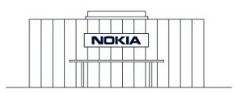
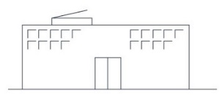
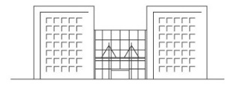
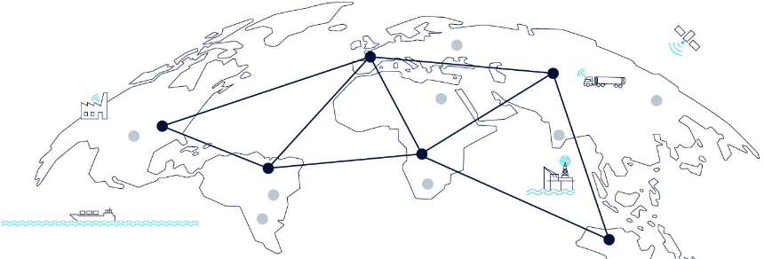
WING Connectivity Management Platform
Real-time management of IoT devices across the globe
IoT Command
Center
Mobile Network
Operators
Enterprises
Global management across technologies and networks
Connectivity Management Platform
SIM Security
WING IoT
platform
Self Service Portal
API Library
Rating & Charging
Onboarding of enterprises
Converged Mediation & Billing
Subscription Lifecycle
Dashboards
Dashboards for CSP, enterprises
WING global
IoT core
infrastructure
Control node
User node
Multi-layer billing
Notes:
WING leverages a single real-time Connectivity Management Platform so that IoT devices can be monitored and managed by the operator – or, in an operator-branded “white label” arrangement – directly by the enterprise itself.
No longer is the connectivity management arbitrarily restricted to one region or hemisphere, but now operators can manage IoT devices and services anywhere on the globe, in real time.
This single global CMP is accessed by multiple parties, each with their own unique views and dashboards, for instance:
The technical department in Mobile Network Operators (MNOs) may have a view that monitors the health and status of connections in the network while the marketing department may be monitoring which applications and services are driving the most traffic.
Enterprise customers of the MNOs will have an MNO-branded portal experience, and given the ability to track their individual shipments around the world or monitor the gathering of data from different sensors
The CMP is designed to be open so that if an MNO has a particular element such as billing platform or the like, it can be integrated with the WING CMP through standard API’s
Having a single global real-time CMP also enables interesting security capabilities. The CMP not only monitors SIMs in real-time (to prevent tampering or theft) but also permits geo-fencing of SIMs so that alarms are raised if the SIM goes outside a specific, predefined geography.

Slide 10
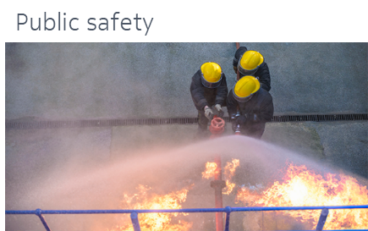
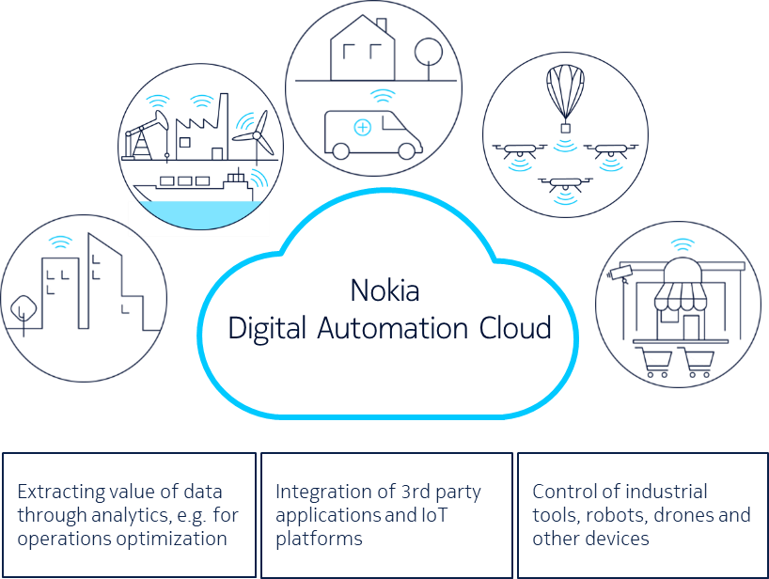
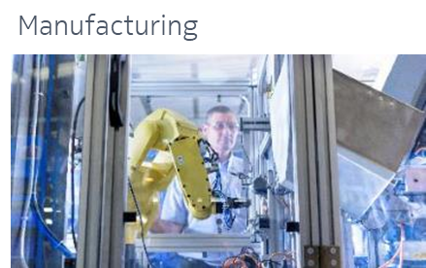



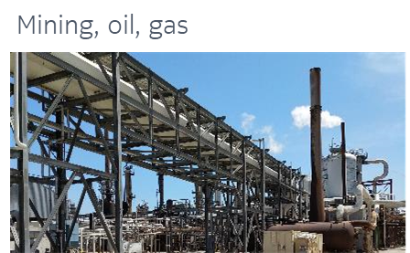
The Future is NOW!
NOKIA Digital Automation Cloud
https://www.dac.nokia.com/
* Cloud native and service based architecture (incl. microservices)

Slide 11










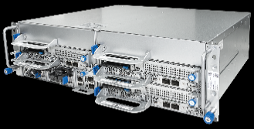
NDAC Overview
On prem wireless connection
Nokia Micro Service Framework for Apps
Nokia Drone Networks Aerial insight service
NDAC Edge video service
NDAC Campus communication services eg. PTT, PTV
NDAC High Accuracy Indoor Positioning (HAIP)
3rd party cloud services, e.g. AWS/IBM/Azure
DA
Applications
Applications
DA edge – data stays local
Nokia DA cloud
Pico, indoor
Micro
Mini Macro
O&M Management
Customer portal
API Gateway
Nokia DA cloud
Basic Analytics
SW management
CPUs, GPUs, storage
Central security
Global Cloud / Datacenters

Slide 12
Business models powered by network performance, data and slicing
Network
Information brokering
1010101010110
0101100101101
110010101001011
1010 0110
1010101
Data
Augmented
gaming
Augmented
dashboard
Self driving
T. mgmt.
Logistics
Factory
automation
Waste
mgmt.
Smart grids
Augmented
reality
Traffic systems
Advanced logistics &
production
Massive metering
Network as a Service
Safety &
Security
Mobile
living
Utility &
Energy
Traffic
Mgmt.
Automotive
Health
Communication
Logistics
Slice
Tailored vertical XaaS solutions
Connectivity +
Performance
Connected
home
Real time
work in cloud
8k Video beamer
4k Video
Virtual
presence
Advanced
monitoring
XXL broadband
UHD video
Virtual reality

Slide 13
Smart farm ecosystem
Underpinned by flexible 5G-enabled infrastructure and applications
Mobile network provider
Specialized
5G network provider
Automation service provider
Farmer
Network as a Service
Specialized
5G network slice
Smart farm applications
High-performance
farming
5G network infrastructure
Local 5G hardware
Automation equipment
Smart farm
Notes:
So how do these 5G capabilities (see previous slide) come together as a solution for smart farming?
Smart farming infrastructure has to be easily deployable, low maintenance, and flexible enough for the very diverse range of activities that take place on a modern farm. This is challenging because most farms, even large ones, are relatively small enterprises in terms of staffing.
However, the flexibility of 5G infrastructure, the specialization power of network slicing, and the responsiveness and security of edge cloud point to the answer.
Hardware infrastructure
Most farms will be in range of macrocell base stations at best and are unlikely to be close to any cloud nodes, so on-farm metrocell and edge cloud deployments will provide the connectivity and processing power needed for automation and monitoring equipment and the applications that run them.
Networking and applications
The application and equipment will be designed by key players in the agri-technology business and potentially deployed and run by specialist contractors.
Specialized network slices will connect, organize and coordinate the various distributed elements to make this happen. Given the customized design of the network slice, it is likely that specialist network providers will create these solutions in partnership with the big farm automation equipment and systems vendors.
This is not a role that traditional operators can easily fill. Instead, their role will be to provide network-as-a-service platforms for the underlying backhaul transport, core network support and access to controlled licensed spectrum.
Smart farming
This 5G ecosystem provides a feasible route to automation on the smart farms, opening up a more productive, safer, less labour intensive future for agriculture.

Slide 14


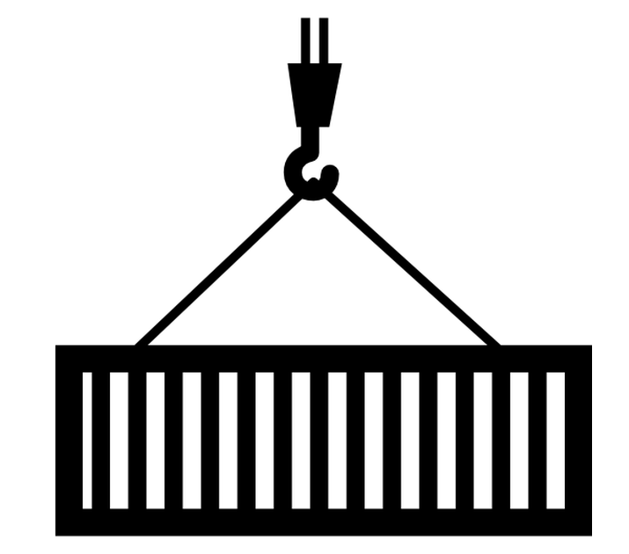
Example IoT solutions for fast time to revenue
Smart Agriculture as a Service
Affordable subscription-based access to regional weather,
soil and pest data to reduce costs and mitigate risks
Best-in-class partners with pre-integrated devices and applications
Livestock Management as a Service
Intelligent livestock location and health management during
gestation or in case of illness or injury
Single point of contact for full go-to-market
Trusted WING global IoT connectivity for secure services
Logistics as a Service
Enables globally integrated supply and distribution networks
with real-time knowledge of location, temperature, etc
Flexible pay-as-you-grow models for lower risk, faster reward
Asset Management as a Service
Simplifying connectivity and management for a range of
connected goods, both industrial and consumer
Notes:
\

Slide 15
Future Farming
Robust, operationally simple, real-time monitoring and automation
Stock health and location monitoring
Automated vehicles
Equipment automation,
robotics,
security
Precision agriculture and field monitoring
The future smart farm will require scalable, resilient, trusted communications
Notes:
In line with many other vertical industries, farming is undergoing a revolution in automation.
Farming sectors such as dairy farming are labor intensive and require 24/7 commitments. Farmyard automation (e.g. automated calf feeders, robotic milking machines) and remote monitoring (for, e.g., stock location) provide additional flexibility and free time for often overloaded staff.
Farms are generally geographically isolated from neighbors, in rural locations: real-time HD security video monitoring can provide additional peace of mind.
Farms are a very challenging environment from a health and safety perspective. Ultra-reliable, low-latency intrusion detection will become a critical safety feature of highly mechanized farm-yards.
Precision agriculture and field monitoring systems will boost productivity yields by ensuring the right level of nutrients, aeration, and water on a finer granularity than previously possible. Real-time monitoring with equipment such as drones ensure fast detection of and response to crop diseases, pests, etc.

Slide 17
Copyright and confidentiality
The contents of this document are proprietary and confidential property of Nokia. This document is provided subject to confidentiality obligations of the applicable agreement(s).
This document is intended for use of Nokia’s customers and collaborators only for the purpose for which this document is submitted by Nokia. No part of this document may be reproduced or made available to the public or to any third party in any form or means without the prior written permission of Nokia. This document is to be used by properly trained professional personnel. Any use of the contents in this document is limited strictly to the use(s) specifically created in the applicable agreement(s) under which the document is submitted. The user of this document may voluntarily provide suggestions, comments or other feedback to Nokia in respect of the contents of this document ("Feedback").
Such Feedback may be used in Nokia products and related specifications or other documentation. Accordingly, if the user of this document gives Nokia Feedback on the contents of this document, Nokia may freely use, disclose, reproduce, license, distribute and otherwise commercialize the feedback in any Nokia product, technology, service, specification or other documentation.
Nokia operates a policy of ongoing development. Nokia reserves the right to make changes and improvements to any of the products and/or services described in this document or withdraw this document at any time without prior notice.
The contents of this document are provided "as is". Except as required by applicable law, no warranties of any kind, either express or implied, including, but not limited to, the implied warranties of merchantability and fitness for a particular purpose, are made in relation to the accuracy, reliability or contents of this document. NOKIA SHALL NOT BE RESPONSIBLE IN ANY EVENT FOR ERRORS IN THIS DOCUMENT or for any loss of data or income or any special, incidental, consequential, indirect or direct damages howsoever caused, that might arise from the use of this document or any contents of this document.
This document and the product(s) it describes
are protected by copyright according to the
applicable laws.
Nokia is a registered trademark of Nokia Corporation. Other product and company names mentioned herein may be trademarks or trade names of their respective owners.

