Slide 1

Climate Change and the Next Decade of Canadian Agriculture
Don Jardine
UPEI Climate Research Lab
February 25, 2020

Slide 2
Climate Change and Agriculture
Climate change is affecting all segments of agricultural enterprise
Climate regulating services have a direct linkage with agricultural systems
  Temperature, CO2, solar radiation, precipitation, wind, frost, etc.
Biotic stressors represent a wild card in the effects of climate change:
  Weeds, diseases, arthropod pests all have to be managed.
Agricultural systems are complex: biological components coupled with natural resources (soil, water, sunshine and air)
Hatfield et al, 2018

Slide 3
Major Climate Related Risks for Canadian Agriculture & Food
Drought*
Heatwaves* & extreme hot temperatures
Heavy precipitation events /storm damage*
Warming temperatures
Pests and invasive species*
Disruption of global food system and global food supply chains*
*Canada’s Top Climate Change Risks
The Expert Panel on Climate Change Risks and Adaptation Potential (2019)

Slide 4
What has been happening (2019)?
Manitoba in late summer 12 counties declare a state of agriculture emergency – too dry
Alberta at Grande Prairie in early November- 40 to 60% of crop still in fields due to snow.
Manitoba, Saskatchewan and Alberta – heavy snow and rain during canola harvest
Maritimes – Post Tropical Storm Dorian in early Sept damaged crops – wind and rain
Quebec and Ontario – Corn planting impeded by heavy rains in April and May – a month behind schedule
British Columbia – Feb. cold snap damages raspberry plants at Fraser Valley

Slide 5
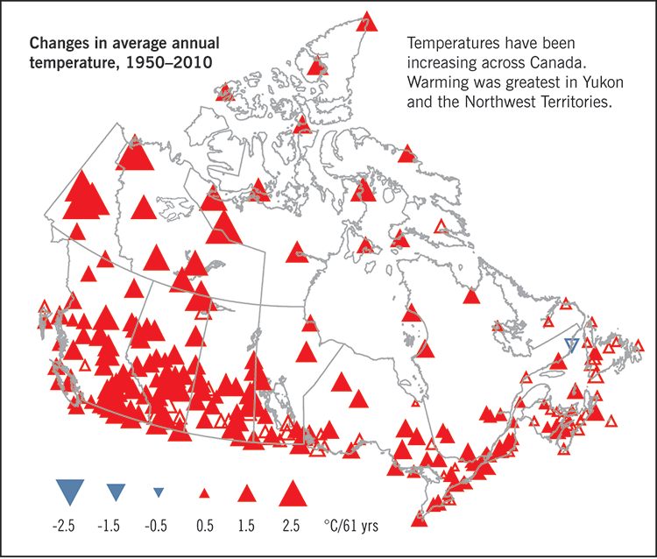
Canada’s Past Temperature

Slide 6
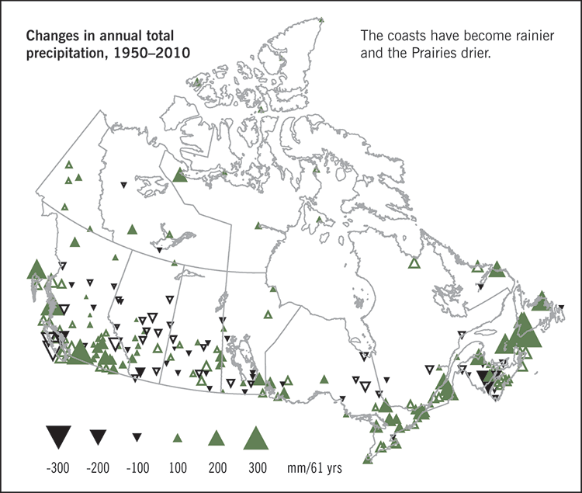
Canada’s Past Precipitation

Slide 7
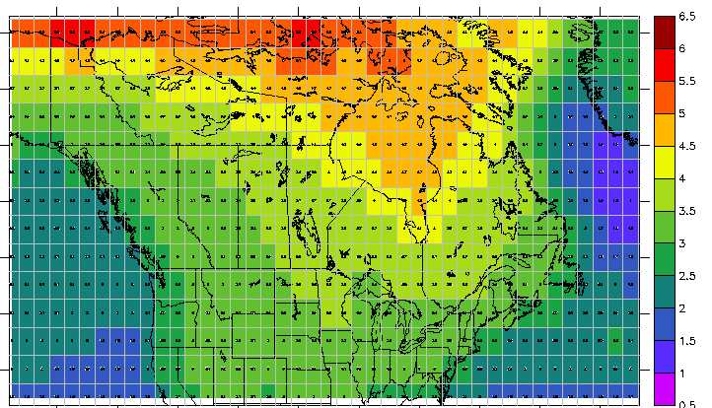
Canada’s Future Temperature
Change in °C in 2050s

Slide 8
Temperature and Agriculture
23-29°C day and 15-21°C night

Slide 9
Temperature and Agriculture

Slide 10
Frost Free and Growing Seasons
Projections are from
Canadian Global Climate Model (CGCM4) 8.5 RCP
(business as usual)

Slide 11
Growing Degree Days (>5°C)
Projections are from
Canadian Global Climate Model (CGCM4) 8.5 RCP
(business as usual)

Slide 12
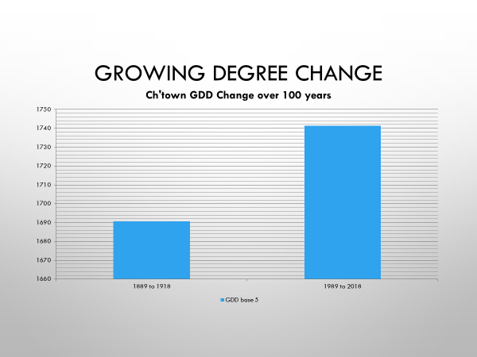
Growing Degree Day Change
Growing degree days are calculated by using the maximum and minimum temperature for every day and subtracting the plant’s lower base threshold which in this document uses a base temperature of 5 degrees Celsius. Increases in GDD may lead to a longer growing season and viability of longer season crops and can be used to predict plant and pest development rates, such as the date a crop reaches maturity. This can also impact the timing of planting and harvest periods. Planting of fall cover crops such as winter wheat could increase if a longer growing season was available.

Slide 13
Charlottetown – Localizer Tool
AR4-Regridded- Ensemble (mean)SR-A2
Parameter | 1981-2010 | 2020s | 2050s | 2080s
Annual Heating Degree Days | 4595.7 | 4349.8 | 3981.3 | 3515.2
Annual Cooling Degree Days | 110.2 | 144.5 | 215.6 | 337.5
Daily Corn Heat Units | 2543.3 | 2729.3 | 3052.8 | 3575.4
Corn Season Length (days) | 152.6 | 157.1 | 166.0 | 183.1
Growing Degree Days (5) | 1702.4 | 1839.4 | 2069.9 | 2415.8
Growing Season Length (days) | 184.7 | 191.5 | 204.0 | 224.1
Frost Free Days | 204.8 | 217.3 | 238.1 | 260.1
Notes:
Corn heat units is a measurement of cumulative heat over the growing season.
CHU:[1.8(daily mean temp-4.4) + 3.3 (daily max temp -10) – 0.084(daily max temp)-10)2}/2=CHU
CHU always uses a base of 10 versus 5 from GDD.

Slide 17
Invasive Species
Invasive plants
  Canada thistle
  Leafy spurge
  Knapweeds
  Purple loosestrife
  Crested wheatgrass
  Giant hogweed
  Carpet burweed
  Water chestnut
  Wooly cupgrass
Annual cost $2.2 B
    Weeds - $1.3 B
    Weed control- $0.3 B
    Costs are expected to rise
Impact productivity of plants
Alteration of ecosystem functioning
Monitoring programs
Management approaches (surveys)
New mapping methods (drones & sensors)
Policy development
Invasive alien terrestrial plants and pests Action Plan

Slide 18
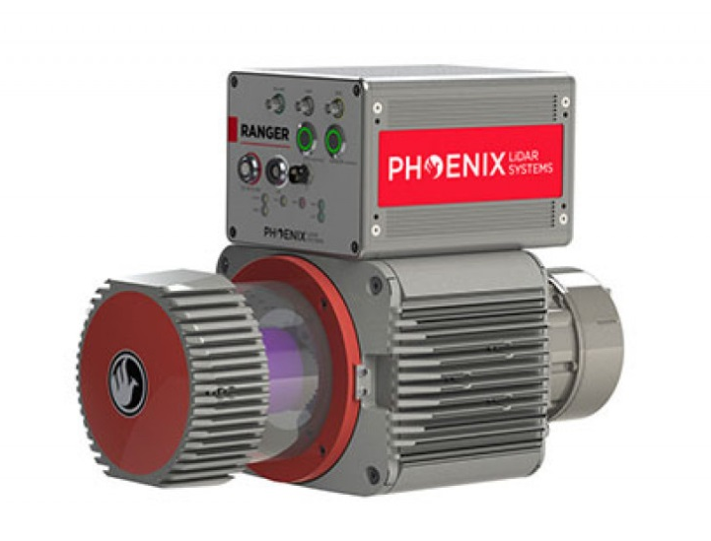
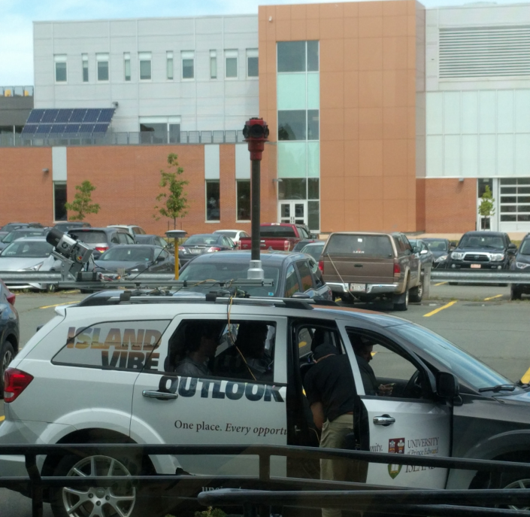
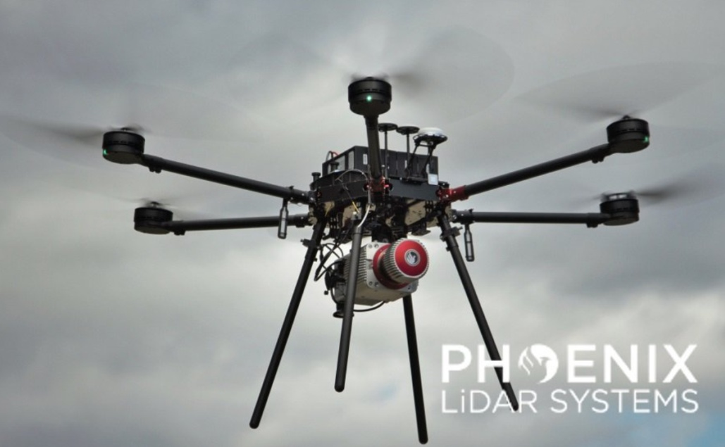
Remote Sensing – Precision Agriculture

Slide 19
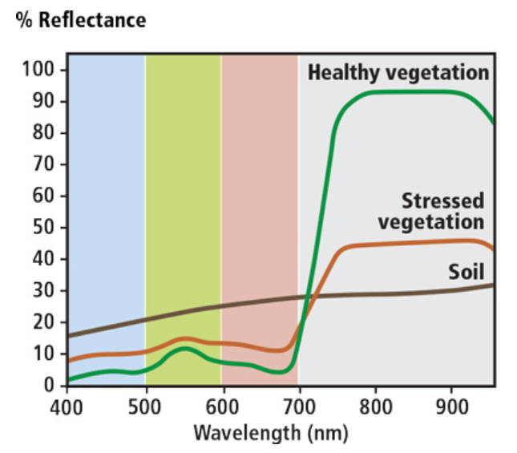
Sensing Plant Health
Visible
Near Infrared
Source: https://phenospex.helpdocs.com/planteye/multispectral-parameter-explanation; modified

Slide 20
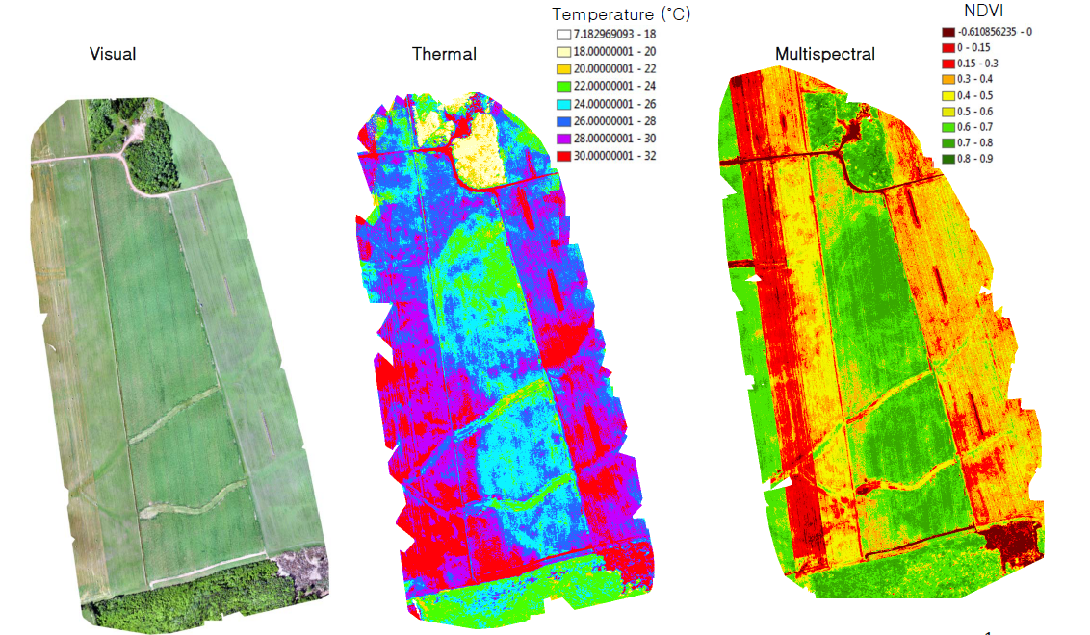
Some Data Sensor Options

Slide 21
Potential Implications of a Changing Climate
Positive
  Longer growing season
  Longer frost-free period
  Lower feed requirements due to warmer temps
  Enhanced carbon sequestration via longer growing season.
  More grazing time for livestock
Challenges
  More periods of drought
  More heat waves and potential mortalities
  Reduced milk production during hot weather
  More extreme wind, rain, storm events and associated damage (floods)
  More pests and disease

Slide 22
Agriculture Adaptation
Drought, heatwaves, extreme wind and precipitation change
  Adopting varieties better able to handle these stresses
  Shift to alternative crops better suited to changing weather patterns
  Establish new growing areas in alternative locations or more use of greenhouses
  Understanding the complexities and interactions of all potential stressors

Slide 23
Conclusions - Projected
Future climate projected to be “warmer and wetter”
Future climate projected to have more frost-free days, longer growing season, growing degree days
Potential for new, longer season crops and options for crops and varieties which grow in more southern climes
Adaptation options are available
New remote sensing tools are available to enable precision agricultural methodology
Policy measures can be exercised
Forest Species will change with time

Slide 24
Questions?
Don Jardine
UPEI Climate Research Lab
dejardine@upei.ca

