Slide 1
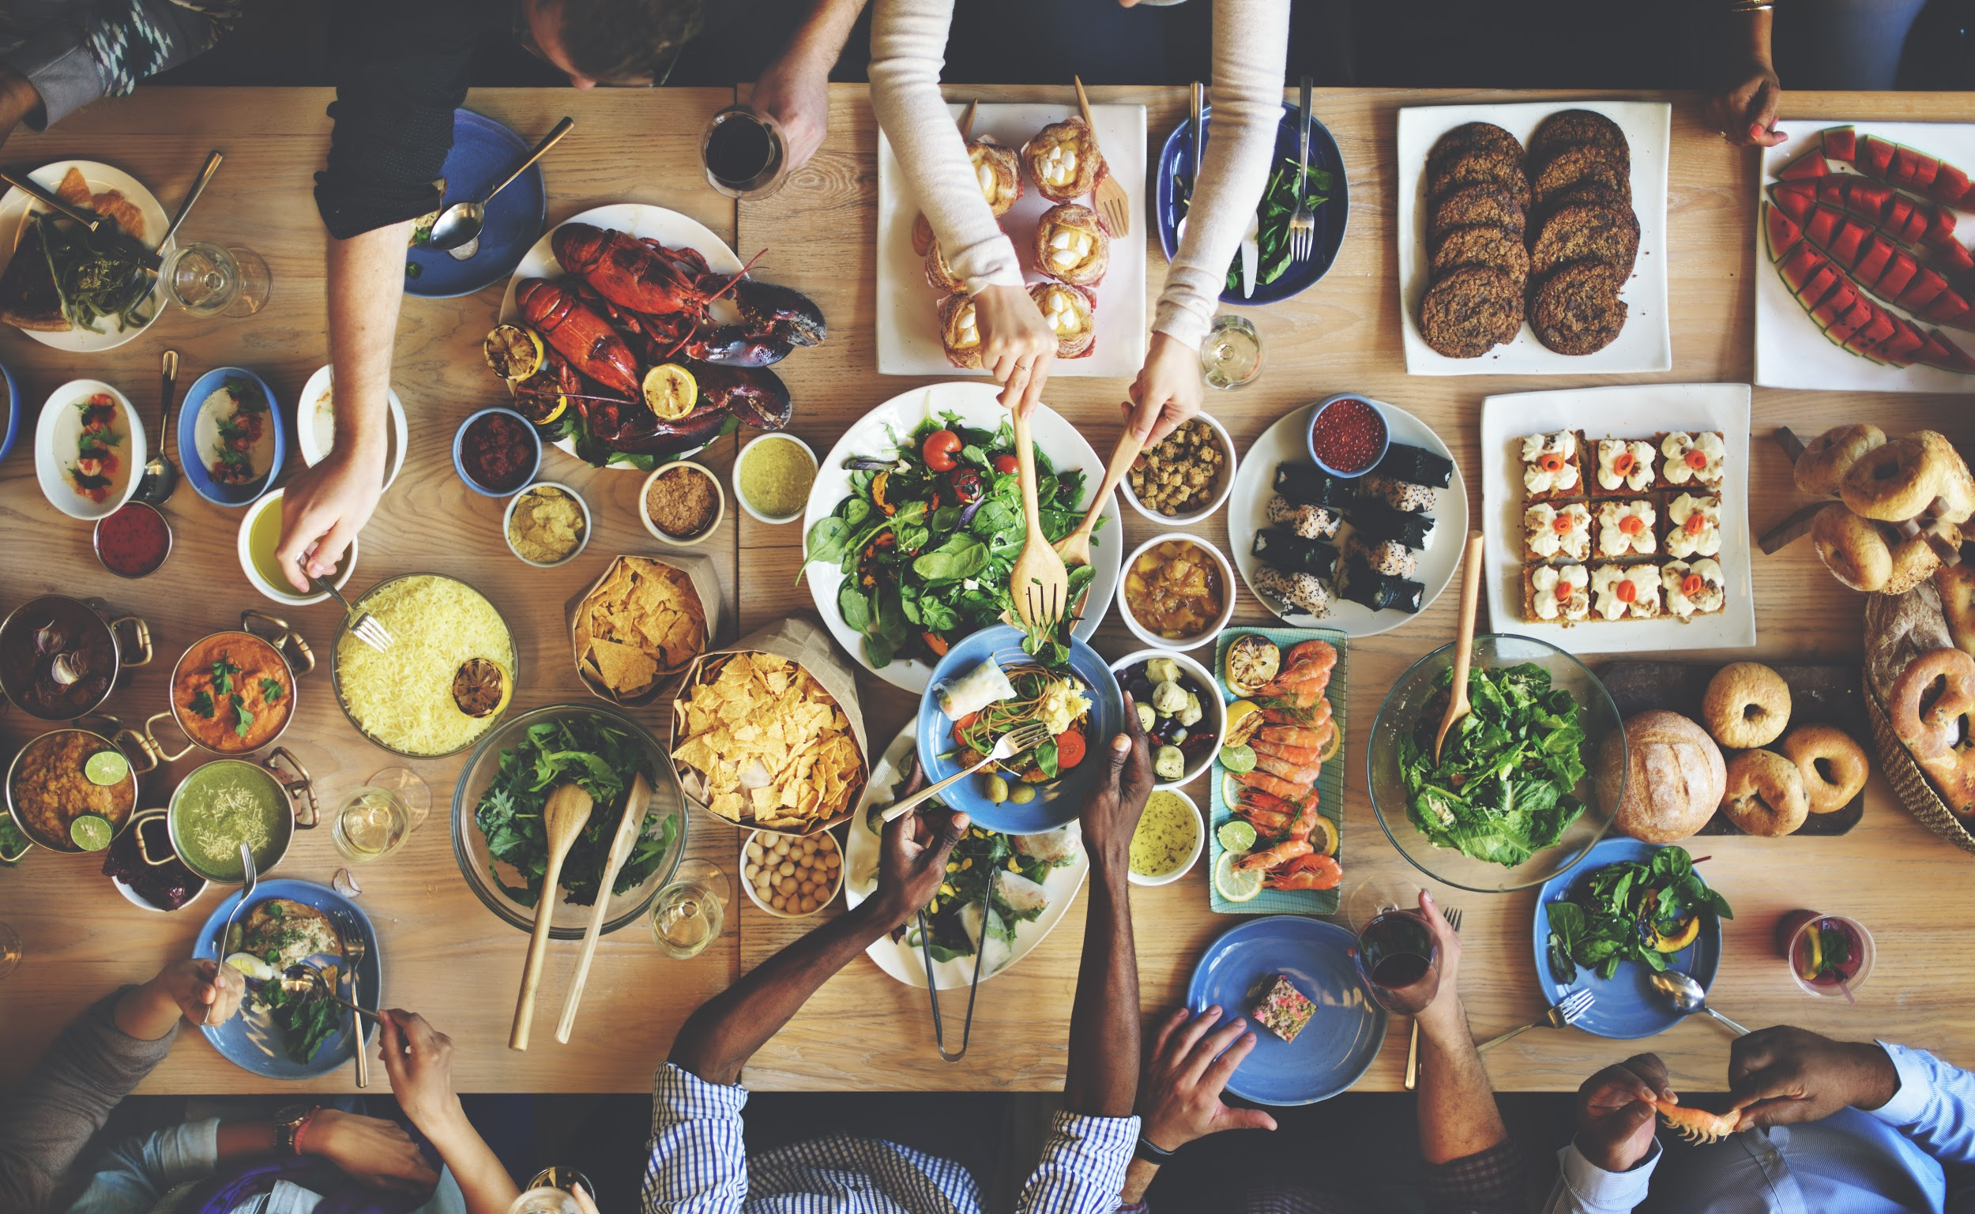

The 2020 trend report

Slide 2

2020 Trends
This year, it’s all about Me
Unpackage Me: Solutions Beyond Recycling
Sober Me: Rethinking Alcohol for a New Generation of Drinkers
Know Me: AI and Hyperpersonalizing Foodservice
Save Me: Environmental Impact-Based Eating
Science Me: Redefining “Real” Food in the High-Tech Era
Entertain Me: Evolving Grocery Shopping from Chore to Experience
Keto Me: The Evolution of Lifestyle Eating From No-Carb to Slow-Carb
Nourish Me: Serving Local Food in Public Institutions
Near Me: Farming Gets Closer to the Consumer
Teach Me: Consumers Want to Know More About Modern Farming Practices
©2020 Nourish Food Marketing. Proprietary and Confidential. All Rights Reserved.
Notes:
This year, it’s all about Me.
2020 will be your year. And hers. And his. It will be a year of individuals taking small steps to make the world a better place. And they are defining that world as increasingly local. At the same time, they will more than ever expect companies to ‘know them’ and provide customization. Gone are the days of mass production as we move to an era of mass personalization.
Here are the trends you need to watch and adjust for in 2020:
Will farmers, producers, and modern agriculture take steps to connect with consumers? And, will Big Food be nimble enough to meet the challenges ahead, or will we continue to see new upstarts drive future innovation? Hang on to your hats – it’s about to get personal.

Slide 3
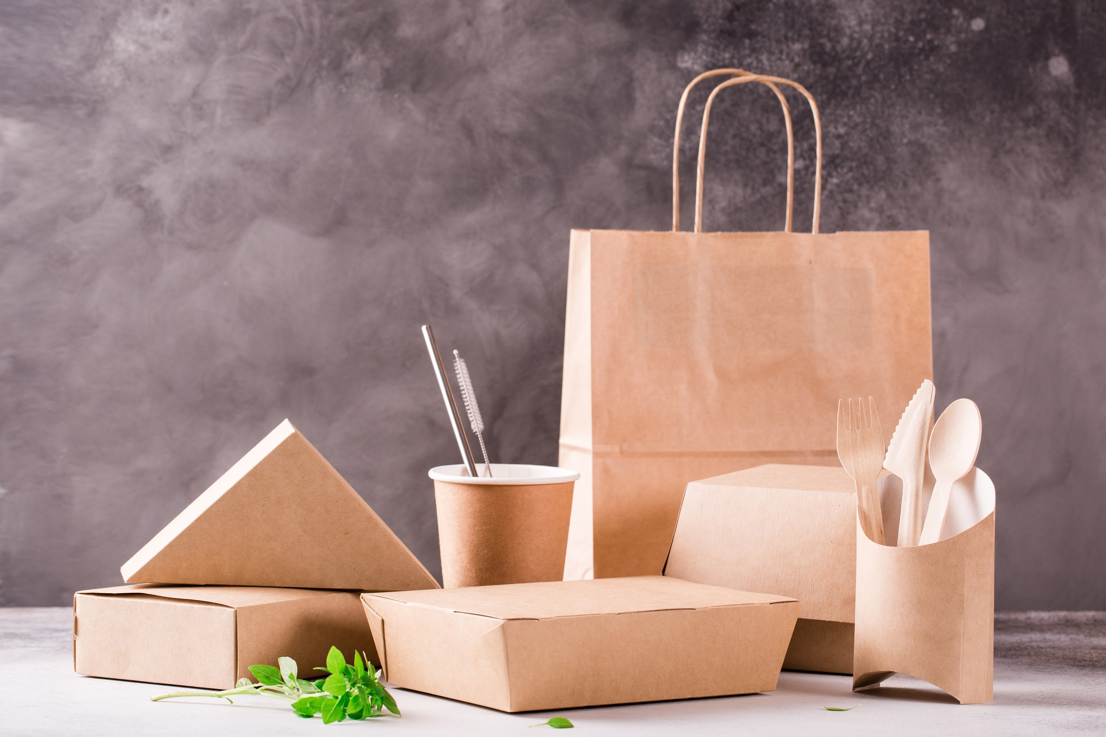
UNPACKAGE ME
UNPACKAGE ME

Slide 4
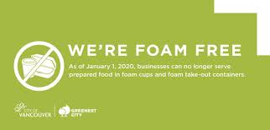
Unpackage Me: Solutions Beyond Recycling
SUP - a term with little awareness 2 years ago
Less than 10% gets recycled. Food wrappers & containers largest component of this.
Move to reduction strategies rather than recycling
Consumers putting onus on Industry
Vancouver foam ban
Upstream v. downstream thinking. Do you have a human resource assigned?
How will you fare in a zero plastic waste future?
©2020 Nourish Food Marketing. Proprietary and Confidential. All Rights Reserved.
Notes:
Single-use plastics (SUPs), a term that wasn’t part of the consumer lexicon two years ago, are the number one issue facing the food industry right now. Less than 10% of plastic gets recycled. Growing issue with microplastics polluting not only our oceans, but now also turning up in our poop. The EU has voted to ban single-use plastics by 2021 and Feds announced plans to ban some SUP & some municipalities going further - Vancouver foam ban for f&. Consumers are becoming desperate to “do the right thing”, but don’t know where to start. How can we satisfy the seemingly contradictory consumer needs for convenience and portability with sustainability?
Some players are responding and working together towards more sustainable packaging. But, we expect this to get a more radical push from consumers as they pursue more reduction strategies rather than recycle strategies.
A study conducted by the Agri-Food Analytics Lab at Dalhousie University found that 94% of Canadians surveyed said they are “personally motivated to reduce single-use plastic food packaging because of its environmental impacts.” The same study found that 71% of Canadians support a ban on all SUPs used for food packaging, and 56% of Canadians are already actively shopping for food with non-plastic packaging.
(Source: Dalhousie University - The single-use plastics dilemma: Perceptions and possible solutions. 2019)
There is mass confusion over what can and can’t be recycled, even between municipalities. How can the consumer possibly get this right? Instead, we are starting to see reduction strategies - circular loop systems, bring your own packaging, and so on.
version of Irving Zola’s parable: “You and a friend are having a picnic by the side of a river. Suddenly you hear a shout from the direction of the water—a child is drowning. Without thinking, you both dive in, grab the child, and swim to shore. Before you can recover, you hear another child cry for help. You and your friend jump back in the river to rescue her as well. Then another struggling child drifts into sight. . . and another. . . and another. The two of you can barely keep up. Suddenly, you see your friend wading out of the water, seeming to leave you alone. ‘Where are you going?’ you demand. Your friend answers, ‘I’m going upstream to tackle the guy who’s throwing all these kids in the water.’”
Upstream v downstream thinking - prevent problem v react. Prevention v firefighting. Systems thinking.
Needs to be someone’s job and need to be measured on it

Slide 5
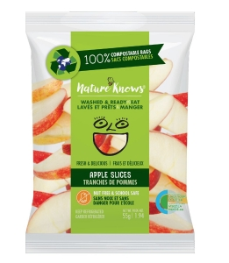

Unpackage Me: Solutions Beyond Recycling
Edible packaging? Compostable packaging?
Will become table stakes like clean label
Closed loop systems?
How brand, tell story?
©2020 Nourish Food Marketing. Proprietary and Confidential. All Rights Reserved.
Notes:
Industry starting to step up, cooperate to find solutions.
Will edible packaging take hold? While The Glenlivet’s recent whisky pods made from seaweed that consumers can eat created some excitement, it feels like more of a fad than a trend, akin to the rise and sudden fall of insect protein.
As ‘clean label’ has become table stakes, so will sustainability, as consumers start to consider the impact the products they choose have on the world.
The same Dalhousie study found that 38% of Canadians said they were willing to pay a premium for biodegradable packaging, and that intention goes up the younger the person is. Grocery stores and takeout generate a lot of packaging waste. What biodegradable or compostable solutions are out there?
Innovative Canadian company Nature Knows sells its ready to eat branded produce in corn-based bags that are 100% compostable while also extending product shelf life by 50%.
Research conducted in US had 50% of digital consumers claiming that environmental concerns impact their purchasing decisions (globalwebindex). Of course, always a difference between intention & action, but still sizable group

Slide 6
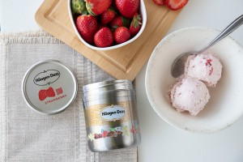
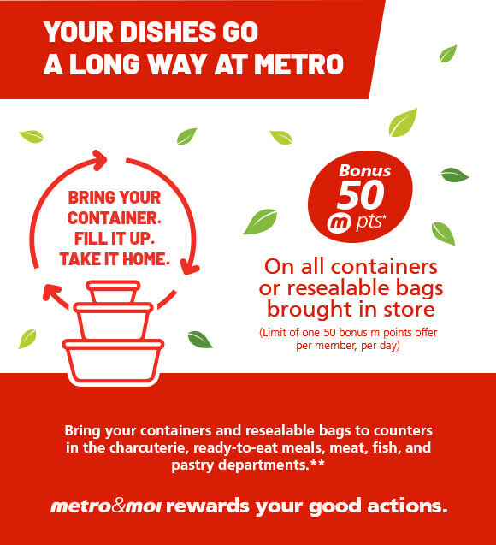
Unpackage Me: Solutions Beyond Recycling
Consumer guilt offset
BYOC
How maintain and lock in brand loyalty?
©2020 Nourish Food Marketing. Proprietary and Confidential. All Rights Reserved.
Notes:
There seems to be a need for a ‘guilt offset’ as online shopping creates more waste. Shoppers are starting to bring their own containers to bulk bins and Unboxed-type markets with refilling stations. Metro Quebec is allowing shoppers to bring their own containers to shop in some categories. Loblaws will test TerraCycle’s Loop program in 2020 for some of its President’s Choice products, as well as select national brands. Products are packaged in a more durable packaging form that is later collected, cleaned, refilled and reused, creating a packaging ‘loop’. Will this circular packaging solution lock in brand loyalty?

Slide 7
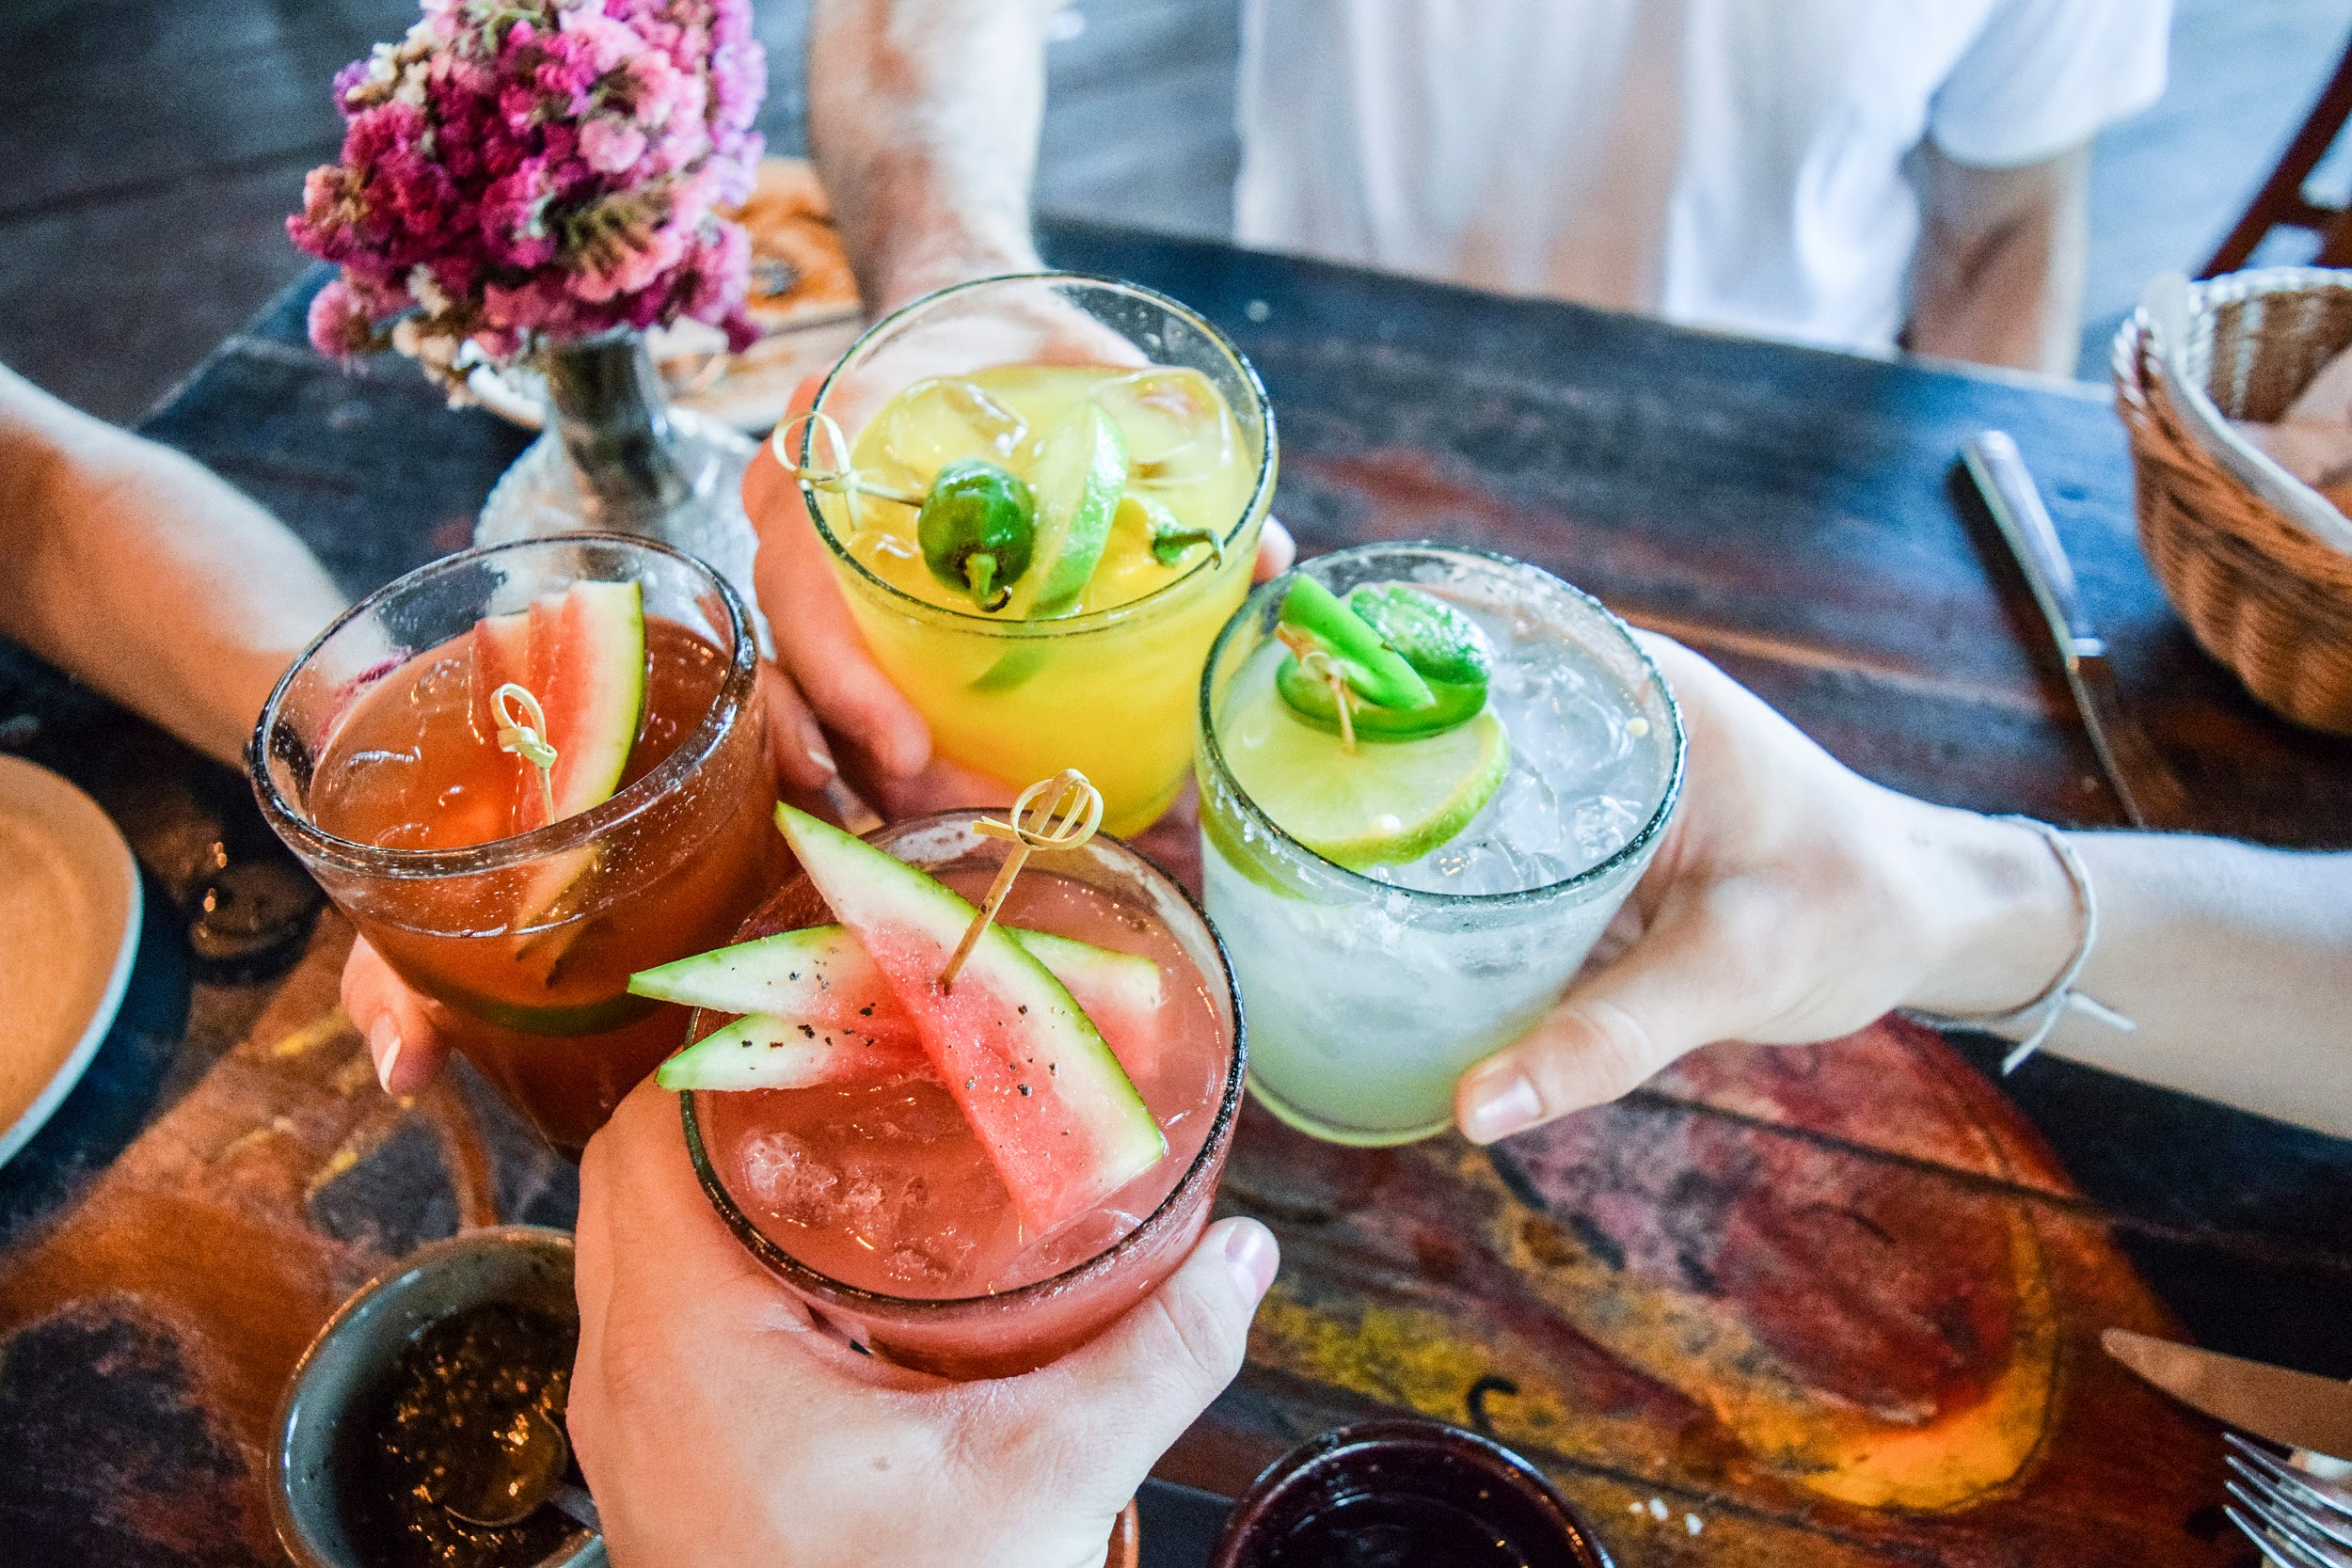
UNPACKAGE ME
SOBER ME

Slide 8
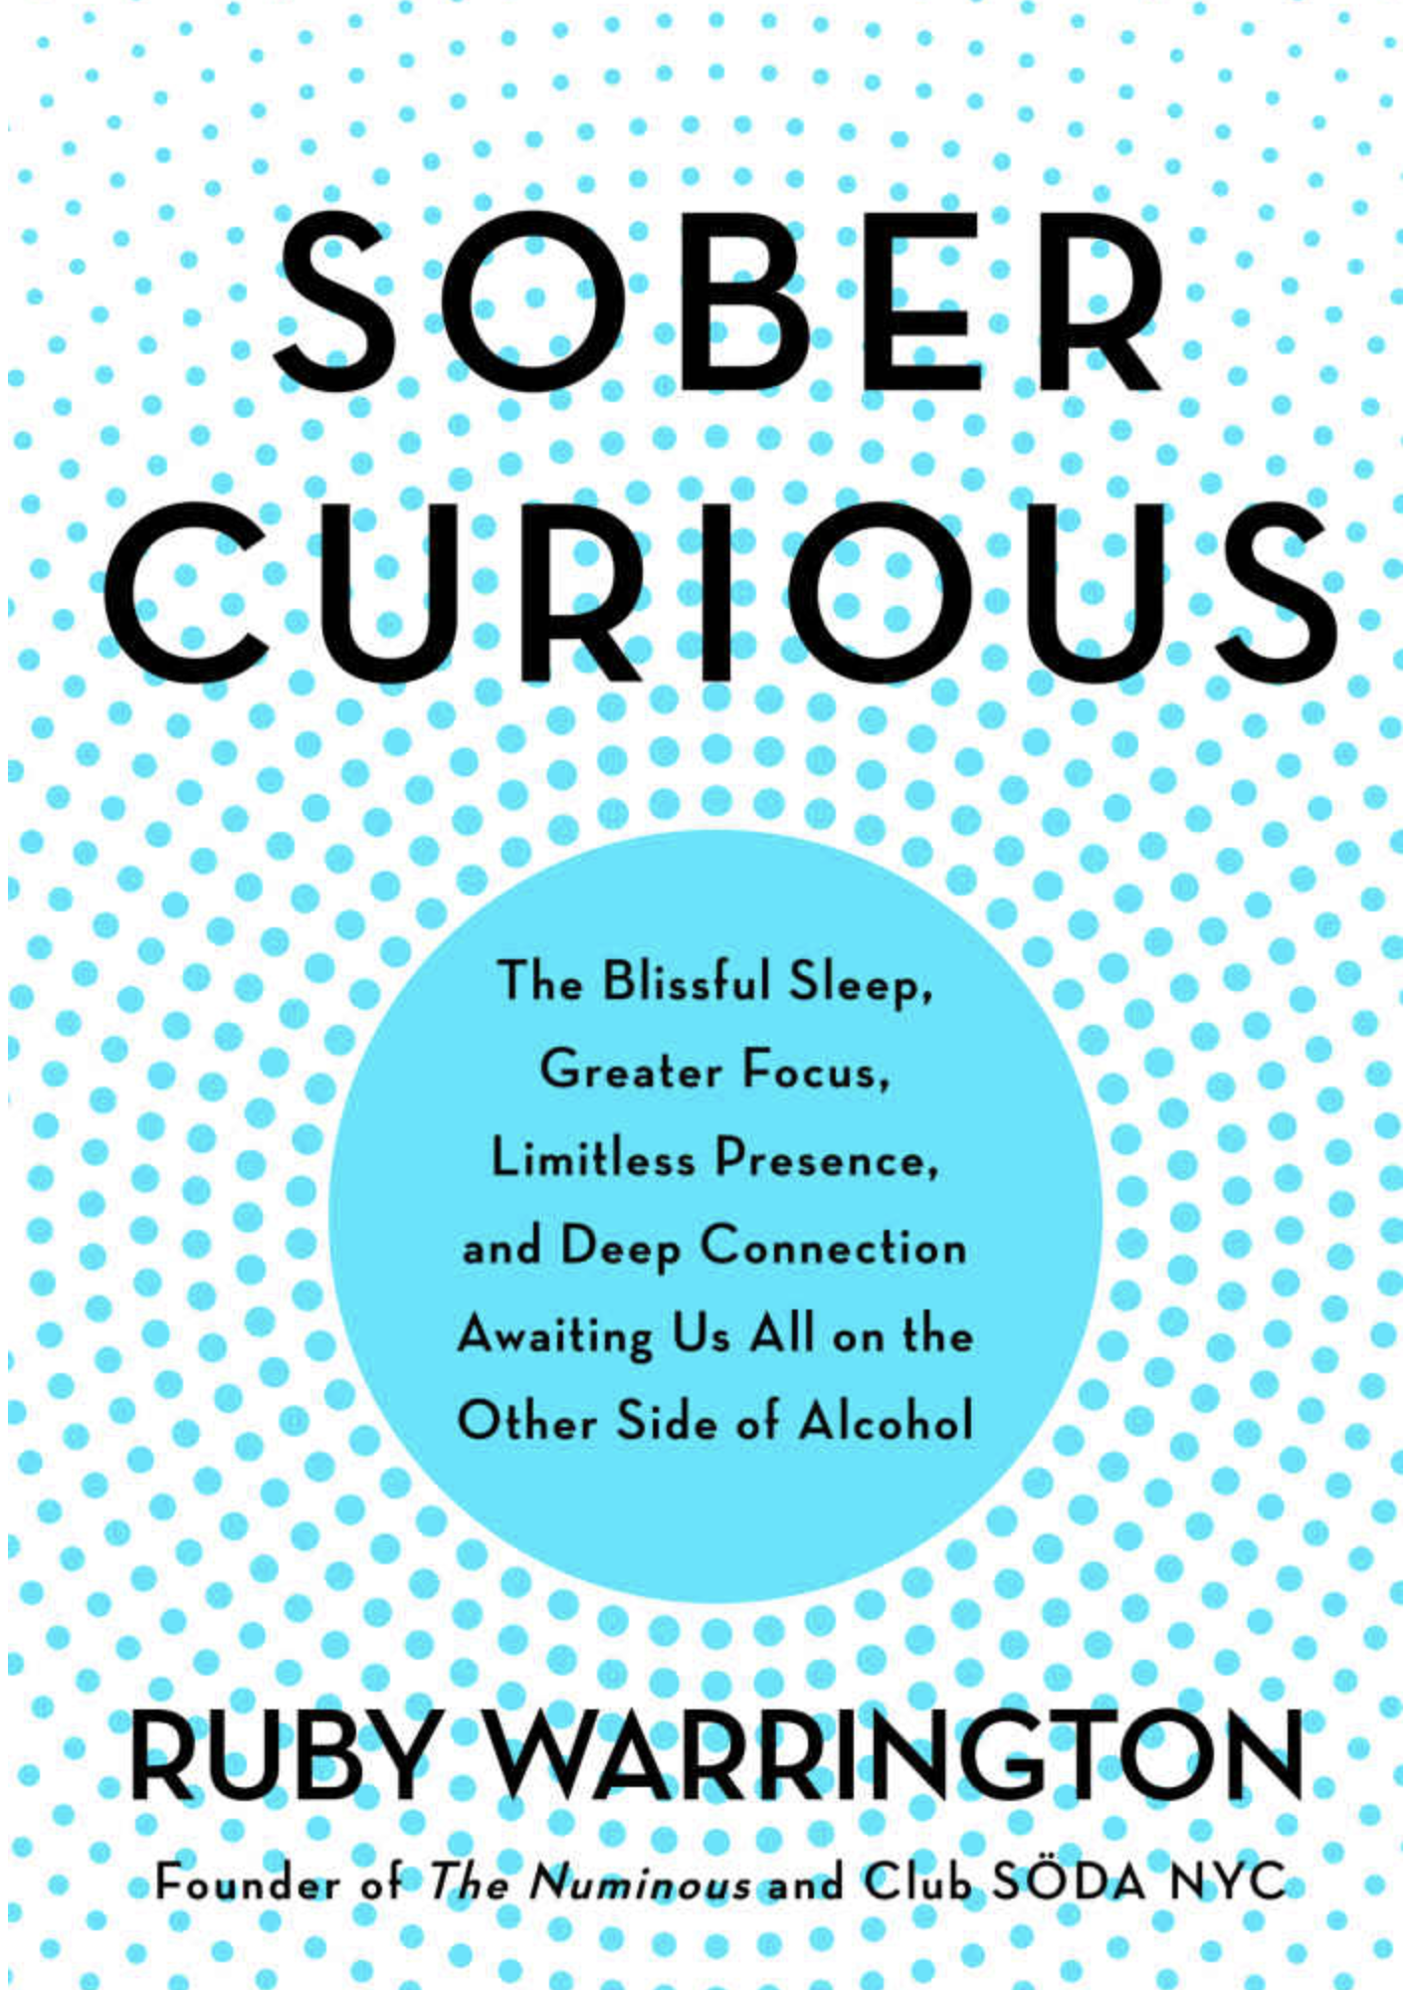
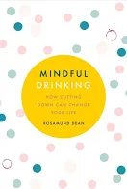
Sober Me: Rethinking Alcohol for a New Generation of Drinkers
Dry January evolving to sober 2020
Younger gens drinking less than parents, but everyone reducing alcohol consumption
Next stage of wellness revolution
©2020 Nourish Food Marketing. Proprietary and Confidential. All Rights Reserved.
Notes:
A recent survey* found that one-third of Canadian adults plan to take part in Dry January, where you go alcohol-free for the month. And according to US Nielsen research, 66% of millennials and 47% of adults claimed to have reduced their alcohol consumption in 2019.
Generation Z and millennials are distancing themselves from their boozy parents. They’re drinking less and embracing the new FOMA (fear of missing alcohol) outlined in Ruby Warrington’s best-selling book on alcohol reduction as the next stage in the wellness revolution. Sobriety is becoming hip, especially in a time of legal cannabis. This doesn’t mean the end of alcohol is nigh. But, it is translating into expensive artisanal cocktails at popular bars rather than total abstinence and AA meetings.
The term “mindful drinking”, coming from a book by Rosamund Dean, means drink less and think about it more. Both books have created online movements to support and celebrate this new sobriety and way of drinking.

Slide 9
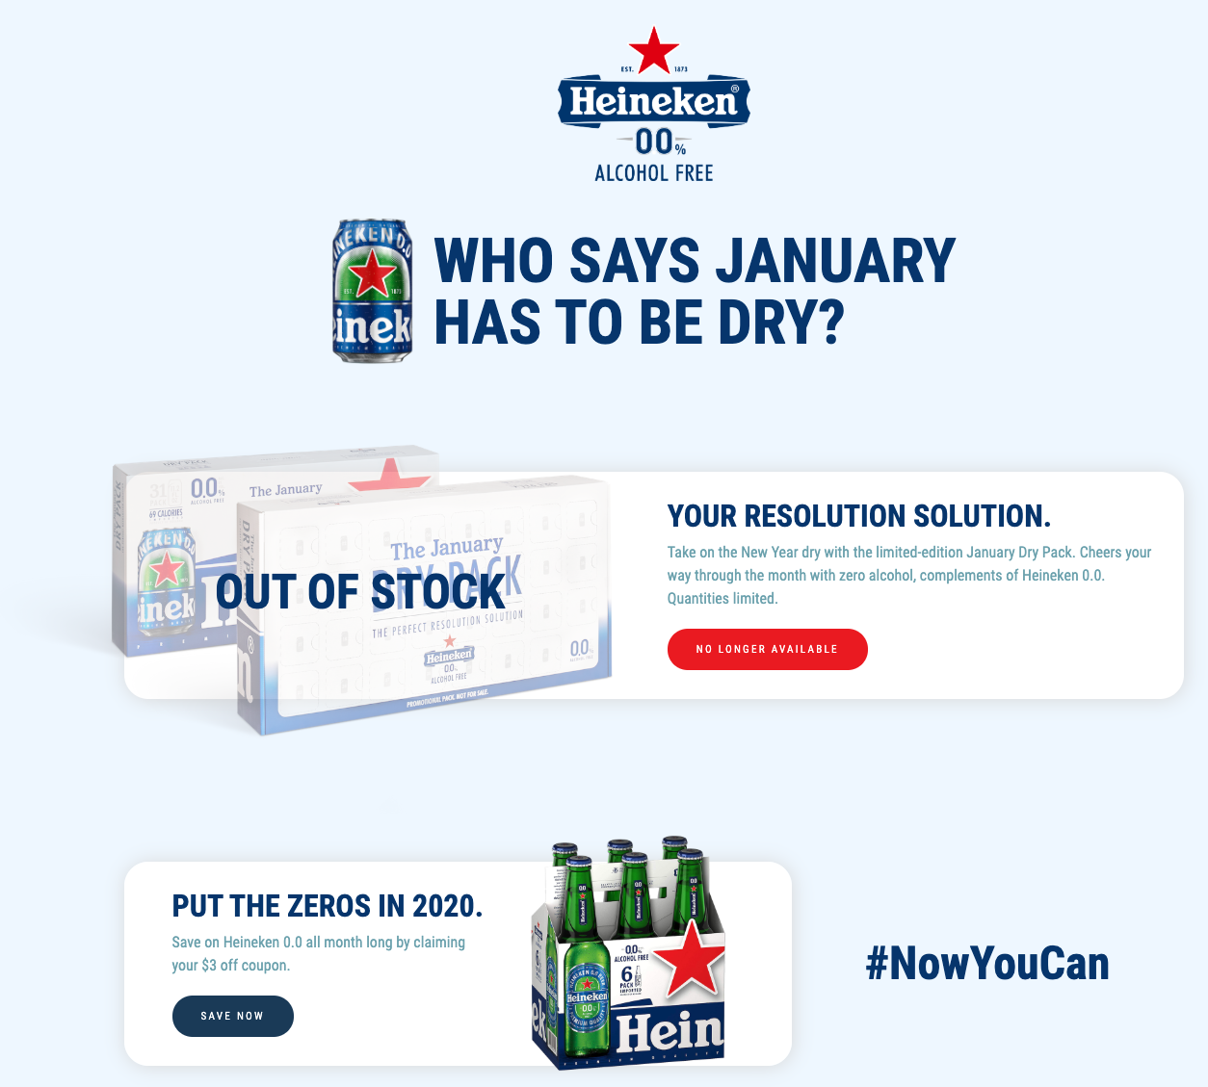
Sober Me: Rethinking Alcohol for a New Generation of Drinkers
Heineken US gave away “zero” beer for Dry January
Campaign focused on helping consumer make small change, tap into communal sense of purpose
©2020 Nourish Food Marketing. Proprietary and Confidential. All Rights Reserved.
Notes:
Brewer Heineken gave away cans of its 0.0% alcohol-free beer to US-based customers to mark Dry January 2020, the public health alcohol abstention campaign. Customers sign up on a dedicated January Dry Pack website to receive a limited edition white and blue calendar, with one can of beer to open for each day of the month. To make the drink taste similar to ‘regular’ beer Heineken brews its 0.0% drink using the same ingredients, A-yeast and processes as alcoholic beer, before removing the alcohol.
campaigns focused on helping people embrace new habits and tap into a communal sense of purpose: Dry January, Veganuary and Sober October to name just a few! Big lifestyle changes can feel intimidating, but these campaigns allow participants to start with a smaller and more accessible step. If your product or service requires people to change their behavior, then could you tap into a relevant charity campaign in order to introduce it in a way that makes it less intimidating?

Slide 10
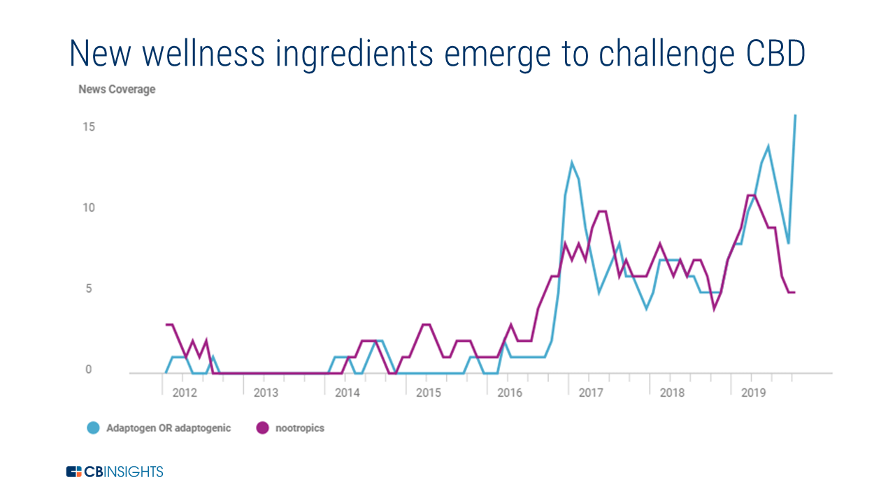
Sober Me: Rethinking Alcohol for a New Generation of Drinkers
Cannabis viewed as healthier, lower calorie
Still want drinks “with benefits”
Adaptogen and nootropics - around longer, benefits better researched
CBD has higher awareness but consumers confused
©2020 Nourish Food Marketing. Proprietary and Confidential. All Rights Reserved.
Notes:
Also contributing to growth in this space is the legalization of cannabis, which is viewed by consumers as being healthier and lower calorie than alcohol.
U.S. wine consumption decreased in 2019 for the first time in 25 years, posting a -0.9% volume loss from the year prior, according to preliminary figures provided to Food Dive by IWSR Drinks Market Analysis.
And “drinks with benefits” doesn’t just mean CBD or THC. 2018 report (Hartman’s Modern Beverage Culture) found that 44% of consumers say they want their beverages to "do something for them." In our 2019 Trend Report, we wrote about the shift from physical to emotional well-being and the rise of medicinal mushrooms or “adaptogens” as consumers like to plants over pills for physical and mental health. Adaptogens (helps with anxiety and stress management - herbs, roots mushrooms) and nootropics (enhances cognitive function - caffeine, grape seed extract) have the potential to be a bigger market than CBD in the wellness drinks space according to intelligence platform CBInsights. Of course, these ingredients are readily available and have been used for centuries in Ayurvedic and traditional Chinese medicines.

Slide 11

UNPACKAGE ME
KNOW ME

Slide 12
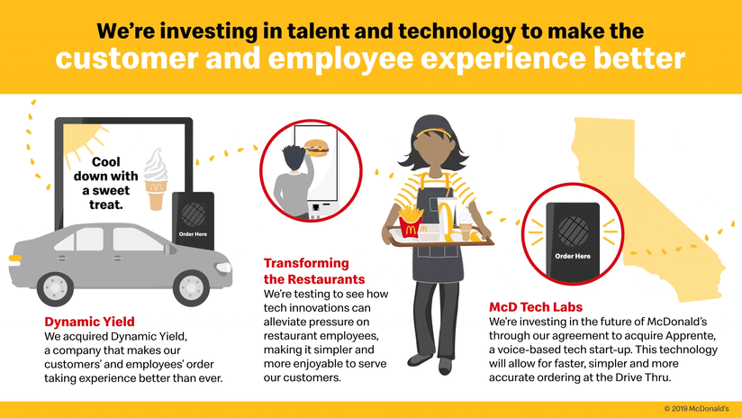
Know Me: AI and Hyperpersonalizing Foodservice
AI plus smart devices allowing for hyperpersonalization
Technology allows for eating recommendations based on our DNA, lifestyle, microbiome
Can affect food shopping, ordering, eating
Are Grocers finally figuring out AI allowing a more personalized shopping experience? CES 2020 highlight was dnanudge coming out of UK test and launching into US this year
©2020 Nourish Food Marketing. Proprietary and Confidential. All Rights Reserved.
Notes:
We’re starting to see personal AI wellness consultants that analyze your DNA, your lifestyle, and your microbiome to develop a customized way of eating. That cell phone we all carry is increasingly becoming a portable lab with increasing functionality to measure our wellbeing. Sounds a lot like Dr. McCoy’s tricorder, doesn’t it?
Businesses can now develop products and content customized for consumers based on their needs and preferences. You can personalize recipe content or promotional offers online and develop customized meal-kits and protein bars.
Walmart purchased AI company Aspectiva in 2019, allowing it to offer personalized product recommendations based on shopper browsing behaviour. McDonald’s purchased two AI companies in 2019 – Dynamic Yield and Apprente. It’s now testing menu boards that can change based on weather patterns, as well as recognize licence plates, enabling purchase suggestions based on the customer’s past orders.
DnaNudge is offering consumers a novel way to make healthier choices when grocery shopping by basing it on their DNA. And lines between Grocery & Health/Drug blurring.
The concept: At the supermarket, customers take a DNA test on the spot via a saliva swab. Then using a wearable band, they can scan food products in the store to see what's best for them based on their genetic makeup. For example, if the results showed a number of genes that are associated with high cholesterol and high blood pressure, the company predicts that person's health could be highly affected by excess salt in their diet, so dry roasted peanuts wouldn't be a healthy snack choice for them.
The band also monitors the person's physical activity — or lack thereof — and will update its food recommendations accordingly.
The UK-based company has been testing the concept in London since November 2018 and is launching in the United States this year.

Slide 13

Know Me: AI and Hyperpersonalizing Foodservice
IBM’s Watson Trendspotter tool to get ahead of trends,improve chance of success
©2020 Nourish Food Marketing. Proprietary and Confidential. All Rights Reserved.
Notes:
IBM’s Watson is working with manufacturers to spot trends earlier, so lead times for innovative new food and beverage products are reduced by up to seven months. With 85% of new product launches failing within 2 years, AI should be a welcome addition to increase those poor odds of success. The Watson Trendspotter tool captures data from various sources like Google, Instagram, QSR menus and other social forums and applies a proprietary algorithm to spot trends ahead of the trend.

Slide 14
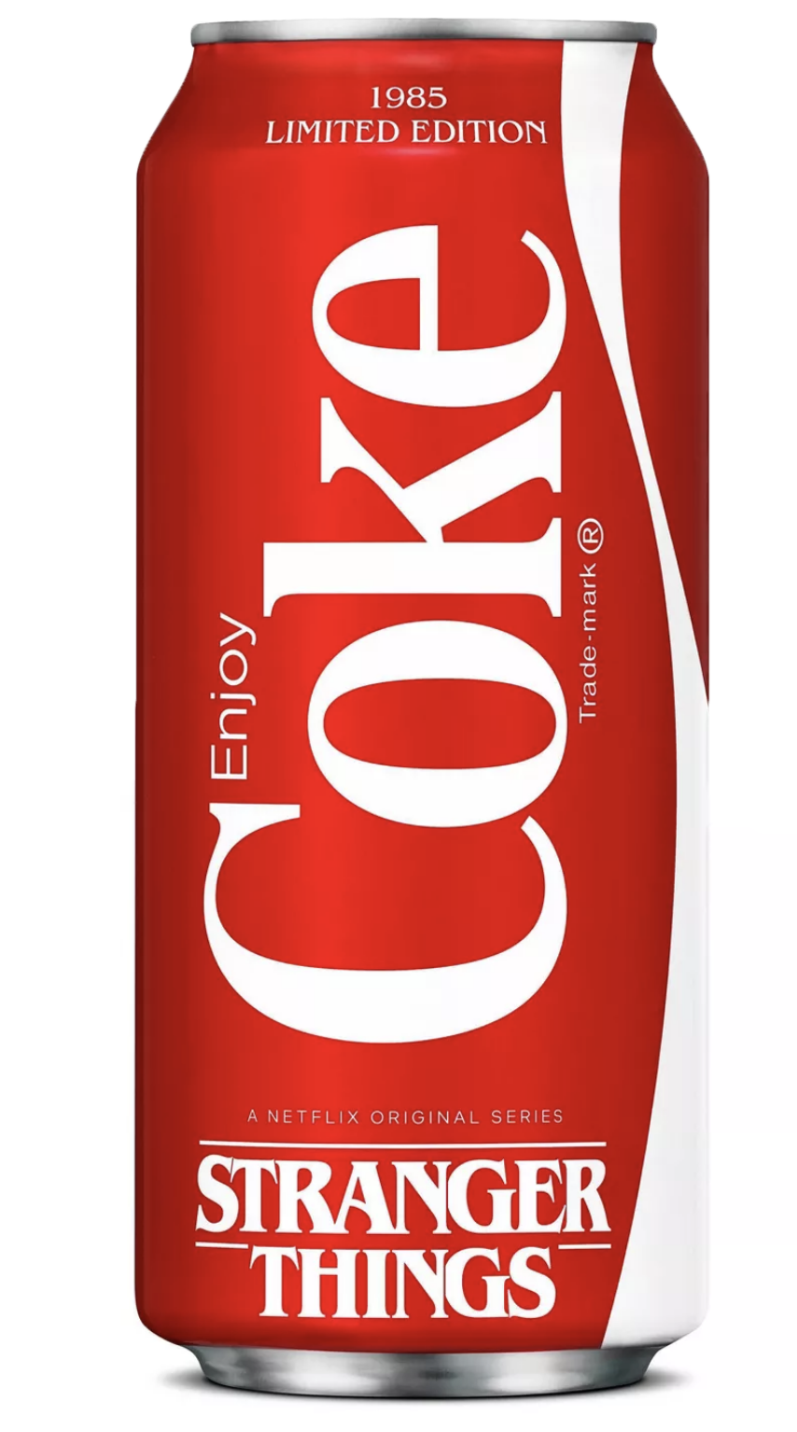
Know Me: AI and Hyperpersonalizing Foodservice
Brands also tapping into nostalgia
©2020 Nourish Food Marketing. Proprietary and Confidential. All Rights Reserved.
Notes:
But, efforts to “Know Me” don’t need to be high-tech. Some companies are successfully tapping into consumer nostalgia with limited-time releases, like the revival of New Coke to coincide with Netflix’s 80s-based series, Stranger Things. Apparently, enough time had passed since one of the most epic marketing failures of all time for Coca-Cola to feel comfortable enough to bring it back.

Slide 15
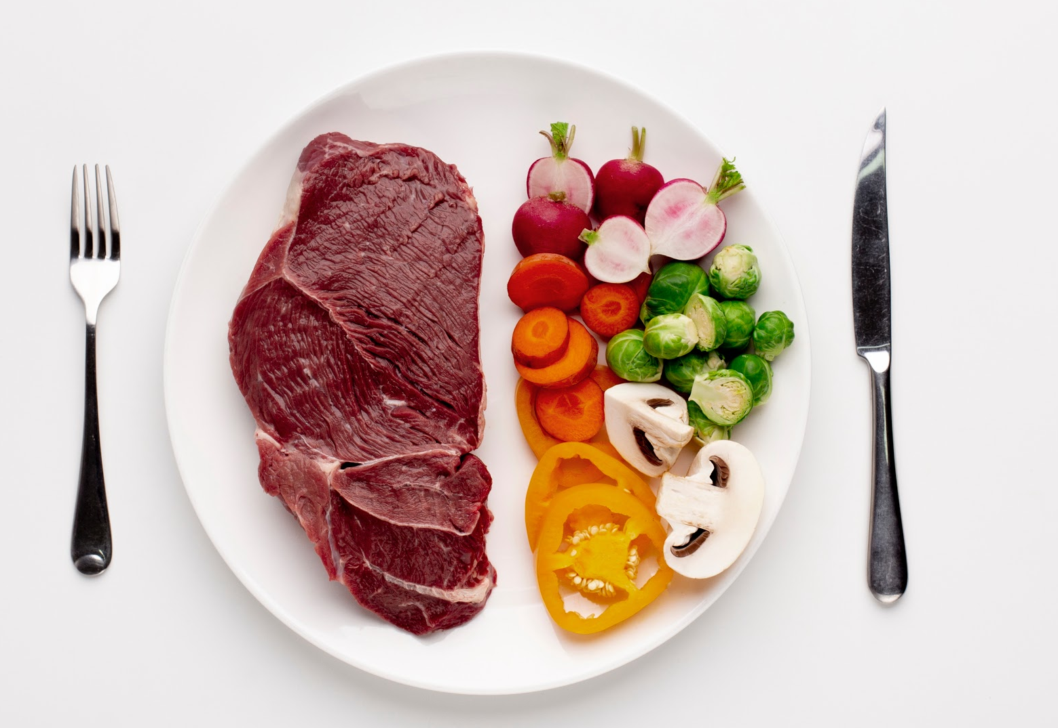
UNPACKAGE ME
SAVE ME

Slide 16
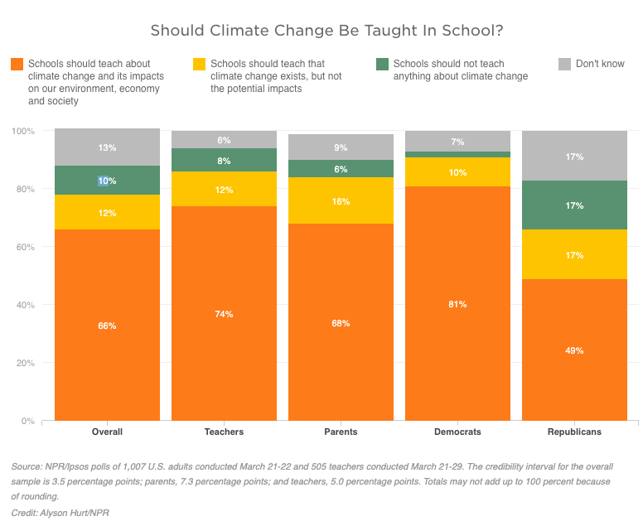
Save Me: Environmental Impact-Based Eating
Climate change top issue in federal election and now top of mind with Australian wildfires
Italy making climate change part of curriculum
Attitudes at tipping tip from aspirational to necessary
©2020 Nourish Food Marketing. Proprietary and Confidential. All Rights Reserved.
Notes:
Climate change emerged as a top issue in the recent Canadian federal election. Will consumers start eating based on environmental or climate impact?
Italy has recently mandated schools to incorporate 33 hours of climate change-related curriculum annually. Students globally are marching against climate change during Fridays for Future protests. And, according to an NPR/Ipsos poll, more than 80% of U.S. parents support teaching climate change in school.
in 2020, attitudes towards sustainable consumption finally reach a crucial tipping point away from aspirational, and towards necessary.
Research conducted with online Canadian members of the Angus Reid Forum (for The Meatless Farm) found that three-quarters (77 per cent) of consumers say they understand the damaging environmental impact of eating red meat and believe it is important to reduce their carbon footprint (74 per cent) – yet only 38 per cent of Canadians reduced meat consumption in order to do so.

Slide 17
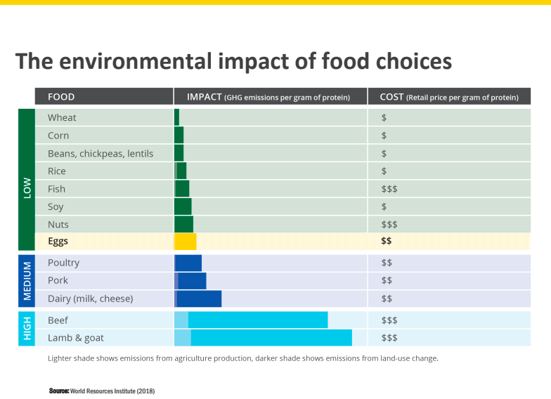
Save Me: Environmental Impact-Based Eating
“Climatarian” diet
Blended products
©2020 Nourish Food Marketing. Proprietary and Confidential. All Rights Reserved.
Notes:
Will this result in a “climatarian” diet where consumers start making food choices not based on food preferences or values but instead based on carbon footprint and lower environmental impact?
Blended or hybrid products (such as mixed plant and dairy, or plant and meat) are starting to emerge as an easier way for consumers to moderate their carbon footprint without giving up their preferred taste for animal products. Rather than doing flexitarian as an “either/or”, it can be done as an “and.” Blended protein is an old concept that recent economic prosperity has taken us away from. During WWII, there were Victory posters in Canada about protein rationing. Boomers’ mothers also mixed hamburger with oats to make the grocery money extend further.

Slide 18
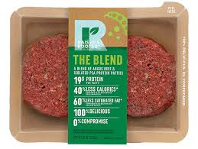
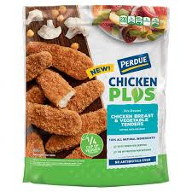
Save Me: Environmental Impact-Based Eating
Tyson’s Raised & Rooted, Perdue’s Chicken Plus
Companies like MLF (carbon-neutral), IKEA (“climate positive”) leading the way
©2020 Nourish Food Marketing. Proprietary and Confidential. All Rights Reserved.
Notes:
In the U.S., Tyson Foods recently launched “Raised & Rooted” shortly after selling its share in Beyond Meat, a totally plant-based processed meat substitute. Perdue, a major chicken processing company, offers a Chicken Plus line of products combining chicken and vegetables.
In Canada, Maple Leaf Foods, one of the largest meat processors in the country, has shifted its vision to focus on becoming “the most sustainable protein company on Earth.” (Note the exclusion of the word ‘meat’.) It has positioned itself for the future by creating a separate plant-based division and building a $300 million in Indiana to support growth. And in November 2019, Maple Leaf announced that it is now a carbon-neutral company, using a combination of operational efficiencies and investments in green environmental project offsets. RBC Capital wrote about potential upside from ESG flow of funds Increasing popularity of ESG investing could drive flow of funds to firms that rate high on those initiatives, and MFI is a leader in our space. ESG (Environmental, Social and Governance) investing refers to a class of investing that is also known as “sustainable investing.” This is an umbrella term for investments that seek positive returns and long-term impact on society, environment and the performance of the business.

Slide 19
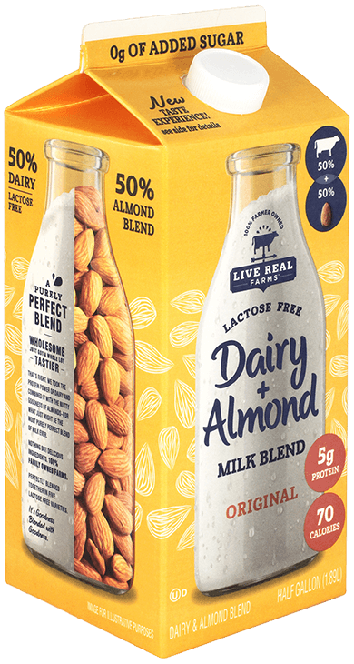

Save Me: Environmental Impact-Based Eating
And “blended” products not just meat
Milk/mylk blends, cheeses
Starbucks CEO telling customers to “go black to go green” or use dairy alternatives
Flexitarianism by product for best of both worlds!
©2020 Nourish Food Marketing. Proprietary and Confidential. All Rights Reserved.
Notes:
You don’t need to choose or make a drastic change - continuum
Live Real Farms is owned by dairy farmers. Their stated goal is to create wholesome, delicious products filled with farm-fresh goodness. Nothing fancy. Nothing artificial. We believe in eating food the way nature intended.
Babybel’s parent recently announced the launch of a hybrid of dairy + plant-based cheese They plan to extend their portfolio beyond cheese by developing hybrid items integrating dairy and plant-based raw materials.
These products leverage the technology necessary to make plant-based products stable, but incorporate real dairy, chicken, or beef to deliver the flavors and textures consumers crave. Given that plant-based ingredients are in short supply, this may be the only way new players can enter the market in the near future.
Starbucks own environmental assessment finds dairy products are the biggest source of its global carbon footprint at 21%. CEO asking customers to drink coffee black or use plant-based substitute!

Slide 20
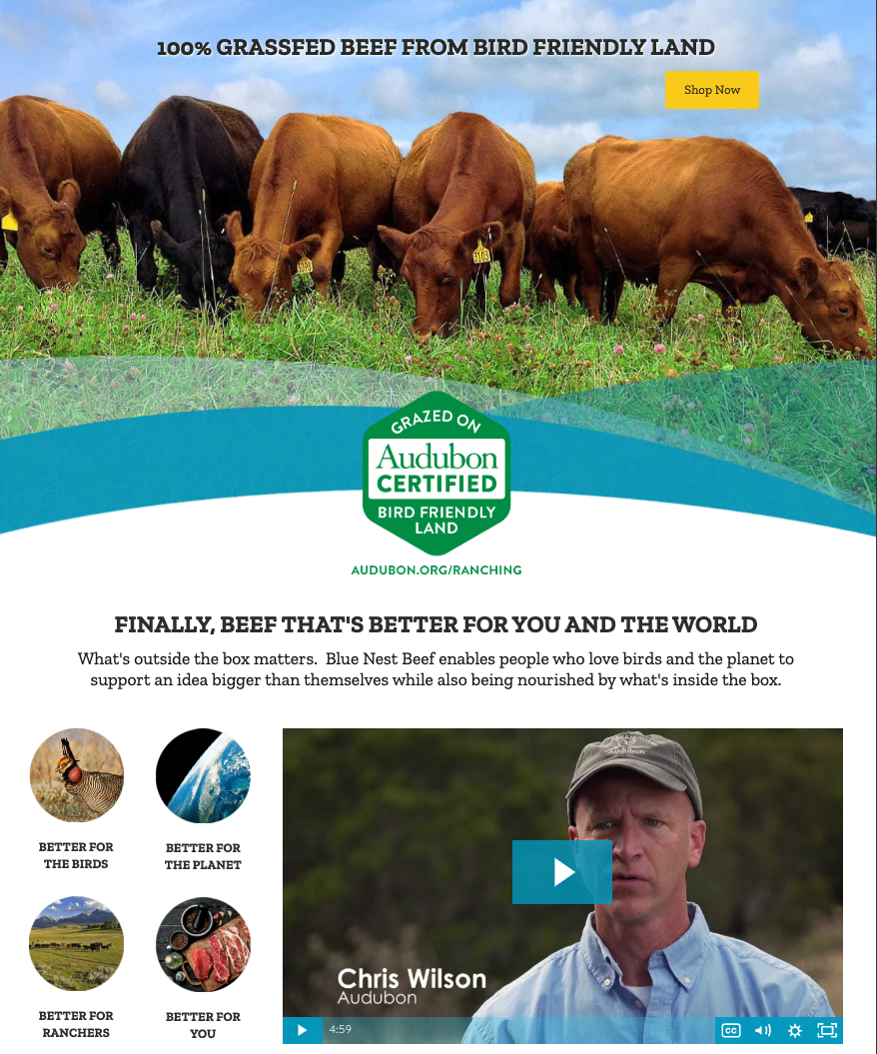
Save Me: Environmental Impact-Based Eating
Move to more sustainable animal proteins
Consumers may trade up to labels like grass-fed
Eat less but “better” and more expensive
©2020 Nourish Food Marketing. Proprietary and Confidential. All Rights Reserved.
Notes:
Meat & dairy hot button for Millennials & Gen Z. Can you trade consumers up to things they view as more premium and sustainable like grass-fed? Less resource intensive ag practices
Blue Nest Beef uses regenerative ag including Audubon certification program for ranchers using bird-friendly practices & grazing methods focused on protecting native grasslands

Slide 21

UNPACKAGE ME
SCIENCE ME

Slide 22
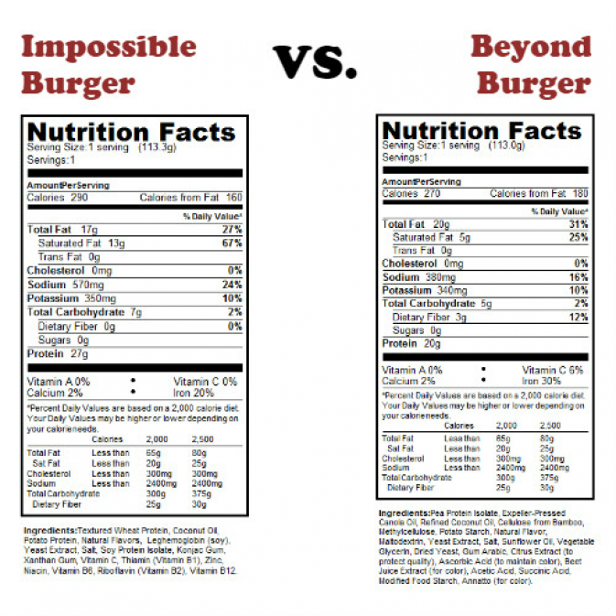
Science Me: Redefining “Real” Food in the High-Tech Era
As plant-based alternatives start to mainstream, expect more conversation around what is “real” food
Eating for planet or personal health?
Consumers have a fear of “food science”. How will consumers react to lab-grown products?
©2020 Nourish Food Marketing. Proprietary and Confidential. All Rights Reserved.
Notes:
We’ve all seen the dramatic growth in plant-based meat and dairy alternatives. According to an August study by Insights West, more than one-quarter (27%) of Canadians indicated they are likely to try a vegetarian diet, with 11% saying they would be willing to go further and pursue a vegan diet. Those numbers rise to 38% and 17% respectively among Canadians 18 to 34. This category is moving beyond niche and becoming part of the mainstream. While plant-based eating is here to stay, we expect more dialogue around what constitutes ‘real food’. It seems ‘plant-based’ has become a very broad term, incorporating everything from vegetables to pulses to grains to seaweed and a Beyond Meat burger. Some are picked straight from the field, and others come out of a lab.
Processed foods have been on the decline as consumers moved to ‘real’ food. Many consumers moved to veganism for health reasons but are now ending up eating a more processed diet. What tradeoffs are consumers willing to make for taste versus health? And what is the role of science in our food going forward? Will consumers who have traditionally rejected GMOs embrace lab-grown meat or milk or seafood? Will they, in turn, embrace other technological advancements in our food system?
As agricultural products like bananas and coffee face supply challenges with climate change, new lab-grown alternatives are being introduced. For example, java brand Atomo has reverse-engineered the coffee bean to develop your morning cup of molecular joe without the beans.
Positivity towards food science also appears to differ based on generation, with Gen Z being the most accepting. 71% of Gen Z respondents were comfortable with tech-assisted food, compared with 56% of Gen X and 58% of Boomers (Source: U.S. Ketchum 2019 Food Tech Consumer Perception Study).

Slide 23
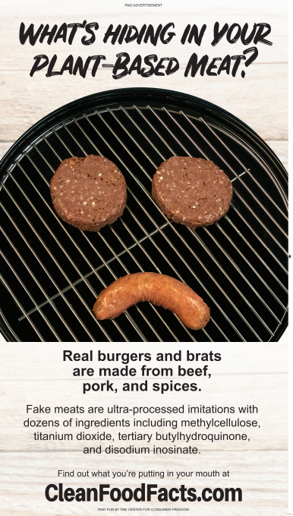
Science Me: Redefining “Real” Food in the High-Tech Era
Campaign funded by The Center for Consumer Freedom
Whole vs. minimally processed vs. ultra processed
Will plant-based products take off like “mylks” in other categories?
©2020 Nourish Food Marketing. Proprietary and Confidential. All Rights Reserved.
Notes:
Go to this website and this is what you see - funded by The Center for Consumer Freedom, a nfp funded by individuals as well as fast food and Tyson
“Plant-based? Vegan? Fake?
Whatever you want to call them, there’s no doubt that alternative meats are skyrocketing in popularity. But take a look at what these foods are made from. Plant-based meat isn’t as healthy as you’d think.
Marketing leads us to believe that “plant-based” burgers consist solely of that—plants. However, the products specifically designed to mimic the texture and flavor of meat contain an extensive ingredient list that’s at odds with the better-for-you image these foods are trying to create.
We’re being duped into eating heavily processed food that contains numerous preservatives, additives, fillers, texturizers, and chemicals linked to cancer. They’re high in sodium, and low in nutritional quality. Consumers should NOT be told that highly processed fake foods are any better for you than the meat products they’re replacing.
The Plant-Based Meat Ingredient Guide exposes the most concerning ingredients in these heavily processed foods, and lets you see exactly which products you’ll find them in.”
There is also growing research on the adverse effects of Ultra-Processed Foods (UPF). A UPF is created when ingredients are pulled apart and reconstituted. Two studies recently published in the British Journal of Medicine link UPFs with higher cardiovascular disease and death. A new theory of obesity claims that eating UPFs changes the brain’s circuitry, making us crave more and more calories.
(Source: Scientific America: Kevin Hall National Institute of Diabetes and Digestive and Kidney Diseases)

Slide 24

UNPACKAGE ME
ENTERTAIN ME

Slide 25
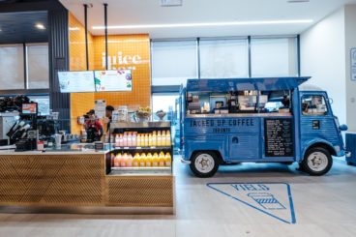
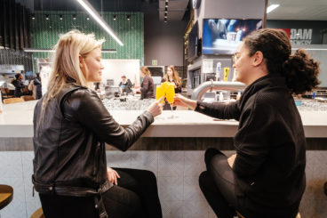
Entertain Me: Evolving Grocery Shopping from Chore to Experience
Centre of store moving to digital, albeit slowly
More perimeter given over to sampling & food demos
Longos LV, Eataly
62% of consumers 18 to 34 enjoy going to these type of venues because they view them as a social occasion
In-store restaurants bring in new customers, adds to bottom line
©2020 Nourish Food Marketing. Proprietary and Confidential. All Rights Reserved.
Notes:
While meal ordering has moved online, grocery has been slower to go digital. Grocery stores will still exist in the future, but they will be increasingly reconfigured for entertainment rather than necessity. Gen Z esp loves IRL experience of shopping. Shoppers will go to physical stores for inspiration rather than to replenish basic household staples. Ontario grocery chain Farm Boy operates smaller-format stores that don’t carry consumer staples, like paper towels, recognizing that these types of categories are the ones to migrate to online purchasing. They position themselves as your second grocery store.
Watch for even more square footage given over to sampling and food demonstrations. Appeals to all ages. Younger attracted to entertainment value. Want to see this trend taken to the max? Visit the newly opened Eataly in downtown Toronto. Or the newest Longos, in Toronto’s trendy Liberty Village, where you can shop while having an alcoholic beverage as the entire 23,000 sq ft store is licenced, a first for a Canadian grocery store. It also features a dine-in Community Zone, acting as a meeting place for local space-challenged condo dwellers - think trendy sports bar with lots of local craft products. As buying food increasingly moves online, there will be a drive to enhance the experience in stores and restaurants beyond just the food and groceries purchased.
y-Pulse research of 5k

Slide 26
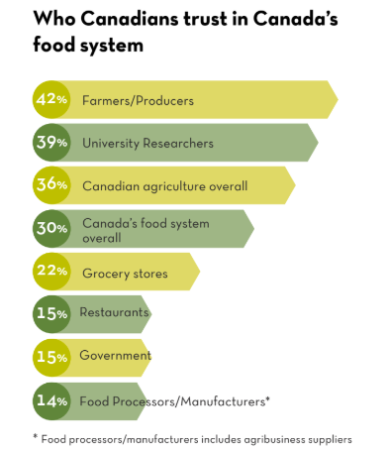
Entertain Me: Evolving Grocery Shopping from Chore to Experience
Consumers becoming disconnected from food sources but want to know more
Farmers & Producers are most trusted
How connect beyond in-store - VR, QR codes
©2020 Nourish Food Marketing. Proprietary and Confidential. All Rights Reserved.
Notes:
Largely because of rampant urbanization, and perhaps our increasingly digital economy, consumers are becoming more disconnected from their food sources. The most recent CCFI 2019 Public Trust Research found that 91% of consumers know little or nothing about modern farming practices. There’s still a glimmer of hope, however, the bridge may be gapped: 60% of Canadians are interested in knowing more about how their food is grown.
Farmers and producers are more trusted as information sources by the public than grocery stores, restaurants, or food processors/manufacturers. There is an opportunity here to capitalize on supposedly divisive digital technology to make a connection. Could augmented reality play a role in bringing the farmer/producer to life at the point of purchase? Can a shopper connect to a VR environment that takes them to the provenance of the food they’re considering? Imagine being transported to a lush coffee plantation in Costa Rica, to eat and drink with your eyes in advance of purchasing.

Slide 27
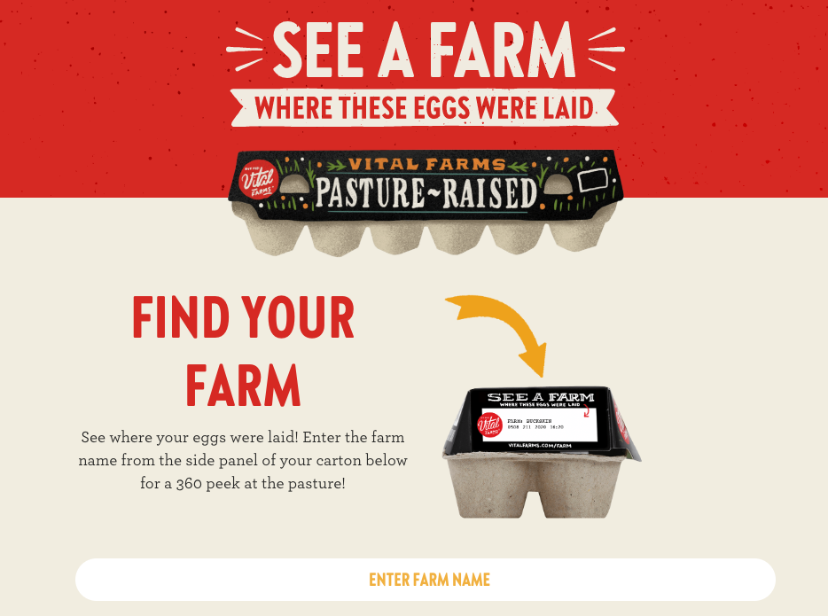
Entertain Me: Evolving Grocery Shopping from Chore to Experience
Vital Farms allows you a 360 peek at pasture your eggs came from
©2020 Nourish Food Marketing. Proprietary and Confidential. All Rights Reserved.
Notes:
Vital Farms is partners with approximately 200 small, family owned farms. The 360° images will be available for every family farm partnered with Vital Farms. The images will be updated at least twice a year.
https://vitalfarms.com/farm/buckskin-acres/ to see in action

Slide 28
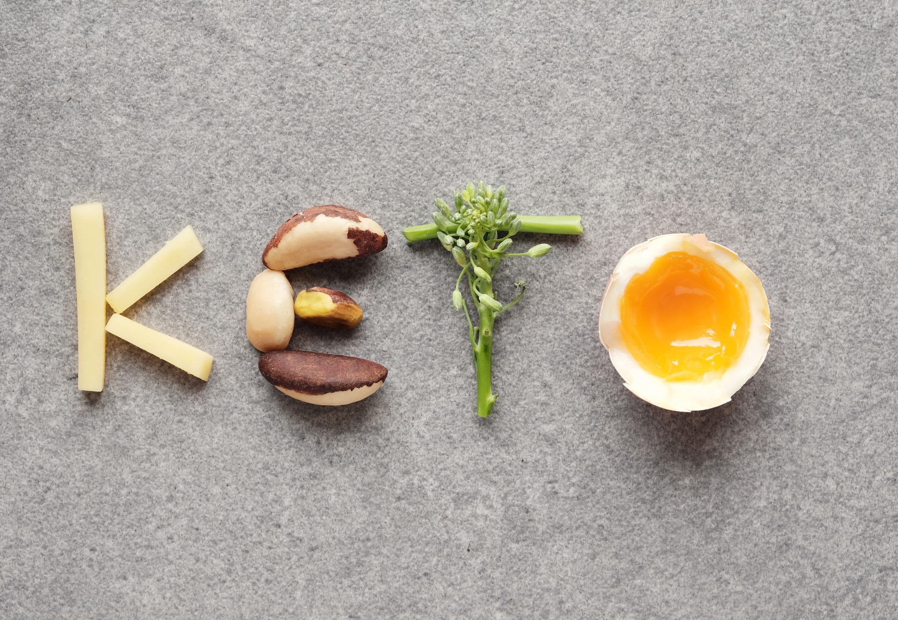
UNPACKAGE ME
KETO ME

Slide 29
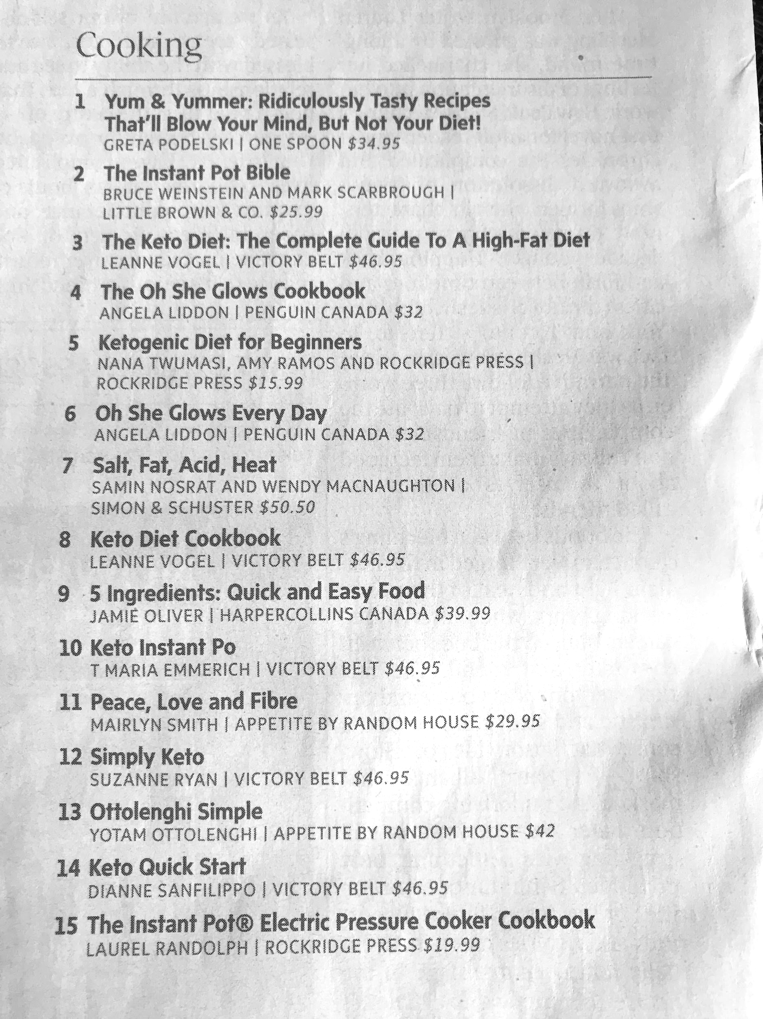
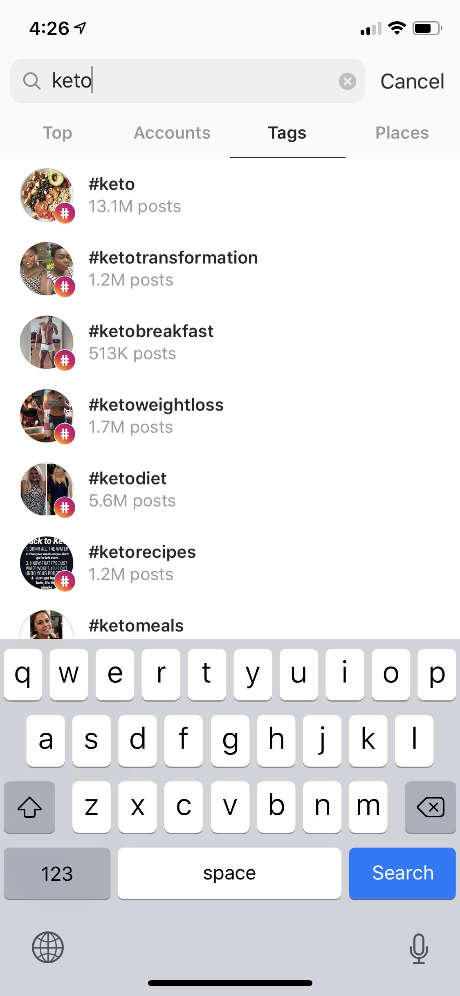
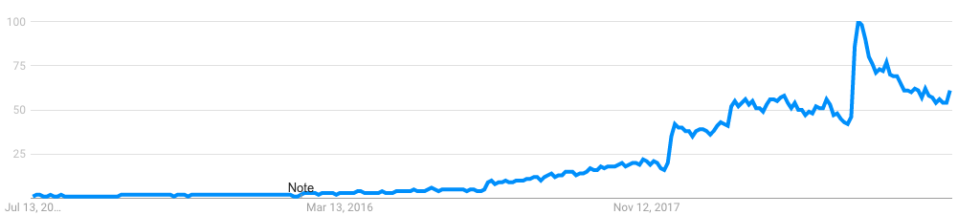
Keto Me: The Evolution of Lifestyle Eating From No-Carb to Slow-Carb
Ketogenic diet remains most popular in North America
“Keto” most googled food-related topic in world
Predicted to remain top diet trend in 2020 BUT new survey suggests more than twice as many Canadians have tried & dropped “Keto diet” than Canadians still on it
©2020 Nourish Food Marketing. Proprietary and Confidential. All Rights Reserved.
Notes:
In last year’s Trend Report, we talked about the Shift to Selective Eating as a way of optimizing both physical and mental performance. The ‘no-carb’ keto diet has led the way with more and more new products entering the market. Interest in this way of eating hasn’t lessened; six of the top fifteen cookbooks on the Canadian best-seller list are about the keto diet. Instagram has 20,000,000+ posts tagged ‘keto’ and related terms. And Google Trends data shows continued strength, with the expected spike at the start of the New Year’s resolution season.
The high fat, moderate protein and ultra-low carb keto diet is likely to remain the top diet trend of 2020, followed by intermittent fasting and clean eating, according to a poll of 1,259 registered dietitians (conducted by marketing and PR agency Pollock Communications and Today’s Dietitian, a trade publication for registered dietitian nutritionists).
New survey from Dalhousie University suggests more than twice as many Canadians have tried and dropped the “Keto diet” than Canadians still on it. http://www.canadiangrocer.com/top-stories/headlines/consumers-cool-on-keto-survey-92276?utm_source=EmailMarketing&utm_medium=email&utm_campaign=Newsletter

Slide 30
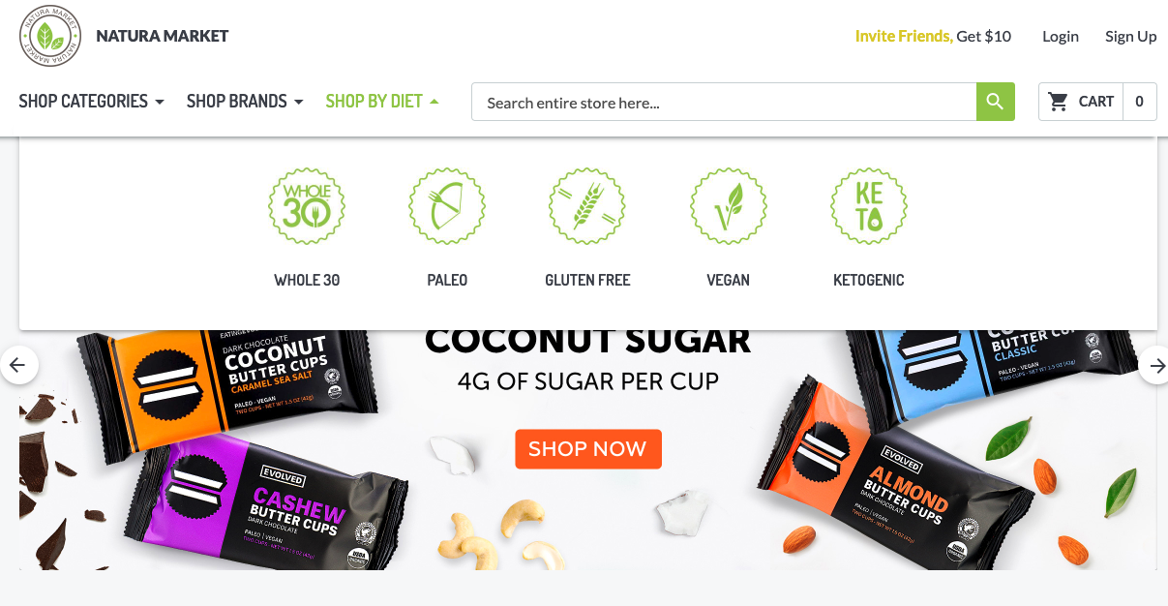
Keto Me: The Evolution of Lifestyle Eating From No-Carb to Slow-Carb
Keto-friendly products
26% of Canadians interested or involved
©2020 Nourish Food Marketing. Proprietary and Confidential. All Rights Reserved.
Notes:
Keto is starting to mainstream and could potentially move into being a lifestyle rather than a diet. Canadian online health food store Natura Market allows you to “shop your lifestyle”, featuring keto-friendly products, as well as other diets like Paleo, gluten-free, and Whole30.
Another recent Dalhousie University poll found that 26% of Canadians had either adopted, tried, or considered trying keto in the past 18 months. That’s a sizable group of consumers. However, it is a very difficult regime to follow and stick with long-term in light of the food exclusions and intermittent fasting. Dietitians are not big fans, as a few healthy food groups are excluded in favour of high fat and protein. However, the diet does seem to get quick weight-loss results.

Slide 31
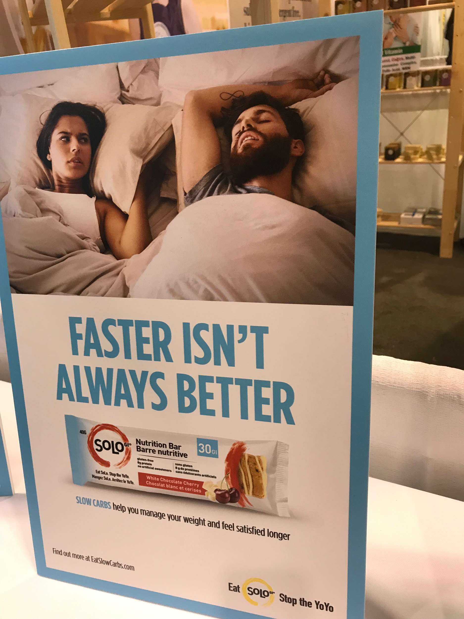
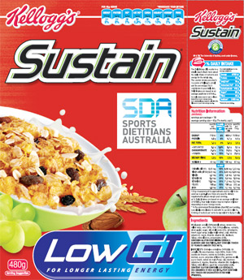
Keto Me: The Evolution of Lifestyle Eating From No-Carb to Slow-Carb
Keto hard to maintain. “Keto friendly” products and sections in Grocery
Move from no to low or slow carbs?
GI labelling exists in Australia
©2020 Nourish Food Marketing. Proprietary and Confidential. All Rights Reserved.
Notes:
While keto is potentially here to stay, could “no-carb” keto be replaced with friendlier “SLOW-carb” products? Will consumers dip in and out of this way of eating by incorporating “keto-friendly” products into their weekly shop? At the recent CHFA Show in Toronto, there were new products that were calling out their GI (glycemic index) numbers on the front of the packaging.
For those that don't know, the glycemic index is a scale ranging from 0 to 100, with 100 being pure glucose, to represent the relative rise in blood glucose level two hours after consuming a particular food. Slow-carb products could offer a more consumer-friendly way to incorporate some of the benefits of a strict keto diet. GI labelling exists in countries such as Australia and there are rumblings that Diabetes Canada is making a second push to convince Health Canada to bring GI labelling here.

Slide 32

Questions?
Sign-up for our newsletter to stay on top of food trends
j@nourish.marketing
lkahn@kahntact.com
linkedin.com/in/jo-ann-mcarthur
Visit our web site to downlaod a copy of the Trend report
https://www.nourish.marketing/
www.Kahntact.com

Slide 33


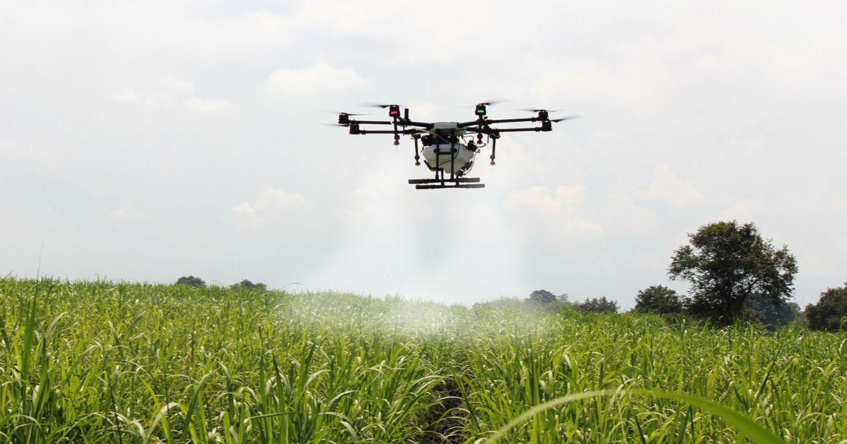

Trends in Canadian Agriculture
Tend to move slower than the consumer marketplace
An older, more traditional, more conservative space
  “I am from Wetaskiwin. You have got to show me”
But when ag goes, it goes quickly
And at times, ag leads the way
Notes:
Blackberry was the #1 phone brand in Canadian ag for many years. Then in less than a year it switched violently to iPhone (and some Android). Drones and autonomous tractors are being used earlier and more aggressively in ag. While ag media habits are still somewhat traditional.

Slide 34
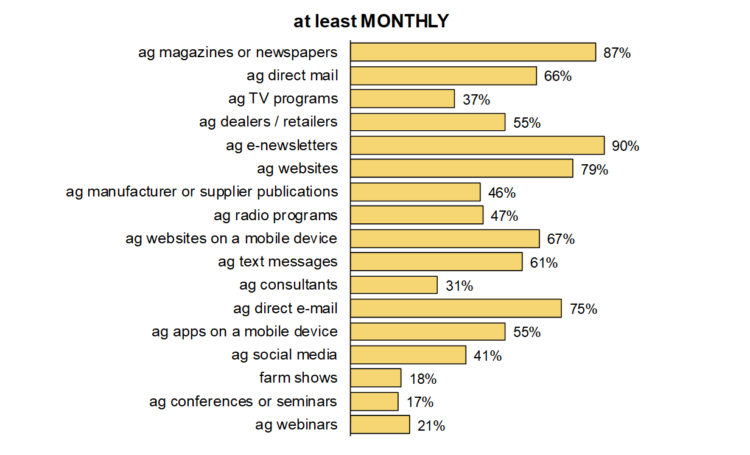
CANADA: Use of media types
Agri Media Committee, 2018 Media Channel Study

Slide 35
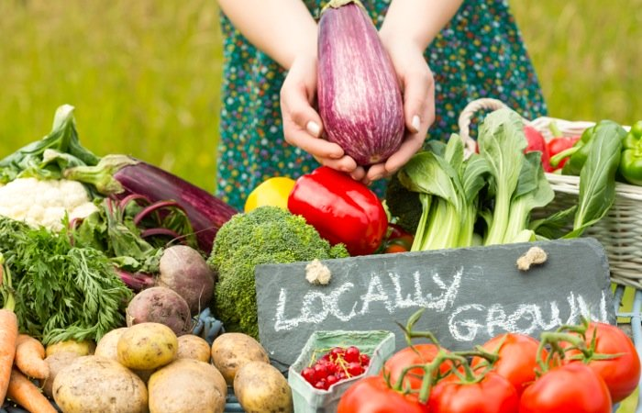
Nourish Me Locally
UNPACKAGE ME

Slide 36
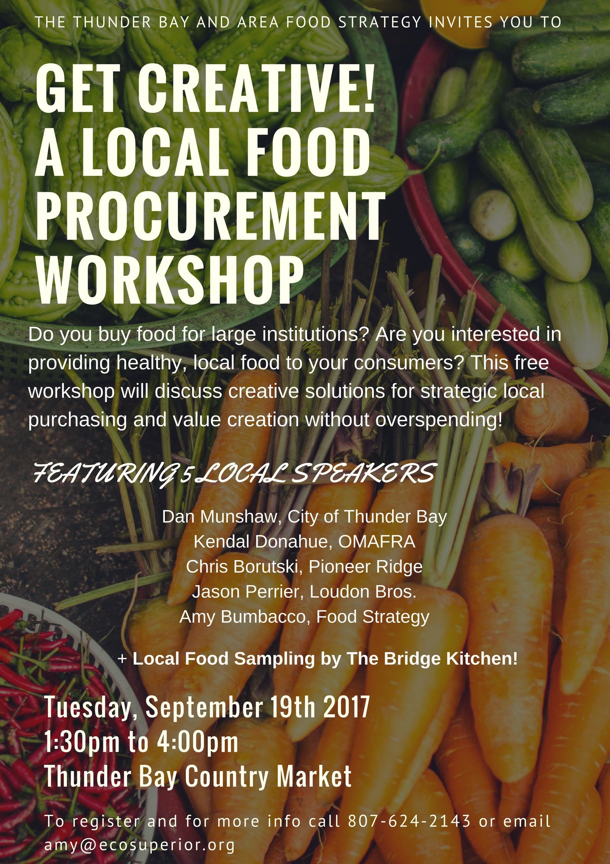
Serving Local Food in Public Institutions
Expectation for eating local is growing in restaurants, on university campuses, hospitals and long-term care homes
One pilot project involving 9 long term care facilities -- Serving Up Local -- switched nearly a quarter of the food served to locally sourced over 2.5 years
Results: 602% increase in Ontario pork servings, a 124% increase in fresh seasonal produce, and 494% increase in provincially-sourced meal entrees
Ontario’s broader public sector institutions spend an estimated $745 million annually on food and beverage -- this is BIG
This reality makes it critical for the facilities to work closely with foodservice providers in the transition to source local
There’s room for the farm story in this equation too!

Slide 37
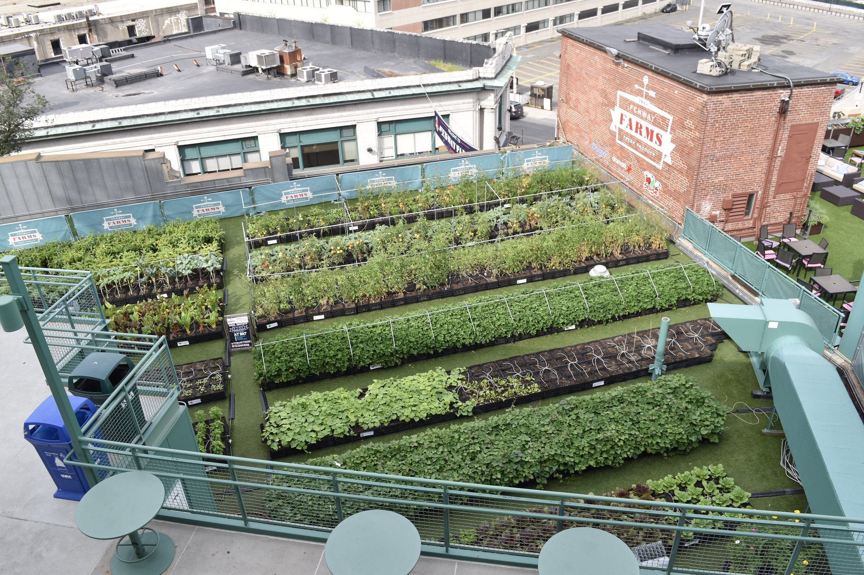
Near Me
UNPACKAGE ME

Slide 38
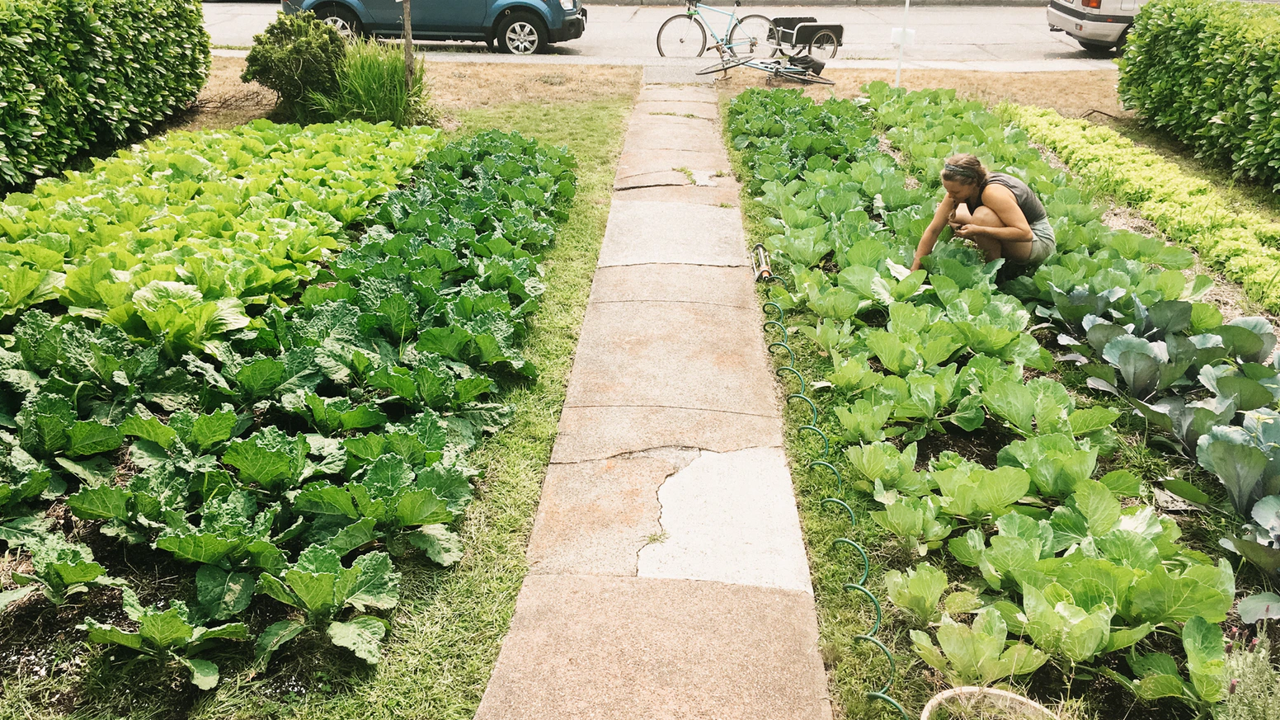
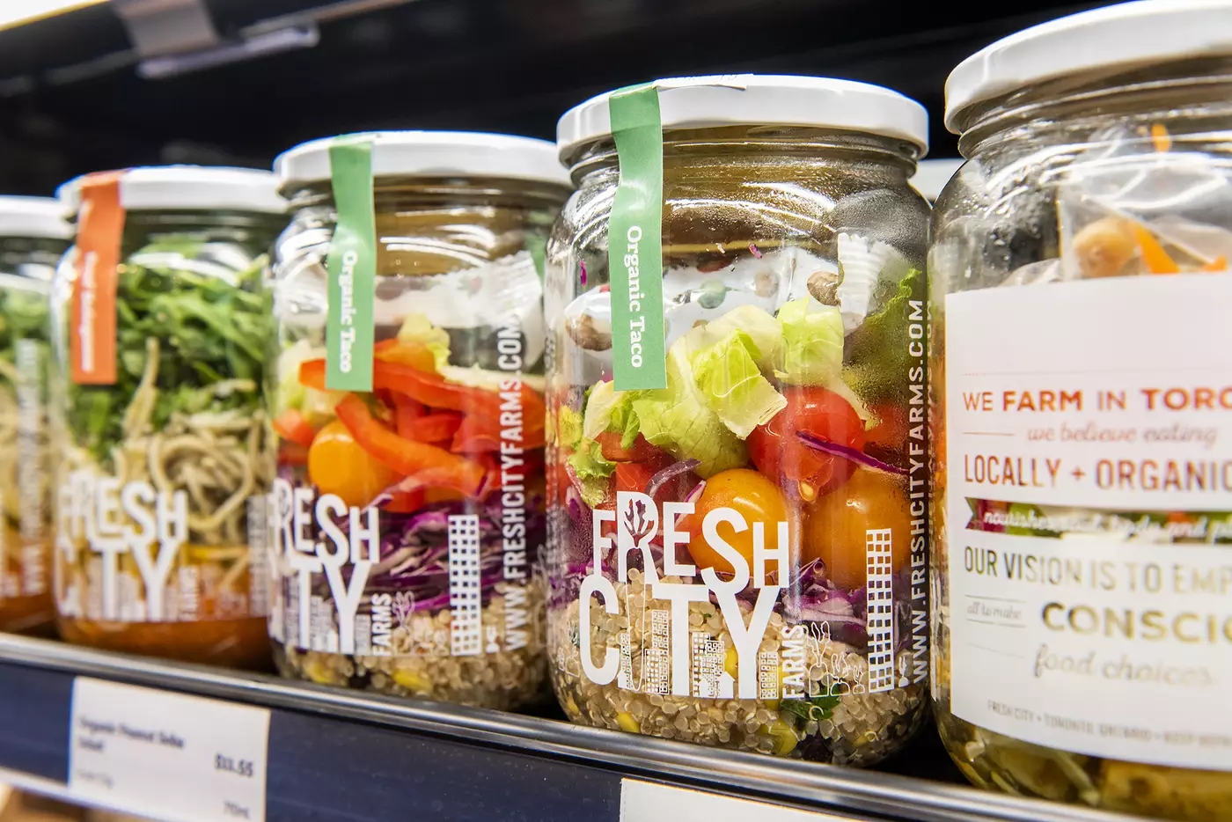
Farming Gets Closer to the Consumer
Growing trend to find innovative ways to bring local food right to where the consuming public is
Consumers increasingly removed from their rural roots but want to know more about their food
Urban “farms” are popping up across the country
Entrepreneurs finding innovative new ways to be involved in producing food, without a traditional rural farm
City Beet Farm - https://www.citybeetfarm.com/
Fresh City Farms - https://www.freshcityfarms.com/
Lady Sara’s Bounty, Guelph

Slide 39
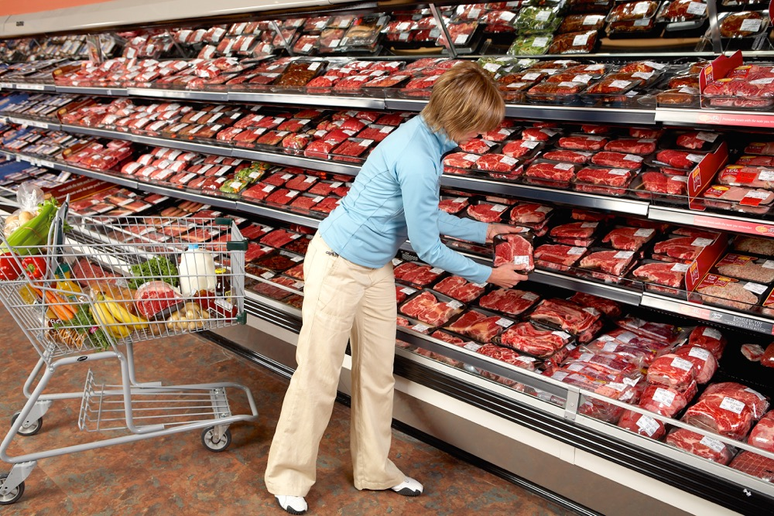
Teach Me
UNPACKAGE ME

Slide 40
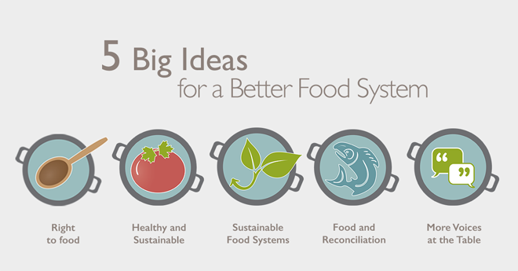
Consumers Want to Know More About Modern Farming Practices
In 2012, more than 90% of respondents to a consumer survey said they knew little, very little, or nothing about Canadian farming practices.
This result has been replicated in subsequent studies, including the 2019 CCFI consumer research report
A majority of survey respondents said they wanted to learn more about modern agriculture -- they aren’t repelled by it; rather, they just don’t understand it
The good news - 35% believe our food system is headed in the right direction (as opposed to 24% who don’t) >> and better than the US where only 26% of consumers think their food system is headed in the right direction
90% of Canadian consumers have moderate to strong concerns relating to food fraud, the practice of mislabelling, adulterating, or counterfeiting food products
Consumers are starting to look more closely at food labels and ask questions about what certain food labels mean

