Slide 1
@mrjustinkingsley

Slide 2
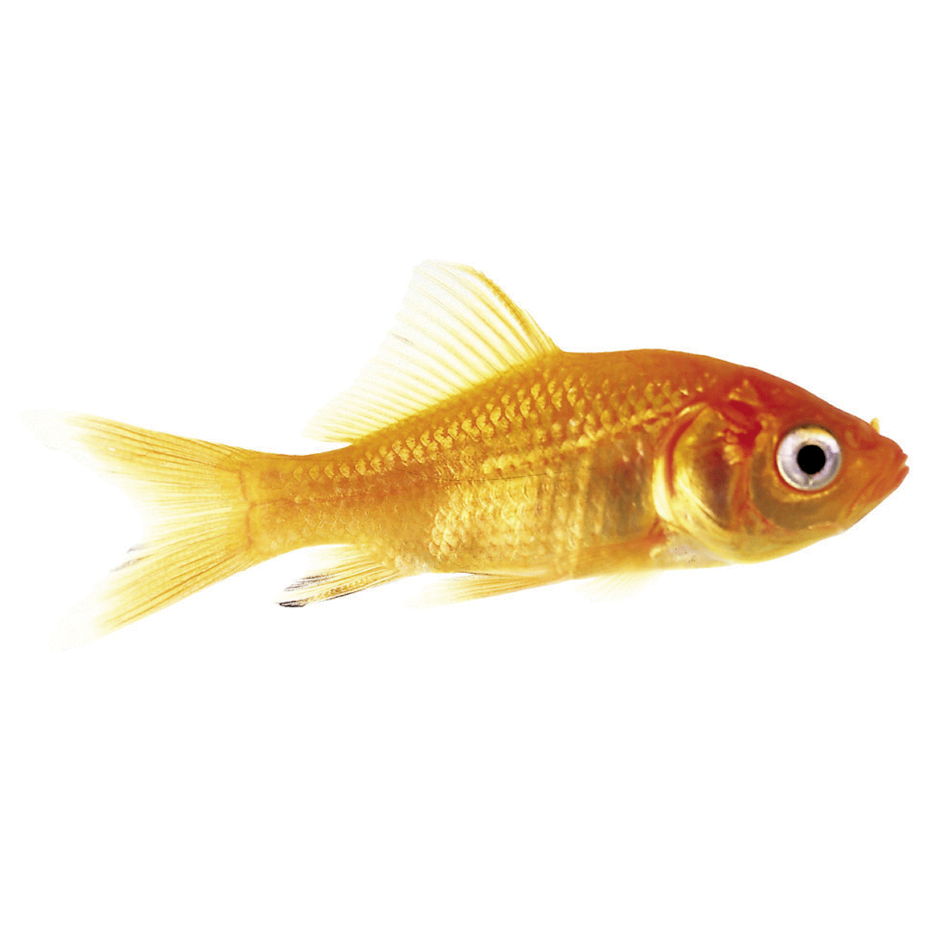
Goldfish

Slide 4
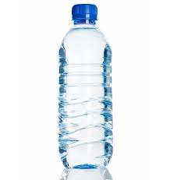
vs

Slide 5
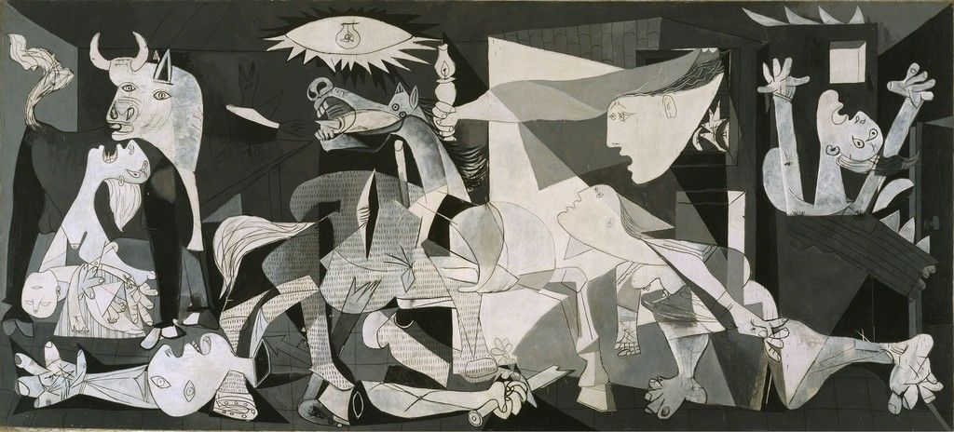

Slide 13
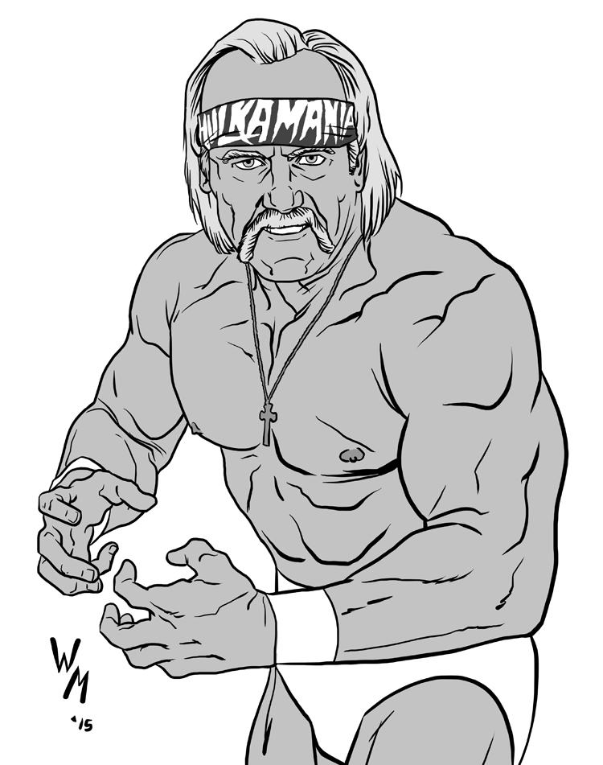

Slide 15
3
33
333

Slide 17
@mrjustinkingsley

