Slide 1



@mrjustinkingsley

Slide 2
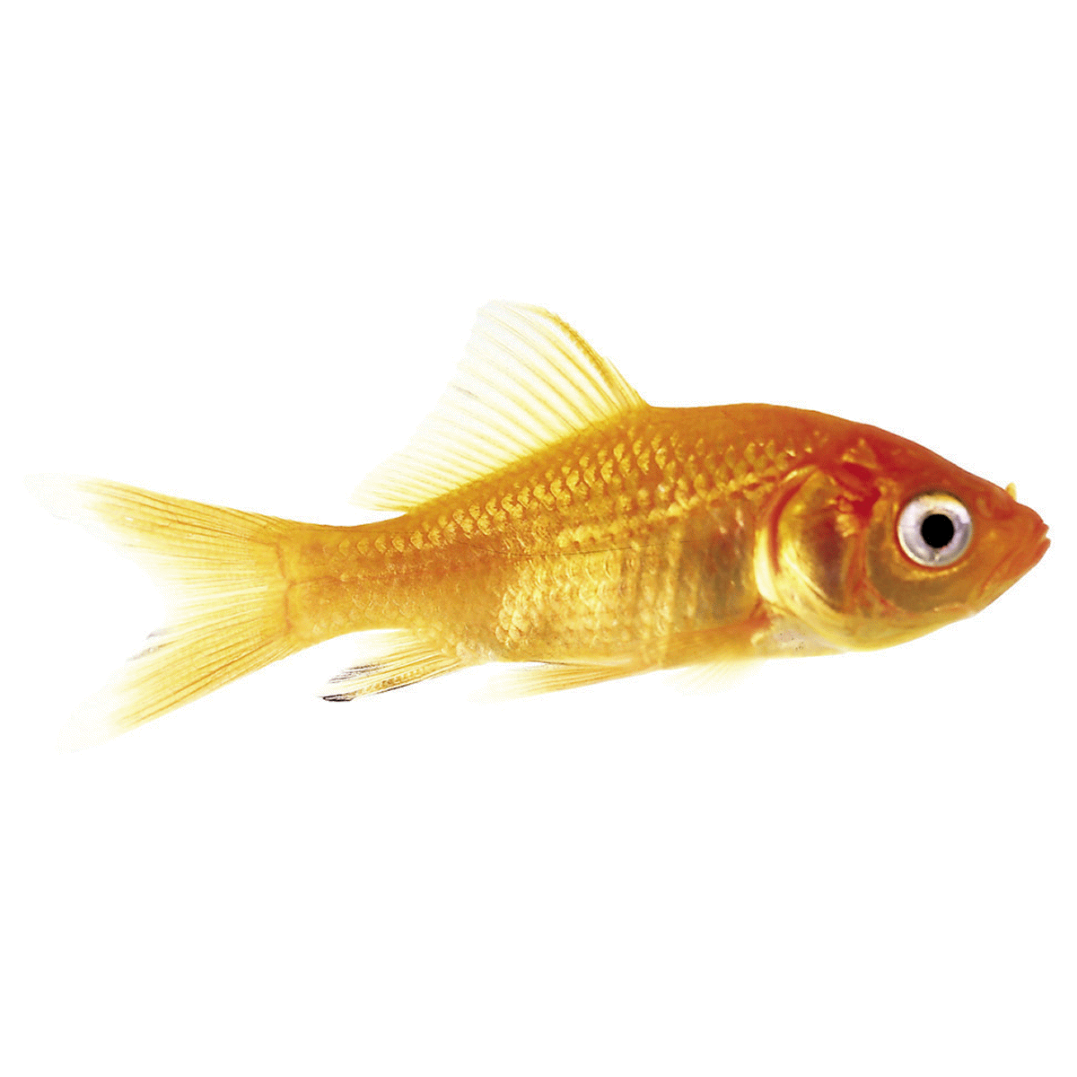
Goldfish

Slide 3


Slide 4
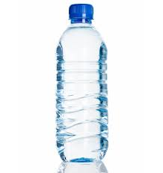

vs

Slide 5
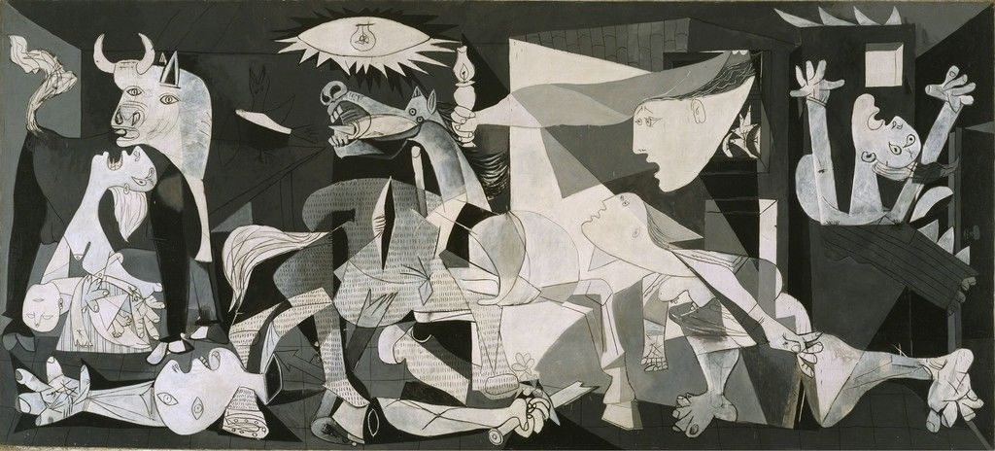

Slide 6


Slide 7


Slide 8



Slide 9


Slide 10


Slide 11


Slide 12



Slide 13
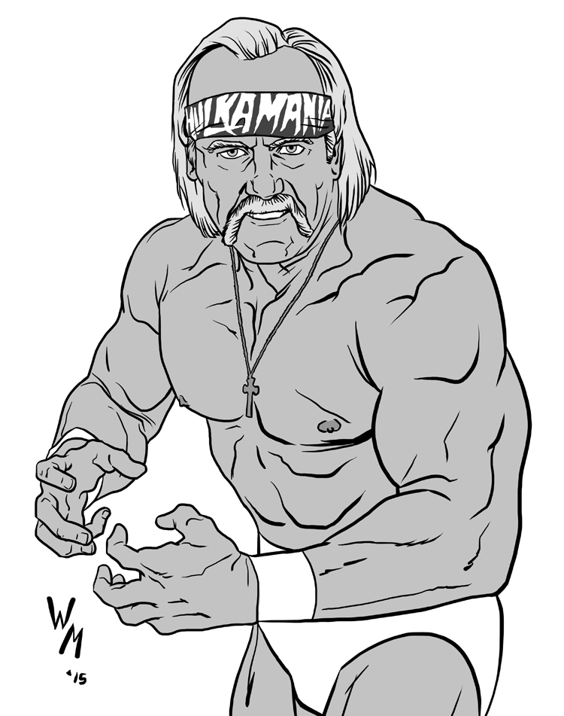

Slide 15
3
33
333

Slide 16


Slide 17

@mrjustinkingsley

