Slide 1
ON GUARD FOR FARMERS
A network of lookouts to protect the mental health of farmers
  Martin Caron
  First Vice-President, UPA
  Ottawa, February 28, 2019

Slide 2
The psychological distress experienced by farmers is a known phenomenon.
2001: Creation of the agency Au Cœur des Familles Agricoles (ACFA)
  Respite home
  Field workers
  2006: Survey and report on the mental health of agricultural producers in Québec (Lafleur and Allard)
  Since 2007: subject increasingly documented
  Specialized articles
  Symposia and conferences
  Research

Slide 3
The psychological distress of farmers is a priority for the UPA.
2015: Adoption of a UPA action plan
  Unanimous resolution of the 320 delegates at the 2015 General Congress
  Commitment of the UPA General Council: 43 representatives from all regions and specializations
  Agreement with the Québec Association for Suicide Prevention to develop training for lookouts on guard for farmers
2016: We take the bull by the horns
  First provincial forum on mental health in agriculture
  First cohort of lookouts receive training for agricultural context

Slide 4
Objectives of the UPA Action Plan
Identify the implications of mental health in agriculture
Reduce the distress felt by farmers and the number of agriculture-related suicides
Work in partnership with the mental, social and health resources in the regions
Mobilize all agri-food stakeholders
Reach out to farmers and farm families who are at risk, often isolated, and in need of social support

Slide 5

Issues contributing to the mental health problems of farmers
Isolation and lack of social support
Physical and mental health condition
Being unaware of available sources of help
Difficulty farmers have in asking for help
Importance of responding appropriately
Photo: www.mauricie.upa.qc.ca/blogue

Slide 6
Training objectives for lookouts on GUARD FOR farmers
Equip agricultural insiders to recognize signs of distress and suicide-prone behaviour among farmers
Train the professionals who regularly interact with agricultural producers to identify people at risk

Slide 7

Lookout Training
7 hours of training
  Developed in partnership with the Association for Suicide Prevention
  Adapted to the agricultural setting
  Training given regionally
  57 trainers across Québec
  Training available in all regions

Slide 8
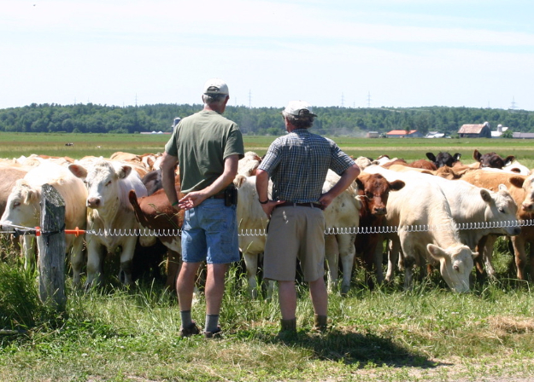
Role of Lookouts
Identify vulnerable individuals
Check for suicidal ideation
Encourage asking for help
Forward information to the designated social worker
Lookouts must act, but not overstep their bounds.
Photo: TCN archives

Slide 9
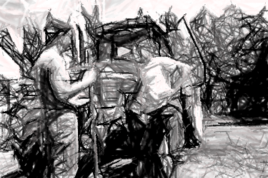
Realistic expectations of lookout intervention
  Allow the person
  To talk about what they are going through
  To recognize and respect their suffering
  To be valued
  Encourage the person in distress
  to take steps

Slide 10
Who are the lookouts?
  Lookouts are selected based on their proximity with farmers
  Veterinarians
  Agrologists
  Accountants
  Account managers
  Inseminators
  Advisors
  Farmers
  Etc.
  The lookouts are contact persons that farmers are likely to speak to in confidence.
637 lookouts trained
from April 2016 to April 2018

Slide 11
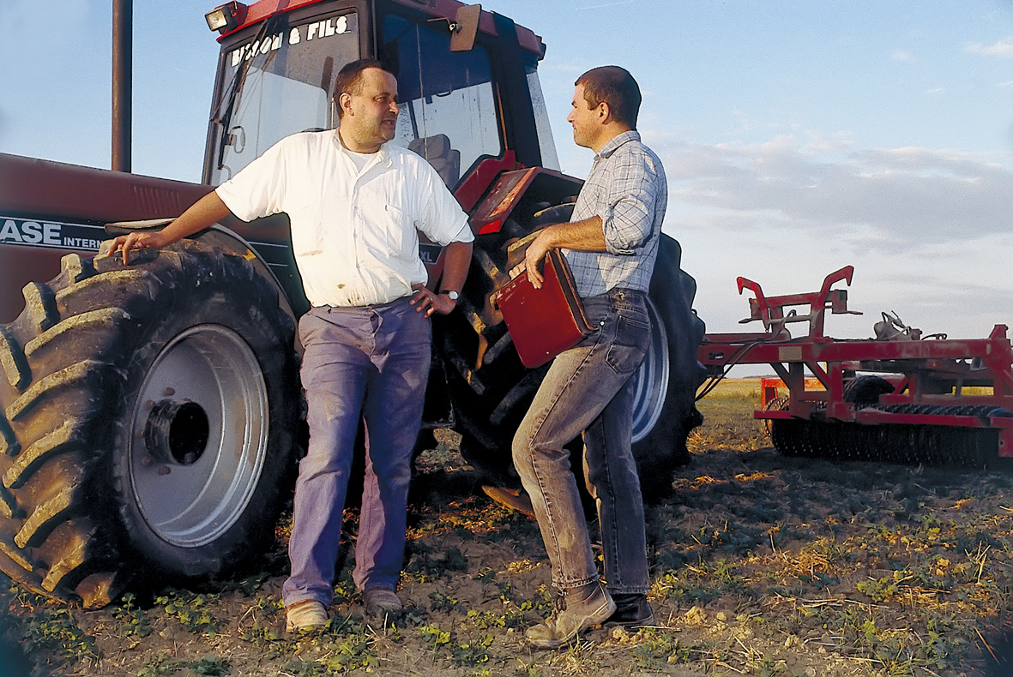
Rules for lookouts
  Be on the lookout during the normal course of work
  Be in contact with farmers
  Ask farmers about how they are doing and what they intend to do
  Preserve confidentiality
Photo: http://www.onisep.fr

Slide 12
Expected results
  Taboo issues are taboo no more.
  Distress, mental illness, professional burnout are talked about.
  Fewer farmers are living in distress.
  Suicide rate in agriculture is reduced.

Slide 13
Support for lookouts
  Their anonymity is preserved.
  They are paired with a designated social worker.
  They receive information updates from trainers.

Slide 14




Partners
  Québec Association for Suicide Prevention
  Regional suicide prevention centres
  Au Cœur des Familles Agricoles (ACFA)
  Integrated Health and Social Services Centres

Slide 15
THANK YOU!
To the UPA’s elected representatives and employees who have moved this project forward
To the Québec Association for Suicide Prevention for its openness and support
To the community organizations and health network for their collaboration
To everyone enlisted in preserving mental health in agricultural settings
To the lookouts on guard in the shadows
To the Canadian Federation of Agriculture for awarding us its Brigid Rivoire Award for Champions of Agricultural Mental Health

