Slide 1
Macro Trends in Agricultural Equipment – Canadian Federation of Agriculture
February 2019

Slide 2
Four Major Trends
Technology
Farm Structure Change
Service-Based Economy
FOUR MAJOR TRENDS
Consumer Awareness, Sustainability, Transparency

Slide 3
No surprise: Operators on farms in Canada continue to get older.
Principal Operator Land Owners in Canada:
6 farmers over 65 for every 1 farmer under 35
5 male operators for every 2 female operators
Source: Statistics Canada

Slide 4
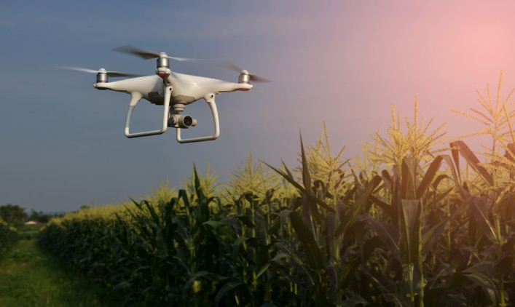
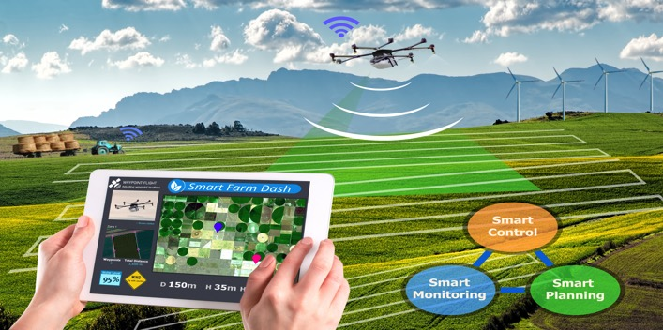
10 Year Trend: The current farmland owning/renting model will evolve gradually. 25 Year Trend: A different story.
No major shifts in farm structure. Large farms continue to get larger, primarily through cash rent. Operators get older, but there is not a mass exodus due to retirement. Most land remains in families; corporate land ownership continues to grow, but remains minor compared to family ownership.
Changing Farm Structure
Average age of a farmer reach age 60+, but they continue to farm. No significant changes in the owner/operator of land.
Most land transfers remain in the family and the amount of land owned by absentee or retired land owners increases. Succession planning intensifies and plans are implemented.
Notes:
In 2011, 36.8 million acres, or 23% of the year’s total farmland, had been rented or leased. Just over 40.1 million acres (or one-quarter of total ag land) was farmed on rented or leased land in 2016. That’s a 2% increase in rented land as a proportion of all ag land in Canada between 2011 and 2016, and a 9% increase in the period’s rented farmland acres.

Slide 5
Four Major Trends
Technology
Farm Structure Change
Service-Based Economy
FOUR MAJOR TRENDS
Consumer Awareness, Sustainability, Transparency

Slide 6
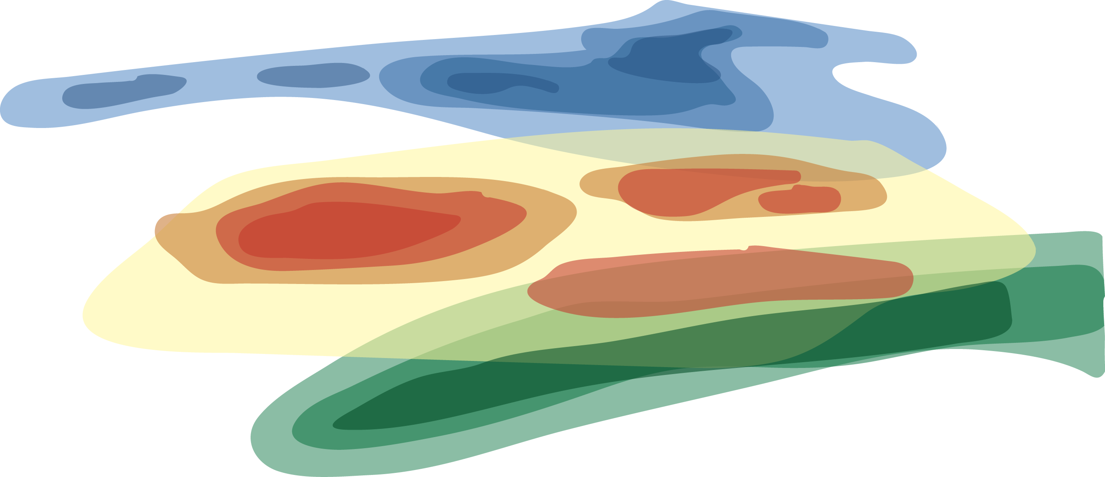
Gaining momentum in 2014, ag tech startups have raised over $550 million in the last five years.
ANALYZING SATELLITE IMAGES
IN-FIELD MONITORING
ASSESSING CROP/SOIL HEALTH
AGRICULTURAL ROBOTS
PREDICTIVE ANALYTICS
Source: https://www.cbinsights.com/research/ai-robotics-agriculture-tech-startups-future/

Slide 7
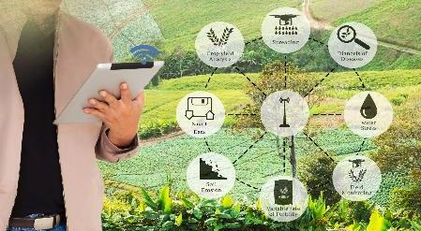
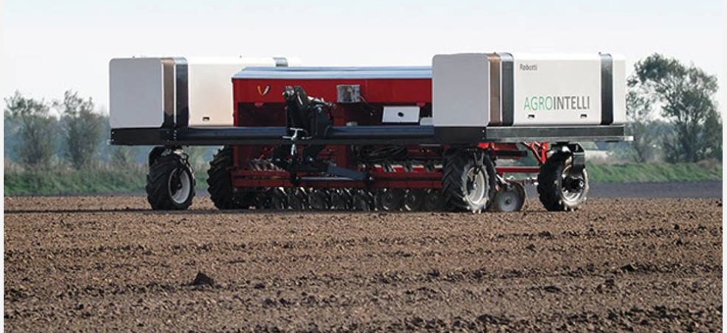
10 Year Trend: Precision Ag will replace crop protection and traits as the center of gravity for crop production.
Operators look for a single enterprise platform to collect, organize and manage their operation. Who will own this platform is yet to be determined.
All categories of Precision Ag tools and technology are moving toward full adoption.
Look for new entrants with no value chain equities to enter agriculture with a platform or new solutions.
Technology and Artificial Intelligence
Who the grower shares their data with is the “Trusted Advisor” – historically a difficult area for ag equipment to operate in now opens up.
Crop science companies attempt to “own the platform”, but are encumbered by the disruption of their core businesses.

Slide 8
Four Major Trends
Technology
Service-Based Economy
Farm Structure Change
FOUR MAJOR TRENDS
Consumer Awareness, Sustainability, Transparency

Slide 9
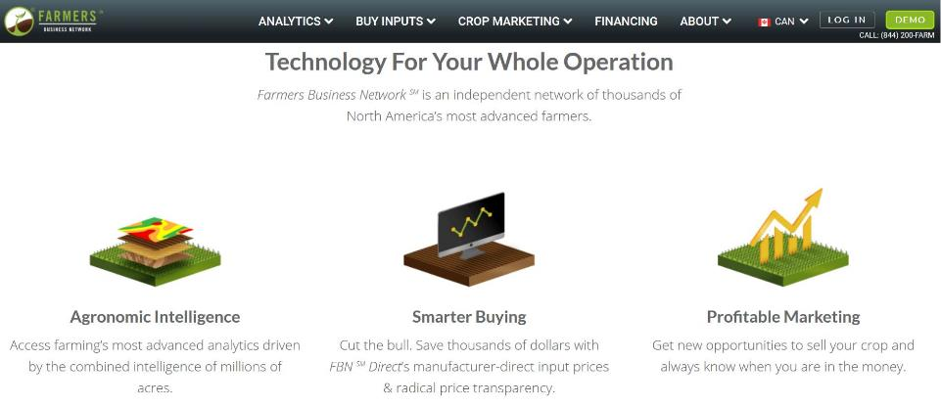
Amazon. Netflix. Uber. What are the market disruptors in Agriculture?
Crop science has a firm grasp on all levels of the analysis and insight.
Ag equipment owns the precision application for the grower. They could capture the decision.
Crop science and the ag retail network currently own the crop production relationship.

Slide 10
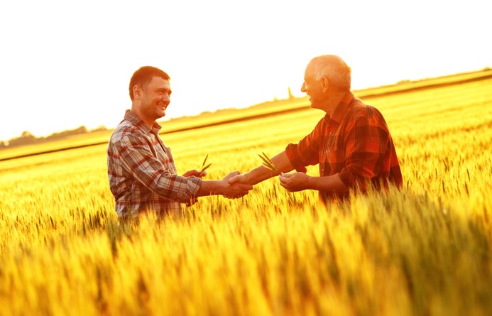
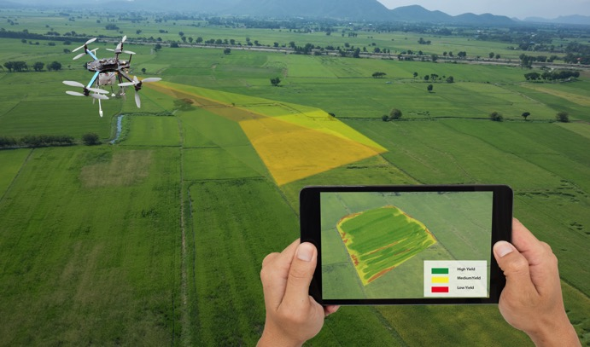
10 Year Trend: The character of service begins to change.
Ag equipment suppliers are challenged to recruit and retain the type of talent required to maintain autonomous power units, drones, Precision Ag technology. At the same time, more maintenance will be conducted by dealers and less by operators.
Service-based Ag Economy
The ability to print parts at dealer locations becomes practical as equipment becomes smaller and made from alternative materials.
New equipment rental arrangements emerge.

Slide 11
Four Major Trends
Technology
Farm Structure Change
Service-Based Economy
FOUR MAJOR TRENDS
Consumer Awareness, Sustainability, Transparency

Slide 12
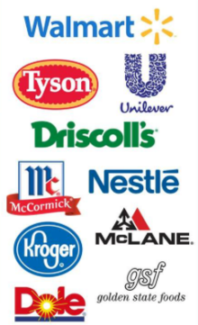
Big food companies are investing in blockchain as a long-term solution to supply chain visibility and traceability in the food industry.
BLOCKCHAIN IN FOOD?
A retailer would know their supplier’s suppliers
It allows specific products to be traced, which would help to reduce food waste.
Contaminated products can be easily and quickly traced, while safe foods would remain on the shelves and not be sent to landfills.
Prior to using blockchain, Walmart conducted a traceback test on mangoes in one of its stores.
It took six days, 18 hours, and 26 minutes to trace mangoes back to its original farm.
Using blockchain, Walmart did it in 2.2 seconds.
Source: https://app.cbinsights.com/research/blockchain-grocery-supply-chain
https://theconversation.com/how-blockchain-technology-could-transform-the-food-industry-89348

Slide 13
10 Year Trend: Blockchain technology (or related technology) will be widely adopted by the food supply chain.
Consumer food companies successfully implement blockchain and bring the supply chain with them.
Transparency in the agri-food sector drives a higher level of accountability for safety, fairness, and sustainable farming practices.
Growing Consumer Awareness, Sustainability, and Transparency
Influencers, to include consumer food companies, continue to confuse organic, GMO-free, vegan-friendly, etc. with healthy, sustainable food.
Highly-educated consumers continue to be influenced by various media forces on the evils of some agricultural practices.

Slide 14
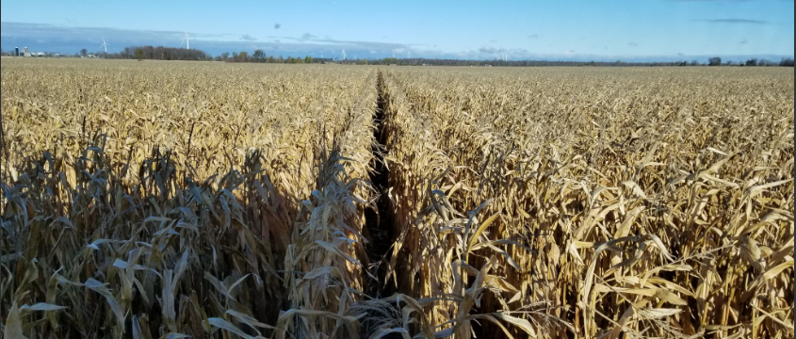
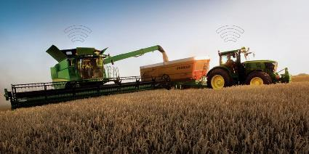
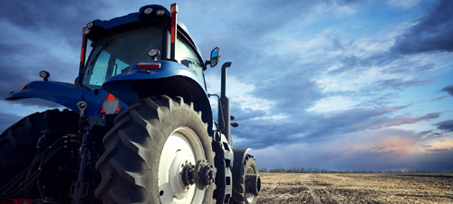
For further information about this report
Howard Mains
AEM Public Policy Advisor, Canada
T: 613.696.0860
E: hmains@tactix.ca
www.aem.org

