Slide 1


PUBLIC TRUST PERFORMANCE METRICS
Public Trust Steering Committee │ March 20th Workshop
Jean-Michel Couture, M.Sc.
Associate, Project Director

Slide 2


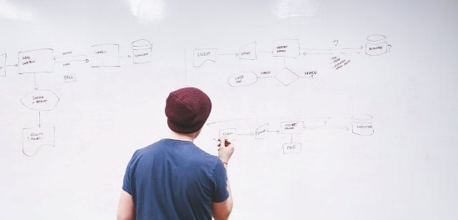

Table of content
1
Context and Project Objectives
2
Proposed Framework
3
How it Works
4
Conclusion and next steps

Slide 3

Context and Project Objectives

Slide 4

A clear call to action
It has been established that to build and maintain trust, it is necessary to:
Do the right thing
Provide proof
Communicate the right messages to the right audience
And operate on a foundation of transparency and with a commitment to continuous improvement

Slide 5









A growing number of actors, platforms, and initiatives
In addition to
On-farm certifications
CSR
reporting
Industry
standards
LCA-related
projects
Notes:
So we need to ask ourselves – is this efficient? And how do we measure the effectiveness of these efforts related to earning trust? And how do we measure the collective efforts for the whole food system?

Slide 6
The challenges
1) How to ensure alignment and consistency?
Experience has demonstrated that individual initiatives are a necessary, albeit insufficient, condition to build and maintain trust over time
The food system is comprised of many individual parts
  Operationally, each part works individually
  However the whole food system or big components of it can be impacted by the actions or lack thereof from individual players
A more collective, consistent, and coordinated approach is needed to…
Streamline efforts | Promote effective practices
Build synergies | Break down silos
Avoid duplications | Ensure continuous improvement
Notes:
“I feel like there are too many different messages, or similar messages coming from too many voices”

Slide 7
The challenges
2) How to measure success?
There is no clear and consistent way to determine if, and to what extent, the activities undertaken in the overall industry and individual groups
to build trust are effective
Individual organizations are facing several challenges
What to measure?
How to compare?
What to improve?
What should I do to effectively build trust?
How to measure performance?
Am I leading the way or lagging behind in how I deal with public trust? In which area(s)?
What action(s) should be implemented first – and how?
What resources can I build on?

Slide 8

Project objectives
To provide a recommended performance metrics approach to allow the agriculture and food sector, as well as the individual participants, to better understand and measure the outcomes of their efforts over time with regard to public trust
The performance metrics system should provide a consistent yet flexible approach that enables to:
Determine If public trust is progressing forward, as well as why and where progress is occurring
Establish how well organizations – individually and as a system – perform in relation to the Public Trust Framework
Report this performance to stakeholders in a clear and consistent manner

Slide 9
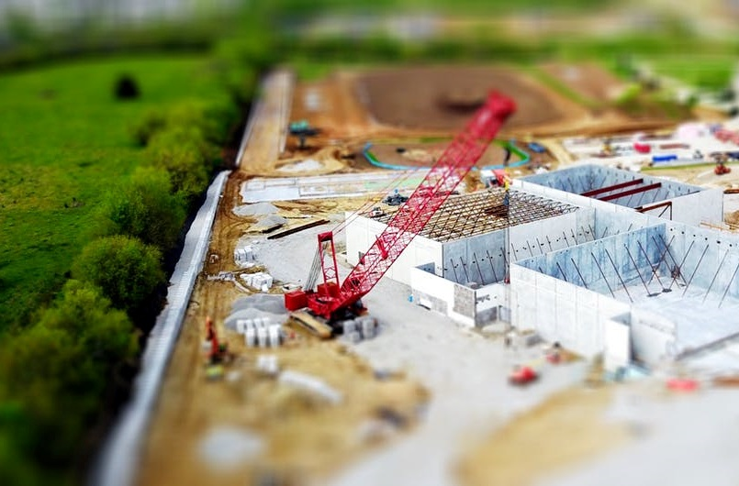
Activities
Review the literature on public trust measurement methodologies and list organizations using such metrics
Review how the PTSC Trust Framework
is used by organizations
Propose a set of metrics and an evaluation tool to measure public trust on a national, sector-wide level
Identify data sources that could be used to assess the sector’s performance with regard to public trust
Assess the feasibility of using computer- and/or web-based applications to capture and publish data

Slide 10
Proposed Framework

Slide 11
Overall structure
The framework is comprised of a set of indicators associated with questions that are to be used to measure performance regarding:
Overall strategic approach
How is public trust being dealt with through strategies and decision-making processes?
Doing the
right thing
What is being done to address public trust issues, prove claims, and improve performance over time?
Communicate with results
How are efforts and achievements coordinated and communicated?

Slide 12
Overall structure
SECTION (3)
e.g. Overall strategic approach
INDICATOR (≈30)
e.g. Stakeholder identification
QUESTION (≈30 + several sub-questions)
e.g. Have you identified the stakeholders / interested parties in your activities?
The proposed framework is a work document

Slide 13
Topics covered
Overall strategic approach
How is public trust being dealt with through strategies and decision-making processes?
Awareness of regulations and
industry requirements
Risk assessment and due diligence
Stakeholder identification and consultation
Awareness of and alignment with agri-food
sector initiatives
Access to knowledge and expertise
Strategy and action plan
Roles and responsibilities

Slide 14
Topics covered
Doing the right thing
Identification of new and/or innovative practices
Research and innovation
Training
Development and/or contribution to the development of tools
Impact assessment
Implementation and adoption of tools and best management practices
Compliance check
Crisis management
What is being done to address public trust issues, prove claims, and improve performance over time?

Slide 15
Topics covered
Communicate with results
How are efforts and achievements coordinated and communicated?
Communication plan
Development of key messages
Alignment and collaboration with other initiatives
Delivery of your messages and public engagement
Reporting
Evaluation of the outcomes

Slide 16
How it Works

Slide 17
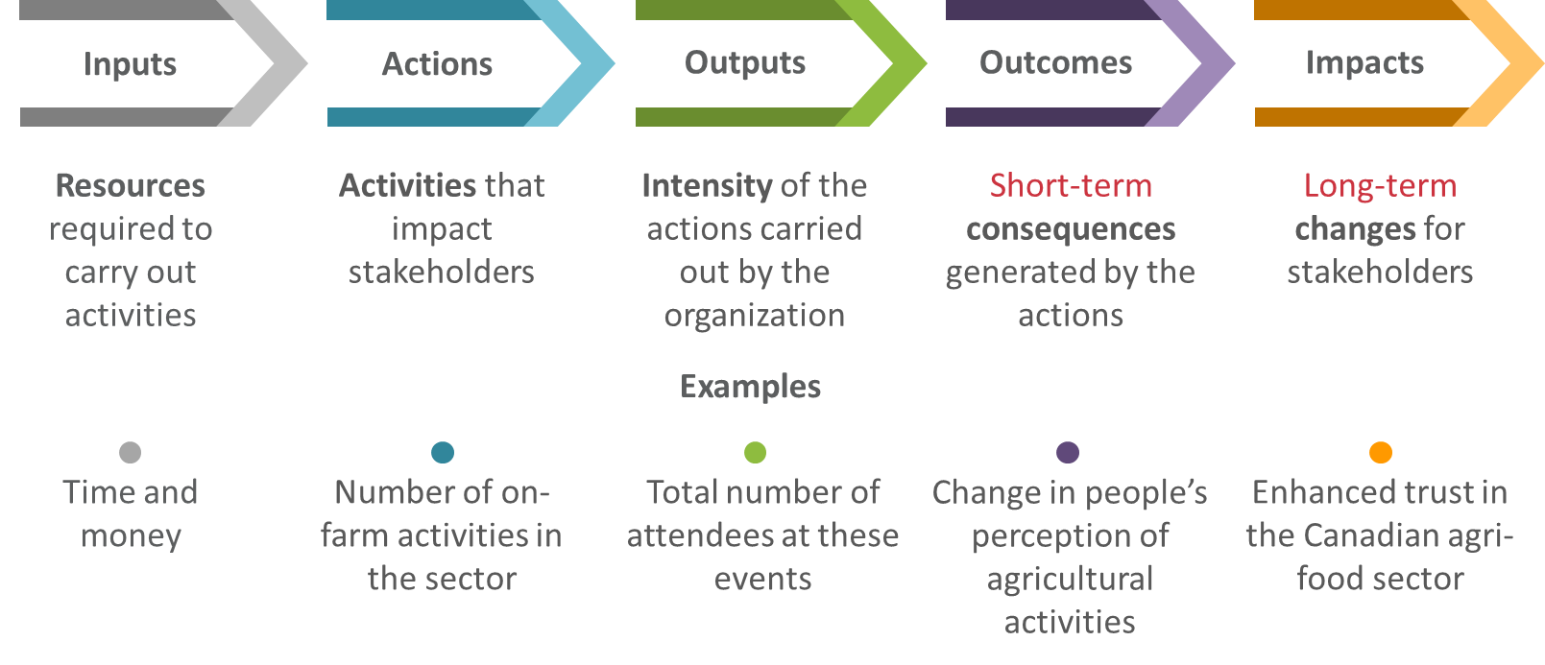
What to measure?
The system is focused on evaluating how well the surveyed organizations conduct their activities

Slide 18

What to measure?
Questions should be generic enough to apply to most and specific enough to provide meaningful insights
Performance needs to be measured in a standardized way across sectors and organizations to allow aggregation and comparison
Indicators have to be associated with practices that can significantly contribute to maintain and build trust
Balanced
Comparable
Trust-building
A framework to lead future improvements
while being able to capture current efforts and initiatives

Slide 19
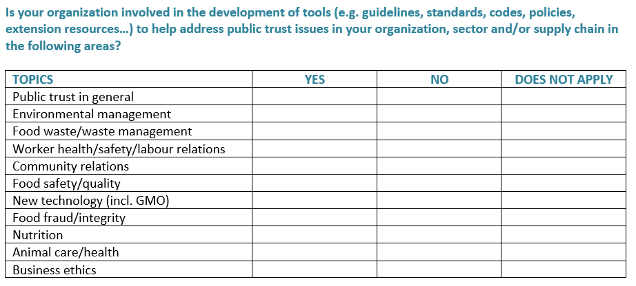
Example of question

Slide 20
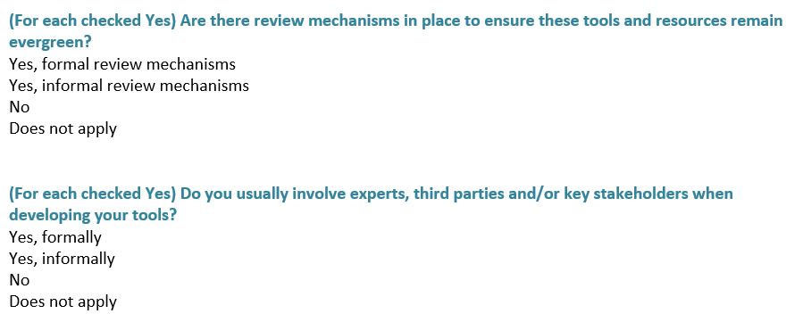
Example of question

Slide 21
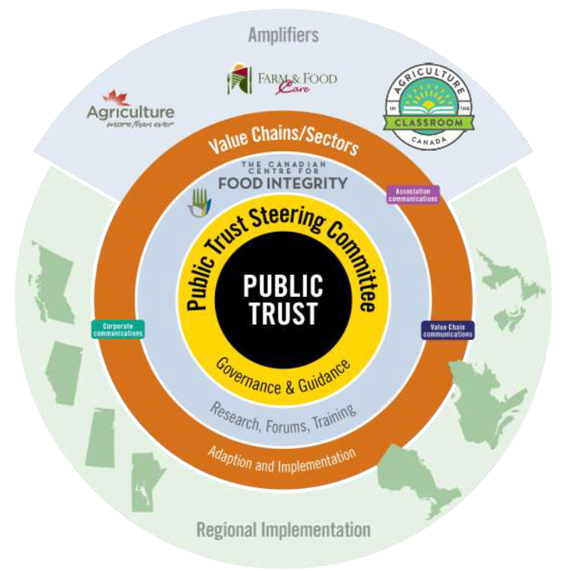
How to assess performance?
The system is meant to convey performance and progress at different scales:
  The overall Canadian food system
  The Canadian Value Chain Roundtables
  The amplifier groups
  Per province/region
  Individual businesses
  The framework is to assess the
  performance and progress:
  At a high level and presented using a
  visual scorecard
  In a consistent yet flexible way
  Using a simple, efficient and cost-effective
  approach
Notes:
Might want to put this later – about the metrics first, then define the scales second.

Slide 22
How to assess performance?
The scoring system
Has your organization developed a formal communication plan (or section for your plan) to deal with public trust specifically?
Yes
No
Does not apply
TOTAL OF 1 POINT
Yes = 0.5
No = 0.25
N/A = Blank
(If YES) Does that plan take into consideration: (Check all that apply)
Overall vision / goals
Communication objectives
Specific target audiences
Key messages
Tactics
Communication channels/media
Timelines
Risks/crisis response
All checked = 0.5
˃ 3 or 7 ˂ checked = 0.25
1 or 2 checked = 0.125
None = 0

Slide 23
How to assess performance?
A common core with only few specificities
The same questions for all
(Types | Geographies | Sectors | Size)
With few exceptions
Value chains Roundtables
Associations
Food companies
Sourcing practices
Compliance with standards
Support | Amplifier groups
Food companies
Farmers
Government
Farmers
Government
Development and enforcement of legislation

Slide 24
How to assess performance?
Recommended data collection strategy
Performance is to be measured by soliciting the participation of the following:
  The Canadian Value Chain Roundtables
  The individual members of the Canadian Value Chain Roundtables
  The amplifier groups
  The participation of other organizations can be considered by the PTSC
While the participation of individual companies or farms outside the roundtables is not expected, they will have the opportunity to use the metrics to assess their own performance and share data if they want to

Slide 25
How to assess performance?
Different levels of evaluation
Organizations
Geographies
Sectors
Value chains Roundtables
National
Alberta
British Columbia
Manitoba
New Brunswick
Newfoundland and Labrador
Northwest Territories
Nova Scotia
Nunavut
Ontario
Prince Edward Island
Quebec
Saskatchewan
Yukon
Beef cattle
Dairy
Hogs and pigs
Poultry
Eggs
Sheep and goats
Horses and other equine production
Apiculture
Crops and oilseeds
Horticulture
Maple products
Associations
Support | Amplifier groups
Food companies
Farmers
Government

Slide 26
Visual representation of results
Individual Scorecard
Overall Performance
Different options depending on the platform used
Basic requirements
Secure
Online
User-friendly
Flexible

Slide 27
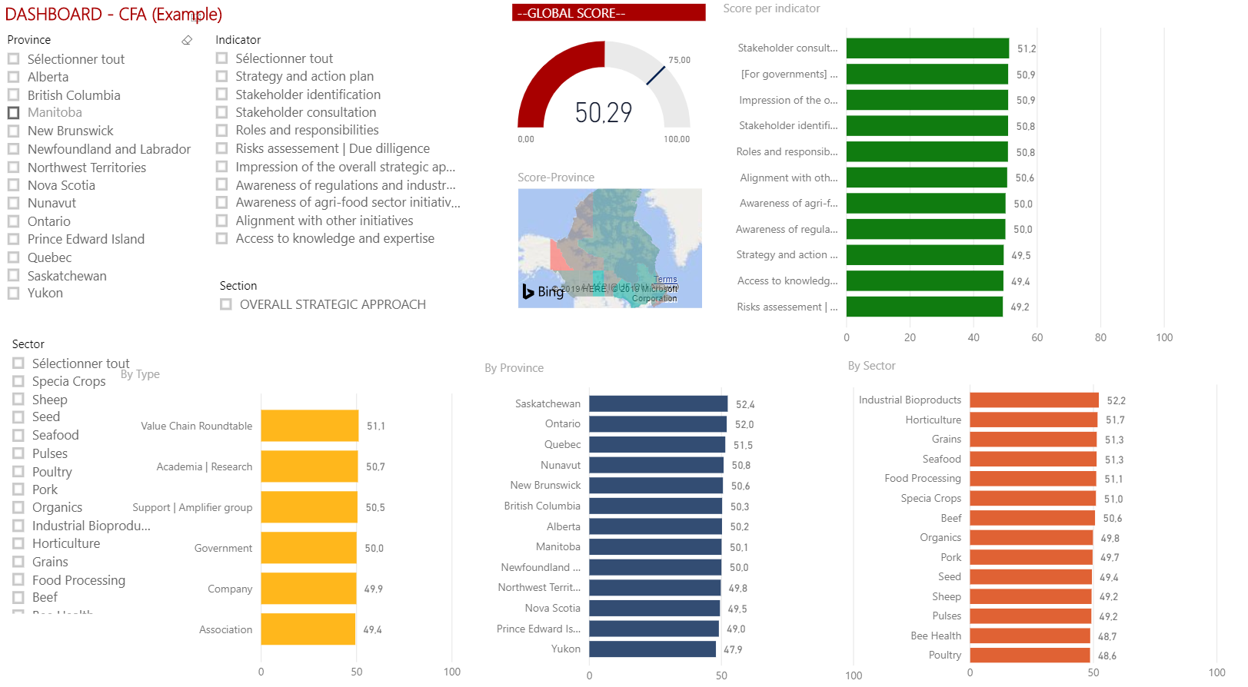
Visual representation of results
Example 1

Slide 28
Visual representation of results
Example 2
Per pillar
Overall
performance
Plan
0%
Do
Say
Indicator 1
55%
Plan
X
Indicator 2
30%
0%
Indicator 3
75%
Indicator 4
50%
X
The final recommendation will depend on who will manage the framework and how it will be rolled out

Slide 29
Conclusion and Next Steps

Slide 30
The expected benefits
1
A baseline to understand who does what, where, and how; compare performance; and provide retroaction
2
A framework to structure action with regard to public trust and develop a more consistent vision
3
An opportunity to streamline efforts and foster alignment
4
A roadmap to set priorities, guide actions, and promote continuous improvement

Slide 31
Pending questions to address
Framework and questionnaire
  Are all the relevant indicators/questions asked?
  Is the wording clear and unambiguous?
  Are indicators relevant to all organizations?
  Should the framework include more sector- and
  organization-specific questions?
  Scoring system
  Should all indicators/questions be weighted the same way?
  How normative should the system be?
  Visual representation
  How should data be collected (who, when, and using which tools)?
  How should performance be measured (data input and validation)?
  What platform should be used to present results (homemade, existing)?
Some potential
users are providing feedback

Slide 32

Next steps
Finalization of the framework, questionnaire, and scoring system
Preparation of the final report
  Learnings from other sectors and organizations
  Insights on the Trust Framework
  Guidance on how to use the framework and questionnaire
  Recommendations on next steps (e.g. a pilot phase)

Slide 33
Thank you!
Groupe AGÉCO
25 Mozart East, office 310
Montréal, Québec H2S 1B1
514 439-9724
www.groupeageco.ca

