Slide 1
Nourrir le monde, ensemble
Carla Ventin
V.-P. principale
Relations avec le gouvernement fédéral
Produits alimentaires et de consommation du Canada
28 février 2019
Notes:
Thank you to CFA
We are pleased to be partnering with the Canadian Federation of Agriculture.
Ron and his team do an excellent job here in Ottawa.
We’re pleased with our strong working relationship, and appreciate their dedication and leadership.

Slide 2



































































Nos membres
2
Notes:
ABOUT FCPC
FCPC is Canada’s largest industry association representing the companies that manufacture and distribute the majority of food, beverage and consumer goods found on store shelves, restaurants and in people’s homes.

Slide 3






















































Nos membres
3
Notes:
ABOUT FCPC MEMBERS
Our member companies are located in both rural and urban Canada in every region, and have facilities in more than 200 federal ridings across the country.
Our members work closely with farmers right across the country, and recognize the importance of close collaboration with farmers to produce some of the highest-quality, safest and trusted food in the world.

Slide 4
Le plus gros employeur
  Le secteur de la production alimentaire est le premier employeur dans le domaine manufacturier, à la fois :
    1) Au Canada :
    Plus important que les secteurs combinés de l’aérospatiale et de l’automobile
    Près de 300 000 emplois dans 6 000 installations, dans chaque région
  2) Dans les régions rurales du Canada :
  Établissement de liens avec les Canadiens dans les régions rurales et éloignées, grâce aux possibilités d’emploi
  Investissement dans l’infrastructure et les services ruraux
  Important marché pour les agriculteurs
4
Notes:
Recent statistics released show less Canadians are choosing to live in rural areas
I come from a small town and it was a great place to grow up.
We need to work together to give Canadians more reason to be there – both farmers and food manufacturers have an important role to play here.
It was a positive signal when the government appointed a new minister for rural economic development, Bernadette Jordan.

Slide 5
Élément de la chaîne d’approvisionnement
Les fabricants d’aliments font partie intégrante de la chaîne d’approvisionnement alimentaire au Canada :
  60 % de la production est vendue à des épiceries et restaurants au Canada
  Transformation de près de 40 % de la production agricole canadienne
Comment dépasser ce seuil de 40 %?
5
Notes:
We are pleased that the federal government and provinces are interested in future growth opportunities in value-added food production.
In the recent report by Mr. Barton, he points out that there is both a demand and need for Canada to increase the processing of food in Canada.
We need to add value to the food grown in Canada, before it is exported.
We want to keep these value-added and future-facing jobs in high-technology here in Canada.
And we can only achieve this, together.

Slide 6
Défis pour l’industrie
Voici les résultats de notre sondage récent :
Il coûte plus cher de mener ses opérations au Canada qu’aux États-Unis.
La plupart des innovations introduites par différentes marques ne sont pas développées ou fabriquées au Canada.
Les dépenses à engager pour qu’un produit se retrouve sur les étagères des magasins au Canada est plus élevé qu’aux États-Unis.
Le fardeau réglementaire croissant et cumulatif est un obstacle à la croissance, à l’innovation et à la compétitivité.
Les autres défis incluent le manque d’accès à de la main-d’œuvre qualifiée, une infrastructure vieillissante et un accès aux marchés qui n’est pas toujours prévisible.
6
Notes:
What is the impact?
We are having a hard time keeping food manufacturers in Canada.
Why does this matter?
Canadian jobs
Canadian farmers
Rural Communities
Prices / Affordability
Product Choice
On the regulatory burden:
Can you imagine the government telling the auto/ forestry/ aerospace or energy sectors to change the way they make their products, label their products and sell their products and at the same time tell us to hurry up and export more?

Slide 7
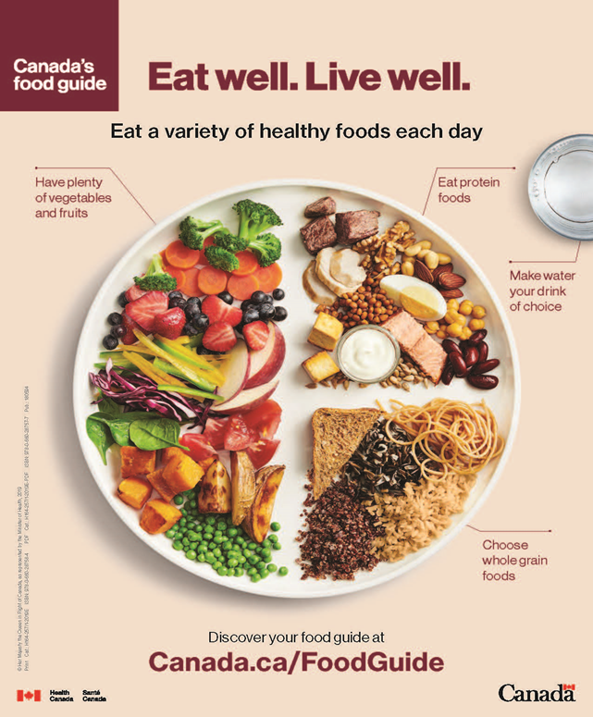

Le « Nouveau » Guide alimentaire canadien
Notes:
Have you ever seen this before?
The CFG was off to a bad start – we weren’t invited to provide our input.
This sent a strong signal to Canadians that we are not to be trusted – we share your concern.
We agree that the Food Guide needs to be modernized and reflect the reality of Canadians’ lives.
We also agree that healthy eating is more than just the foods you eat – eating should be a pleasure.
We recognize that Canadians should be limiting their intake of nutrients of concern, such as sodium, sugar and saturated fats.
But categorizing food as ‘highly processed’ unfairly vilifies food that can be part of a healthy diet and that many Canadians rely upon as a convenient, affordable, safe and nutritious option.”
Definition of processed food: Any product that is washed, cut, packaged, frozen or canned. (What did you have for breakfast?)
E.g. 100% fruit juice, which is a good source of essential nutrients and a cost effective way to help people meet fruit intakes all year long, should be limited
Food processing has an important place within Canada’s food system and will continue to supply safe, convenient and non-perishable foods.
The reality is that people are time starved - People are looking for tasty, convenient, affordable and nutritious products to feed their families and our members will continue to respond to consumer needs.
Background:
Processed or prepared foods and beverages that contribute excess sodium, free sugars or saturated fat should not be consumed regularly; and highly processed foods should be limited
Canadians are advised to “be aware of food marketing”
It does not consider the ultimate impact on food access and affordability for the most vulnerable in our society

Slide 8



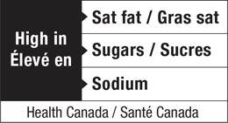
Les symboles sur le devant des emballages
8
Notes:
Thank you to CFA for working closely with us against warning labels on food.
We’ve come a long way – from black and white warning labels to red stop signs to these images.
This is another way to demonize our industry and products as “unhealthy”.
Most Canadians rely on the NFt to provide information about the salt, sugar and fat content in food – why do we need a new label?
Evidence that it doesn’t work – an untested and costly experiment.
Think of the implications – on the one hand the government is saying we have the potential to be a leader global food production and on the other hand many of the products that Canada makes would have a FOPL that implies they are unhealthy and should not be consumed.
The government’s EST report recommended exploring alternative options to FOPL and we certainly hope that the government accepts this recommendation.

Slide 9
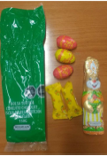
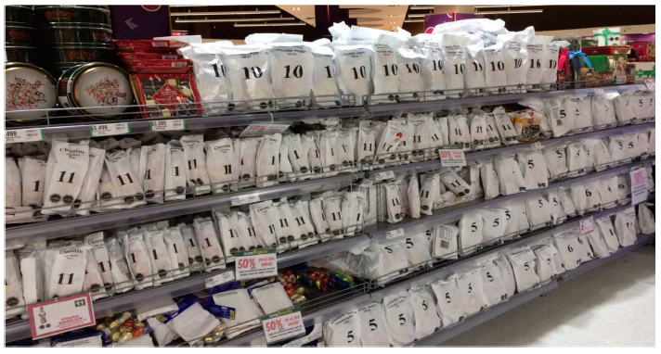
Restriction de la publicité visant les enfants
Santé Canada propose d’interdire la publicité faisant la promotion d’aliments qualifiés de « mauvais pour la santé ».
Le projet de loi S-228, la Loi sur la protection de la santé
des enfants, attend d’être approuvé par le Sénat.
Impacts possibles :
Adoption de critères sur la nutrition qui définissent
certains aliments comme étant « mauvais pour la santé »
Emballage et étiquetage
Conséquences imprévues
Absence d’une consultation réelle avec
l’industrie et les agriculteurs.
Quelles en seraient les conséquences du point de
vue du commerce international?
9
Notes:
Industry prepared to do more.
Focus on education and healthy, balanced, lifelong habits.
Stigmatizing certain foods won’t reduce childhood obesity.
The nutrition criteria HC has suggested is so low it would exclude almost all foods except, for example, fruits and vegetables.
But if your product is an ingredient in any other product, know that food would almost certainly be defined as unhealthy.
Health Canada’s proposed approach is not the Quebec model
IMAGES:
But there are models that are currently in place in other markets in the world that we believe Health Canada is attempting to emulate.
Here is a photo of a grocery store shelf in Chile….
The external wrapping in Chile is placed by retailers.
The legislation there places liability on retailers for ensuring everything in their store is compliant with the legislation so our understanding is the retailers have put items in the overlay packaging (bad for the environment).
S-228 at first reading contained the same retailer liability provisions.

Slide 10
Salubrité alimentaire
Les Canadiens continueront de s’alimenter.
La question pour les partis politiques et les Canadiens est la suivante :
  D’où voulez-vous que vienne votre nourriture?
10
Notes:
We create some of the safest, affordable and highest quality food in the world.
Should we rely on the US/ China and EU to get our food??
What can the government do to help us stay here in Canada for the benefit of all Canadians?
We need to break down silos – Economic departments need to speak with HC and ECCC.
We need to stop stigmatizing the agri-food industry and the people who work in it.
Create a regulatory environment that enable growth and innovation, while maintaining safety as a priority.
An economic lens needs to be applied to regulations.
Listen to us. Engage and consult. Work in partnership.
Final Thought:
We are in unchartered waters and have been facing unprecedented challenges.
With an election, there are a lot of opportunities.
We need to carefully navigate the government’s twin objectives of public health and economic growth.
Both can be achieved.
Thank you for your partnership and support.
Never before have we worked so closely together.

