Slide 1
Coordination, Funding and Food System Harmony

Slide 2
Agenda
The Topic Areas
Governance & Structure
Funding
Food System Harmony
Approach
Recap of survey & interview comments
Discussion

Slide 3
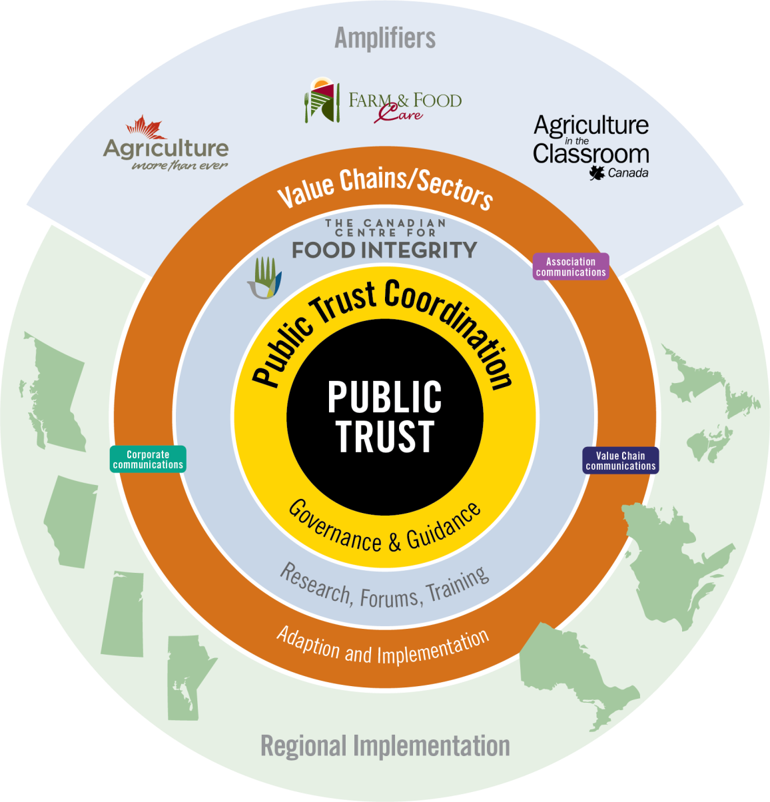
Methodology
Input gathered from 1-on-1 interviews & conversations

Slide 4
1. Coordination

Slide 5
Coordination … a recap
Almost unanimous support for a coordinated, synchronized, collective approach to addressing public trust within Canada’s food system
Many comments similar to:
“Lack of a national coordination process is the most limiting factor impeding the advancement of public trust”
“Coordination will help reduce confusion and streamline performance”
“Coordination will provide efficiency and effectiveness”

Slide 6
Coordination … a recap
Communications and coordination within a commodity and within a value chain is progressing
but
Greater coordination is needed to provide synergy to all components of the food system and all public trust related activities

Slide 7
Coordination … a recap
Coordination is sensitive … and must be handled properly
The coordinator should never speak on behalf of any sector or segment of Canada’s food industry without the approval of the sector/segment.
However, the coordinator could and should help elevate awareness of the overall industry and its actions and commitment to building public trust.
A fairly common comment:
“Agriculture doesn’t need another organization …”

Slide 8
What’s Required?
A ‘home’ for public trust within Canada’s food system – a place to call, where there’s someone who knows what’s happening within each group and can make the appropriate connections, and point us in the right direction
Some one / group with accountability and responsibility for synchronizing the various public trust initiatives within Canada’s food system – national, provincial and regional
‘Coordination’ involves working with (and not bossing over) other sectors, value chains, organizations, public trust initiatives
Coordination that is not biased towards any sector or segment of the food system … or any production system
Coordination with no political agenda other than advancing public trust in Canadian food and farming
A structure and governance system that is cost and time efficient

Slide 9
Existing Coordination Mechanisms
Public Trust Steering Committee
Intended as a ‘hub for public trust’
A new, informal group set up in 2017
A group built with representation from across the Canadian food system including governments
Level of engagement varied
Funded by only a few organizations, with no ‘on-going’ funding model in place
Not a legal entity – nor a registered charity or a not-for-profit – so cannot receive or spend money
Additional work required to become truly operational
“Good in theory; questionable in results.”

Slide 10
Existing Coordination Mechanisms
2. All-Chairs VCRT Committee
A committee composed of the chairs of all the VCRTs
Designed to bring discussion and alignment to topics and issues – public trust being one of the many issues
Good level of engagement by AAFC and chairs
Committee coordinated and funded primarily by AAFC
Not a legal entity – nor a registered charity or a not-for-profit – so cannot receive or spend money
Additional work required to become truly operational as a coordination body for advancing public trust in Canada’s food system

Slide 11
3. Canadian Centre for Food Integrity (CCFI)
A ‘service provider to Canada’s food system’ focused solely on helping build public trust
Recognized by all/most sectors of Canada’s food system
Gained credibility for quality & relevance in public trust
Operational today … with a structure (board and management) in place and ~ $1 million budget
Governance is limited today to members
A legal entity – with registered charity & not-for-profit status

Slide 12
3. Canadian Centre for Food Integrity (CCFI)
CCFI Board of Directors has indicated that if it is the desire of the stakeholders, it is prepared to take on the role of ‘coordination’
and
it is prepared to adjust its current structure and governance model in a manner that aligns with the requirements of the coordination role

Slide 13
2. Governance
.
.

Slide 14
Governance … a recap
An effective, efficient governance system to direct and guide the advancement of public trust deemed very important
Articulating the most desired governance system was a challenge
Important to have a governance system based on complementary competency and passion for public trust; not composed simply by industry representation.
The governance system should be ‘balanced’, reflect a solid understanding of the entire Canadian food system as well as proficiency on how to build trust. ‘Balanced’ generally means respected in each of the sectors – producer, processor, food company, food retail and food service
Governance and leadership must provide clarity on the coordination Mandate, as well as the Vision and key strategies that will be build and advance public trust
“Governance is likely tied to funding – at least in some way”

Slide 15
Governance & Structure
Stakeholders
Board Structure
CEO

Slide 16
3. Funding Model

Slide 17
This ‘strategic plan’ work shown here today was funded primarily through government, with significant contribution of time from a number of individuals
Thank you Farm Credit Canada and MNP for lunch and refreshments

Slide 18
Funding Model … a recap
An important challenge … and one that requires greater commitment and support from all stakeholders … including governments
Many comments similar to:
Funding is the biggest challenge
‘Core funding’ - funding for coordination vs programs – is the toughest component of funding attraction
Industry players must step forward and provide funding that matches the importance of the issue
Governments also have a funding role to play – federal & provinces
A membership/involvement fee that encourages maximum participation and involvement of everyone (individuals, organizations, corporate) from all components of Canada’s food system is desired

Slide 19
Funding Model … a recap
Related to government support:
Public trust is a ‘common good’ initiative and government must be involved and supportive
Governments, Federal and Provinces, know that public trust is important and they play a funding role ….that’s why it was noted as one of the pillars of the new CAP policy
Governments contribution from a funding perspective can best be delivered by ensuring there is ‘core funding’ for coordination, and some form of matching funds that align with specific programs

Slide 20
Funding Case Study Models
1. The Manitoba ‘United Way’ model
Government provides core funding that contributes to coordination administration. Why?
Because the government recognizes that the United Way provides tremendous services that likely would have to be provided by government if the United Way didn’t exist; and
Manitobans recognize that without effective administration, the funding model is impeded
All United Way raised funding goes towards programs and services
Many corporations/organizations provide some type of matching support to employees and individual contributions

Slide 21
Funding Case Study Models
2. Saskatchewan’s ‘Public Trust’ Funding Model
Saskatchewan Ministry of Ag provides an annual grant that has limited strings attached and funds can be used towards coordination and administration of public trust initiatives
The Saskatchewan Ministry also provides program funding that delivers a level of matching support for qualifying programs
The maximum amount of funding provided by the Saskatchewan Ministry will never exceed 25% of the total funding for public trust (a + b ≤ 25% of total funding)

Slide 22
4. Food System Harmony

Slide 23
Food System Harmony … a recap
‘Harmony’ within the industry is deemed important.
Lack of harmony is a key reason for diminishing trust with the industry.
Most referenced that there is ‘food safety’ harmony and that a similar level of harmony needs to be established around public trust
Many expect further diminishing of harmony going forward. Examples cited include: the plant-protein/animal-protein issue; marketing claims pushing the boundaries; labeling claims, etc.
The majority stumbled on ‘how to build harmony’ --- but they reiterated the importance of addressing issues ‘within the industry’ prior to them being aired in public
There was total consensus that ‘competition’ and ‘differentiation’ must not be impeded, and that disruptors must feel welcome
A ‘voluntary’ system supported by the majority of stakeholders is desired.

Slide 24
‘Canadian Animal Health Institute’ case study
General Highlights
Starts with agreement to Code of Conduct/Code of Marketing Practices
Sets out the framework
Principles of Agreement
Expert Assessment Panel process
Public meeting with a binding decision

Slide 25
Discussion and Direction

Slide 26
Your thoughts on …
What are the most important elements of coordination?
‘Who’ should be assigned accountability and responsibility for coordinating Canada’s public trust initiatives
The governance system required

Slide 27
Your thoughts on …
A funding model to provide the necessary funding to support coordination and alignment
How to encourage maximum involvement and participation by all stakeholders – individuals, organizations, corporate and governments

Slide 28
Your thoughts on …
The importance of a ‘harmony’ initiative
‘How’ to build a ‘harmony’ initiative that builds harmony without impacting competition or differentiation.

