Slide 1
“Carbon Pricing: Impacts and Opportunities”
Canadian Federation of Agriculture AGM Presentation
Feb. 27, 2019

Slide 2
Overview
About Us
Introduction / The Biological Bridge
Potential Opportunities
Potential Impacts

Slide 3
About Us
Environmental consulting firm working in agriculture, bioenergy and agri-food sectors
Assist clients in navigating the complex and evolving world of sustainability
Experts in developing science-based metrics and solutions to enhance social license and public trust
Vision: “Mainstream Sustainability”
Notes:
We want to see a world where growth and development are always sustainable, food suplly chains create as little environmental impact as possible and low carbon energy and management pathways are prevalent.

Slide 4
Viresco Solutions

Slide 5
Introduction

Slide 6
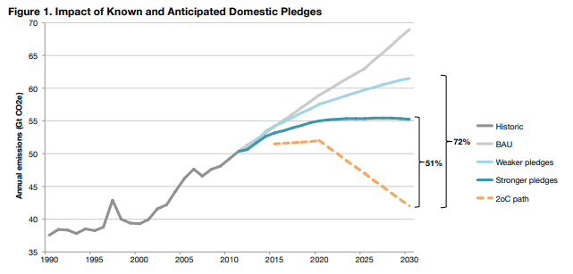
Problem: The Gap
Source: http://www.climateadvisers.com/mindthegap/

Slide 7
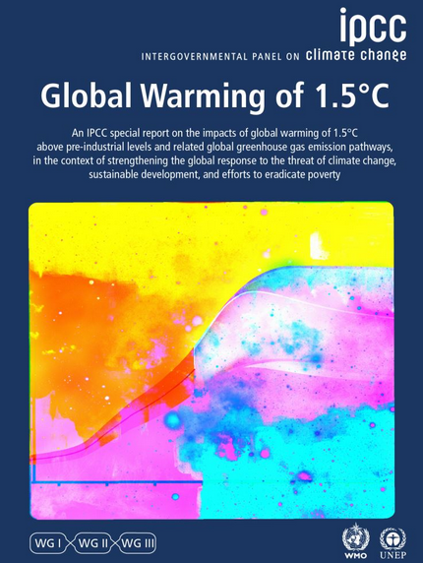
And Then…
1.5°C Modelled Pathway
Decline of ≈ 45% in CO₂ from 2010 levels by 2030
Net zero: ≈2050
2.0°C Modelled Pathway
Decline of ≈ 25% in CO₂ from 2010 levels by 2030
Net zero: ≈ 2070
Pathway for non-CO₂ emissions similar in both scenarios
(Source: IPCC, Headline Statements from the Summary for Policymakers)

Slide 8
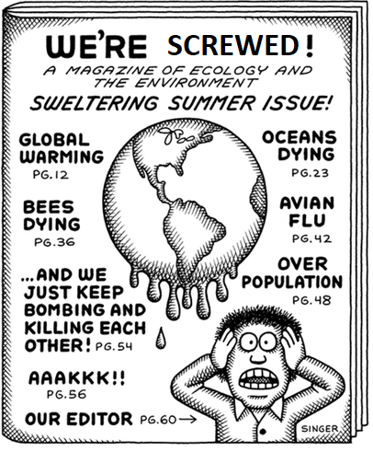
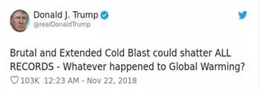
Responses….
Source: Andy Singer

Slide 9
Source: Quantis, 2019

Slide 10
The Biological Bridge
AFOLU sector responsible for approx. 25% of global anthropogenic GHG emissions (Smith et al., 2014)
Need to feed 9 billion by 2050
Concept: Switch AFOLU sector from problem to solution, while also transitioning energy
Protection: Avoided conversion (forests, grassland, wetlands, etc.)
Improved Management: Fertilizer (4R Nutrient Stewardship), livestock (feed use efficiency, manure management), cropping (no-till, cover crops),etc.
Restoration: Reforestation
Potential: 30+ % of solution in next 10-15 years (Bronson et al., 2017)
Notes:
Solutions that are available immediately
Net source to net sink
Status: Growing interest (e.g. Nature4Climate, Science Based Targets Initiative), but historically less interest and funding
Often cheaper cost per tonne
Co-benefits – biodiversity, water quality, etc.
“… combination of forestry and agriculture potentials from IPCC AR4 … for the AFOLU sector are estimated to be ~3 to ~7.2 Gt CO2eq/yr in 2030 at 20 and 100 USD/t CO2eq, respectively.”
Nature4Climate estimates 11 gigatones/year

Slide 11
Carbon Pricing – potential opportunities

Slide 12
Different Carbon Pricing Structures
Compliance Markets | Voluntary Markets | Insetting/Supply Chains
Created through regulations and laws at the National or Sub-National level (e.g Alberta, BC, Quebec, California) Buyers: Large emitters required to reduce emissions by law Price: $15 - $50 Risks: Policy uncertainty, invalidation | Usually managed through a third party registry (e.g Climate Action Reserve, Verra (VCS), Gold Standard, etc.) Buyers: Any individual, business, non-profit, municipality, utility, etc. voluntarily reducing emissions Price: $1 - $45+ Risks: Finding buyers, price uncertainty | An investment in an emission reducing activity within a company’s supply chain. The emission reduction (i.e. inset) can be claimed by the company that sponsored the activity. (Gold Standard, Carbon Accounting and Insetting Framework)
Market Pull

Slide 13
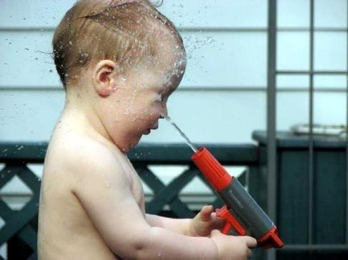
Alberta’s Carbon Pricing Framework – The First 10+ Years
A series of Firsts:
Economy-wide Baseline-Credit System w/hybridized Offset System
Based on ISO 14064/14065 Standards
Over 30 Protocols/Methodologies
Over 145 Offset Projects for over 40 Mt of registered reductions
Technology Fund (>$500M invested)
Proving ground for other systems: Australia, Poland, California, United States, Brazil, Korea, China, British Columbia, Ontario, Quebec
“What we have to learn to do, we learn by doing”
-Aristotle
Notes:
Offsets at Scale from Agriculture:
Over 17 Million tonnes of CO₂e reduced
Over $200 million cash injection
First jurisdiction to demonstrate soil carbon at scale; need for aggregation

Slide 14
Alberta’s Agricultural Protocols
Over 20 Million tCO₂e reduced and over $200 million cash injection!
Aerobic Composting
Agricultural Nitrous Oxide Emission Reductions (4R’s)
Anaerobic Decomposition of Agricultural Materials
Biofuel Production and Usage
Conservation Cropping
Emission Reductions from Dairy Cattle (Recently adapted into Kenya)
Energy Efficiency Projects
Reduced Age at Harvest of Beef Cattle
Reducing Greenhouse Gas Emissions from Fed Cattle
Selection for Low Residual Feed Intake Markers in Beef Cattle

Slide 15
Case Study– Fertilizer Management
The 4R Nutrient Stewarship Platform is a Canadian Innovation and has been incorporated into a Carbon Offset Protocol called NERP
The 4R Platform has been recognized by the UN and various national and private-sector strategies.
The NERP Generates carbon offsets for:
4R Beneficial Management Practices – Right Rate, Time, Place, Source (4R Nutrient StewardshipTM)
Manage applied N in more comprehensive way to reduce N₂O emissions
Fuel Use – reduced passes
Gives 3 options for implementation: Basic, Moderate, Advanced
Projects are now being developed in Alberta’s Compliance-Based Offset System; Pan-Canadian NERP Strategy
Global expansion
Protocol: https://open.alberta.ca/publications/9781460125502

Slide 16
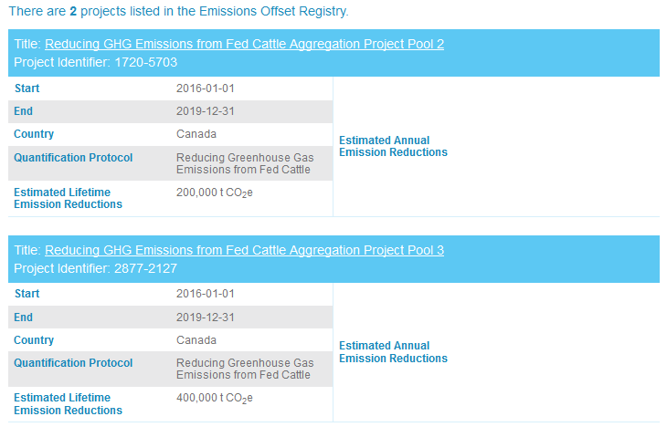
Case Study – Beef Carbon
Fed Cattle Protocol – first beef carbon in the world
Quantifies enteric and manure reductions associated with practices that increase feed use efficiency (e.g. beta-agonists, genetic improvements, feed changes, etc.)
Clean Cow project - DSM has developed a (feed) solution that reduces enteric methane emissions from cattle/cows by at least 30%.

Slide 17
Additional Protocols Under Development
Avoided Conversion of Grasslands
Soil carbon storage and sequestration from maintenance of grasslands and non-conversion to cropland
Avoided Conversion of Peatlands
Maintenance of carbon stored in boreal peatlands via replacement of mined peat fibre with digested dairy manure.
Grasslands Management
Rangeland BMPs for improved soil sequestration
Measurement based rather than practice based
Notes:
Avoided conversion of peatlands
New approach for biological sector – replacement of peat fiber with fiber from digested dairy manure
Replacement concept is analogous to the replacement of energy produced by fossil fuels with energy from renewable sources.
Utilising Tier 2 emission factors and data from Canada’s NIR – linking emissions per unit area time to amount of replacement product used
Functional unit is weight or volume of replacement product sold
Grazing and Forage Management
Grazing and forage management practices - highly variable, multiple paddocks, different plant species/productivity and highly adaptable depending on weather, pasture condition, alternate feeding opportunities, herd size and characteristics, prices, manager’s goals, etc
Setting practice-based (intervention) quantification is elusive
After 8 years of trying - measurement of the outcomes of improved forage and grazing management practices is where we need to go

Slide 18
Market Drivers – Supply Chains
Encourages emission reduction targets in line with level of decarbonization required to keep global temp. increases below 2^{O}C vs pre-Industrial levels
AgriFood Corporations with SBTs
Collaboration between:
Notes:
For financial institutions, car manufacturers and most oil and gas companies, sector-specific science-based methodologies are not fully available yet, meaning the SBTi cannot officially validate their targets. For oil and gas companies, if their targets are aligned with the Absolute contraction method, then their targets can be validated by the SBTi. Car manufacturers can also refer to the transport project to officially validate their targets.
The new target validation service will cost USD 5000, which includes up to two target assessments (companies can choose between one preliminary and one official, or two official validations). Subsequent resubmissions under the new service would cost USD 2500 per submission. Note that resubmissions will only include one target assessment (preliminary or official). The resubmission price is available to companies that have submitted at least once using the new target validation service and/or to companies that were approved through a preliminary* validation under the current service.
Free service available until end of 2018
Many global organizations are clearing the way for private sector investment to flow into working agricultural landscapes to enable Natural Climate Solutions (NCS)
Gold Standard, Science Based Target Initiative, Nature 4 Climate* – WWF, CDP, TNC, CI, UNDP, WBCSD, WRI, UN Global Compact, WMB
WBCSD – Climate and Energy Group - ‘Scaling up Investment in NCS’ – overcome Demand side barriers
Will drive investment, but need solid, science-based metrics to feel confident in investing
Shell Global – Nature-Based Solutions Initiative, Native Energy, The Nature Conservancy (NatureVest)

Slide 19
Supply Chain Insetting 2018 –Enabling Investment
First Corporate Working Group (Oct 2018) - Mars, Danone, General Mills, Cargill, Barry Callebaut, Ben&Jerry’s, McDonald’s, Chanel and L’Oreal

Slide 20
Cool Farm Tool
Widely used by global agribusinesses to source sustainable products
Multiple metrics: water, carbon, biodiversity, economics
Currently being adapted into North America (starting with beef and nutrient management)
Objective: trace sustainability metrics through supply chains
Driven by McDonald’s, Alberta Beef, CFI, BIXS, ENGOs and others

Slide 21
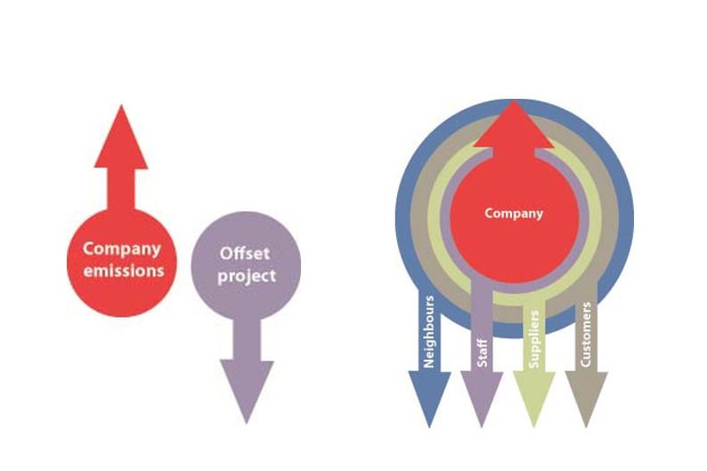
Carbon Accounting and Insetting Project
Purpose: To create a framework for carbon insetting that integrates recent advancements in precision agriculture and satellite imagery (Piloting for following practices: cover crops, reduced tillage, advanced nutrient management)
Partners:
Bayer
US National Corn Growers
Soil Health Partnership
AgSolver
Applied Geosolutions
DNDC-ART
Climate Smart Group
CropGrowers
Funders: USDA CIG/Bayer
Offsetting vs. Insetting
Source: Tipper et al. (2009). “Is ‘Insetting’ the New ‘Offsetting’?”

Slide 22
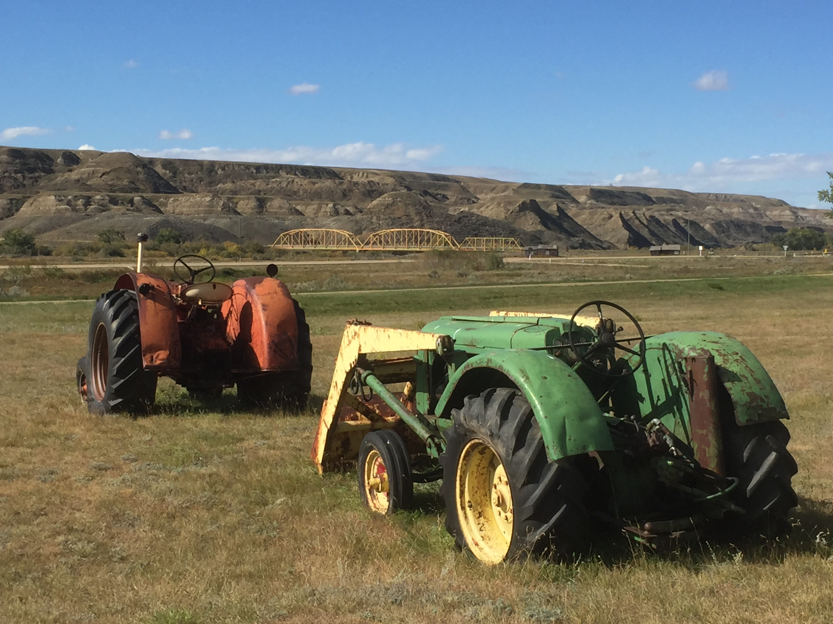
Carbon pricing – challenges

Slide 23
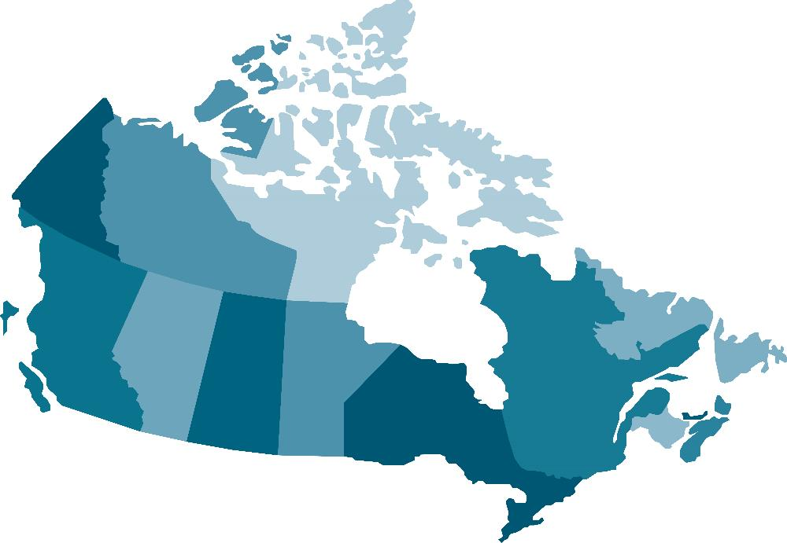
Pan Canadian Patchwork ;-)
Includes: PCF Offset Harmonization Framework
QUEBEC
WCI – Link to California
Cap and Trade
LFEs, Power Imports, Fuel Distributors
By 2030:
Petroleum consumption 40% below 2013
Offsets
Renewables 25% above 2013
ALBERTA
Benchmark ETS & OBPS (EPC, Offsets) - $30/tonne
Oil Sands Cap (100Mt)
Coal phase-out 2030
30% renewable energy
Carbon Levy (Fuels)
2018 - $30/t
BRITISH COLUMBIA
Offsets (CNG)
Benchmark ETS (LNG, coal, new entrants?)
Carbon Tax (Fuels)
$30/t - Frozen
MANITOBA
OBA system??
$25/tonne C levy
Offsets
*
TAX-TRADE HYBRID
Cap & Trade
NFL
“Carbon tax” (on gasoline)
AB SGER-model (>25kt onshore)
(Price not yet listed)
Offsets
SASKATCHEWAN
OBPS Style for Sectors
Offsets
Technology Transfers
Coal Equivalency Deal
ONTARIO
Made in Ontario Plan
Cap and Trade?? Backstop?
Offsets

Slide 24
Ag Challenges – Risk, Cost and Scale
Agricultural projects are not metered - risk/cost
Reliance on Modeling and Estimates – good, but risk
Each farm has small emission reductions and are diffuse on the landscape – cost (needs aggregation)
Soil sequestration is not permanent – risk (100 years+?)
Revenue stream is small – scale/cost
Activities can shift – risk (leakage)
Additionality can be difficult to meet (requires further barriers analysis w/experts)

Slide 25
Thank You!
Candace Vinke
Sustainable Development Director
Viresco Solutions
candace@virescosolutions.com
+1-403-926-2902

