Slide 1
Canadian Journey to Public Trust Best Practices – Issues Management
Violet Muringai and Ellen Goddard
Public Trust Steering Committee Workshop
March 20, 2019
Ottawa

Slide 2
Public Trust: Agriculture and Food
Remember trust is a two way street – not only trust held by consumers but also trust held by farmers
Common themes in all studies of trust
Emphasis not always the same
Problematic to assume simple rules, for example that honesty and transparency is always the best way to rebuild trust
There are studies suggesting that sometimes ‘denial works better than apology’ in cases of corporation corruption (Fuoli et al, 2017, Public Relations Review, 43:645-660) and rebuilding trust in the corporation after the incident

Slide 3
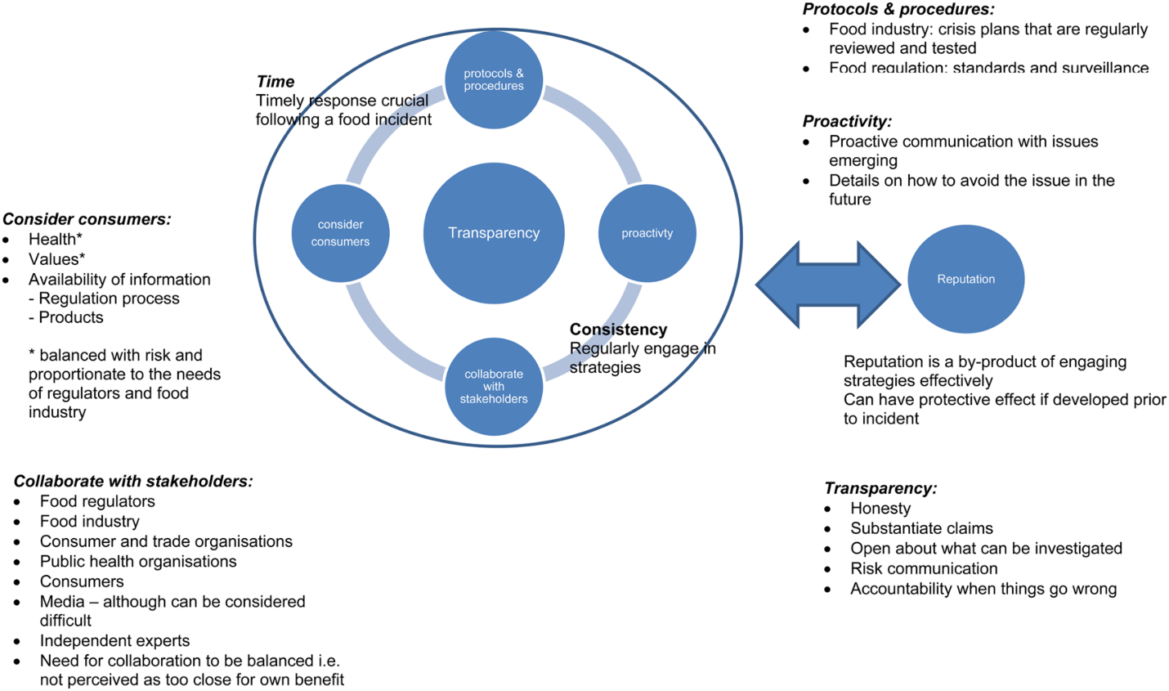
Fig. 1: Proposed model for (re)building consumer trust in the food system after a food incident.
Health Promotion International, Volume 32, Issue 6, 12 April 2016, Pages 988–1000, https://doi.org/10.1093/heapro/daw024
The content of this slide may be subject to copyright: please see the slide notes for details.
Notes:
Fig. 1: Proposed model for (re)building consumer trust in the food system after a food incident.
Unless provided in the caption above, the following copyright applies to the content of this slide: © The Author 2016. Published by Oxford University Press. All rights reserved. For Permissions, please email: journals.permissions@oup.com
3

Slide 4
Table 2: Percentage agreement and average ranking (day to day activities and in an incident)
with the importance of strategy statements by participants from the electronic survey
(n = 58)
Wilson et al, Health Promotion International, 32:6, December 2017, pp 988-1000
Strategy | Media (n= 15) (%) | Food industry (n = 15) (%) | Food regulatory (n= 28) (%) | Overall average agreement (%) | Average ranking
 |  |  |  |  | Daily basis | Following a food incident
1. Be transparent | 100 | 100 | 100 | 100 | 8 | 8
2. Have protocols and procedures in place | 100 | 100 | 92 | 97 | 6 | 6
3. Be credible | 100 | 88 | 92 | 93 | 7 | 7
4. Be proactive | 100 | 100 | 100 | 100 | 6 | 7
5. Put consumers first | 90 | 66 | 57 | 71 | 7 | 7
6. Collaborate with stakeholders | 80 | 62 | 92 | 78 | 4 | 5
7. Be consistent | 90 | 88 | 80 | 86 | 5 | 4
8. Educate stakeholders and consumers | 100 | 75 | 76 | 83 | 4 | 3
9. Build your reputation | 90 | 88 | 85 | 87 | 3 | 2
10. Keep your promises | 100 | 88 | 92 | 93 | 5 | 4

Slide 5
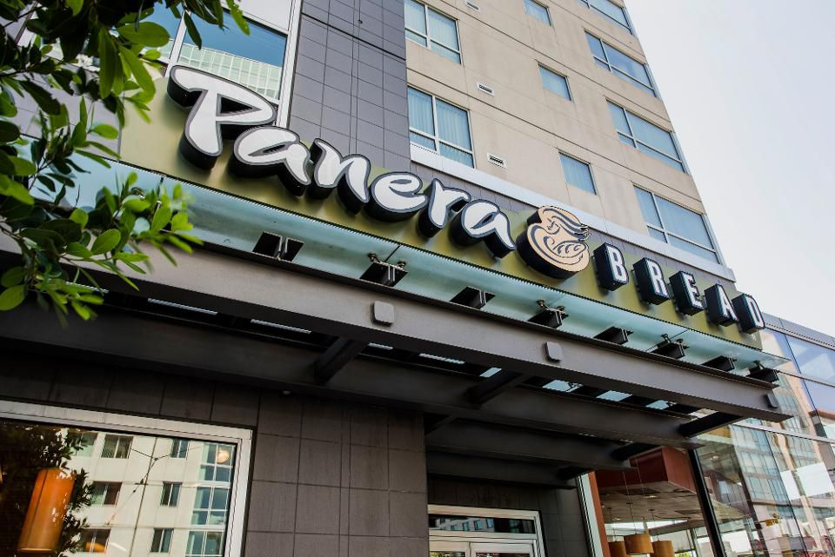
Mar 14, 2019
There are five principles of Trust Building and Panera Bread is hitting on all five cylinders.
1. You are what you do
2. Lead the debate; do not hide from it
3. Openness is an opportunity
4. Become a trustworthy source of trustworthy messages
5. Be a good citizen: it pays
The Five Principles Of Trust Building, https://www.forbes.com/sites/larrylight/2019/03/14/the-five-principles-of-trust-building/#61b0713c541d
Larry Light Contributor, CMO Network, CEO of Arcature brand consultancy focused on growing brand value
Notes:
Panera Bread’s expansion of its clean food messaging is right on target with good citizenship: the brand is treating transparency not just as an ingredient list but as a referendum on how food must be produced.

Slide 6
Trust in probiotics damaged by food industry’s unhealthy and 'aggressive‘ past, warns regulation expert
By Nikki Cutler
21-Feb-2019 - Last updated on 21-Feb-2019 at 09:15 GMT
https://www.nutraingredients.com/Article/2019/02/21/Trust-in-probiotics-damaged-by-food-industry-s-unhealthy-and-aggressive-past-warns-regulation-expert
'Lackluster' third-party organic certifier process hurting the popular food, report finds
By Cathy Siegner Published March 18, 2019
https://www.fooddive.com/news/lackluster-third-party-organic-certifier-process-hurting-the-popular-food/550649/
‘Fake news’ is undermining trust in food: ‘Facts should remain facts’
26-Feb-2019 By Katy Askew
HTTPS://WWW.FOODNAVIGATOR.COM/ARTICLE/2019/02/26/FAKE-NEWS-IS-UNDERMINING-TRUST-IN-FOOD-FACTS-SHOULD-REMAIN-FACTS
SNC-Lavalin would be wise to emulate Maple Leaf Foods
By Alan Freeman. Published on Mar 17, 2019 3:21pm
'Maple Leaf could have blamed sloppy employees for the deadly listeria outbreak. It could have blamed faulty machinery. It could have blamed slack government food inspections. But it decided to take full responsibility and move on. It’s unfortunate that SNC-Lavalin never did the same.‘
https://www.youtube.com/watch?v=zIsN5AkJ1AI

Slide 7
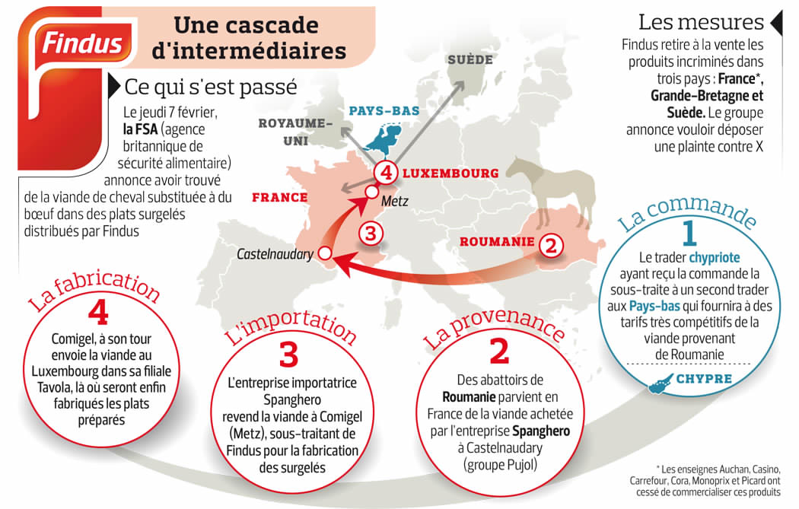
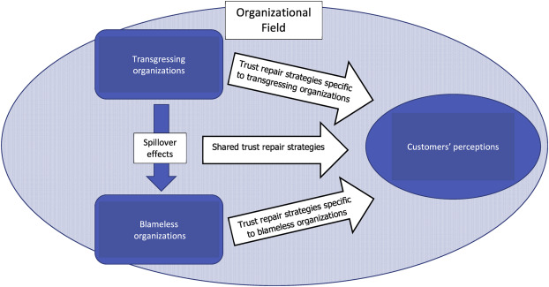
Fig. 1. Mapping trust breach within the field, trust repair strategies and customers' perceptions.
Branko Bozic,Sabina Siebert, Graeme Martin, A strategic action fields perspective on organizational trust repair, European Management Journal, Volume 37, Issue 1, February 2019, Pages 58-66

Slide 8
Table 1. Comparison of key trust repair actions by transgressing vs blameless organizations.
Branko Bozic,Sabina Siebert, Graeme Martin, A strategic action fields perspective on organizational trust repair, European Management Journal, Volume 37, Issue 1, February 2019, Pages 58-66
Transgressing organizations |  | Blameless organizations
Tesco’s trust repair action | Asda’s trust repair action | Morrisons’ trust repair action |  | Waitrose’s trust repair action
Ongoing beef product DNA testing required by the UK government
Frequent reporting of negative results from their product testing
Showing understanding of the importance of their customers’ trust
Minimizing the fact that their supply chain is very complex and international | Withdrawing products as a precautionary measure
Increasing supply of meat from local producers located in the UK | Stating that their supply chain is relatively simple and that it involves local meat producers
‘Closing ranks’ (Retailers signed a joint letter)
Publicly acknowledging the problem and involvement in the scandal |  |  | Demonstrating ongoing commitment to and support for UK farming
‘Minimizing the problem’ |  |  | Highlighting good knowledge of supply chain and emphasizing full traceability of meat
Announcing greater commitment to UK farming |  |  | Demonstrating quality/appropriateness of their supply chain and product testing
Proactive in their commitment to reform their supply chain |  |  | Assuring customers that their products are correctly labelled
Promising more frequent testing of their supply chain and supplied food |  |  | Reassuring the public that they only source meat from local beef producers (100% British) that they know
Enabling communication with their customers |  |  | Informing their customers that their meat sales increased (implying that other customers trust them)
Openly communicating about on-going business restructuring |  |  | Product withdrawal of Findus lasagna (due to horsemeat)
Divesting themselves from implicated meat suppliers |  |  | Opening-up of supply chain/ ‘opening the black box’ | their ‘products are made according to their high standards and separately from other companies’ products’

Slide 9
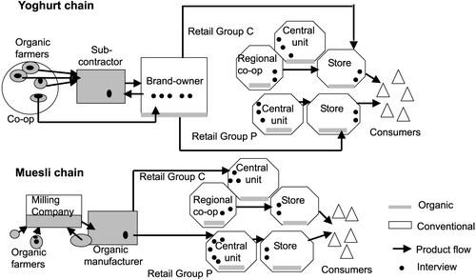
Collaboration and Trust in Two Organic Food Chains
Marja‐Riitta Kottila, Päivi Rönni, (2008) "Collaboration and trust in two organic food chains", British Food Journal, Vol. 110 Issue: 4/5, pp.376-394, https://doi-org.login.ezproxy.library.ualberta.ca/10.1108/00070700810868915
Figure 1 The case chains

Slide 11
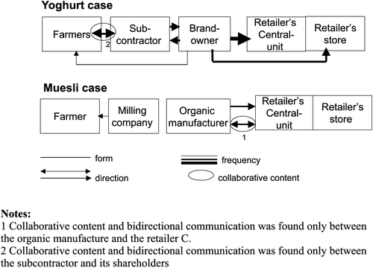
Figure 2 The communication between the actors in both cases

Slide 12
Collaboration was found only in a few dyadic relationships, not at the chain level. Findings suggest that high frequency of communication is not an indication of collaboration, and is less important than the quality of communication in the creation of trust, the prerequisite for collaboration. Particularly the competence demonstrated as an exchange partner, seemed to hold the key for a trustful relationship. Neither the power imbalance nor the different value systems were insuperable obstacles for trustful and collaborative relationship.
Marja‐Riitta Kottila, Päivi Rönni, (2008) "Collaboration and trust in two organic food chains", British Food Journal, Vol. 110 Issue: 4/5, pp.376-394, https://doi-org.login.ezproxy.library.ualberta.ca/10.1108/00070700810868915

Slide 13
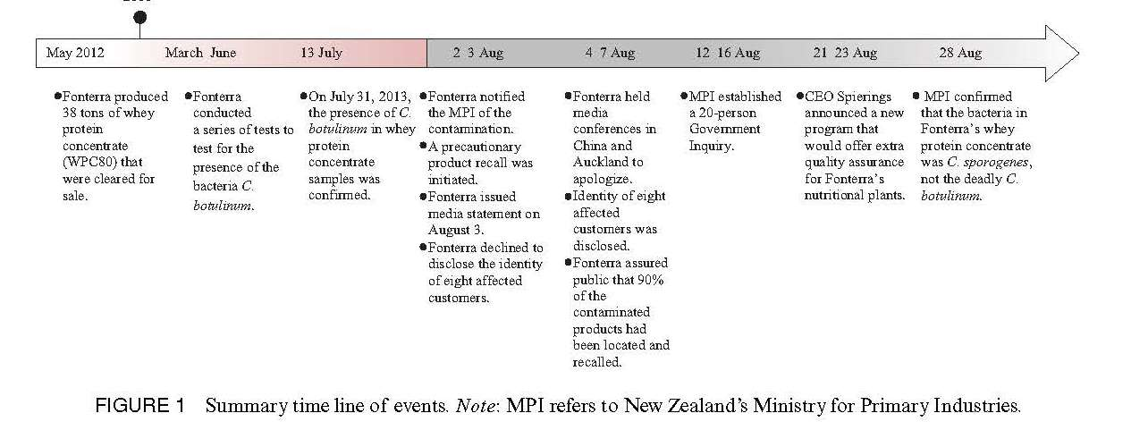
Augustine Pang, 2017, Product Safety Failure and Restoring Reputation Across Markets: Fonterra’s Management of the 2013 Bacterial Contamination Crisis, Journal of Marketing Channels, 24:136–152, 2017

Slide 14
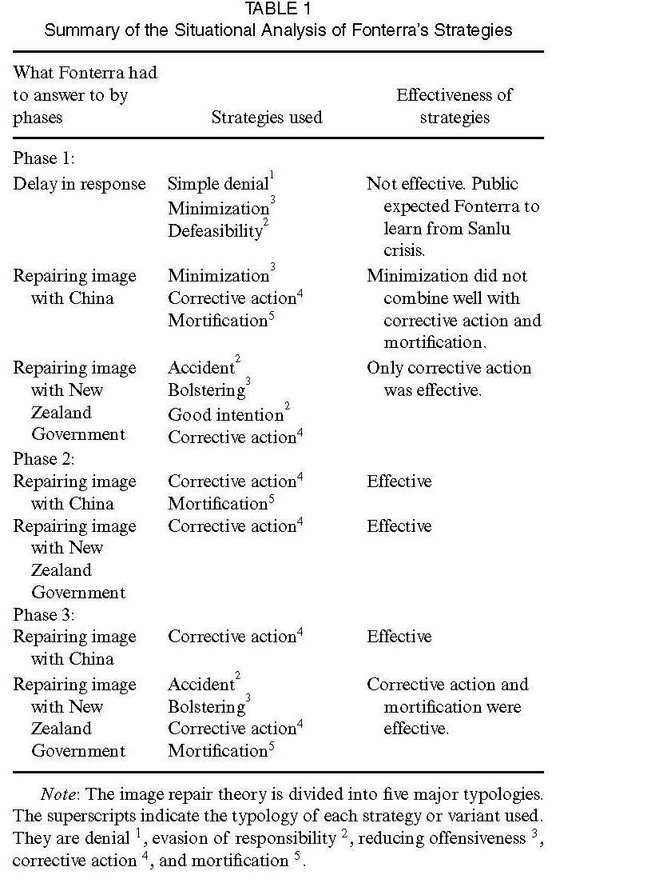

Slide 15
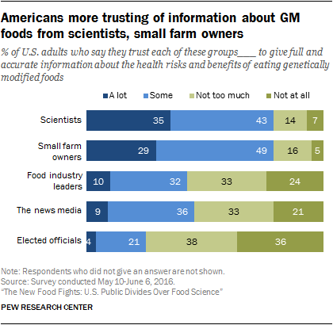
Public opinion about genetically modified foods and trust in scientists connected with these foods
http://www.pewresearch.org/science/2016/12/01/public-opinion-about-genetically-modified-foods-and-trust-in-scientists-connected-with-these-foods/

Slide 16
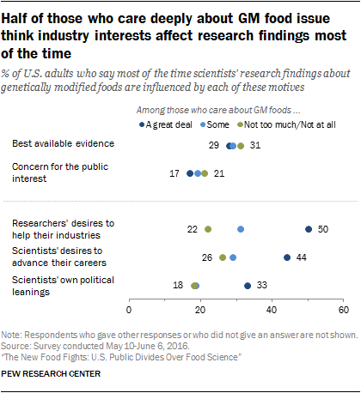

Slide 17
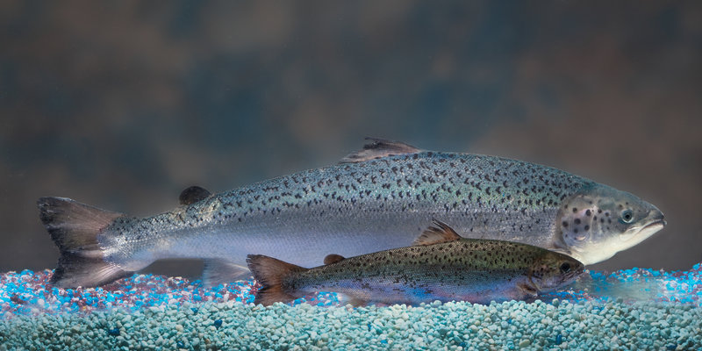
Costco
(September 2017)
Federated Co-operatives Ltd
(September 2017)
IGA (Owned by Sobeys)
(September 2017)
Loblaw
(September 2017)
Longo’s
(September 2017)
Metro
(September 2017)
Overwaitea Food Groups
“August 2017)
Sobeys
(November 2017)
Walmart Canada
September 2017)
AquAdvantage® Salmon
Product being sold unlabeled – is that a good thing?
The Canadian Biotechnology Action Network solicited public statements from Canada’s largest grocery chains, to clarify store policy on the sale of genetically modified (GM or genetically engineered) salmon for consumers.

Slide 18
And so …..
Caution required about a single strategy for ‘fixing’ trust
Sometimes ‘your’ problems are created by your competitors
Certain key components (communication, transparency) but which components should be emphasized is context specific
Relationship with regulators is important – does public acrimony generate trust?

Slide 19
Thanks for your interest
Acknowledgements:
great interactions about TRUST with
excellent graduate students,
colleagues,
PTSC,
scientists,
commodity organizations
and the public…………..

