Slide 1
4R Nutrient Stewardship Climate-Smart Agriculture
Garth Whyte, President & CEO CFA Annual Meeting February 2019

Slide 2
“Fertilizer is magic. We couldn’t grow enough food to feed 1/3 of the world without this incredible addition that drives crop productivity.”
- Bill Gates, November 2018

Slide 3
Notes:
high level messages: passed a resolution to adopt 4Rs two years ago, update on where the 4R program has come (gov’t adoption, additional MOUs, etc.) now what we need from CFA is counted acres – how do you do that? Get your local ag retailer to become designated. Conclude with the “What’s in it 4R Me” from a farmer’s perspective.

Slide 4
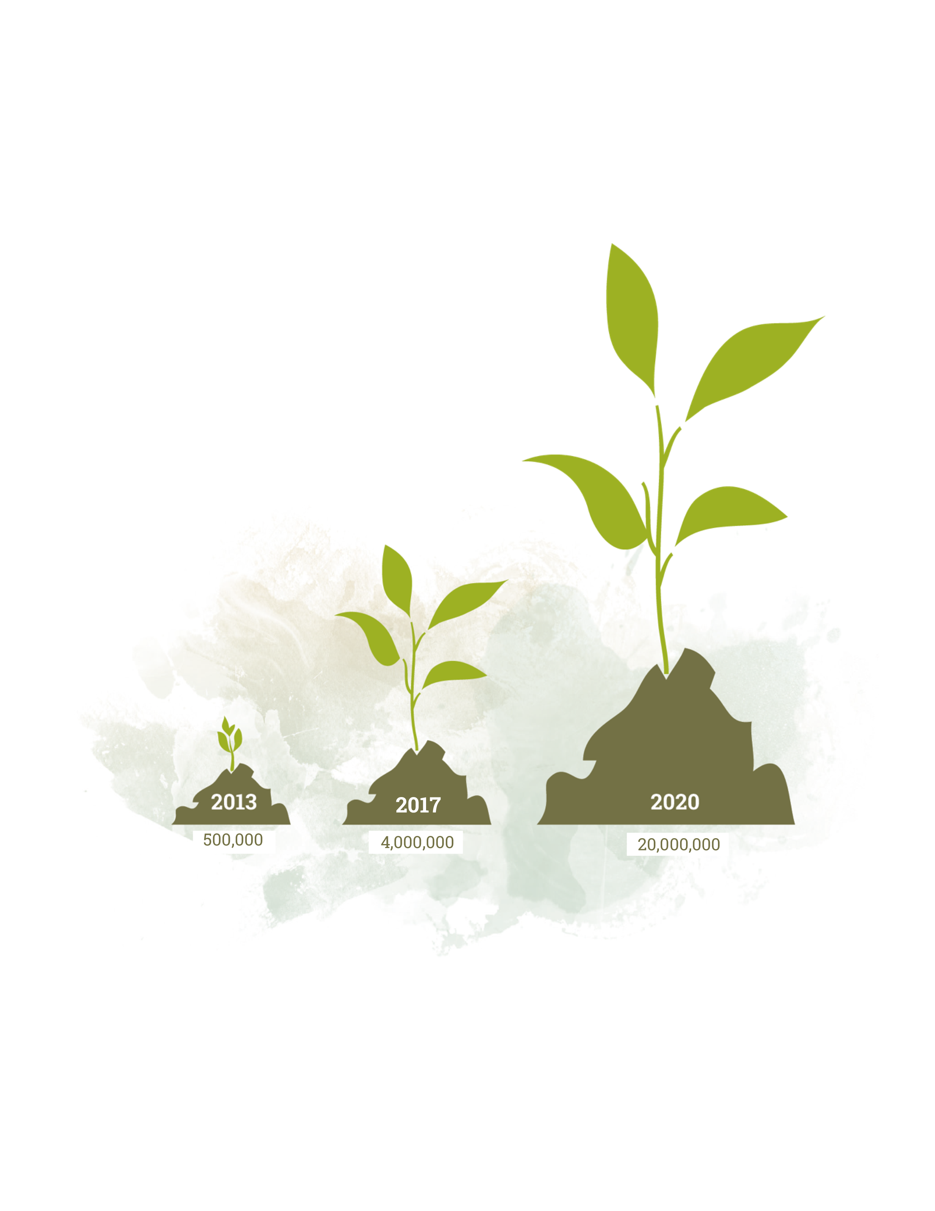
20 Million 4R Acres by 2020
Goal: Verified 4R Acres

Slide 5
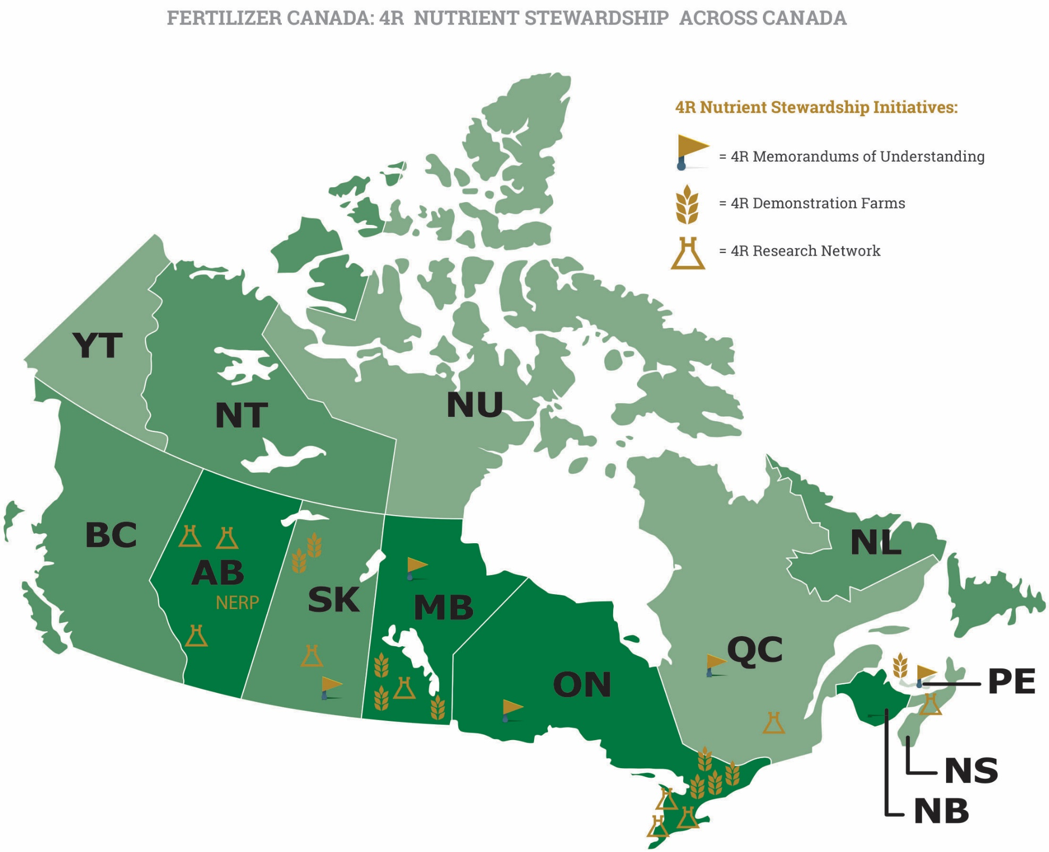
4R Nutrient Stewardship Across Canada

Slide 6
Recognition of 4R Nutrient Stewardship
Notes:
Furthermore to demonstrate support of the 4R Nutrient Stewardship system, The International Joint Commission issued a report on phosphorus in Lake Erie, which endorsed 4R Nutrient Stewardship as an important opportunity to improve fertilizer use in the watershed and increase water quality.

Slide 7
Climate Change Solution – Ontario, Manitoba and Saskatchewan
The Prairie Resilience: A Made-in-Saskatchewan Climate Change Strategy
Target of 25 per cent of Saskatchewan’s cropland under 4R designation by 2025.
A Made-in-Ontario Environment Plan and A Made-in-Manitoba Climate and Green Plan
4R Nutrient Stewardship reduces nutrient loading
Potential indicator for improved water quality and reduced emissions.

Slide 8
Grower Awareness of the 4Rs
Source: Fertilizer Use Survey 2017 | Sample Size: 1,317
Notes:
Survey of growers across Canada on fertilizer source, rate, time and place practices, and grower familiarity with 4R Nutrient Stewardship
All major grain, oilseed and pulse crops, including canola, peas, barley, lentils, spring and durum wheat in the West provinces (AB, SK, MB) and corn, soybean, winter wheat in the East (ON, QC)
Since 2014, over 3,200 growers across Canada have completed the online survey

Slide 9
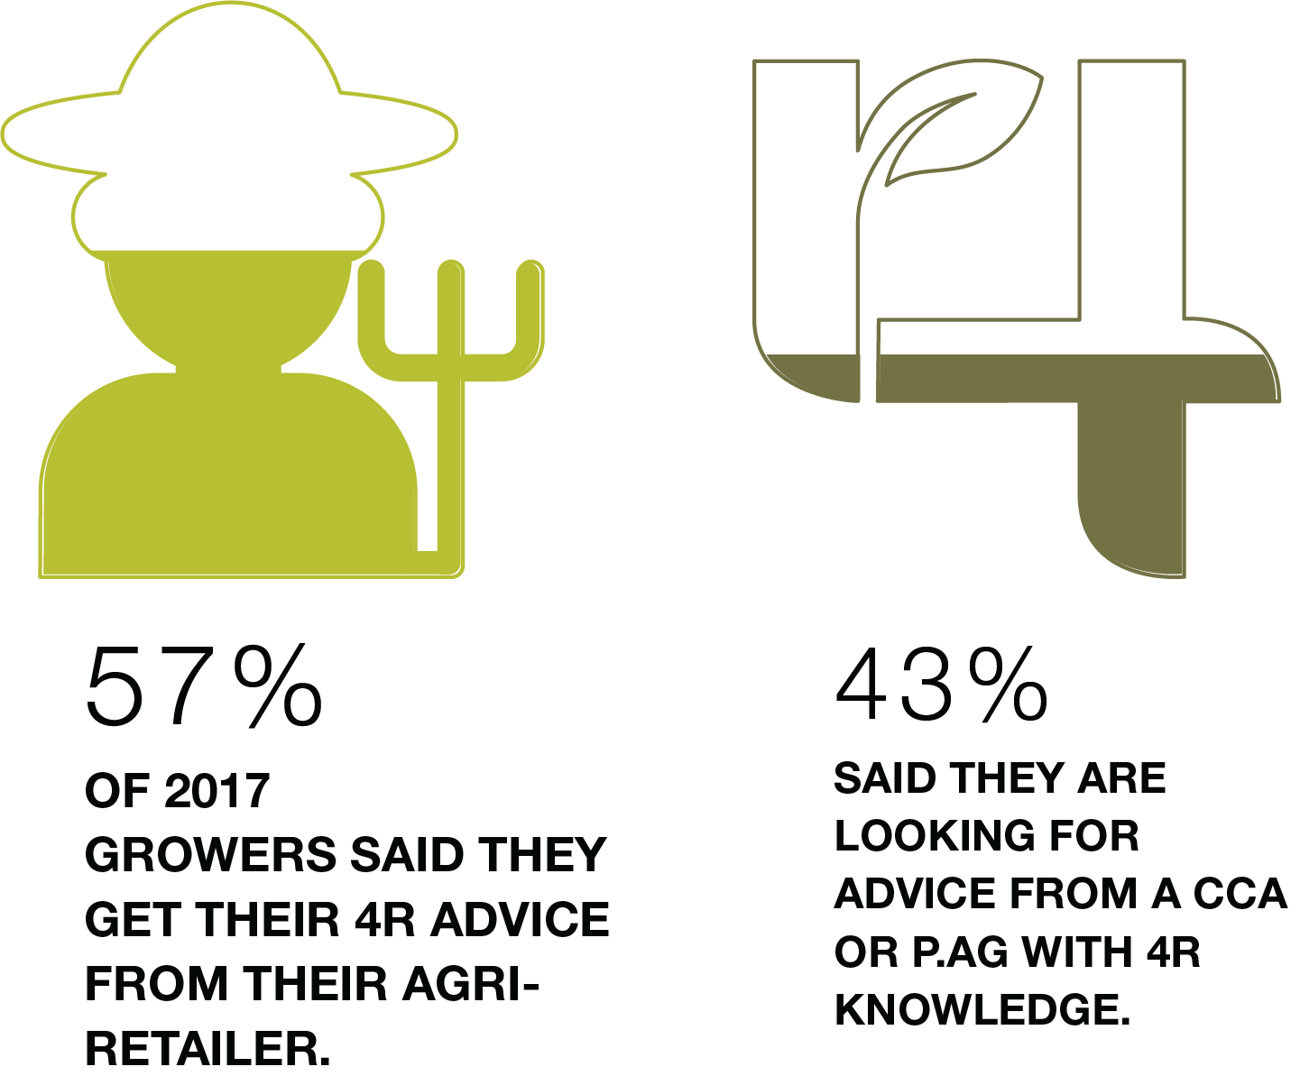
Putting 4R Principles into Practice
Source: Fertilizer Use Survey 2017 | Sample Size: 1,317
Notes:
Survey of growers across Canada on fertilizer source, rate, time and place practices, and grower familiarity with 4R Nutrient Stewardship
All major grain, oilseed and pulse crops, including canola, peas, barley, lentils, spring and durum wheat in the West provinces (AB, SK, MB) and corn, soybean, winter wheat in the East (ON, QC)
Since 2014, over 3,200 growers across Canada have completed the online survey

Slide 10
Call To Action
Discuss 4R Nutrient Stewardship on-farm implementation with your local ag-retailer or Certified Crop Advisor. Encourage them to become 4R Certified or 4R Designated
CFA should set an acre goal for 4R implementation on members farms

Slide 11
www.fertilizercanada.ca

