Slide 1
Public Trust Steering Committee March 20th Workshop Canadian Centre for Integrity Presentation

Slide 2
Public Trust Online Survey 2019

Slide 3
Background and Methodology
These are the findings from an online Canadian Centre for Food Integrity survey conducted on behalf of the Public Trust Steering Committee
Objective: to identify the risks, opportunities, and recommendations to help shape the future for earning trust in Canada’s food system.
This study took place online from January 17-February 13, 2019
A total of 134 responses were collected (128 respondents are members of a Value Chain Roundtable, 6 are not)
Notes:
To come

Slide 4
Key Insights
Respondents differ significantly from general population Canadians on all questions
Concern for public trust most highly rated as a food system macro issue overall (versus a specific company/sector issue) - which ties in with the mostly highly identified need for collaboration and coordination
Gaps identified in several key areas
between actual/perceived communications best practices versus consumer needs
responsibility for providing information versus rating on transparency performance
identified risks versus actual consumer concerns out of order
Notes:
To come

Slide 5
Big Picture Issues Compared to Canadian General Population

Slide 6
We are not the target audience. Is the Canadian food system headed in the right direction?
Canadian Gen Pop
Total PTSC
Q1. In general, do you think the food system in this country is moving in the right direction, or is off on the wrong track?
Base: Canadian Gen Pop 2018 (n=2018) All respondents (n=134)

Slide 7
We are not the target audience. Overall Impression of Canadian Agriculture
% Positive
55%
83%
% <4 not labelled
Q2. Please indicate your overall impression of Canadian agriculture today, would you say it is… Base: CCFI Canadian Gen Pop 2018 (n=1509), All Respondents (n=132)

Slide 8
Who is responsible for providing information about how food is grown?
Canadians and respondents agree – farmers are near the top of the list; governments at 61%.
Consumers hold the rest of the food system significantly more responsible than respondents.
Gen Pop
-
67%
62%
73%
-
-
46%
52%
Q5. Using a scale of 0 to 10, please indicate the level of RESPONSIBILITY each of the following groups has in providing information about how food is grown or produced in your industry so consumers can make informed food choices. Give a rating of 0 if you believe they have no responsibility to provide information and a rating of 10 if you believe they have a high level of responsibility to provide information. Base: CCFI Canadian Gen Pop 2017 (n=1307), All respondents (n=103)

Slide 9
Key Finding: Transparency Performance Gap
Performance Gap
53pts
52pts
50pts
40pts
38pts
29pts
23pts
21pts

Slide 10
Concerns and Risks

Slide 11
Top Five Agri-Food System Issues of Concern
50%
47%
42%
40%
36%
Government Policies and Regulations (International)
Government Policies and Regulations (Canada)
Public Trust in Canadian
Agri-Food Chain
Consumer Reactions to New Practices or Technologies
Access to International Markets
% Very Concerned (8-10)
Q3. How concerned are you about the following issues using a scale from 0 to 10 where 0 means you have no concern at all and 10 means you are very concerned about the issue?
Base: All respondents

Slide 12
Top Risks to Sector/Organization – When asked to choose top three
41%
34%
25%
23%
22%
Policies and Regulations
Public perception/trust
Market
access
Distrust/misunderstand science/technology
Price/cost of food/affordability
% Very Concerned (8-10)
Q4. In your view, please list the top three potential risks to your specific sector and organization.
Base: All respondents

Slide 13
Public trust is identified most as a food system concern. Level of concerns higher for overall agri-food system.
42%
35%
27%
Public trust in Canadian
agri-food chain
Public trust in
my Sector
Public trust in my organization/operation
% Very Concerned (8-10)
Q3. How concerned are you about the following issues using a scale from 0 to 10 where 0 means you have no concern at all and 10 means you are very concerned about the issue?
Base: All respondents

Slide 14
Impact of Public Perceptions on Operations Predicted to Grow
% <4 not labelled
Q7. How much do public perceptions of the industry impact the way you operate today?
Q8. In your opinion, what is the likelihood that public perceptions of the industry will impact your ability to operate in the next 5 years?
Base: All respondents (n=101)

Slide 15
Top Risks within the Public Trust Framework
The “Hub”
(Coordinated Support)
“Doing the Right Thing”
CONCERNS ABOUT TREATMENT OF LIVESTOCK & POULTRY (47%)
CRISIS EVENT WITHIN SECTOR (46%)
USE OF FARM CHEMICALS (42%)
Trusted Assurance/ Verification System
LACK OF KNOWLEDGE OF GOV’T REGULATIONS OR INSPECTION SYSTEMS (40%)
LACK OF KNOWLEDGE OF QA PRACTICES (37%)
LACK OF CONFIDENCE IN GOV’T INSPECTIONS OR STANDARD ENFORCEMENT (36%)
Communication
VOLUME OF CREDIBLE INFO FROM CONSUMER FOOD INFLUENCERS IS LOW (49%)
VOLUME OF INFO FROM CRITICS IS HIGH (48%)
VOLUME OF CREDIBLE INFO FROM EXPERTS IS LOW (37%)
….. Transparency …..
….. Continuous Improvement …..
% Very High Risk (8-10)
Notes:
Note on %

Slide 16
Best Practices

Slide 17
Most Effective Public Trust Building Activities
65%
57%
52%
46%
Companies taking responsibility when there is a food safety recall or other incident
Public communications from farmers about our sector
Sharing authentic information open and transparently, including areas needing improvement
Including key stakeholders in action planning, key message development and citing them in communications
Creating a coordinated communications strategy to earn trust in Canadian food system with consumers
% = Extremely Effective (8-10)
Q10. Listed below are some activities that have been undertaken to gain public trust. Based on your experience, please rate the effectiveness of each of the following using a scale of 0 to 10 where 0 is not effective at all and 10 is extremely effective to improving trust
Base: All respondents

Slide 18
Top Current Practices
52%
47%
45%
33%
We invest in 3rd party efforts together with many others in the food system to be more effective in earning trust
We communicate our business practices and science-based rational to the public
When developing our policies, third party experts are consulted.
Organization invests in earning public trust as foundational part of our success
When communicating policies publicly, credible 3rd party experts who were consulted are cited
% = Always (8-10)
Q11. Please rate your level of agreement with each of the statements below when it comes to current practices that your company / organization uses. Base: All respondents

Slide 19
Views of Top Current Practices – Disconnect with Measured Effective Ways of Earning Trust
33%
When communicating policies publicly, credible 3rd party experts who were consulted are cited
Communications start with values and beliefs before we communicate facts
% = Always (8-10)
Q11. Please rate your level of agreement with each of the statements below when it comes to current practices that your company / organization uses. Base: All respondents

Slide 20
Messages/Practices to be Highlighted
Q12. What messages or practices within your sector should be highlighted to the public?
Base: All respondents (n=82)
Notes:
The most common messages or practices respondents feel should be highlighted to the public relate to food safety and sustainability/environment. Roughly one in five cite assurance systems, best management practices and nutrition/health messages while one in ten say the remaining messages are important areas to be emphasized to Canadians.
GAP – Animal welfare was rated as the highest risk in the ‘Do the right thing’ category. It is not rated highly in a message to be conveyed.

Slide 21
Building Public Trust

Slide 22
Improving Public Trust: Agri-Food System Overall
What to do Better
What to Stop
% <5 not displayed
Q13b. What is one thing the agri-food system overall could do better to improve trust? Base: All respondents (n=80)
Q14a. What is one thing the agri-food system overall should stop doing to better improve trust? Base: All respondents (n=1509)
Notes:
Improved collaboration and communication are the top areas requiring betterment. Slightly fewer feel transparency and government/regulation can be improved.
One-quarter cite poor communications and defensive responses as areas to stop in order to improve trust in the agri-food system. Just under one in five call for the elimination of segregation and inter-food system competition in pursuit of public trust.

Slide 23
Improving Public Trust: Sector-Specific
What to do Better
What to Stop
% <5 not displayed
Q13a. What is one thing your sector specifically could do better to improve trust? Base: All respondents (n=82)
Q14b. What is one thing your sector specifically should stop doing to better improve trust? Base: All respondents (n=62)
Notes:
The overwhelming top suggestion for growing sector-specific trust centers on a general need for improved communications followed by stronger sector collaboration and specific communications about production practices.
Communication (poor/ineffective) is once again the top suggestion regarding what should stop in order to better improve trust, and defensive/arrogant responses to issues is equally cited. Just under a quarter feel inaction and lack of ownership over trust must be improved.

Slide 24
Mind the Gaps Messages/Practices/Risks Gap
There is a gap between perceived and known practices to build trust, as well as a second gap to the risks.
Respondents are nearly twice as likely to cite science-based information as important to share with Canadians than shared values/emotion based messaging. CCFI 2016 Public Trust research illustrates the latter to be 3-5 times more effective for earning trust.
The same research revealed third-party stakeholder engagement and messaging to be viewed positively by Canadians for both credibility and transparency, yet is only cited by 6% of respondents.
Only 13% named animal welfare as a topic area to highlight for messages – yet it received the highest risk rating in the ‘do the right thing’ pillar of this research. The disconnect with the CCFI public trust research with consumers also shows the largest gap between trust and responsibility on animal welfare.
Notes:
Only 10% on shared values vs 18% on science based management practices = and stakeholder engagement low at 6%.
Both proven ways to earn trust . GAP

Slide 25
Public Trust Research Inventory
Notes:
This document is a library of publicly available research related to public trust in agriculture and food, and in general. It covers work conducted in Canada comprehensively, and globally more marginally. The purpose of this inventory is to help document what work is done in this field to provide a good base of understanding on existing work, as well as identify gaps and new opportunities in this field. Please note that all sources are in English. This inventory was developed by the Canadian Centre for Food Integrity. It was presented in March 2019 as part of a project commission by the Public Trust Steering Committee, with funding support provided by Agriculture and Agri-Food Canada under the Canadian Agriculture Adaptation Program. The Canadian Centre for Food Integrity will continue to populate this resource moving forward as an evergreen document as part of their mandate to help the food system earn trust; with a specific priority around public trust research. To access articles or submit new research to be added, please email: learnmore@foodintegrity.ca

Slide 26
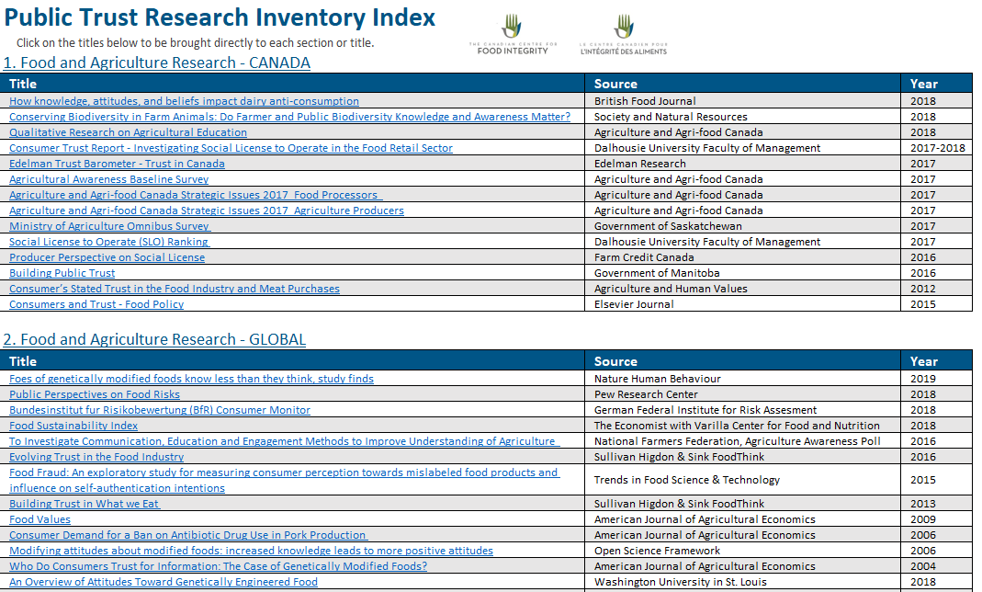

Slide 27
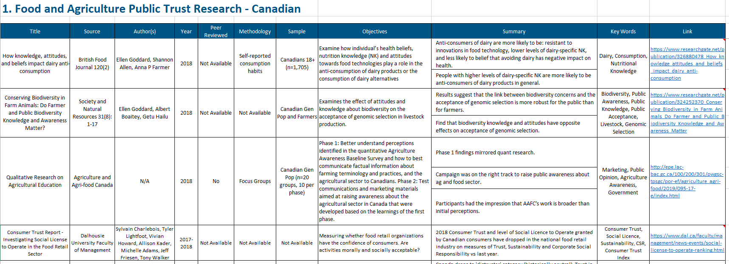

Slide 28
Interested in this work?
Keep in touch.
Sign up for CCFI e-news to get monthly updates and invites to webinars, events, research highlights at www.foodintegrity.ca @foodintegrityCA
Save the date! Public Trust Summit November 13-14th Saskatoon, co-hosted with Farm & Food Care SK

