Slide 1
Federal Carbon Pollution Pricing System – with focus on agriculture
Canadian Federation of Agriculture AGM
February 27, 2019
Wearable technology, developed with funding
from the NSERC Discovery Grants program
Source: Western University

Slide 2
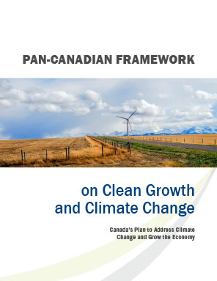
Addressing climate change and growing the economy
Carbon pricing is one of the four pillars of the Pan-Canadian Framework.
Provinces and territories had the flexibility to develop their own carbon pollution pricing systems meeting stringency criteria [the federal benchmark].
The federal government committed to implement, in whole or in part, a system in jurisdictions that request it or that do not have a system that meets the federal benchmark [the federal backstop].
The Pan-Canadian Framework includes more than fifty other measures to reduce greenhouse gas emissions, foster adaptation and resilience to a changing climate, enhance the development and adoption of clean technology solutions.
ADOPTED
December 9, 2016

Slide 3
Key milestones
Oct 2016
Pan-Canadian Approach to Pricing Carbon Pollution announced by PM
Dec 2016
Pan-Canadian Framework on Clean Growth and Climate Change signed by First Ministers
May 2017
Technical Paper on the proposed design of the federal carbon pricing backstop released for comment
Dec 2017
Letters sent confirming Sept. 1 timeline for PT carbon pricing plans
Jan 2018
Jun 2018
Draft Legislative Proposals and proposed regulatory framework for large industries released for comment
May 2018
Compliance options paper released for public comment
Greenhouse Gas Pollution Pricing Act received Royal Assent
Oct 2018
PM announces where the federal system will apply based on assessment against the federal benchmark
Dec 2018
Proposal for OBPS regulations released for comment
Jan 2019
Federal OBPS requirements start to apply in backstop provinces (July 1, 2019 in NU, YK)
Apr 2019
Fuel charge comes into force (July 1, 2019 in NU, YK)

Slide 4
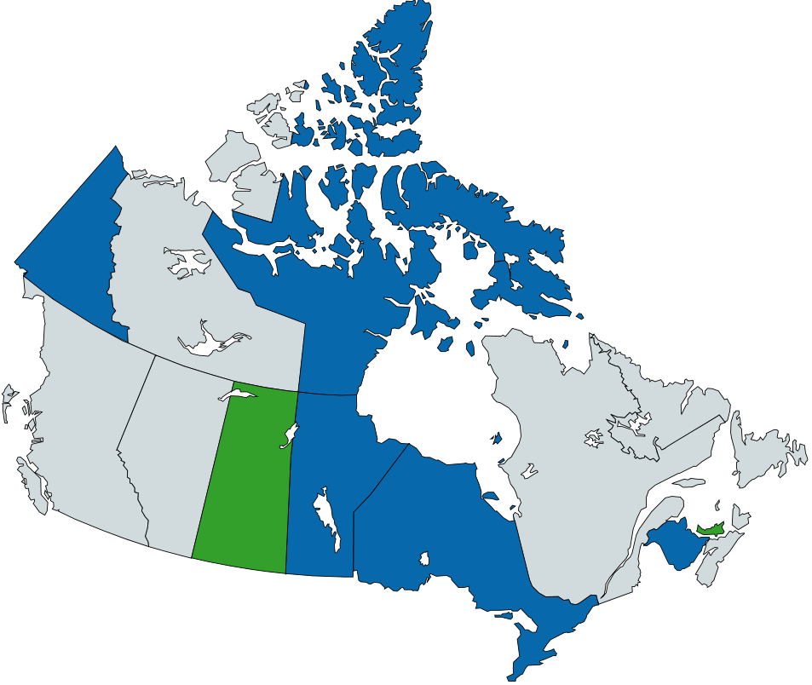
Carbon pollution pricing systems in Canada
Federal backstop applies in full
Provincial/Territorial system applies
Federal backstop applies in part

Slide 5
The federal carbon pollution pricing system
Under the Greenhouse Gas Pollution Pricing Act, adopted on June 21, 2018, the “backstop” has two parts:
Regulatory charge on fossil fuels – will apply on April 1, 2019 in backstop provinces (July 1, 2019 in NU, YK).
Generally payable by fuel producers or distributors
$20 per tonne of carbon dioxide equivalent (CO2e) in 2019, rising by $10 per year to $50 per tonne CO2e in 2022.
Performance-based pricing system for industrial facilities (the Output-Based Pricing System or OBPS) – requirements began on January 1, 2019 in backstop provinces (July 1, 2019 in NU, YK).
Designed to maintain competitiveness of emissions intensive, trade exposed industrial facilities.
Instead of paying the fuel charge on fuels that they purchase, facilities will pay the carbon pollution price on the portion of their emissions above a greenhouse gas (GHG) emission limit; enables emissions trading, including eligible offset credits from provincial systems.
Applies to facilities with emissions of 50 kt and above in covered sectors, with the option to apply for voluntary participation for facilities emitting 10 kt or more in emissions intensive, trade exposed sectors.

Slide 6
Breakdown of Canada’s Emissions by Sector
Agriculture contributes 10.2 % of Canada’s total greenhouse gas emissions.
Agriculture emissions are projected to be 75Mt in 2030, 3 Mt above 2016 levels.
Source: ECCC, 2018, National Inventory Report 1990-2016: Greenhouse Gas Sources and Sinks in Canada, Canada’s submission to the United Nations Framework Convention on Climate Change, Table A10-2.

Slide 7
Most greenhouse gases generated by the agriculture sector will not be subject to carbon pollution pricing
Greenhouse gas emissions from biological sources are not priced.
Biological emissions from crop and animal production contributed to 83 % of emissions from agriculture in Canada.
Targeted relief from the fuel charge
The federal fuel charge does not apply to gasoline and light fuel oil (e.g., diesel) used in tractors, trucks and other farm machinery for the purpose of farming.
This approach is consistent with currently implemented carbon pollution pricing systems in British Columbia and Alberta.
Canada’s Greenhouse Gas Emissions from Agriculture in 2016 (in Mt CO₂e)
Source: Canada – National Inventory Report 1990-2016 part 3, 2018, table A10-2.

Slide 8
Re. Relief from the fuel charge for farmers provided under the federal carbon pollution pricing system
The Greenhouse Gas Pollution Pricing Act provides that a registered distributor can generally deliver, without the fuel charge applying, gasoline or light fuel oil (e.g., diesel) to a farmer at a farm if the fuel is for use of farming activities.
Farmers do not need to register.
The relief is provided upfront through the use of exemption certificates, when certain conditions are met.
The exemption certificate forms are now posted online (https://www.canada.ca/en/revenue-agency/services/tax/excise-taxes-duties-levies/fuel-charge.html)
If you have question on this matter, you may contact:
By email: fuelcharge@cra-arc.gc.ca
By phone: 1-866-330-3304

Slide 9
Impact of carbon pollution pricing on farms where the federal system will apply – direct impact
This impact will depend on consumption patterns, farm size, operation type, weather over a given crop year and the carbon pollution pricing system that applies where a given farm is located.
For an individual farm located in a jurisdiction where the federal fuel charge will apply, the impact can be assessed based on the rates provided in the table below.
Federal Carbon Pollution Fuel Charge Rates for Fuels Commonly Used On Farms
According to Statistics Canada, expenses for heating fuels contributed to about 1% of total farm operating expenses in Canada in 2017.
Partial relief from the fuel charge (80%) is proposed to apply to natural gas and propane used in commercial greenhouses.
Fuels | $20/tonne of CO₂e – April 1, 2019 | $50/tonne of CO₂e – April 1, 2022
Gasoline used on farm | exempt¹ | exempt¹
Light fuel oil (e.g., diesel) used on farm | exempt¹ | exempt¹
Marketable natural gas | 0.0391 $/m³ | 0.0979 $/m³
Propane | 0.0310 $/litre | 0.0774 $/litre
Heavy fuel oil | 0.0637 $/litre | 0.1593 $/litre
Source: Greenhouse Gas Pollution Pricing Act, Schedule 2.
1. Subject to certain conditions (e.g., fuel is used in eligible farming machinery).

Slide 10
Impact of carbon pollution pricing on farms where the federal backstop will apply – indirect impact
Electricity
Facilities generating electricity from fossil fuels will be covered by the federal output-based pricing system, hence they will need to comply for only a portion of their emissions.
The proposed fuel differentiated approach maintains a strong signal to move away from coal while reducing price impacts on business and households.
Under the OBPS, facilities will have the option to comply by paying an excess emission charge, submitting federal OBPS surplus credits, submitting eligible offset credits, or any combination of the above.
Road Hauling and Rail
The impact on transportation cost will vary, notably depending on distance and fuel efficiency of vehicles.

Slide 11
Impact of carbon pollution pricing on farms where the federal backstop will apply – indirect impact (continued)
Fertilizers
Fertilizers produced in backstop jurisdictions will be covered by output-based performance standards – an approach that limits competitiveness risk.
Fertilizer price index from 2002 to 2016, Saskatchewan and British Columbia

Slide 12
Approach to Carbon Pollution Pricing Proceeds
Provinces with their own carbon pollution pricing systems can use proceeds to support their residents, grow the economy, and protect the environment (i.e., BC, Alberta, Quebec, NWT, Nova Scotia, Newfoundland and Labrador, PEI).
Proceeds from the “backstop” will be returned directly to the governments of provinces and territories that requested the federal system (i.e., Yukon, Nunavut, PEI [OPBS]).
In remaining provinces (i.e., Saskatchewan, Manitoba, Ontario, and New Brunswick):
Direct fuel charge proceeds
About 90% will be returned to residents through Climate Action Incentive payments.
Residents in rural and remote areas will receive a 10% supplement.
Residents may claim their payment when filing their tax returns and receive it as part of their tax assessment starting in early 2019.
Remaining proceeds will support SMEs, colleges & universities, schools, hospitals, municipalities, non-profits, Indigenous communities.
OBPS proceeds will be used to support future climate actions in the jurisdiction in which the proceeds are collected.

Slide 13
Potential for carbon offsets
Environment and Climate Change Canada released a proposal for the OBPS regulations on December 20, 2018.
This proposal includes the use of offset credits from existing provincial systems as a compliance option for facilities covered under the OBPS.
The proposal is to establish a list of eligible existing programs and protocols to facilitate the use of offset credits from existing programs in the early years of OBPS implementation.
Protocols for activities that occur across multiple jurisdictions and that are not covered by carbon pricing will be assessed first.
ECCC thus proposes to prioritize agriculture, waste and forestry project types.
The GGPPA allows for the potential future development of regulations to establish a federal offset system for projects that prevent greenhouse gas emissions or that remove greenhouse gases from the atmosphere.

Slide 14
Other government initiatives
Under the current $3 billion policy framework, the Canadian Agricultural Partnership (CAP), the federal, provincial and territorial governments will continue to support various initiatives to help the sector.
Aside from support provided through the CAP, the Government of Canada funds other programs to foster the research and adoption of innovative practices and technologies:
AgriScience and AgriInnovate will help support resiliency and sustainability of the sector through science, research and adoption of innovative practices and technologies ($466 million)
Agricultural Greenhouse Gases Program ($27 million)
Agricultural Clean Technology Program ($25 million)

