Slide 1
Before Going to Market: Ask Polly
CFA – Public Trust Research
Grassroots Public Affairs

Slide 2
1. How do Canadians feel about modifiers in relation to food grown/made in Canada? 2. How do Canadians feel about government regulations for agriculture? 3. How do Canadians feel about food waste? 4. Canadian practices compared to international practices?
Objectives

Slide 3
Definitions
Engagement: Number of Canadians that are posting and sharing a topic on Twitter
Positive: Number of Canadians that are in favour with the statement of measurement
Negative: Number of Canadians that are NOT in favour with the statement of measurement
Neutral: Number of Canadians that are undecided on the statement of measurement

Slide 4
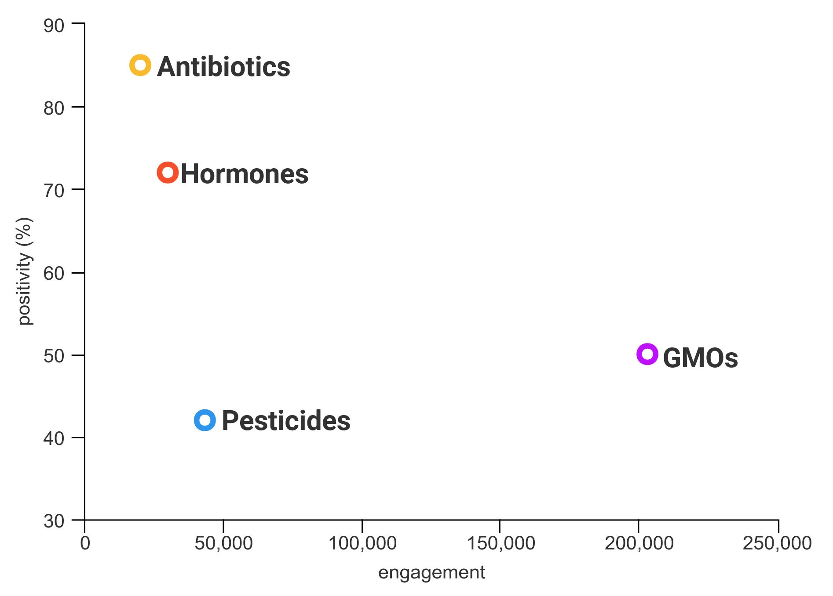
Canadians are most positive towards the use of antibiotics in relation to food grown/made in Canada
Most engaged on GMOs
Most negative on pesticides
Most positive on antibiotics
How do Canadians feel about modifiers in relation to food grown/made in Canada?

Slide 5
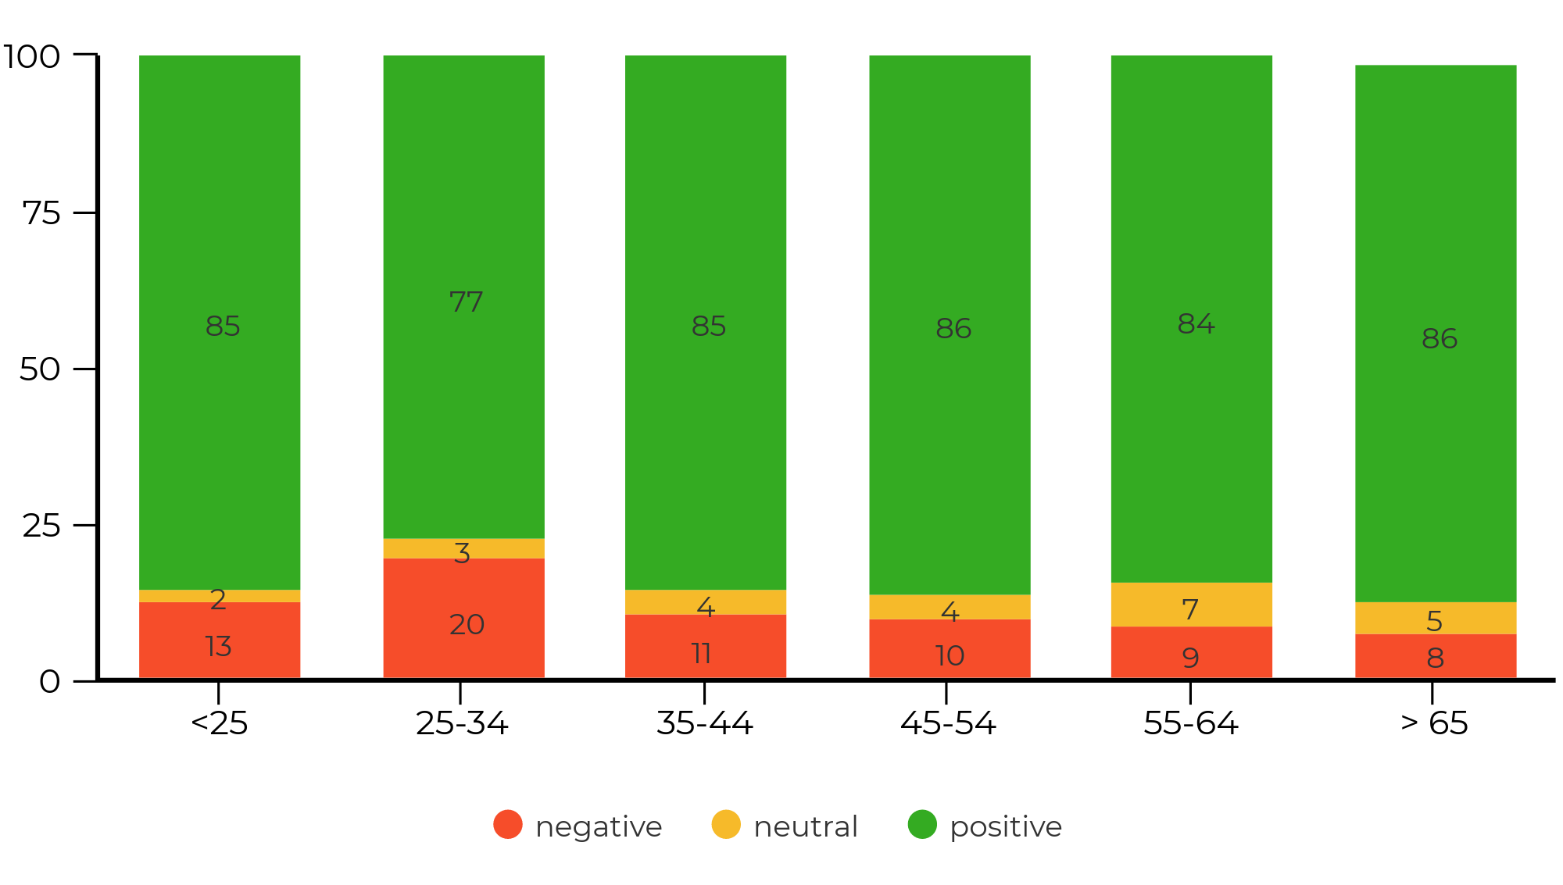
Canadians are more positive than negative towards government regulations
Overall population:
16,700 engaged
84% positive
12% negative
How do Canadians feel about government regulations for agriculture in Canada?

Slide 6
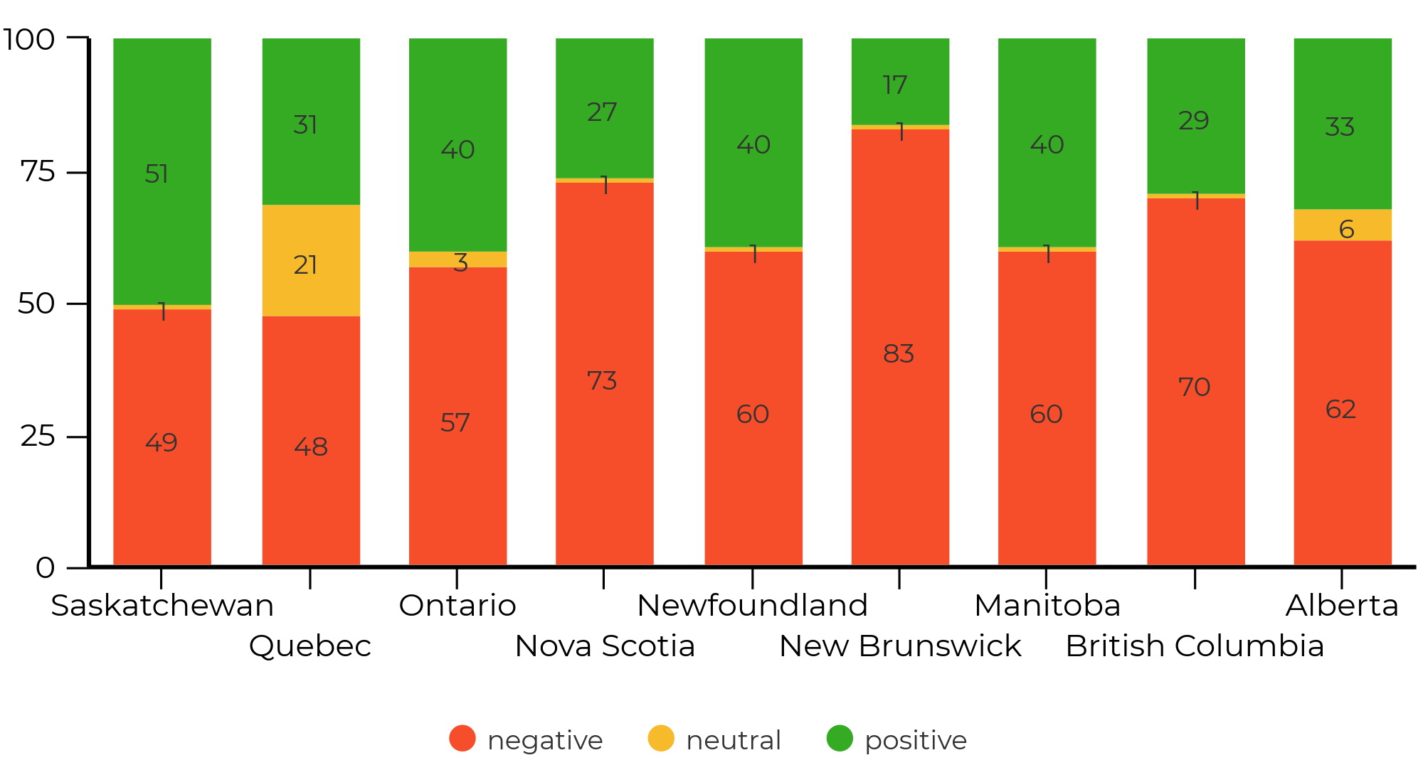
Canadians are more negative than positive towards food waste
Overall population:
259,600 engaged
36% positive
61% negative
Ontario most engaged, then BC
How do Canadians feel about food waste in Canada?

Slide 7
Canadians are slightly more positive towards Canadian food quality, yet more positive to imported food safety
2,736,300 engaged
2,340,400 engaged
711,100 engaged
608,000 engaged
Canadian practices compared to international practices? - Quality of food and food safety

Slide 8
Canadians are slightly more positive towards imported food farming practices and processing standards
168,900 engaged
112,600 engaged
1,405,500 engaged
1,361,200 engaged
Canadian practices compared to international practices? - Farming practices and processing standards

Slide 9
Canadians are slightly more positive towards Canadian food nutritional content
558,400 engaged
524,800 engaged
Canadian practices compared to international practices? - Food nutritional content

Slide 10
1. Canadians are more positive towards the use of antibiotics 2. The Canadian population is in favour of government regulations for agriculture 3. Canadians are negatively engaged on the topic of food waste 4. Canadians are slightly more positive towards imported food safety, farming practices, and processing standards. 5. Canadians are slightly more positive towards Canadian food quality and nutritional content.
Summary

Slide 11
109 York Street, Suite 200 Ottawa, Ontario, Canada
K1N 5T4
info@AdvancedSymbolics.com
(613) 620-3386

