Slide 1

Canadian Federation of Agriculture
AGM 2019
Christa Wright – Operations Manager

Slide 2


Be the LEADER for agriculture education in Canada
Notes:
We strive to be the leader for agriculture education. We provide ABC, accurate balanced and current information.

Slide 3



Notes:
Nine provincial member organizations

Slide 4
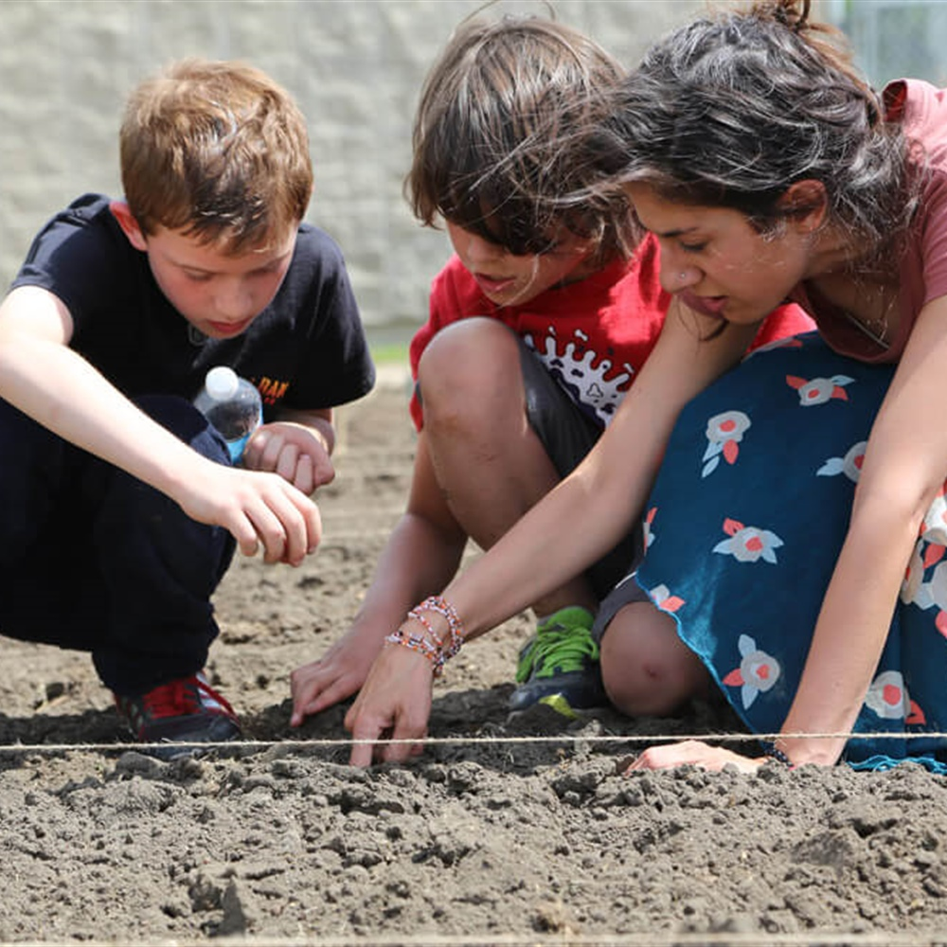
Why Provincial AITC’s
Trusted, boots on the ground to deliver and connect
Vehicle into classrooms
Have built lasting relationships with provincial teachers
Deliver quality provincial resources and programs
Connections with provincial
curriculum

Slide 5

Why AITC Canada
Leverage national funding support for larger scaled projects e.g AAFC
Development of Canadian ag education initiatives to support provincial efforts and increase reach
  thinkAG, snapAG, Canadian Educator Resource Matrix, Curriculum Map tool
National AITC voice reaches new levels of engagement – Public Trust, VCRT

Slide 6


Slide 7
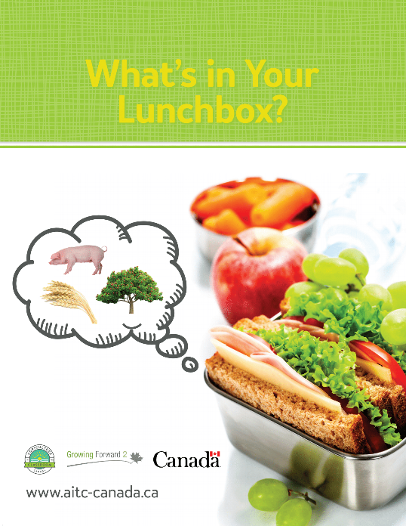
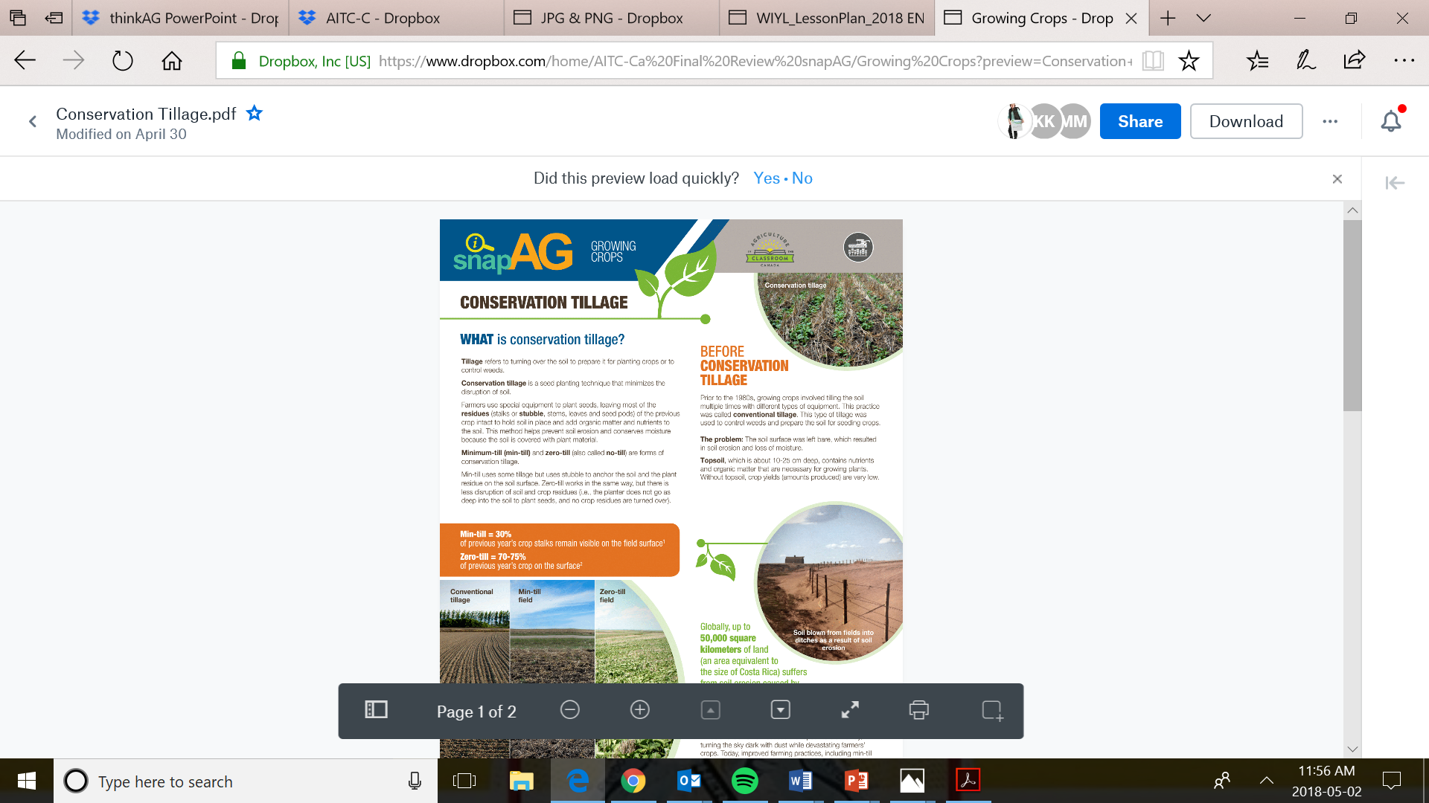

NEW RESOURCES

Slide 8

Notes:
54 two pages of facts on the hot topics in agriculture. They can be used by teachers, students, industry and the public. Animal health, animal care, pesticides, biotechnology, plants, soil, GMO, organics, environment, health, food the list goes on!

Slide 9

Notes:
General Farming, Organics, GMO, plant biotechnology, animal science, food, animal health

Slide 10


ENGAGE!
CAREER RESOURCES
thinkAG come alive
Notes:
AITC-C Canada conducted a survey with 1002 students. Less than half of the students associate these careers with agriculture. Technology & Innovation, Business, Engineering and Mathematics and only 52% science

Slide 11

Notes:
Canadian Agriculture Literacy Month March 2019 We are will reach over 40,000 students, we need volunteers
Our provincial organizations are still seeking volunteers! They have training sessions, tool kits, you don’t have to be a professional speaker. Tell your story!

Slide 12
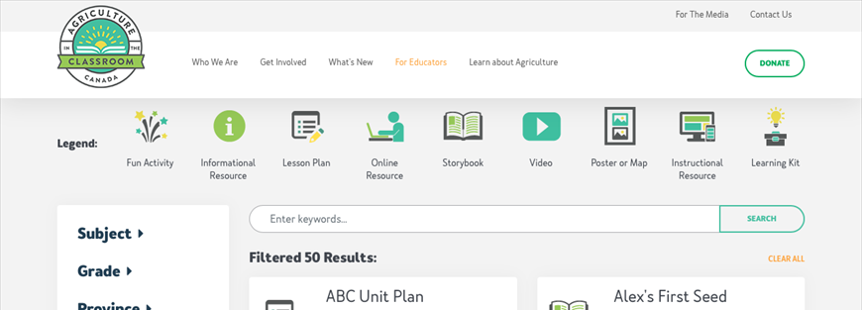
Canadian Educator Resource Matrix
www.aitc-canada.ca

Slide 13
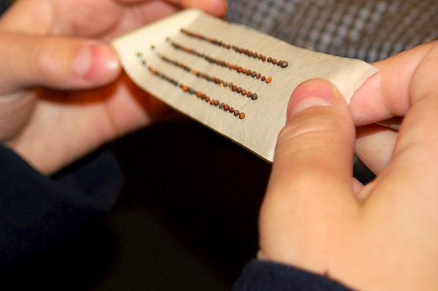
Where to Next?
Scale up and scale out current
offerings
Expand the Educator Matrix-
    invite sector to participate!
Enhance snapAG
Come ALIVE on www.aitc-canada.ca

Slide 14

Partner with us!
  Foundational
  Friends of AITC-C
  Educational Partners
  Strategic Partners
  Events Partners
This Photo CC BY-NC
Notes:
AITC-C’s Foundational Partners are champions of agriculture education in Canada. With a contribution of $10,000, our foundational partners help sustain our work and help us continue our success into the future.
Like all good friends, Friends of AITC-C give our work a boost. These businesses, organizations, and individuals support our work with contributions of up to $10,000.
Our Educational Partners are leaders in moving AITC-C programming forward. These partners provide funding for specific resources, programs, and initiatives that are shared with teachers and students across Canada.
AITC-C is proud to work with our Strategic Partners, who help to plant the seeds of success. Our Strategic Partners help our mission in non-monetary ways, offering support, resources, and expertise in-kind.
We value collaboration and conversations, and our Special Events Partners help make sure our voice is shared. AITC-C has many opportunities for special event partnerships, including sponsorship of meetings, marketing, advertising, and conference fees

Slide 15
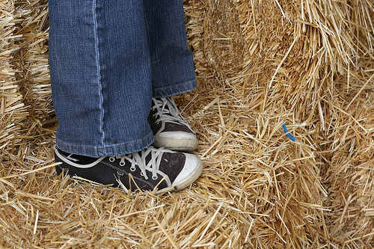
What can YOU do?
  DONATE
  FUND
  PARTNER
  EXPERTISE
  VOLUNTEER
  GET LOUD
  BE PROUD
Notes:
Donate- Who donates to a charity, we are a charitable organization, choose us!
Fund: Fund us, support us, we are delivering ag education to over 1 million students
Partner: 5 different ways to partner, Foundational, Friends of AITC-C, Educational, Strategic and special events
Expertise: You are the experts in your field, we need you to collaborate and work with us to deliver the ABC;s Accurate Balanced and current information
Volunteer: CALM!!!!!
Help us tell your story!
GET LOUD! Be Proud! Our story is a good story, one that we are all proud of, one that needs to be told. We have an obligation to educate students on where their food comes from and how important ALL sectors of Agriculture and Agri Food is.

Slide 16
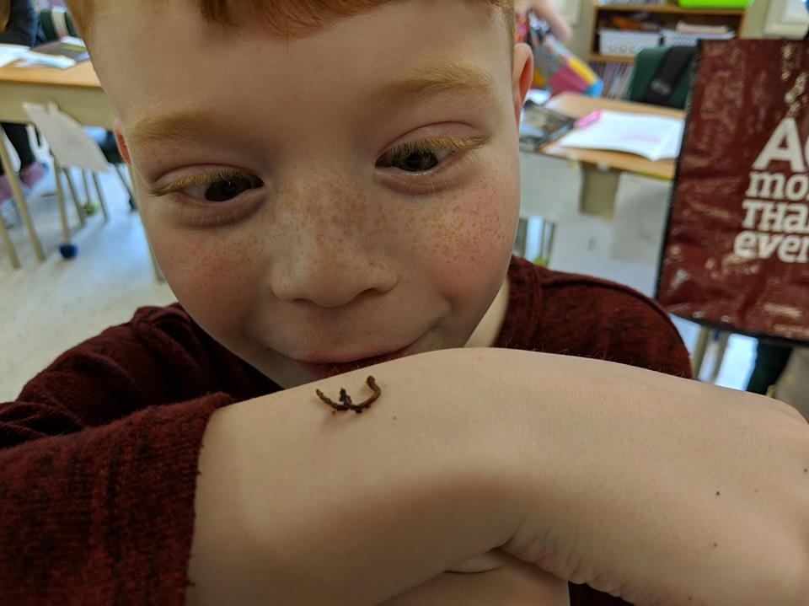
Notes:
5.2 million reasons to partner with AITC-C, this is just one of them.

Slide 17




CONTACT US
www.aitc-canada.ca
@AITCCanada
info@aitc-canada.ca
1-833-AITC-CAN

