Slide 1
Public Trust Communications
Resources Toolkit: Interim Report
March 20th, 2019
Presenters:
Robert Mensies & Brent Smith
Contact:
Adam Kozachuk
204.272.3274
akozachuk@6pmarketing.com

Slide 2
Session Agenda
1.0 Objectives / Project Outcomes 2 min
2.0 Resource Toolkit Overview 3 min
3.0 User Research Findings 5 min
4.0 Public Trust Success Stories 10 min
(introducing six cases, with an in-depth review of one)
5.0 Public Trust Best Practices (overview of one) 8 min
6.0 Communication Tools & Templates 5 min
(five tools with an in-depth review of one)
7.0 Future Optimization
Notes:
Reflect recommendations list of 2.0

Slide 3
1.0 Objectives / Project Outcomes

Slide 4
1.1 Objectives / Project Outcomes
Create a resource kit that helps thousands of individual
agri-food organizations be more effective with their public trust communications
As thousands of individual organizations become more adept at communicating their public trust messages, millions of Canadians can be reached by credible voices
Create pragmatic, highly usable resources that benefit players of all budget sizes across the food chain
Notes:
A compelling “care statement”
An interesting insight that they don’t have
Mention that throughout this Balance the need to provide detailed overviews of each communications component without overwhelming users

Slide 5
1.2 Objectives / Project Outcomes
To develop a pragmatic and highly usable resource kit, acquire an objective understanding of who we’re helping:
  Demographic profile of highest likelihood resource users
  Let users define areas of highest need for communications resources
  Who they view as highest credibility sources and success stories
Develop version 1.0 of the resources, then rely on user feedback to help evolve the resources year over year
Balance the need to provide detailed overviews of each communications component without overwhelming users

Slide 6
2.0 Resource Toolkit Overview

Slide 7
2.1 Resource Toolkit Overview
Part A: PROJECT STRATEGY and APPROACH
    Ideal outcomes, project process, cost/benefit analysis on a national public trust campaign, reporting, exponential collective impact
Part B: PROFILE of TOOLKIT USERS
    User research findings: user demographics, psychographics, public trust (PT) progress level, perceived success stories, road blocks, common PT terminology, useful PT resources and experts
Part C: BEST PRACTICES and INFORMATION
    Defining public trust, audience profiling, messaging and creative development, selecting and purchasing media, social media strategic plan and management, use of media relations, measuring public trust, crisis communication preparation, distribution amplifiers

Slide 8
2.2 Resource Toolkit Overview
Part D: COMMUNICATIONS TOOLS and TEMPLATES
    Overall communications approach, communications plan template, social media strategy template, messaging matrix template, public trust measurement sample research questions
Part E: MAXIMIZING TOOLKIT UPTAKE
    Communications Plan to raise awareness and entice maximum number of food chain players to adopt the toolkit and best practices resources. Standard communications plan includes audience profile, key messages, recommended tactics for reaching audience, budget ranges for creating tactics.
Part F: FUTURE STUDY and FUTURE OPTIMIZATION
    Future considerations and actions to optimize tools and resources

Slide 9
3.0 User Research Findings

Slide 10
3.1 User Research Goals
Goals of the primary user research undertaken by 6P Marketing was to identify:
  Users’ public trust knowledge level and terminology
  Identify where they are in the public trust communication cycle
  Let them define their areas of greatest need (information and tools)
  Who they see as experts and success stories (boosts resource cred)
  Demographic profile of highest likelihood users (geo, size, chain link)
  Increase credibility of final resources by involving users in their development

Slide 11
3.2 User Research Methodology
PTSC leader insights to help form the in-depth research interview guides and survey design
Research interviews with user organizations across the food chain
Research interviews with public trust experts as defined by users
Survey with organizations across the Canadian food chain
(greatest participant concentration was primary producers and producer associations but findings were balanced out by org IDIs and PTSC leadership mentioned above)

Slide 12
3.3 Where They Are in the Cycle
Organizations’ level of exposure to and activities in PT communications are mainly positioned in two scenarios:
  They are learning about the concept or have a base
  understanding but are not sure what steps to take next
OR
  They are building on tactics that are working in their public trust plan (implementing + optimizing) but know there are areas for improvement and are interested in learning from others

Slide 13
3.4 Most Useful Best Practices & Information
Best practices & information mentioned most often as valuable to them include:
  Success stories of how others used communications to improve PT - Useful for adjusting or optimizing their plans
  Objectively measuring your public trust – what to measure and how - So that they can be proactive
  How to write messaging to reach your target audience –
  to use consistent terminology / language in the industry

Slide 14
3.5 Most Useful PT Tools
Tools mentioned most often as valuable to them include (in order):
  PT Communications Plan Template
  Messaging Matrix template
  Social Media Strategic Plan template
  Sample research questions for measuring your public trust
  Quick guide on establishing your overall public trust communications approach

Slide 15
3.6 Recognized PT Experts & Resources
Most often mentioned as PT resources they turn to:
  Food and Farm Care representative
  Sector association
  CCFI representative
Most often mentioned as PT experts:
  Kelly Daynard, ED at Farm & Food Care
  Crystal MacKay, CCFI
  Clinton Monchuck, Farm and Food Care SK

Slide 16
3.7 Respected PT Success Stories
Successes in earning PT seen by users:
McDonald’s – imagery and communications are connected to farmers
Maple Leaf Foods – Crisis management and sustainability work
Farm & Food Care – Messaging about farmers, how things are done and why
Why do they think these organizations were more successful?
  > Having more transparency with what, how and why things are done
  > Connecting farmers with consumers in conversation / dialogue / communications

Slide 17
4.0 Public Trust Success Stories

Slide 18
4.1 Success Story Selection Criteria
Research suggests they are respected success stories
Focus on the communications aspect (messaging/approach)
Ensure at least one success story directly touches each of the specific links in the chain
Also applicable to organizations with smaller budgets

Slide 19
4.2 Template for each Success Story
Each PT Success Story is framed in the following template:
Description of the Challenge Faced: What were the public concerns that needed to be addressed?
Organization’s Actions and Approach: Brief summary of key tactics deployed to counter the challenge and build trust
KSFs and Elements: What was present that culminated in this generating the desired result?
Resulted Impact on the Organization: Measurables and/or positive outcomes from the investment
Applying the Success Elements to Your Organization: How
can this story apply to your organization’s case

Slide 20
4.2 Template for each Success Story
Each PT Success Story is framed in the following template:
Description of the Challenge Faced: What were the public concerns that needed to be addressed?
Organization’s Actions and Approach: Brief summary of key tactics deployed to counter the challenge and build trust
KSFs and Elements: What was present that culminated in this generating the desired result?
Resulted Impact on the Organization: Measurables and/or positive outcomes from the investment
Applying the Success Elements to Your Organization: How
can this story apply to your organization’s case
*Each section will be accompanied by a quote from an industry expert

Slide 21
4.3 Six Success Stories
Maple Leaf Foods
McDonald’s
The “Fresh Air Farmer”
CRSB’s Sustainable Beef Pilot and Program
Farm & Food Care
“The New Farm” Project

Slide 22
4.3 Six Success Stories
Maple Leaf Foods
McDonald’s
The “Fresh Air Farmer”
CRSB’s Sustainable Beef Pilot and Program
Farm & Food Care
“The New Farm” Project

Slide 23
4.4 Maple Leaf Foods: Challenges Faced
A success story for multiple reasons, this is an example of how an organization’s public trust terrain and challenges shift over time, requiring a corresponding shift in communications content and approach
2008’s food safety crisis to 2017’s a.) environmental impact
b.) animal care c.) food additives / nutrition
Notes:
2008 marked the most acute pubic trust crisis in Maple Leaf Foods history (Listeriosis outbreak). They had to regain the public’s trust risk the complete destruction of the brand and/or whole corporation
Fast forward to 2017 when public concerns had shifted to three new areas including: environmental impact of the food Canadians consume, animal care and health concerns related to food additives.

Slide 24
4.4 Maple Leaf Foods: Challenges Faced
“Canadians want to know what and why of processes and practices. They want to know what is being done to
minimize environmental impact. What is being done
to ensure the highest animal care.”
– Clinton Monchuk, Executive Director of Farm & Food Care Saskatchewan
Notes:
2008 marked the most acute pubic trust crisis in Maple Leaf Foods history (Listeriosis outbreak). They had to regain the public’s trust risk the complete destruction of the brand and/or whole corporation
Fast forward to 2017 when public concerns had shifted to three new areas including: environmental impact of the food Canadians consume, animal care and health concerns related to food additives.

Slide 25

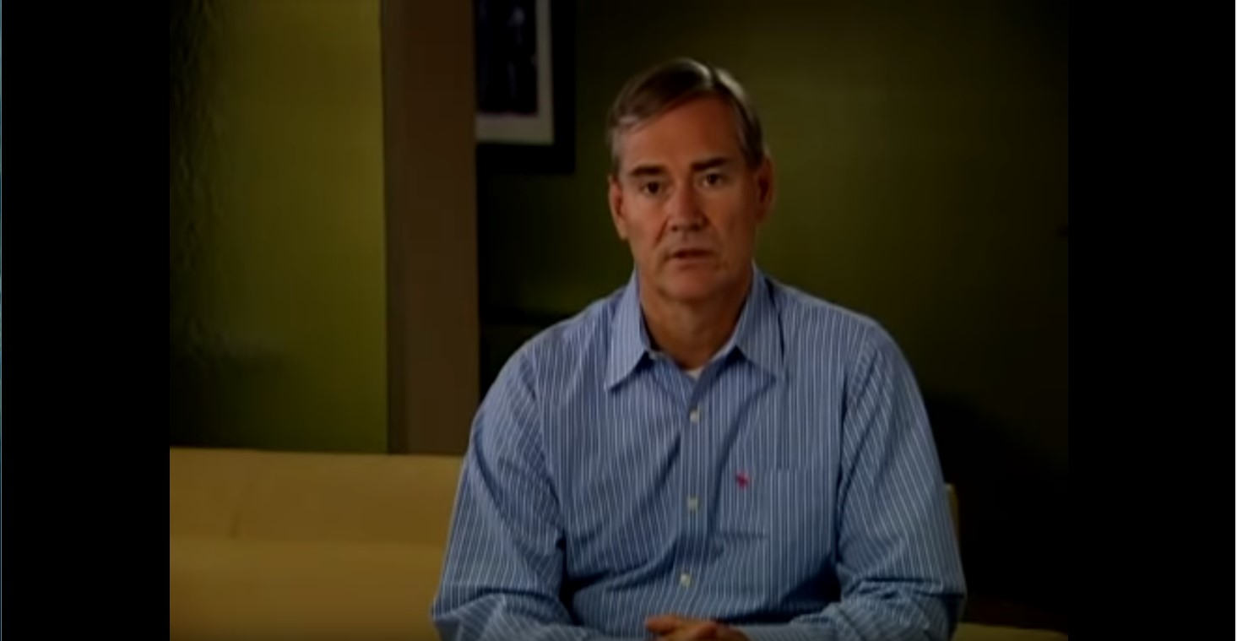
4.5 Maple Leaf Foods: Action & Approach
2008 Food Safety Crisis
Addressed head-on by CEO Michael McCain in a series of national TV ads and online videos: https://www.youtube.com/watch?v=zIsN5AkJ1AI

Slide 26
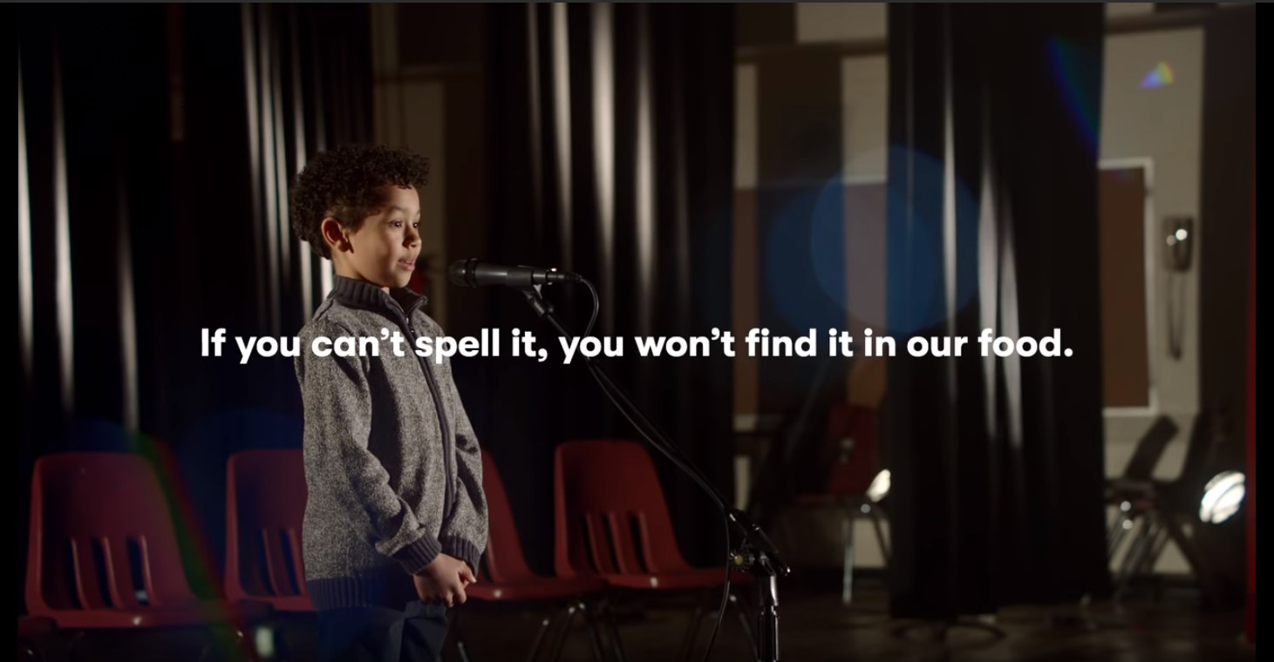
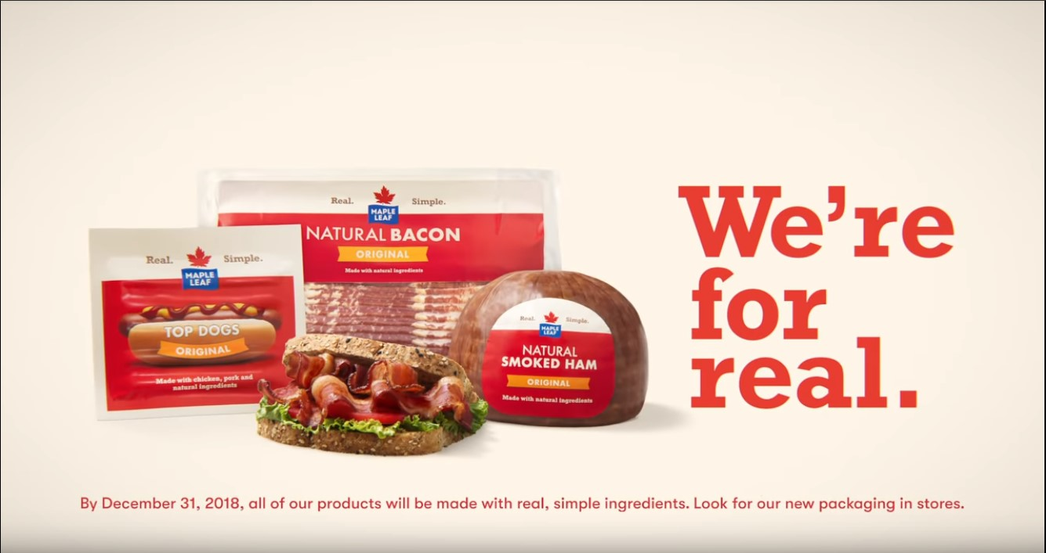
4.5 Maple Leaf Foods: Action & Approach
Food Additives & Processing
To address rising consumer concerns around food additives, the company eliminated most additives from their food, launched a national TV campaign and extensive online campaign promoting videos focused on this commitment: https://www.youtube.com/watch?v=LGBfbyx8FBY

Slide 27
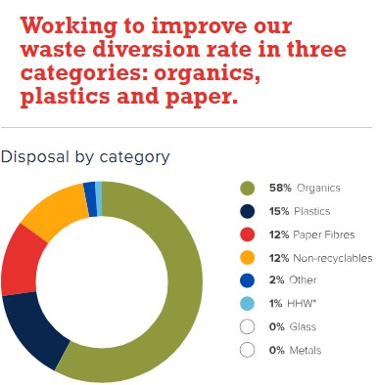

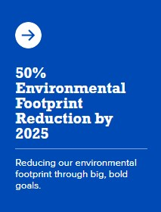
4.5 Maple Leaf Foods: Action & Approach
Environmental Impact & Sustainability
Addressed by measuring environmental impact, setting ambitious goals for improvement, tracking progress against goals, and reporting publicly in an annual sustainability report: https://www.mapleleaffoods.com/sustainability/better-planet/

Slide 28
4.5 Maple Leaf Foods: Action & Approach
“…Showed transparency. Showed the public that
companies could be trusted going forward.”
– Clinton Monchuk, Executive Director of Farm & Food Care Saskatchewan

Slide 29
4.6 Maple Leaf Foods: KSFs and Elements
Food safety / Listeriosis:
  Sincere apology from CEO w/ a large media investment that enabled coast-to-coast reach
  Took total accountability and outlined specific steps to ensure it didn’t happen again
  Food recalls in excess of $20 million so public saw they are taking it seriously
Food additives:
  Invested in a major product change by eliminating high concern food additives
  Financed a national TV campaign and online video campaign to address the topic head-on (“We’re for real”)
Environmental:
  Took accountability and acknowledged the fact that their products have a significant environmental impact — set clear goals, invested in attaining them, and reported annually
  Transparency in measuring their impact in each of these areas
  Set specific goals and timelines to improve them, graded their performance, reported on them annually in an open forum

Slide 30
4.6 Maple Leaf Foods: KSFs and Elements
“…Highlighted to consumers that they are willing to change, put resources into change and making sure that consumer interests come first.”
– Clinton Monchuk, Executive Director of Farm & Food Care Saskatchewan

Slide 31
4.7 Maple Leaf Foods: Impact
In 2008 there was serious question IF the brand could survive the blow to the public’s trust. However, due to their top-calibre approach, Maple Leaf is one of the most respected food brands in the country and a highly profitable corporation
Their approach around sustainability, environmental impact, and animal care are all held up as leading examples of successful public trust by experts and organization leaders in Canada’s food chain

Slide 32
4.7 Maple Leaf Foods: Impact
“By doing the right thing, indicating they made a mistake,
Maple Leaf did not go out of business. Many companies
that did not take ownership of a crisis closed.”
– Clinton Monchuk, Executive Director of Farm & Food Care Saskatchewan

Slide 33
4.8 Maple Leaf Foods: Applying to your Organization
Q1. Are you aware of any negative societal impacts (i.e. environmental) that
your organization or products have on Canadians? If so, would you be
willing to name and talk about the steps you’re taking to improve?
Q2. The focus of Maple Leaf’s public trust communications evolved
significantly over a 10-year period – has your communications focus changed over time?
Q3. When it comes to public trust issues that your customers/stakeholders
have, how would you currently rate your use of video and website
content to address them (straightforward, accessible, pleasant to
consume, reasonably objective)? Is there room for improvement and,
using Maple Leaf as an example, how might you improve?

Slide 34
4.8 Maple Leaf Foods: Applying to your Organization
“If we don’t get out of the gate and lead where
agri-food goes, we are going to be pulled into
a game that we don’t want to be in.”
– Clinton Monchuk, Executive Director of Farm & Food Care Saskatchewan

Slide 35
5.0 Best Practices Information

Slide 36
5.0 Best Practices Information
Defining public trust
Audience profiling
Messaging and creative development
Selecting and purchasing media
Social media strategy and management as it relates to PT
Use of Media Relations (press coverage)
Objectively measuring your public trust
Crisis communications preparation
Amplifiers that can help with your content and message distribution

Slide 37
5.0 Best Practices Information
Defining public trust
Audience profiling
Messaging and creative development
Selecting and purchasing media
Social media strategy and management as it relates to PT
Use of Media Relations (press coverage)
Objectively measuring your public trust
Crisis communications preparation
Amplifiers that can help with your content and message distribution

Slide 38
5.1 Selecting and Purchasing Media
It’s important to understand the value and capability of each individual platform in delivering your message
No one medium can reach all of your audience
The following are the different types of media and how
you might use each to your advantage:

Slide 39
5.1 Selecting and Purchasing Media
Traditional Media
Traditional media platforms play a significant role in delivering your message through popular, culturally specific mediums.
Out-of-Home Advertising
  Highly noticeable, budget flexible, audiences on the go
Television
  Trusted, credible, and highly influential, fosters emotional connection, most versatile and far-reaching medium
  30-second spots offer opportunities for sponsorship tags and live interviews as well as appearances on local, community-focused programs
Radio
  At home, in the car, at work, and at play
  Very cost-effective
Print
  Highly impactful and influential
  Mass circulation and/or reach a very targeted niche audience

Slide 40
5.1 Selecting and Purchasing Media
Online Media
Online advertising is cost-effective, targeted, and highly measurable. It provides a high level of engagement and interactivity.
Websites
  Attracts your target audience
  Provides calls to action, motivates them to take further action
Pay-per-Click / Paid Searches
  Target your audiences based on interests and online search history
  Top of the Google search page results when desirable key words are entered
Social Media
  Find, target, and reach your audience with ease
  Widespread, mass campaign or campaign(s) targeting very specific groups

Slide 41
5.1 Selecting and Purchasing Media
Grassroots
Connection and conversation with your audiences, engage them one on one.
Examples:
Events like community fairs; exhibitions; sporting events; consumer, community, and industry events
Harness the power of agri-food youth networks and organizations such as 4H and Agriculture in the Classroom to spread the word through various non-producer-targeted programs
Creating programs and information pieces that can be delivered at the farm gate

Slide 42
5.1 Selecting and Purchasing Media
How to choose the best media to deliver your message
Your audience → Who are you trying to reach?
Your messaging → What is your campaign message going to be?
Your budget → What is your annual budget?
(own the audience you can afford to own)
What are your KPIs? → What are you going to measure and how are you going to measure it?

Slide 43
6.0 Tools and Templates

Slide 44
6.0 Tools and Templates
Tools and templates provided will be of value to agri-food organizations of large and small budgets, complex and simple
Your overall PT communications approach, what you need, where to start
Public Trust Strategic Communications Plan template
Social Media Strategic Plan template
Messaging Matrix template to summarize all key PT messages
PT measurement – sample research questions

Slide 45
6.0 Tools and Templates
Tools and templates provided will be of value to agri-food organizations of large and small budgets, complex and simple
Your overall PT communications approach, what you need, where to start
Public Trust Strategic Communications Plan template
Social Media Strategic Plan template
Messaging Matrix template to summarize all key PT messages
PT measurement – sample research questions

Slide 46
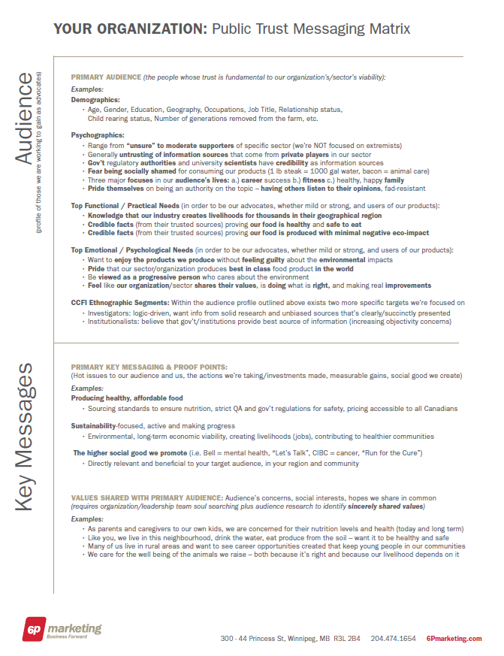
6.1 Messaging Matrix Template

Slide 47
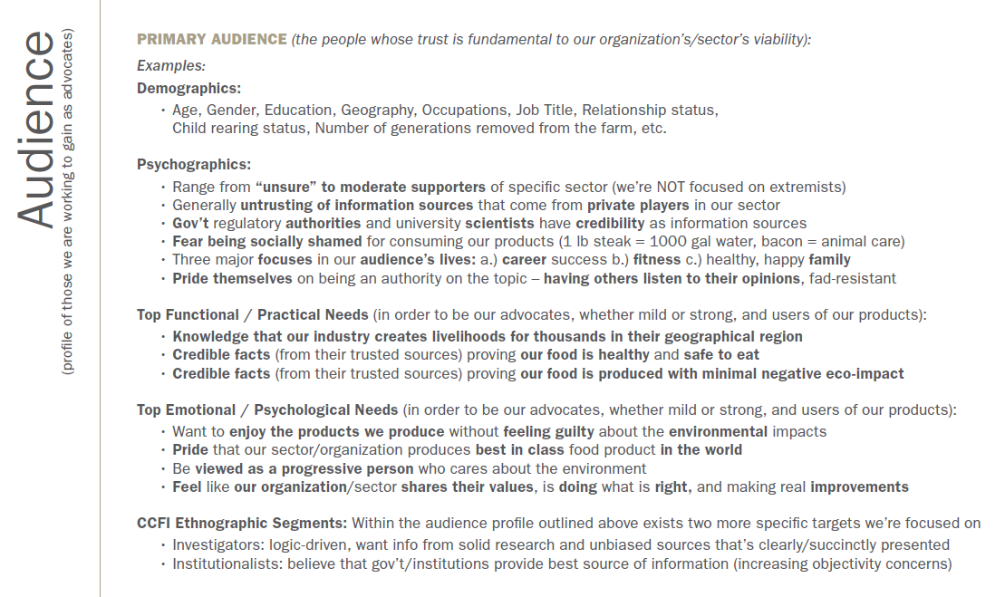
6.1 Messaging Matrix Template

Slide 48
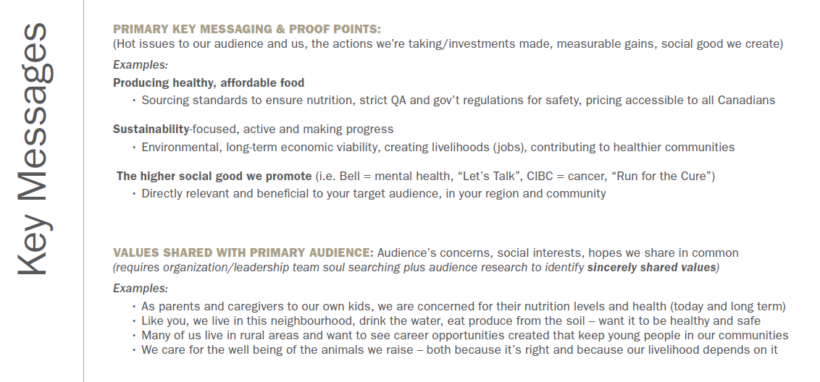
6.1 Messaging Matrix Template

Slide 49
6.2 Messaging Matrix Content
A messaging matrix is a critical strategic tool composed of:
a brief audience summary (including functional and emotional needs, differentiation and purchase criteria) and prioritizes the primary and secondary key messages to be communicated in all forthcoming marketing tactics:
  Ensuring alignment with your target audience profile, functional and psychological needs
  Ensuring consistency and prioritization in the messaging across internal and external tactics on your PT campaign
  Functioning as a standalone strategic tool to guide copywriters, content developers, and designers in order to craft compelling messaging and tactics that resonate with target audiences

Slide 50
7.0 Future Optimization

Slide 51
7.0 Future Optimization
For future steps, we recommend:
After 8 to 10 months in market, carry out an objective assessment of the PT resources and toolkit, primary lines of inquiry being:
  Toolkit usefulness
  How to optimize tools
  Missing pieces
Recommended methodology is 18 in-depth research interviews (3 for each of the 6 links of the value chain), as well as online survey to resource kit users

Slide 52
Thank You

Slide 53
8.0 Appendices

Slide 54
8.1 Resource Toolkit Sources
Multiple sources of research and expertise have been used to develop the resource kit, including but not limited to:
  Direct insights for leaders of the PTSC
  Findings from Kim McConnell’s 2016 public trust report
  Canadian consumer food multi-year trends from CCFI
  Digital ethnographic research from CCFI
  A decade of public trust communications experience of 6P Marketing
  Research interviews with public trust experts (as defined by users)
  Research interviews with user organizations across the food chain
  Survey with organizations across the Canadian food chain

Slide 55
8.2 User Findings: PT terminology
Users are most often mentioning trustworthiness and credibility when talking about PT:
Tone is seen as important and they would like to use terminology that is more inclusive to improve their PT standing such as
Dialogue, Building relationships, Listening, Transparency, Cultivating trust
They do NOT like and want to avoid terms they view as more condescending / confrontational such as
Ability, Acceptance, Education

Slide 56
8.3 User Findings: PT roadblocks
Most significant roadblocks in progressing their PT communications include:
Not enough time to push it forward
Lack of budget
Most significant roadblocks in acceptance of what the PTSC is doing re: PT communications help:
Need to trust where the PTSC tools and resources come from:
  Who are their experts?
  Need transparency with their criteria for experts and processes
  Need a tone that is collaborative; not be “spoken down to”
  Want to be kept informed about what the PTSC is doing

Slide 57
8.4 User Findings: Highest likelihood users
Smaller organizations with more budgetary restrictions and less time to prioritize public trust communications are most in need of these best practices and tools
All sectors and levels see the value in these tools
Influencers of decisions relevant to PT are most often Board or member committees followed by Directors of Communications
Nearly half of those interviewed online and in-depth indicate they have easy access to expertise; however, they are still likely to use the best practices and tools discussed in this research

