Slide 1
Forecasting and Addressing Employer Skills Needs
A presentation to the EI Employers’ Forum
Benoit Tessier, Director General
November 1, 2018

Slide 2
Overview
Key trends guiding our priorities
Trends transforming sectors, industries, and occupations
Key priorities framing ESDC’s policy agenda
ESDC programming that supports employers:
  Sectoral Initiatives Program
  Student Work Placement Program
Discussion

Slide 3


Key Trends Guiding our Priorities
Canada benefits from a skilled labour force…
Low national unemployment rate (lowest in 40 years), high employment rate, and strong job growth
Highest post-secondary education attainment level among OECD countries
… but challenges remain
Slow labour growth with aging demographics
Labour shortages and skills mismatches in sectors / occupations plus high unemployment in some regions
Meanwhile, some groups are more vulnerable
Indigenous people face persistent skills and employment gaps
Impact of automation/technology on jobs and skills
Sectoral innovations and transformations are creating challenges and opportunities for local workforces
Women have lower participation rates and income, and are underrepresented in some occupations
Impact of automation on low-skilled, middle-skilled workers
Workers from under-represented groups are more vulnerable

Slide 4



Trends Transforming Sectors, Industries & Occupations
What does it mean…
A call for action…
  Key drivers of change:
  Changing Skills Needs
  42% of all jobs could be adversely impacted by automation over the next two decades – Brookfield Institute
  half of jobs are expected to go through a significant overhaul of the skills required – RBC’s Human Wanted Report
  Innovation driving increasing demand for higher skills (e.g. digital)
  Significant Growth in Some Sectors
  Canadian economy expected to add 2.4 million jobs over the next four years, all of which will require a new mix of skills
  Difficulty finding skilled workers
  39% of Canadian SMEs are having difficulty finding new employees – BDC 2018 Labour Shortage Report
  “Canada needs a solution to help fill the gaps in labour market information on skills and competency demands and there is a need for increased collaboration with employers to determine what competencies will be required in the Canadian economy” Canada’s Advisory Council on Economic Growth
  “Canada needs to work with business and post-secondary education partners to improve the collection and analysis of labour market data… … as well as to invest in internships for Canadians to develop experience and other soft skills that employers are looking for” Universities Canada 2014
Technology
Global Integration
Changing Demographics

Slide 5
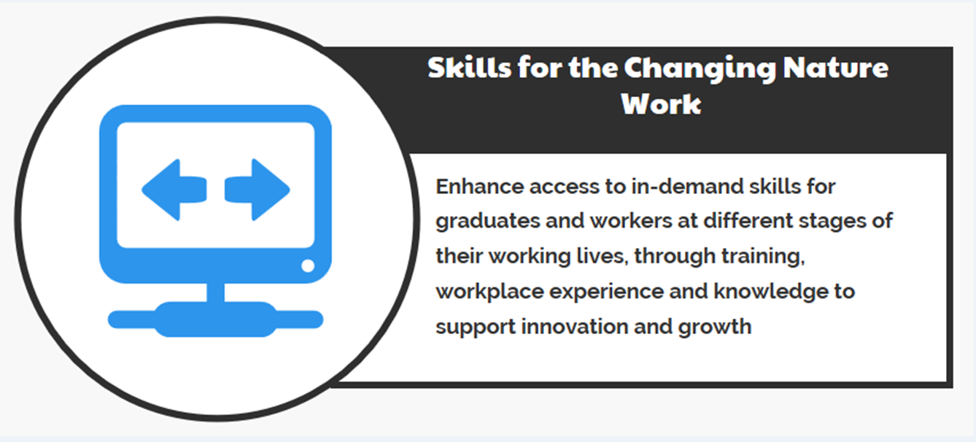



Four Key Priorities Frame ESDC’s Policy Agenda

Slide 6
Sectoral Initiatives Program (SIP)
Demand-driven program helping sectors identify, forecast and address human resources and skills issues
Address current and future skills shortages by supporting the development of sector-specific or cross-sectoral intelligence, national occupational standards, skills certification and accreditation systems
Funds partnership-based projects that bring together industry associations, employers, unions, post-secondary education institutions, and other levels of government
Call for Proposal every 3-4 years, with the flexibility to fund projects in between if funds are available
Annual program budget of $26.9 million

Slide 7
SIP Business Lines
Sectoral
Intelligence
National
Occupational
Standards
Certification
Accreditation
Regimes
Business Lines
Outputs
Outcomes
Sectoral Intelligence (LMI)
Industry Forecasts
Informed Business Decisions
NOS
Occupational Standards
Industry Validated Skill Requirements
Certification/Accreditation Regimes
Curricula/Training
Alignment of Business/Training/Skills

Slide 8


Sectoral Intelligence (LMI)
Stakeholder organizations in key economic sectors produce high quality projections of skills needs
communicate their demands
use the information effectively for decisions on major investments, HR planning, recruitment, and training strategies
Mining Industry
Forecasts
Industry specific forecasts of changes in employment and hiring requirements – national & regional
Ties projections to commodity price variability – presenting differing scenarios
Private sector and provincial governments use MiHR’s LMI modelling system to produce custom reports to help address HR/skills challenges
Construction LMI
Based on surveying the plans of purchasers of construction services
Validated by a network of regional and local stakeholders across Canada
Forecasts produced annually, track projected labour market tightness by region and occupation over 1-10 years
Information used to plan projects &, training offerings, for job seekers to make career decisions

Slide 9

National Occupational Standards (NOS)
Standards are put in place or updated to allow for:
consistent national approaches to defining skill requirements of jobs
skills development & recruitment, that align with sector needs and expectations
NOS are effective tools for:
Improving communication between employers, educators, trainers and workers of expectations and requirements
Addressing weaknesses in inconsistent education/training supply across an occupation
Establishing:
competency-based HR management
credentialing approach to occupational training
ITAC’s Business Technology Management (BTM) constructed its ICT educational accreditation and career planning program using 27 priority NOS
BTM programs boost universities’ capacity to provide students with leading edge knowledge and skills based today’s high tech labour market targets: core business practices and ICT specific tools
3,200 students currently enrolled in BTM programs in 20+ universities
BTM programs boast 1,000 graduates annually, over 10% enrolment growth and 90% graduate placement rate

Slide 10

Certification and Accreditation
Employers have a reliable proxy measure (via certifications) of skill competency that:
  indicates skill-readiness for jobs
  is transferable across regions and specific business contexts
Certification and accreditation systems are effective for:
Integrating a formal quality control framework for education/training
Validating competencies acquired from training and experience
Easing labour mobility and labour market adjustment
Enabling employers to know what skills they’re getting
emerit Tourism Training and Certification
Most comprehensive occupation-specific training for tourism jobs in the world
Certification for 27 high demand occupations (e.g. Travel Counsellor, Sales Manager, and Food & Beverage Manager)
Over 12,000 emerit-certified professionals working in Canada

Slide 11
SIP: Funding Innovative Solutions
Terms and Conditions include the flexibility to invest in “creative solutions to labour market issues”
SIP has invested in some exploratory and innovative initiatives that have contributed to subsequent programming:
  A SIP-funded project with the Canadian Manufacturers and Exporters and Siemens tested the concept and led to the development of the Student Work Placement Program.
  A SIP-funded project with University of Ottawa led to the Budget 2018 announcement of the Education and Labour Market Longitudinal Linkage Platform.

Slide 12



SWPP: Government of Canada Announcements
The Government of Canada’s 2016 Budget announced a one-time investment of $73 million over four years to better prepare students for the world of work by supporting:
In 2018, the Government increased its commitment to helping students by investing an additional $11.3M over three years to create 1,500 new additional student work placements in cyber security and artificial intelligence fields to ensure Canadian students are at the forefront of emerging global trends
  new co-op placements and
  work-integrated learning opportunities for students,
  with a focus on high-demand fields, such as STEM and business.
  partnerships between employers and willing post-secondary institutions
  to better align what is taught
  with the needs of employers.

Slide 13











Student Work Placement Program (SWPP)
Information and Communication Technology
ACTIVITY STREAM 1:
Create
new work placements
Up to 11,500 new work placements
Wage subsidy of up to $5,000 per placement
Wage subsidy of up to $7,000 for under-represented groups: women in STEM, newcomers, indigenous, 1st year students, disabled students
Focus on developing work-ready skills – emphasis on entrepreneurship / business skills to support innovation
Biotechnology
STUDENT WORK PLACEMENT PROGRAM
supports sustainable quality work placements for students in
high-demand fields, such as STEM and business.
Environment
Aerospace / Aviation
EMPLOYER CONSORTIA
Mining
ACTIVITY STREAM 2:
Support sustainable partnerships between Industry and willing PSE
Direct connections between PSE institutions and employers to align skills development to labour market demand
Outreach and support to facilitate participation of SMEs
Entrepreneurship
Electricity
Financial Services

Slide 14




Delivery Approach: Employer Consortia
EMPLOYER CONSORTIA
Third‑party organizations representing the skills development and human resource interests of a sector, engage with:
EMPLOYERS
  to ensure quality WIL placements are offered.
  to ensure that large employers act as industry champions.
  to help SMEs participate in WIL.
PSE INSTITUTIONS
  to promote student work placements and recruit PSE students.
  to collaborate with employers to align skills development to labour market demand.
STUDENTS
to help them find relevant WIL opportunities in their field of study/career path.
to provide feedback on the quality of WIL placements.

Slide 15
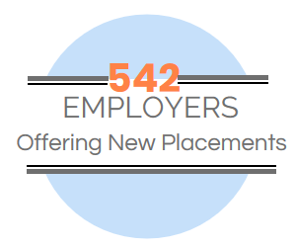
SWPP: Placements in Key Economic Sectors
151
Environment
249
Information &
Communications
Technology
102
Biotechnology
15
Aerospace &
Aviation
11
Electricity
14
Entrepreneurship

Slide 16
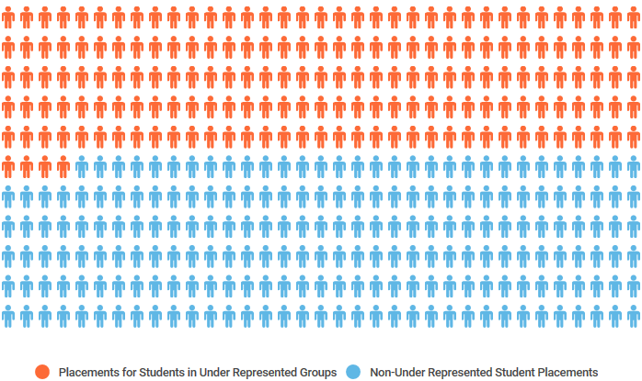
SWPP: Exceeding Targets for
Under-represented Groups
46%
of total student work placements created
through the SWPP were for students in
under-represented groups

Slide 17
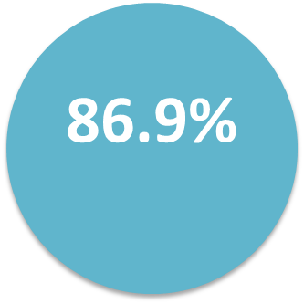
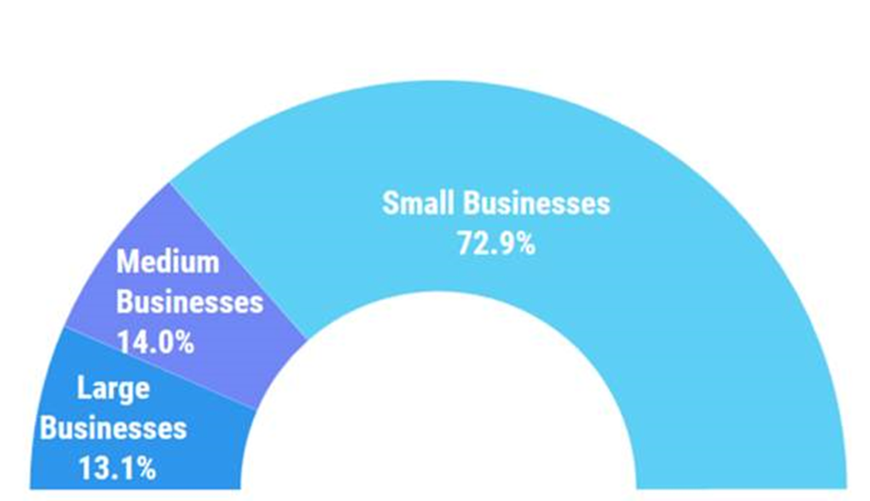
SWPP: SME Representation
of all employers participating in the Program were SMEs!

Slide 18
Discussion

