Slide 1
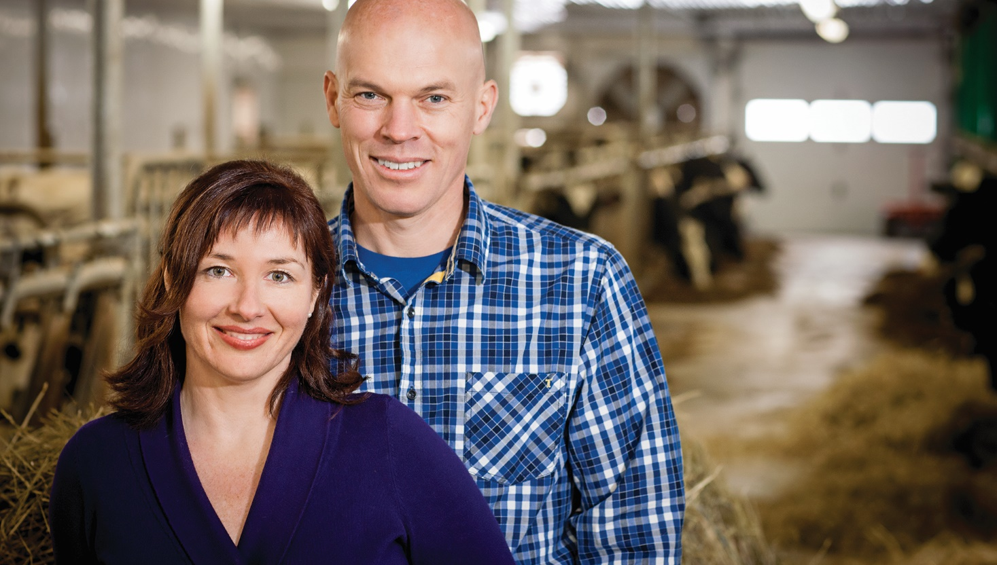
The power of partnership
Michael Hoffort
President and CEO
Farm Credit Canada

Slide 2
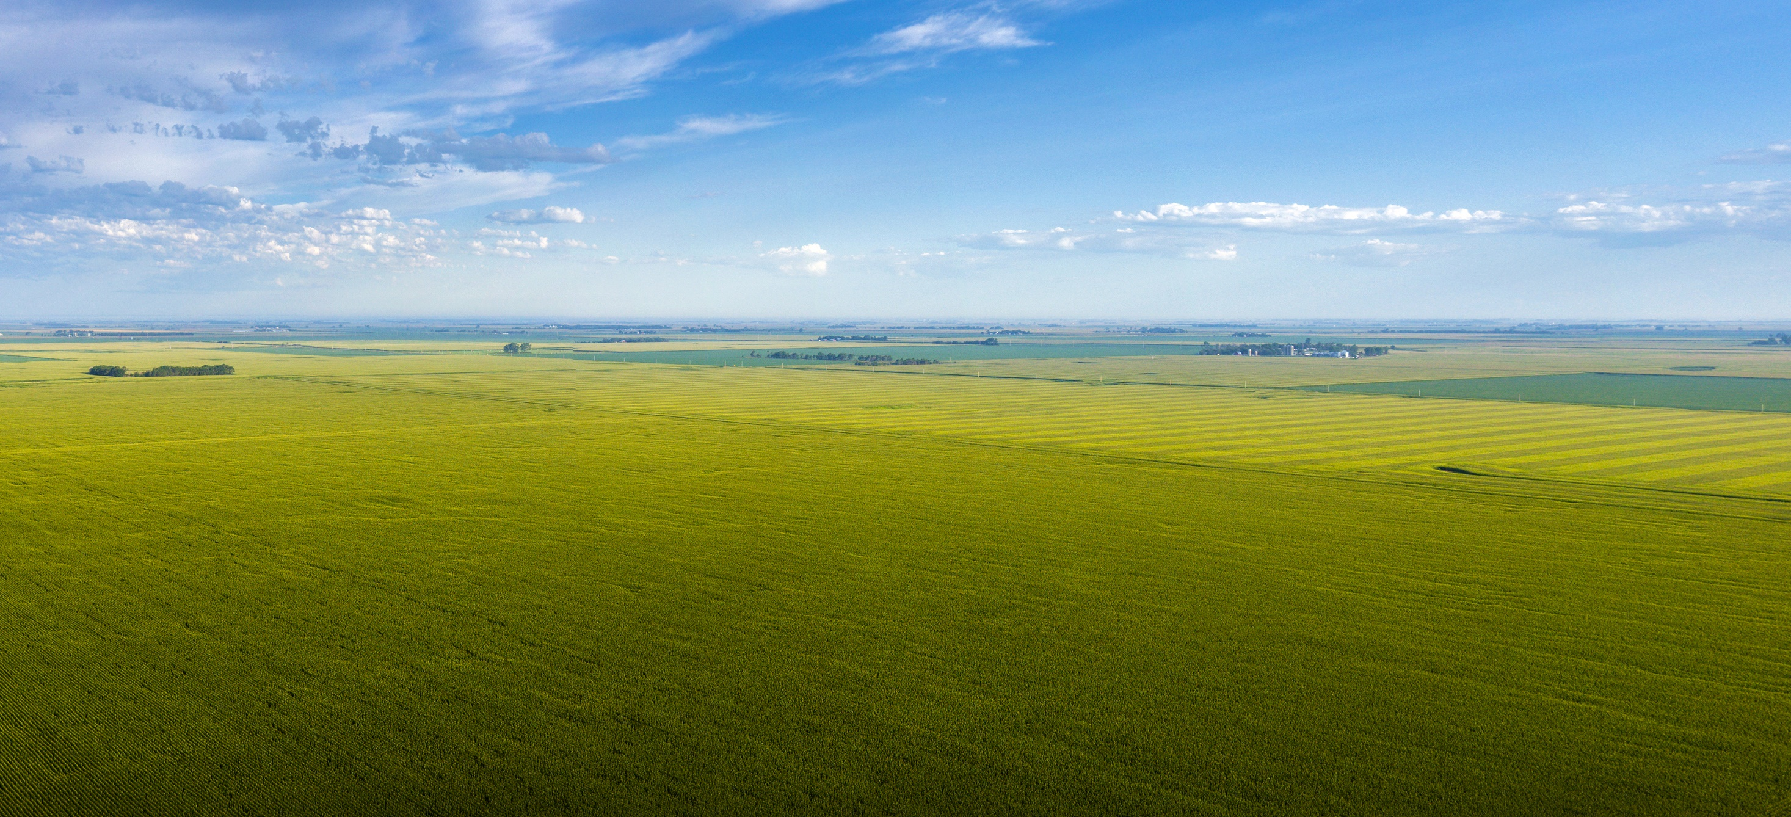
Agenda
Debrief on Canada’s Agriculture Day
FCC’s response to industry opportunities
The power of partnership

Slide 4
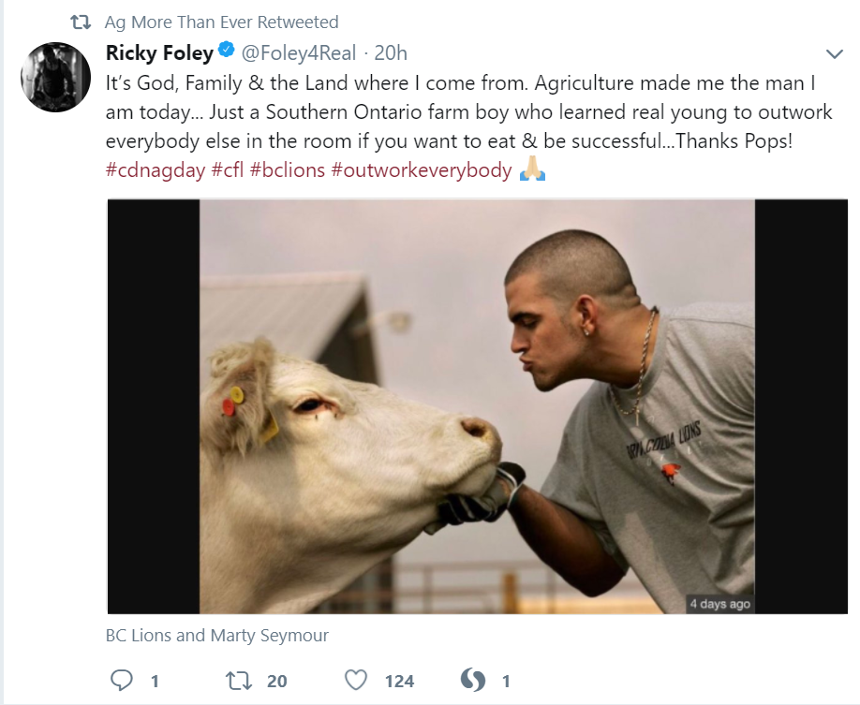
23 million people reached through social media
250+ events

Slide 5
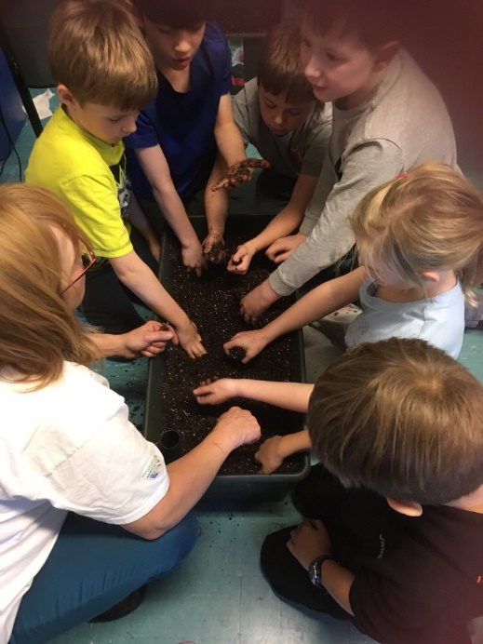
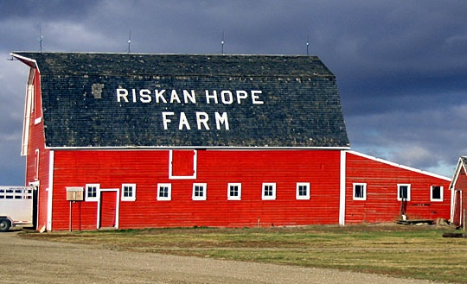
250+ events across the country!
#CdnAgDay
Craik, Saskatchewan
University of Guelph
Ag in the Classroom Newfoundland
Notes:
As I speak, our hashtag that you can see on the top-right corner of the screen is trending in Canada.
Well over 100 events across the country, touching thousands of people!
Agriculture in the Classroom Newfoundland and Labrador events in the schools
Riskan Hope Farm tour – bringing students to visit a farm in Craik SK
University of Guelph Food Talk is hosting an event at the university to help share their story with students, staff and community members
Not every event is a huge one either. A couple of hours down the road from the Riskan Hope Farm , near Shell Lake Saskatchewan, a farmer named Irene is inviting people to her place for a kitchen party! Irene is a small farmer who has llamas, sheep and goats. These are usually the types of events that we don’t hear about but know there’s many just like this being planned. It shows the true essence of Canada’s Agriculture Day and it’s inspiring all types of people across Canadian agriculture to get involved.

Slide 6
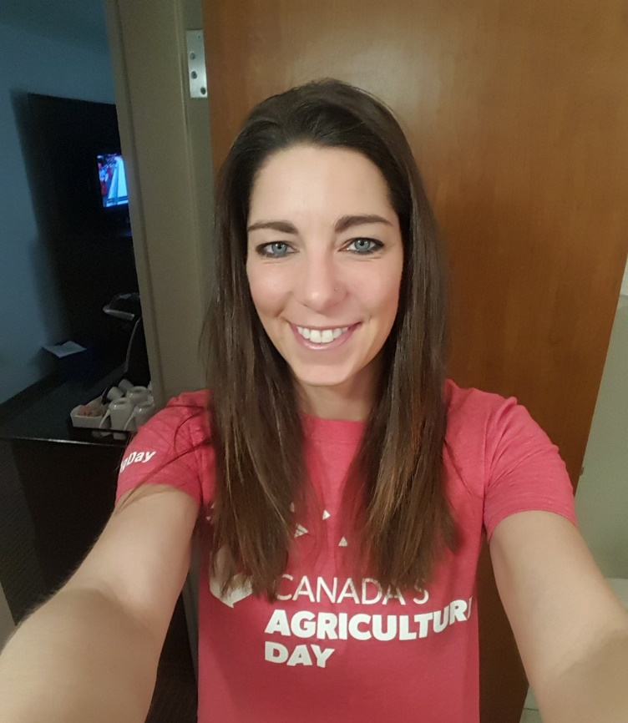
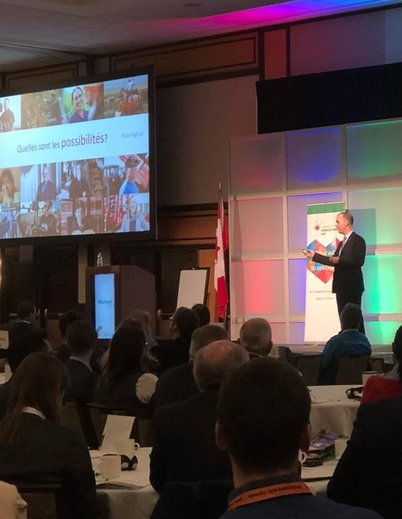
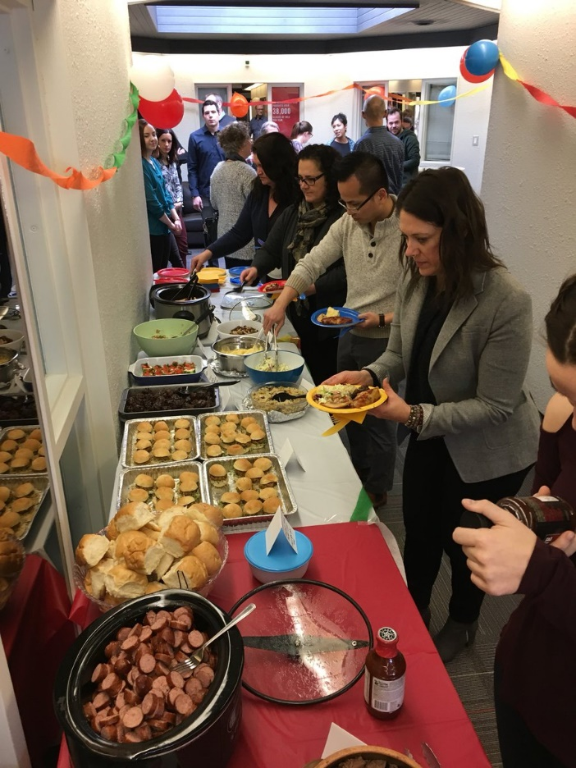
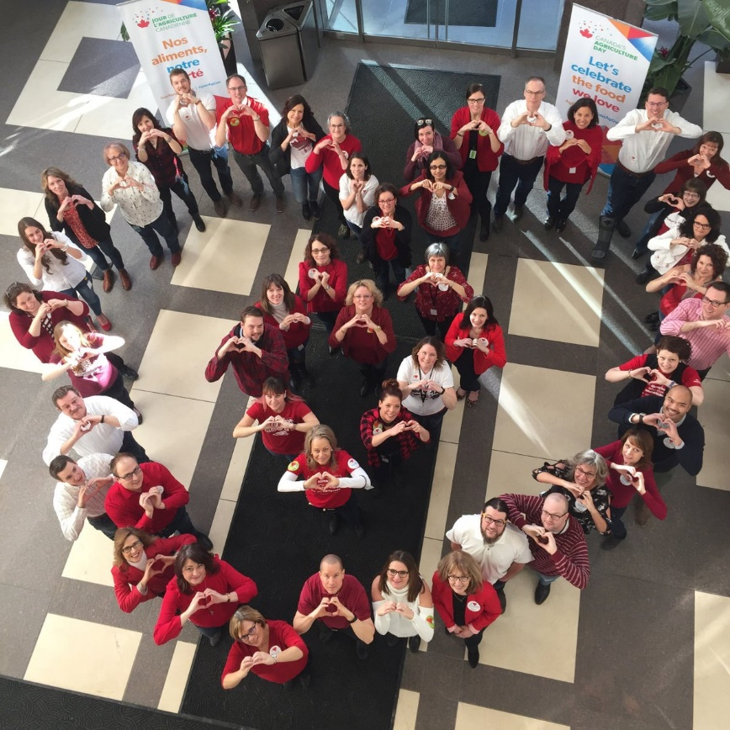
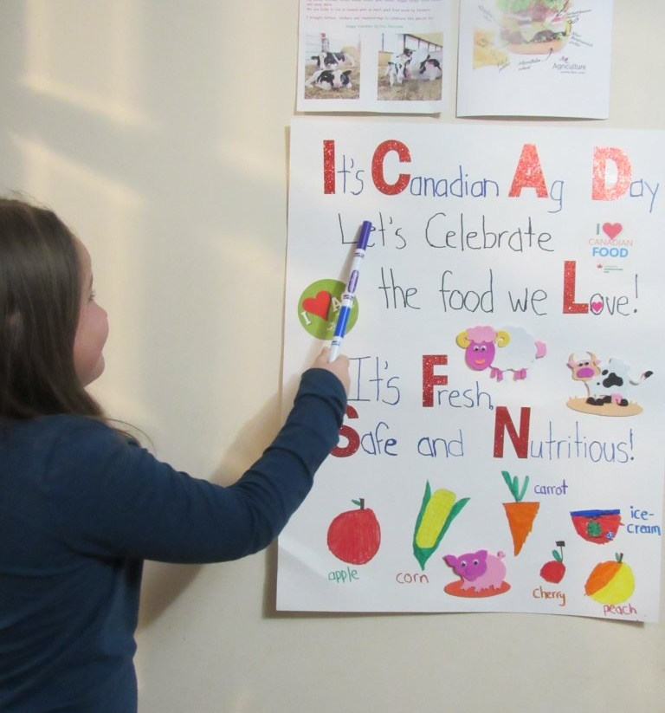
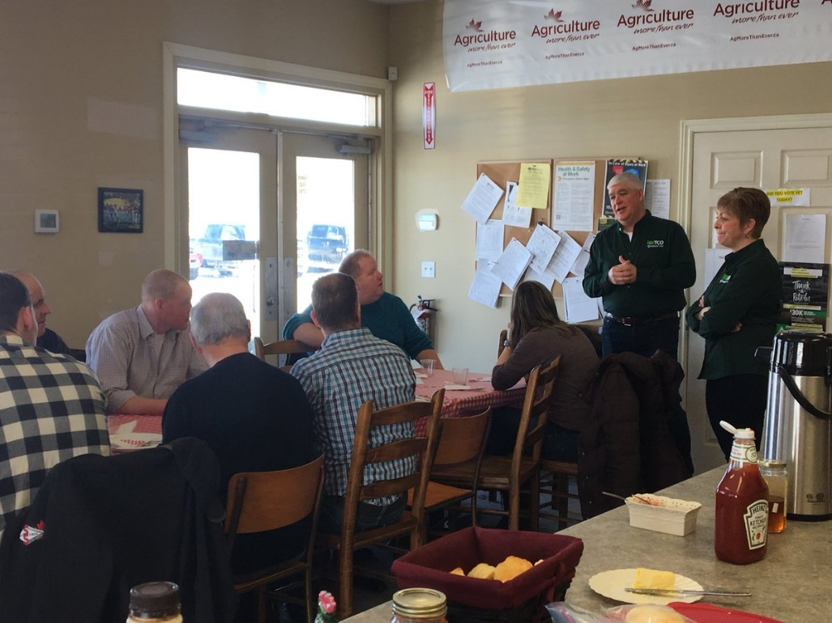
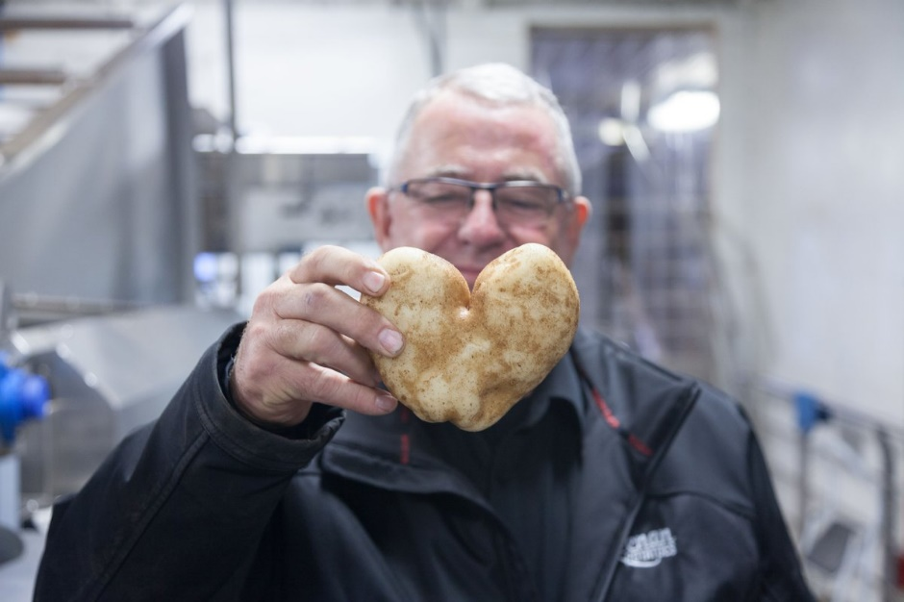
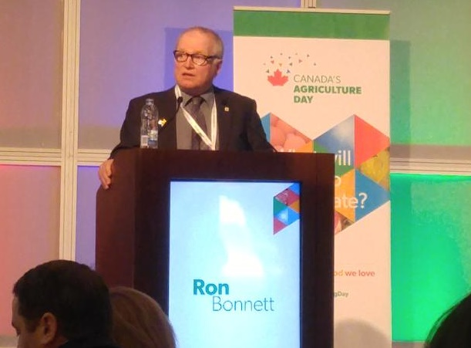
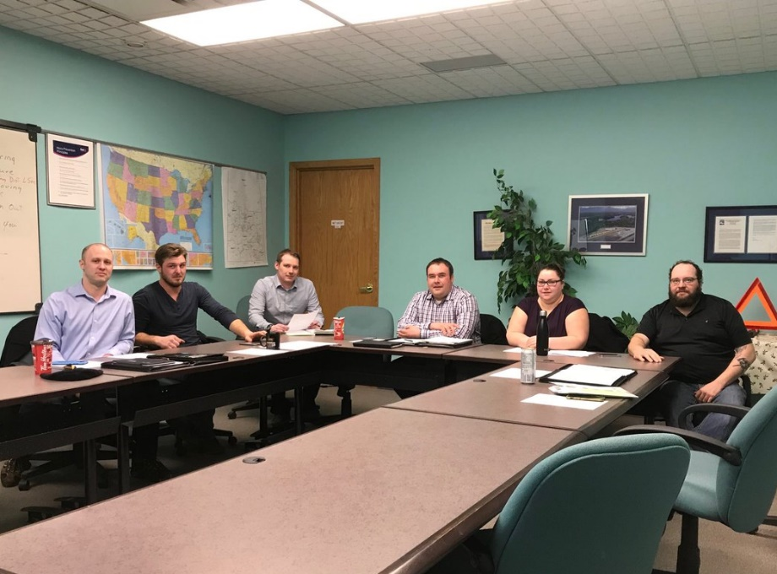
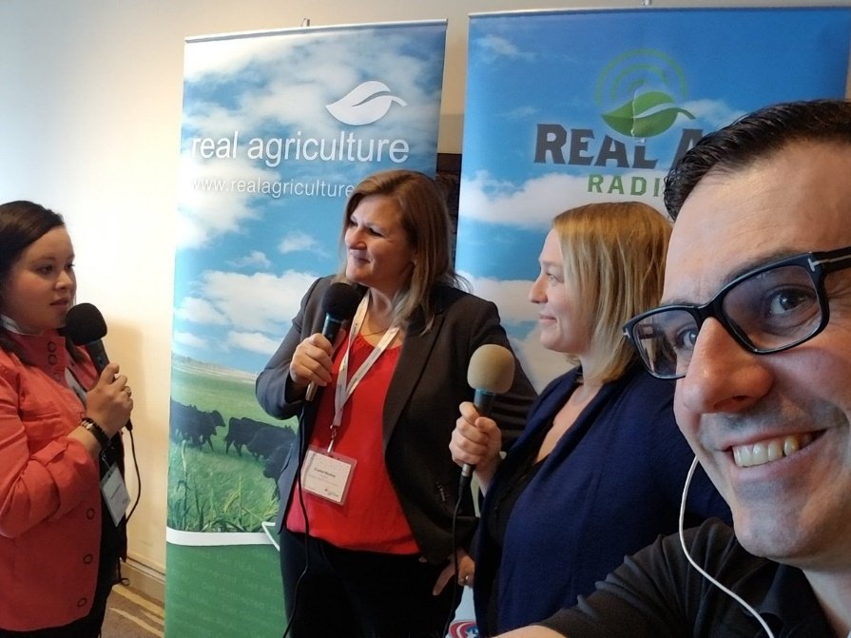
250+ events across the country!
#CdnAgDay
Craik, Saskatchewan
University of Guelph
Ag in the Classroom Newfoundland
Notes:
As I speak, our hashtag that you can see on the top-right corner of the screen is trending in Canada.
Well over 100 events across the country, touching thousands of people!
Agriculture in the Classroom Newfoundland and Labrador events in the schools
Riskan Hope Farm tour – bringing students to visit a farm in Craik SK
University of Guelph Food Talk is hosting an event at the university to help share their story with students, staff and community members
Not every event is a huge one either. A couple of hours down the road from the Riskan Hope Farm , near Shell Lake Saskatchewan, a farmer named Irene is inviting people to her place for a kitchen party! Irene is a small farmer who has llamas, sheep and goats. These are usually the types of events that we don’t hear about but know there’s many just like this being planned. It shows the true essence of Canada’s Agriculture Day and it’s inspiring all types of people across Canadian agriculture to get involved.

Slide 8
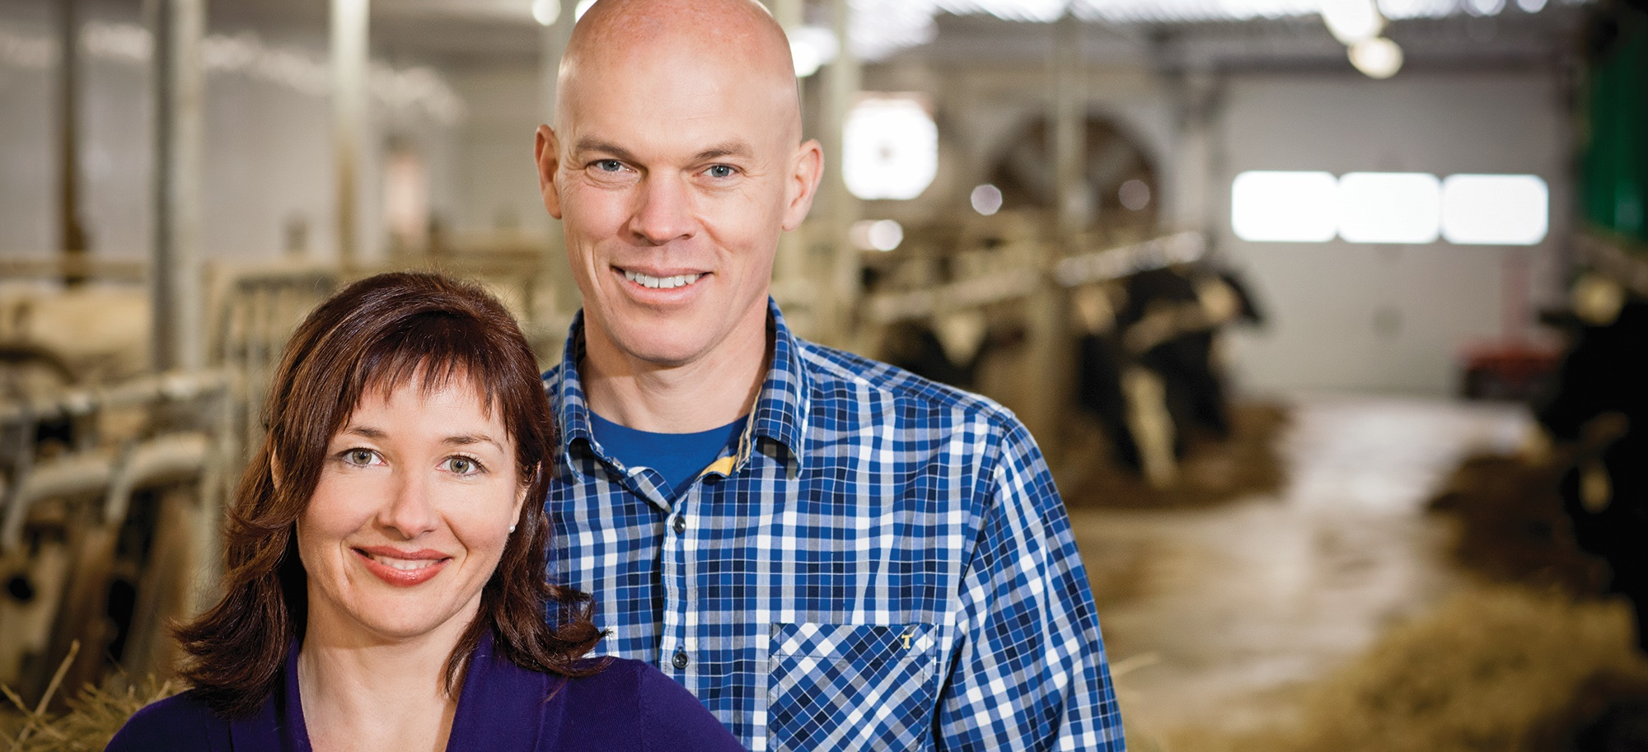
Canada’s Agriculture Day objectives
#CdnAgDay
Build a bridge between the industry and consumers
Celebrate Canadian agriculture and food
Connect with Canadians
Look ahead to a bright future

Slide 9
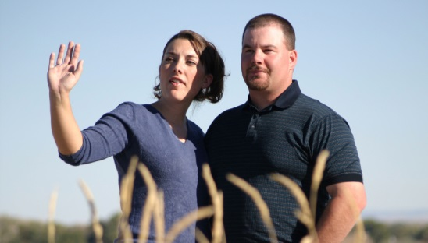
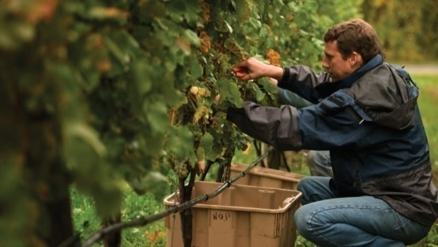
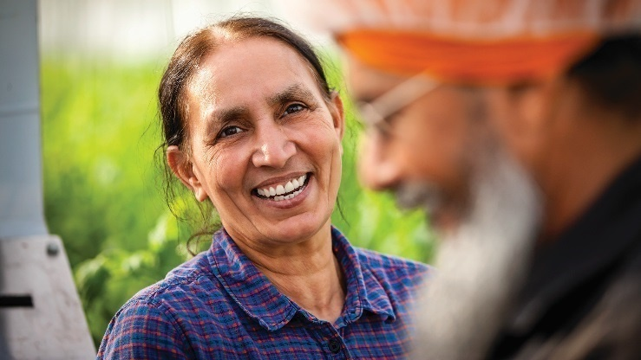
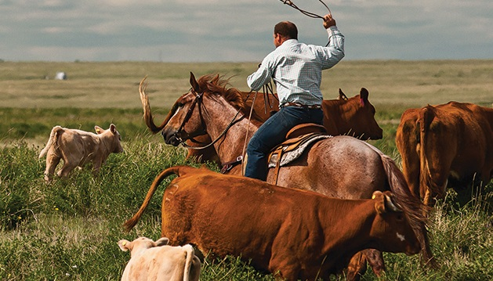
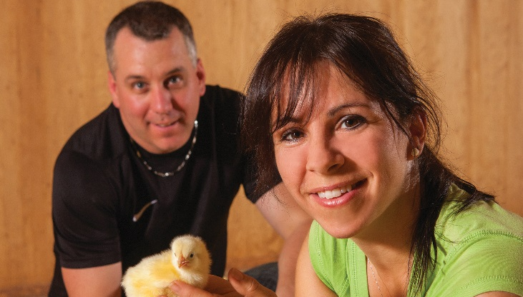
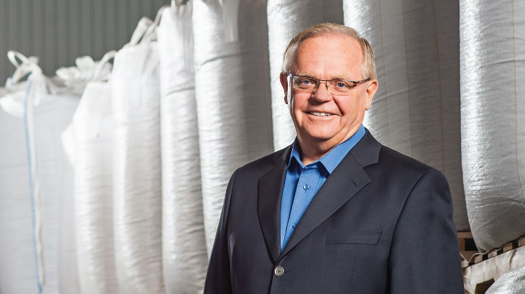
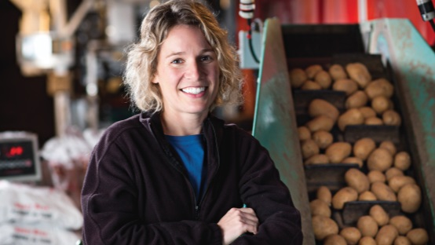
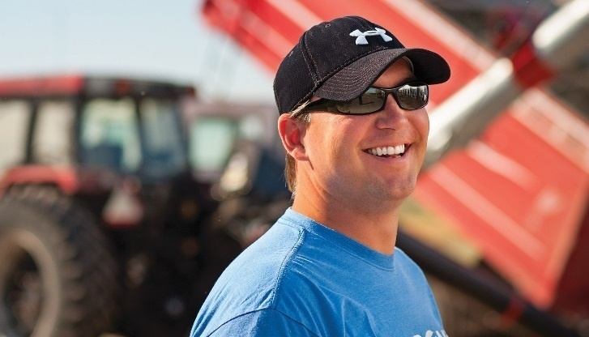
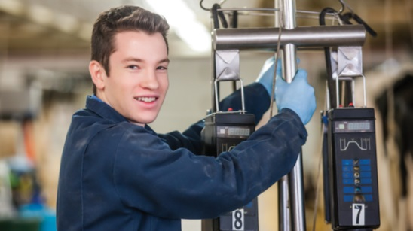
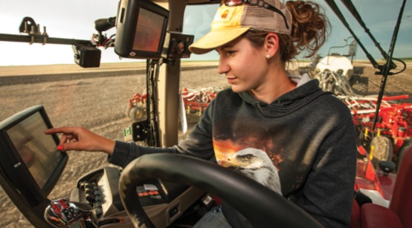
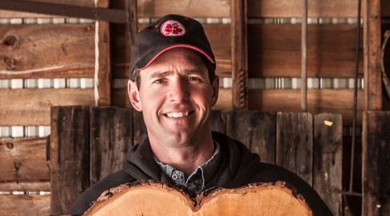
Why are we all so passionate?

Slide 10
What are the possibilities?

Slide 12
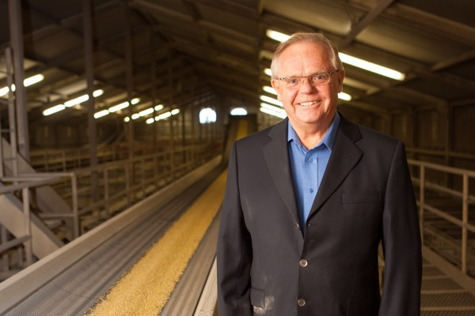
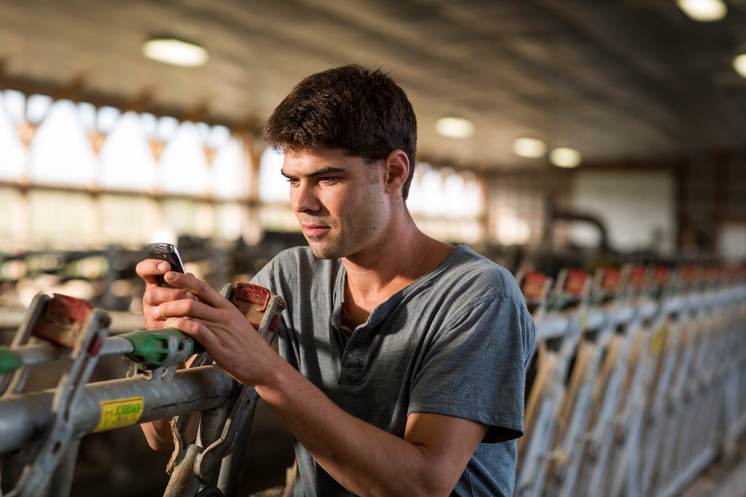
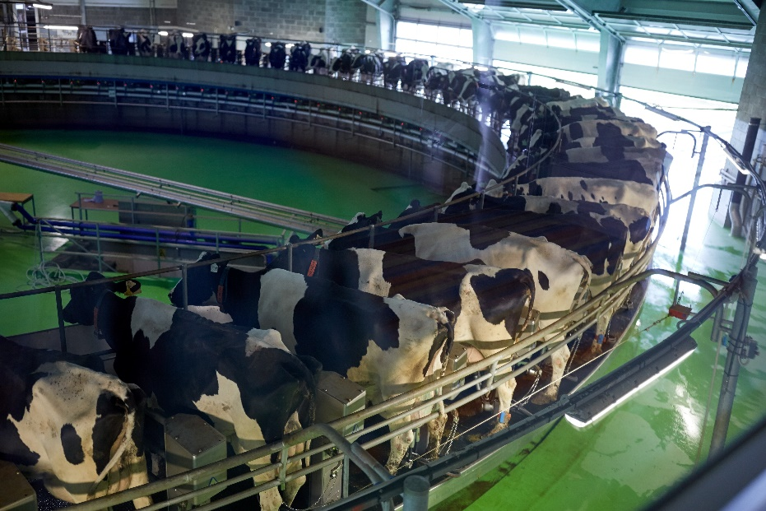
An amazing launching point
Record lending – major investment in ag and agri-food
New technology
Historically strong portfolio performance
Notes:
Record lending – major investment in ag and agri-food: On track to surpass our $9.2B disbursement target for this year.
Historically best portfolio performance: 99.6%
New technology

Slide 13
$75B
by 2025
Notes:
$75B by 2025 – Minister’s ag day release Quote from minister?

Slide 14
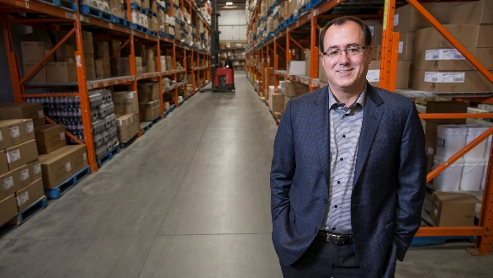
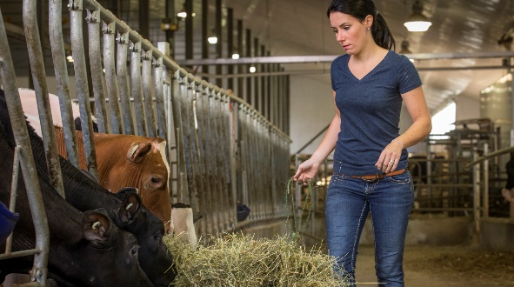
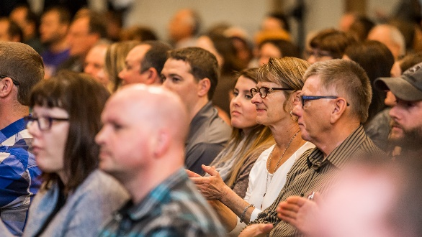
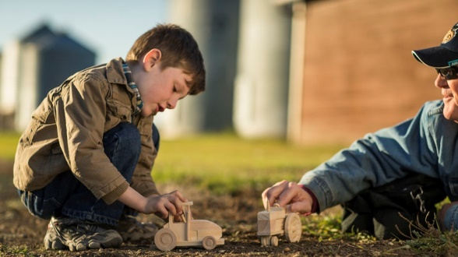
Strategic priorities for FCC
Opportunities for Canadian Ag
Add more value
Support the next generation
Renew knowledge offer
Innovate
Promote an inclusive, sustainable industry
Notes:
As discussed when we reviewed the Corporate Plan at the December meeting ….
Five key areas of focus – will touch on each of them
Re-envision commitment to A&A
Enhance support to next generation of ag
Advance FCC’s knowledge offering and advisory services
Adopt innovation as a way of being
Position FCC as a CSR leader

Slide 15
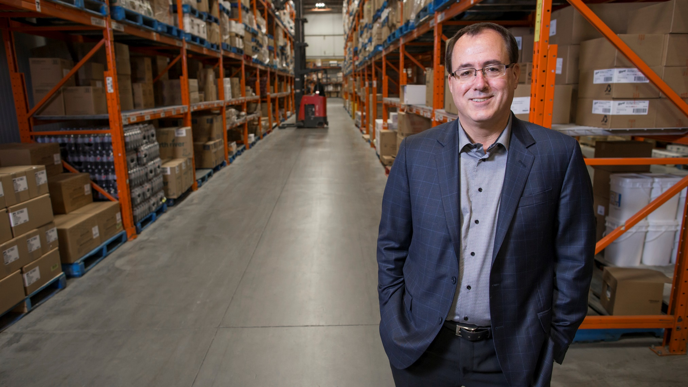
Add more value
Notes:
As discussed when we reviewed the Corporate Plan at the December meeting ….
Five key areas of focus – will touch on each of them
Re-envision commitment to A&A
Enhance support to next generation of ag
Advance FCC’s knowledge offering and advisory services
Adopt innovation as a way of being
Position FCC as a CSR leader

Slide 16
Support the next generation
Add more value
Support the next generation
Share knowledge
Innovate
Promote an inclusive, sustainable industry
Notes:
As discussed when we reviewed the Corporate Plan at the December meeting ….
Five key areas of focus – will touch on each of them
Re-envision commitment to A&A
Enhance support to next generation of ag
Advance FCC’s knowledge offering and advisory services
Adopt innovation as a way of being
Position FCC as a CSR leader

Slide 17
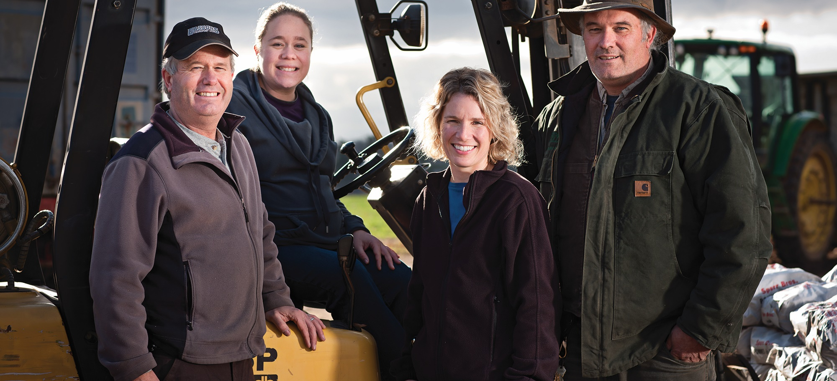
Agriculture’s burning platform
Average age of Canadian farmer:
55
Value of Canadian farm assets:
$591B

Slide 18
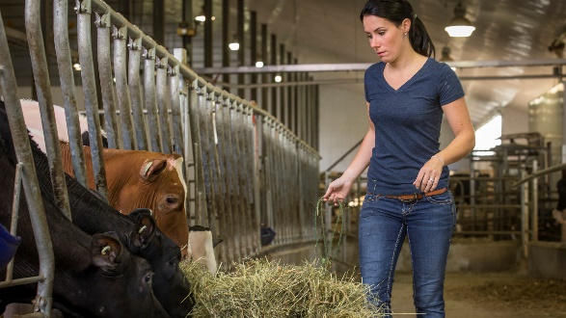
Share knowledge
Add more value
Support the next generation
Share knowledge
Innovate
Promote an inclusive, sustainable industry
Notes:
As discussed when we reviewed the Corporate Plan at the December meeting ….
Five key areas of focus – will touch on each of them
Re-envision commitment to A&A
Enhance support to next generation of ag
Advance FCC’s knowledge offering and advisory services
Adopt innovation as a way of being
Position FCC as a CSR leader

Slide 19
Innovate
Add more value
Support the next generation
Share knowledge
Innovate
Promote an inclusive, sustainable industry
Notes:
As discussed when we reviewed the Corporate Plan at the December meeting ….
Five key areas of focus – will touch on each of them
Re-envision commitment to A&A
Enhance support to next generation of ag
Advance FCC’s knowledge offering and advisory services
Adopt innovation as a way of being
Position FCC as a CSR leader

Slide 20
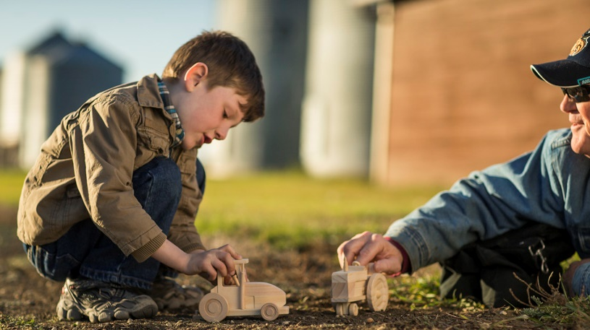
Promote an inclusive, sustainable industry
Add more value
Support the next generation
Share knowledge
Innovate
Promote an inclusive, sustainable industry
Notes:
As discussed when we reviewed the Corporate Plan at the December meeting ….
Five key areas of focus – will touch on each of them
Re-envision commitment to A&A
Enhance support to next generation of ag
Advance FCC’s knowledge offering and advisory services
Adopt innovation as a way of being
Position FCC as a CSR leader

Slide 21
Opportunities for Canadian Ag
Add more value
Support the next generation
Share knowledge
Innovate
Promote an inclusive, sustainable industry
Notes:
As discussed when we reviewed the Corporate Plan at the December meeting ….
Five key areas of focus – will touch on each of them
Re-envision commitment to A&A
Enhance support to next generation of ag
Advance FCC’s knowledge offering and advisory services
Adopt innovation as a way of being
Position FCC as a CSR leader

Slide 22
How are we going to get there?

Slide 23
The power of partnership

Slide 24
The power of partnership
www.agmorethanever.ca
Notes:
524 partners
4,000+ agvocates

Slide 25
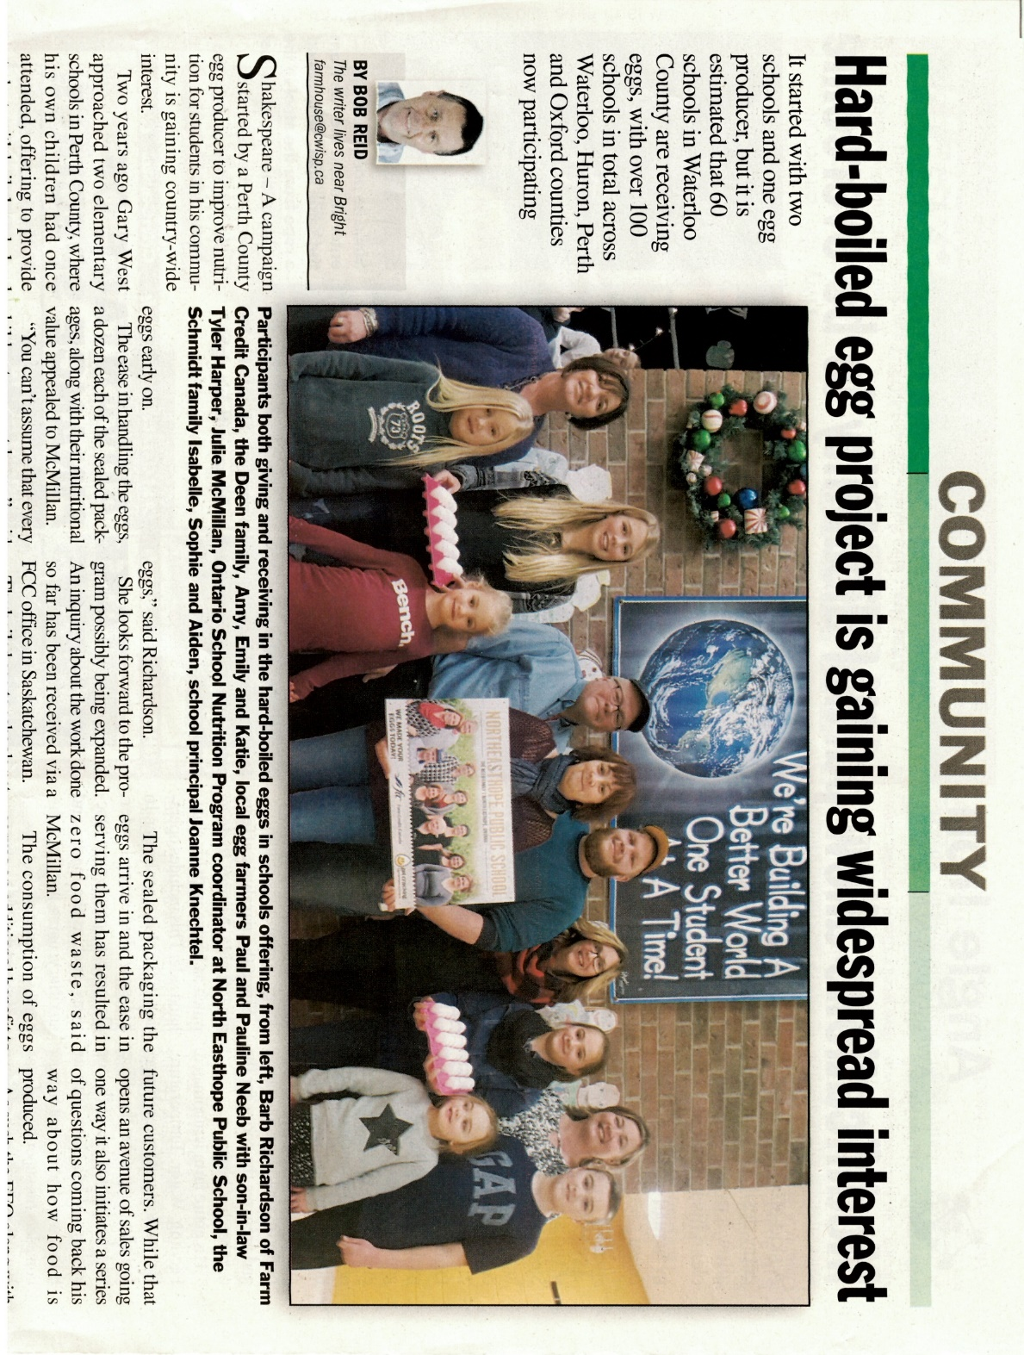
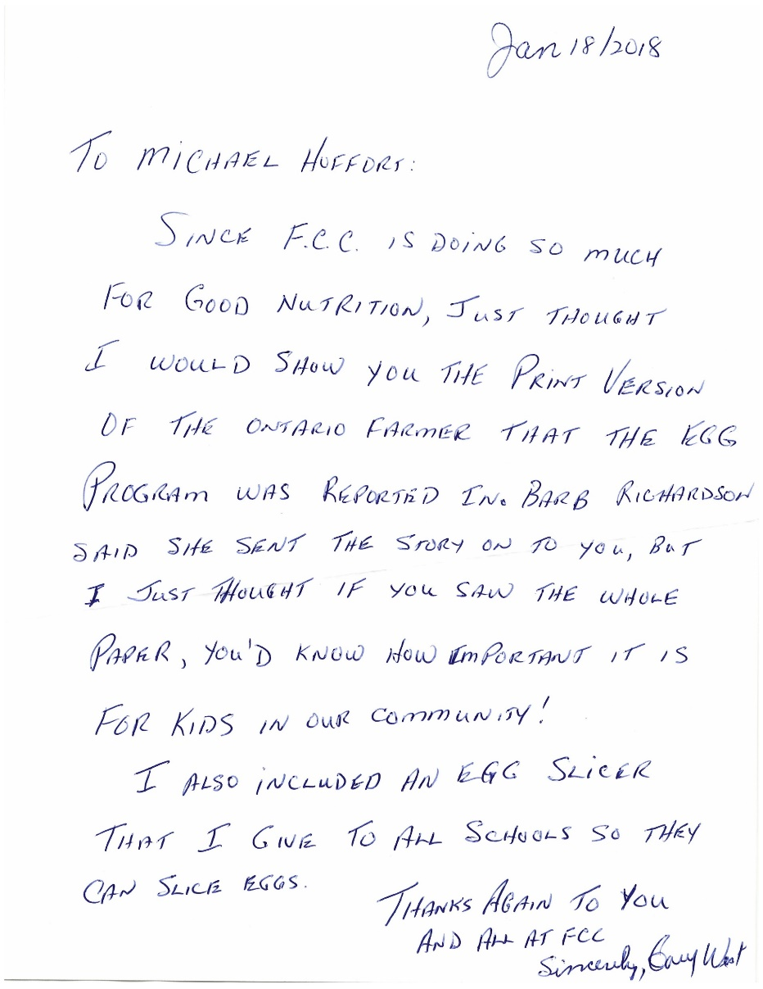
The power of partnership

Slide 26
The power of partnership
Notes:
Todd – Mental health/4H Leaders/participants Another org?

Slide 27
You’ve been doing this for 80+ years
Notes:
Todd/marty – CFA activity
Broad perspective on pressing issues to the industry
Sustainability round tables
Mental health
Food policy

Slide 28
“If you want to go fast, go alone. If you want to go far, go together.”
-African proverb

Slide 29
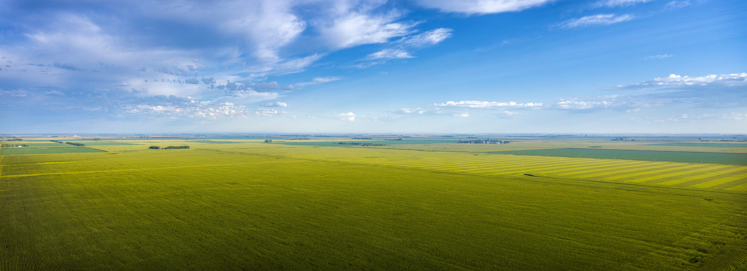
Canadian agriculture
A world of opportunity

