Slide 1
Fertilizer Canada Partnering for Success
Garth Whyte, President & CEO CFA Annual Conference March 1, 2018

Slide 2
“
Canada will become the trusted global leader in safe, nutritious, and sustainable food for the 21st century.
- Dominic Barton, chair, Advisory Council on Economic Growth
”
Notes:
Food Policy
Agriculture and Agri-Food Canada has launched a consultation on a national Food Policy, which will set the long-term vision for the health, environmental, social and economic goals of food, including:
Increasing access to affordable food;
Improving health and food safety;
Conserving soil, water and air; and
Growing more high-quality food
Current Status: Consultation was launched on May 29, 2017
Actions: Submitted response, due August 31, 2017
Timeline: No timeline for response to or implementation of strategy
Smart Agri-Food Supercluster
The Government of Canada will invest $950-million to create “superclusters”. In response to this opportunity, a coalition of agri-food groups led by Olds College submitted an application and was approved in the first round to develop data in the crop, livestock and processing sectors.
Current Status: With approval from Fertilizer Canada’s Board of Directors, Fertilizer Canada submitted a letter of support and proposed project under the supercluster.
Actions: Fertilizer Canada is appealing for approval of funding to this supercluster in related advocacy meetings.
Timeline: It is expected that funding for approved superclusters will be announced in early 2018.

Slide 3
Extreme weather events _{Global}
Risks Report 2018
Environmental
Natural disasters Failure of climate-change
mitigation and adaptation
Impact
Water crises
Biodiversity loss and ecosystem collapse
Cyberattacks
Societal
Food crises
Large-scale involuntary migration
Technological
Interstate conflict
Man-made environmental disasters
Geopolitical
Likelihood
www.andrewwinston.com Twitter: @AndrewWinston
Source: Andrew Winston

Slide 4
Source: Andrew Winston

Slide 6
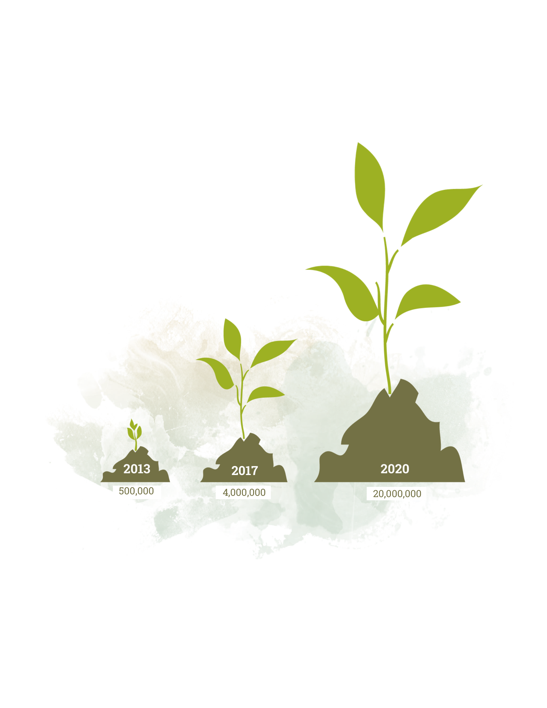
20 Million 4R Acres by 2020

Slide 7
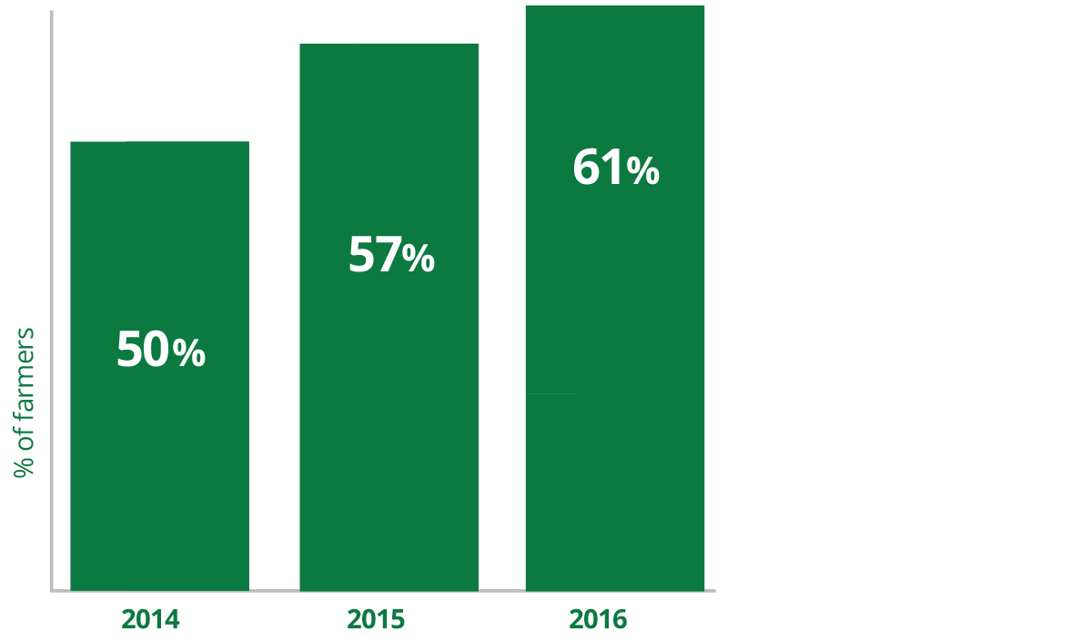
Grower Familiarity with 4R Nutrient Stewardship
* Source: Annual Fertilizer Use Surveys conducted by Pulse Canada

Slide 8
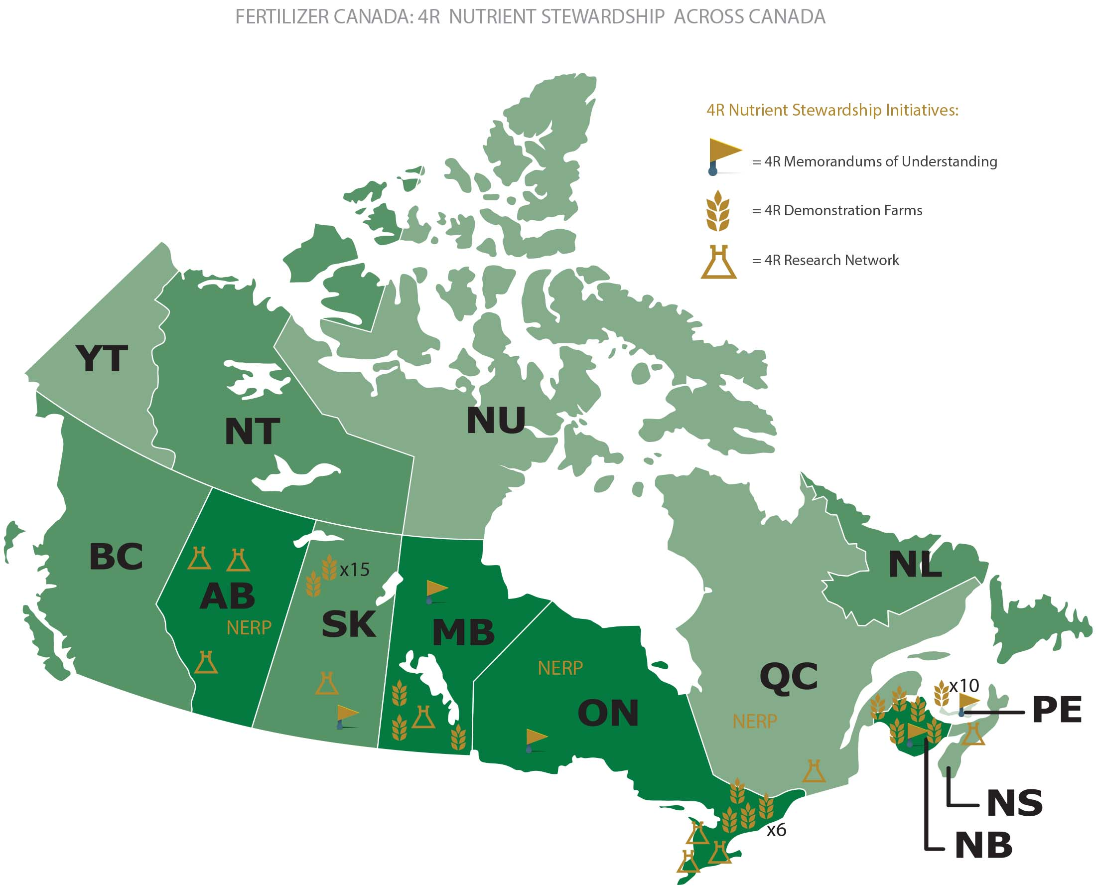
4R Nutrient Stewardship Across Canada

Slide 11
Working Together
Associations: Integrate the 4Rs into your organization goals and strategies
Growers: Implement the 4Rs as proven best practices for nutrient management, endorsed by the CFA
All: Utilize Fertilizer Canada’s eLearning resources on the 4Rs and safety and security

