Slide 1
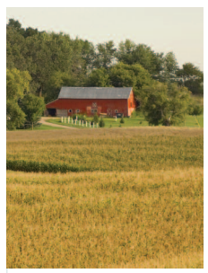
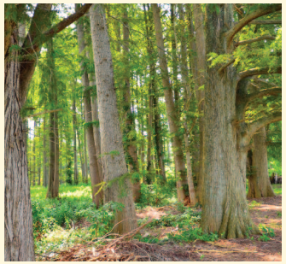
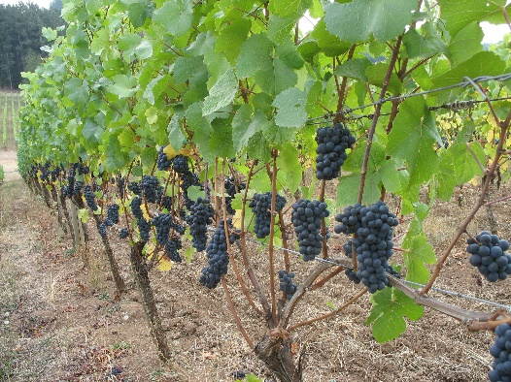
Climate Smart
Agriculture:
A New Vision &
Model for Agriculture
Lois Wright Morton, PhD Rural Sociology
North American Climate Smart Agriculture Alliance (NACSAA)
2018 March 1

Slide 2

An invitation…
North America Climate Smart Agriculture Alliance
A diverse, producer-led group of agricultural leaders

Slide 3
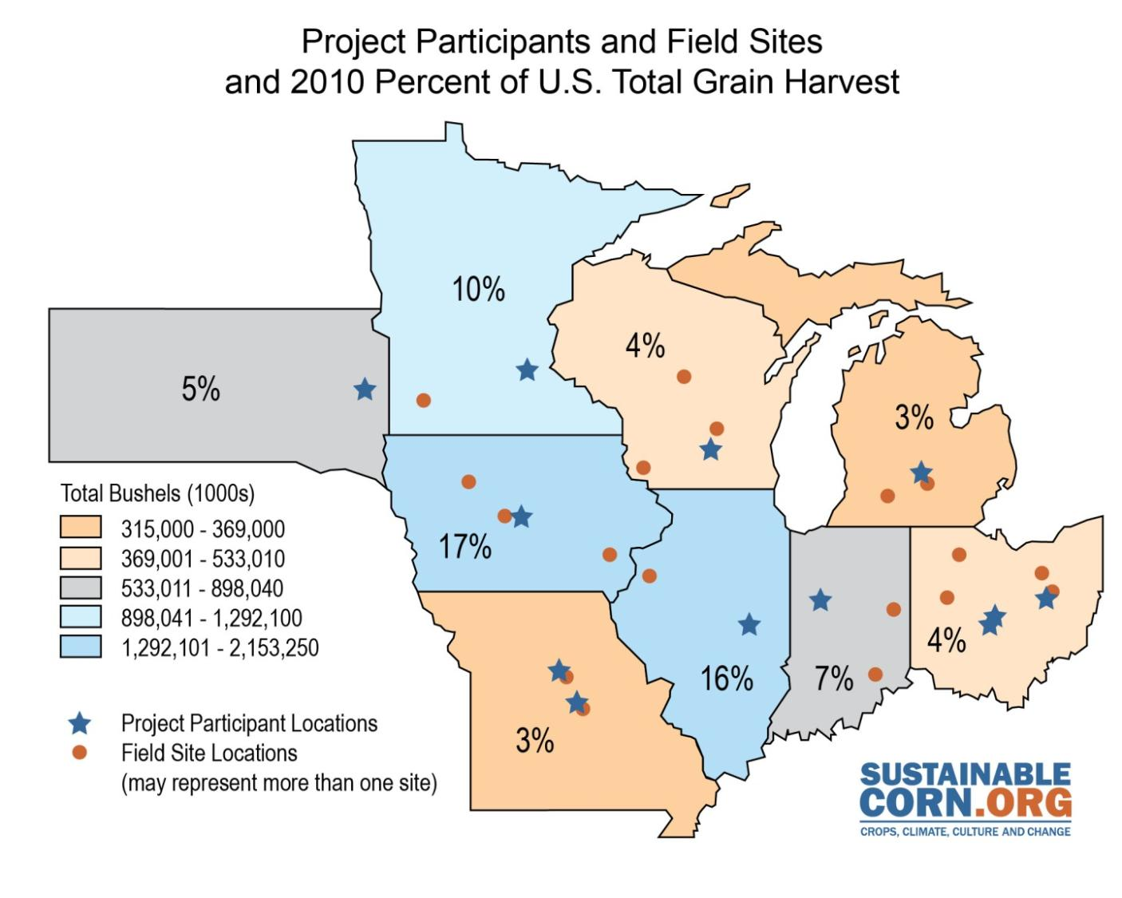

USDA-NIFA Climate & Sustainable Corn
Coordinated Agricultural Project (CAP) 2011-2017
36 research sites, field experiments
14 sites, GHG measurements
9 Upper Midwest states
10 Land Grant Universities
USDA-ARS
~140 faculty, graduate
students, post docs,
& technical staff
~200 farmers
Advisory board of industry,
NGO, agencies,
farmers & educators
The 11 institutions comprising the project team include the following Land Grant Universities and USDA Agricultural Research Service (ARS):
Iowa State University, Lincoln University, Michigan State University, The Ohio State University, Purdue University, South Dakota State University,
University of Illinois, University of Minnesota, University of Missouri, University of Wisconsin, and USDA-ARS Columbus, Ohio.
Notes:
2011 USDA-NIFA funded climate coordinated agricultural projects: reflecting the LGU mission and capacities: research, extension, and teaching.

Slide 4
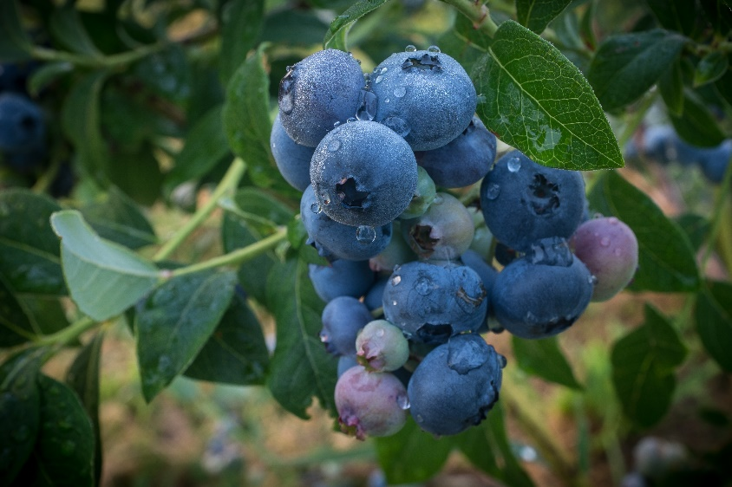
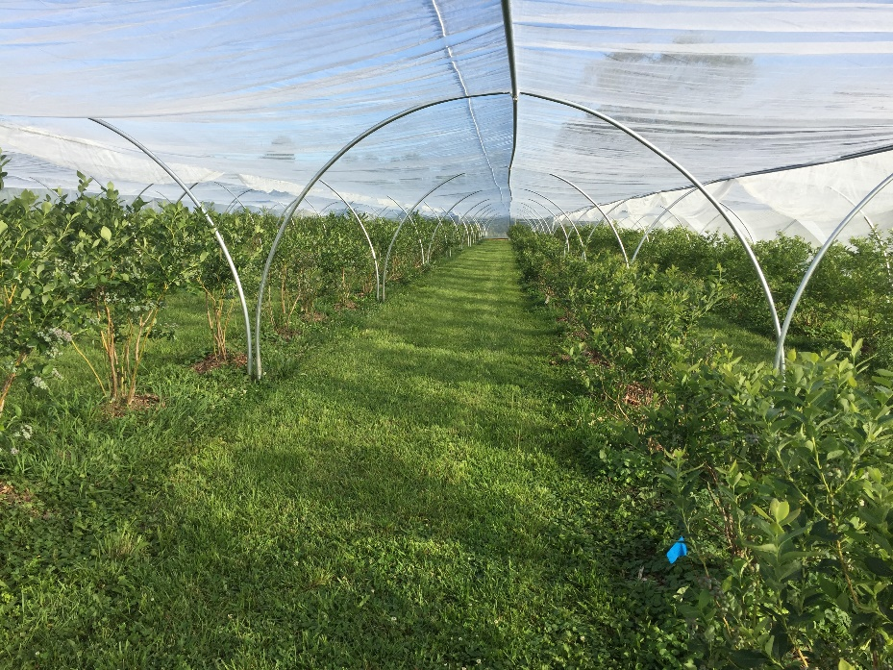
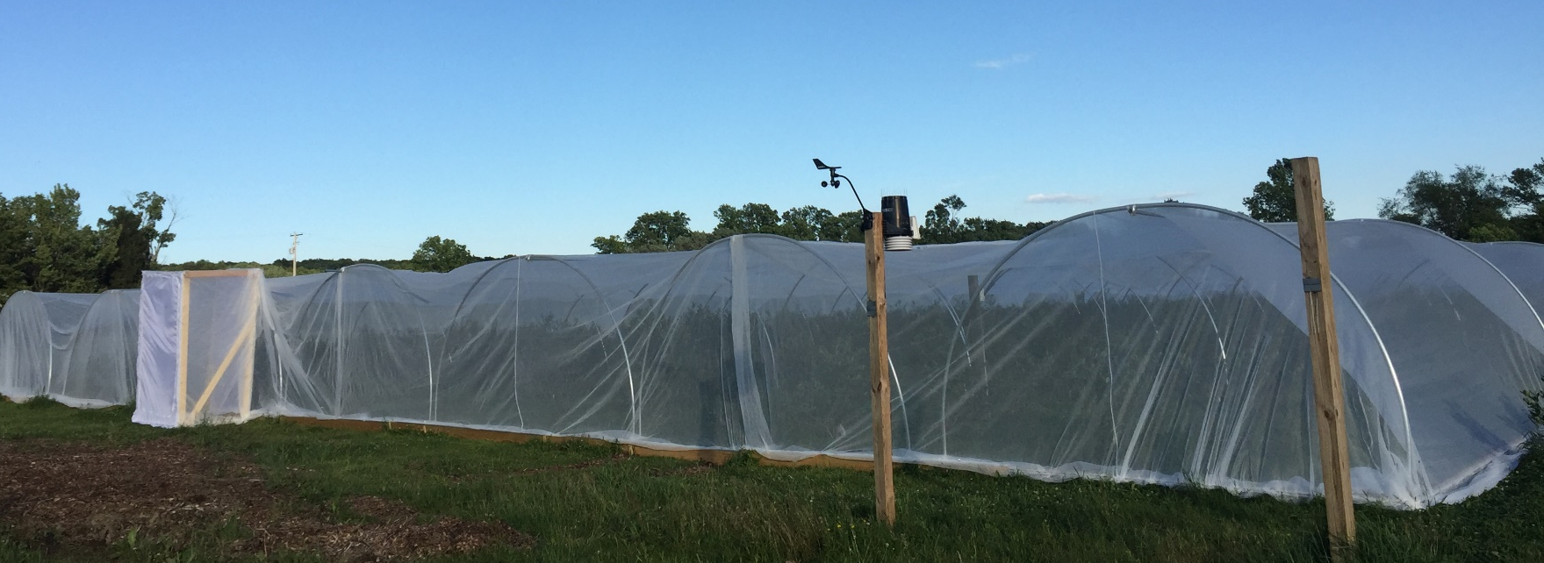
Outwash Terrace Farm

Slide 5
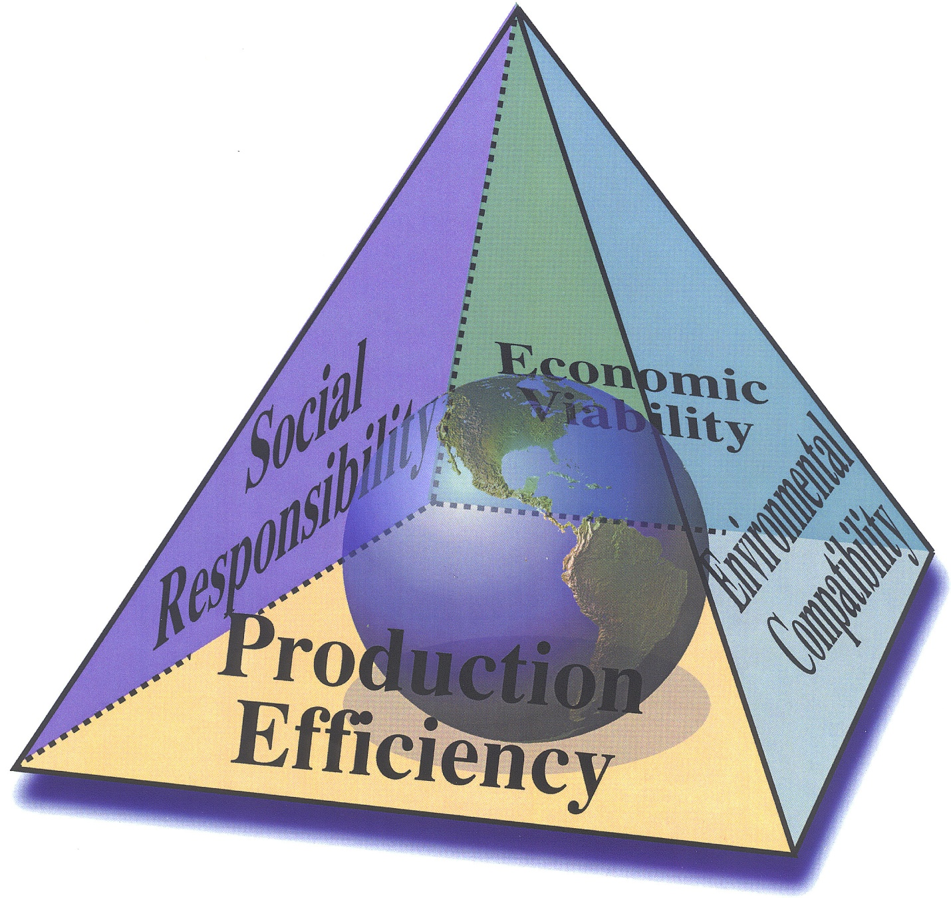
Farmers, specialty crop growers,
ranchers, foresters, and
our entire value chain are
juggling lots of balls
Figure Source: Bobby D. Moser, Vice President for Agricultural Administration and Dean, College of Food, Agricultural, and Environmental Services, The Ohio State University. “An Agricultural Call to Arms: Addressing Society’s Concerns”, <http://ohioline.osu.edu/paradigm/a0.pdf>

Slide 6
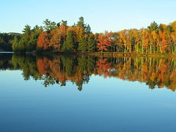
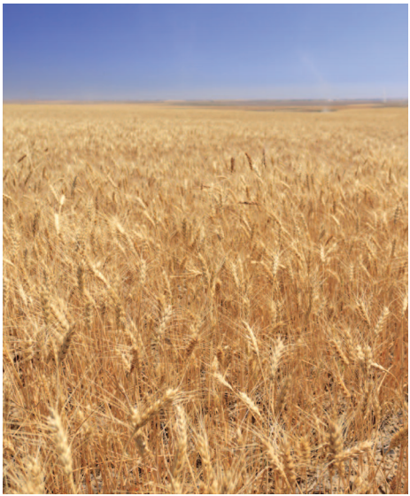

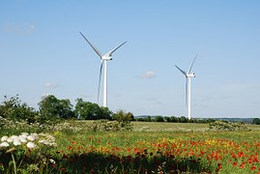
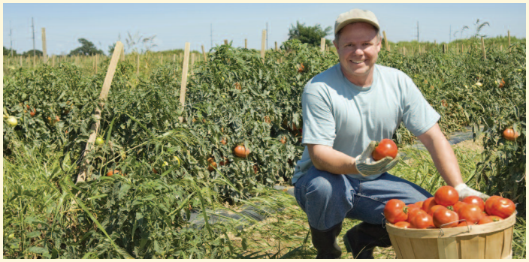
Ecosystem Services
Fiber
Feed
Core Functions
of
Agriculture
Clean Energy
Food

Slide 7
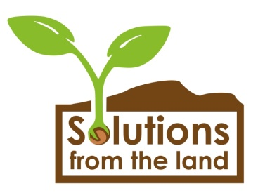
Solutions from the Land Vision
By 2050, agricultural systems and forests can be simultaneously managed to:
  satisfy domestic and global demand for safe, abundant and affordable food, feed, fuel, and fiber;
  support economic growth and sustainable development; reduce hunger and malnutrition;
  improve soil, water and air quality; enhance biodiversity and ensure ecosystem health, including preserving habitats;
  and deliver mitigation and adaptation solutions to mounting global climate challenges.
Notes:
Integration across agriculture, forestry and conservation can provide all of these services from the land, relieve pressure on natural habitats, conserve biodiversity and improve resilience in the face of climate change.

Slide 8
SfL’s Land Management Model
Less government driven
Multi-stakeholder partnerships
Integrated planning
Landscape scale planning & implementation
Incentive driven-rewards for ecosystem
services
8
Notes:
8

Slide 9
many challenges to secure this vision…
Conflicting Policies
Inadequate Rewards for Ecosystem Services
Declining Investments in Research and Innovation
Loss of Working Lands
And…
Market Volatility

Slide 10
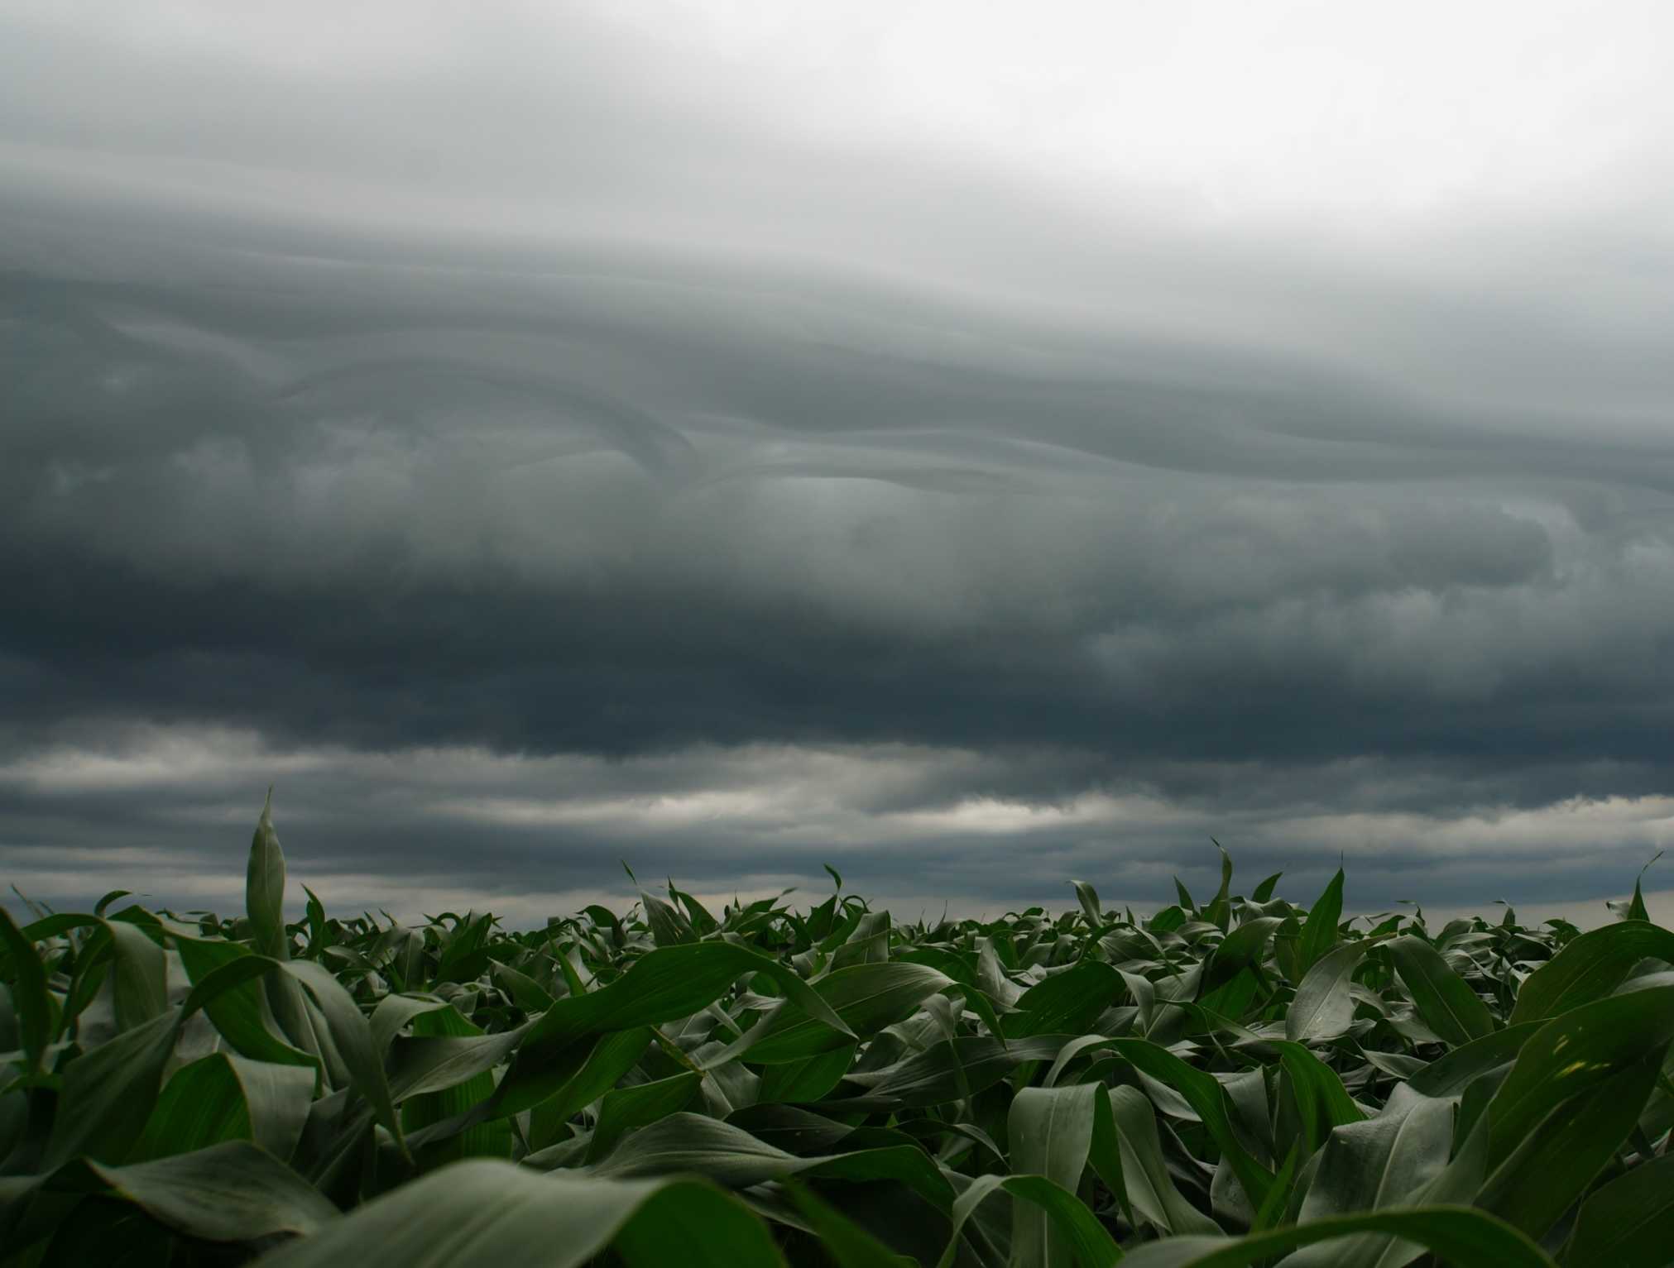
…more extreme weather events
and a changing climate which
are changing agriculture

Slide 11
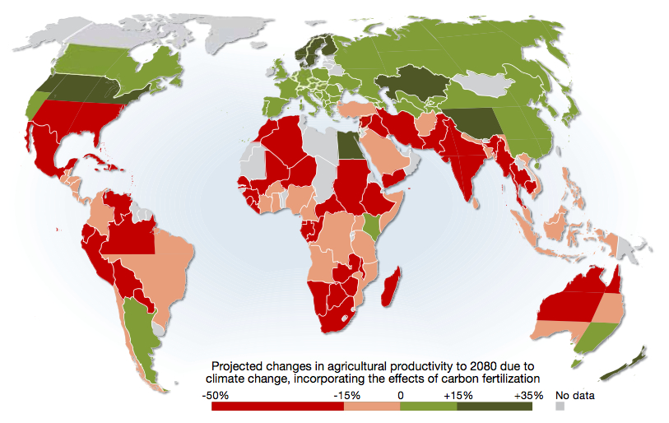
Projected changes in agricultural productivity to 2080 due to climate change
Figure courtesy of : http://www.grida.no/publications/rr/food-crisis/

Slide 12
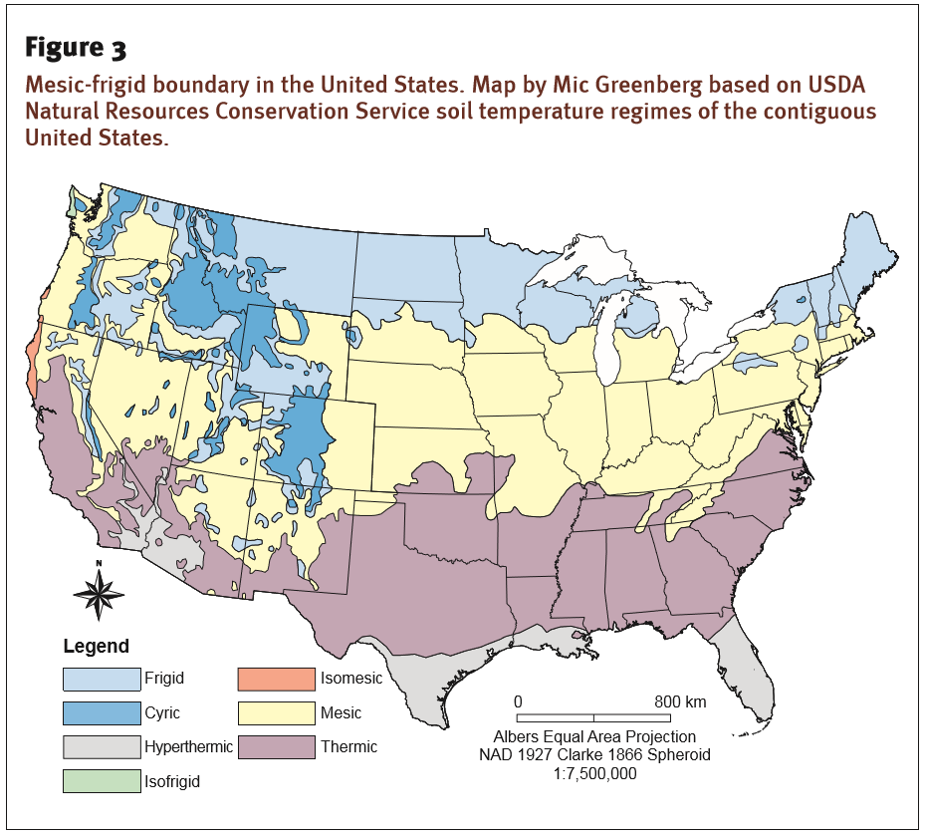
Morton, L. W. (2014). The science of variable climate and agro-ecosystem management. Journal of Soil and Water Conservation. 69:6:2017A-212A

Slide 13
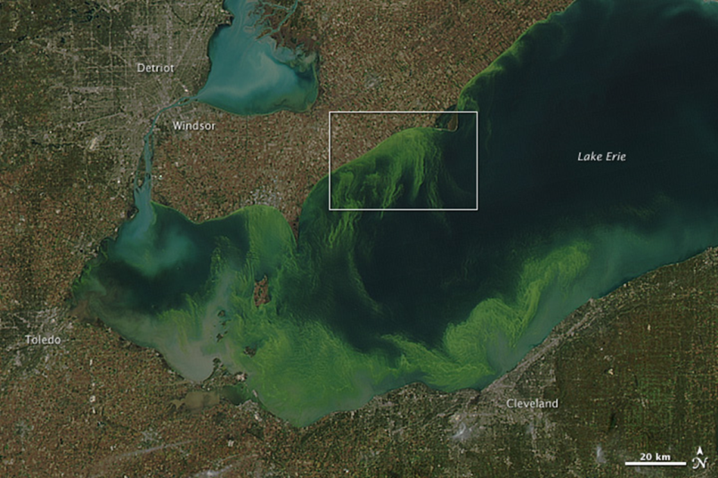
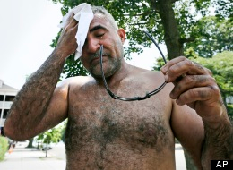

Impacts of Climate Change:
Photo of Lake Erie courtesy of NASA: http://earthobservatory.nasa.gov/IOTD/view.php?id=76127&eocn=image&eoci=related_image
Photo of man courtesy of the Associated Press: http://www.huffingtonpost.com/2013/07/17/heat-wave-2013_n_3612966.html
Photo of child courtesy of: http://www.nokidhungry.org/problem/hunger-facts

Slide 14
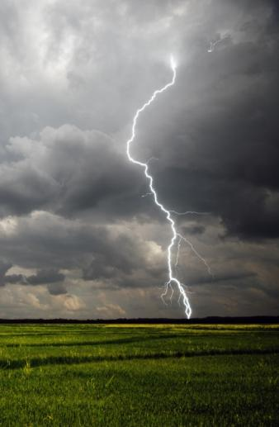
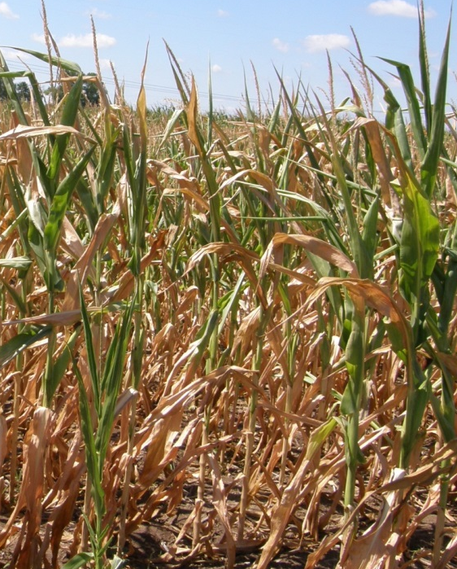
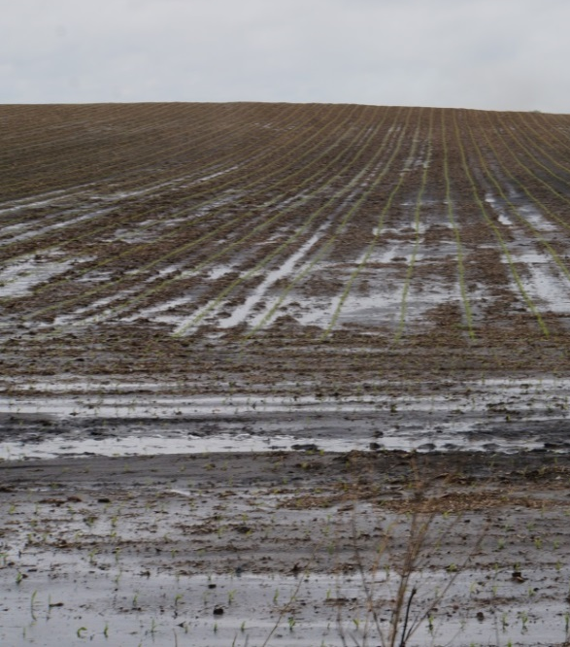
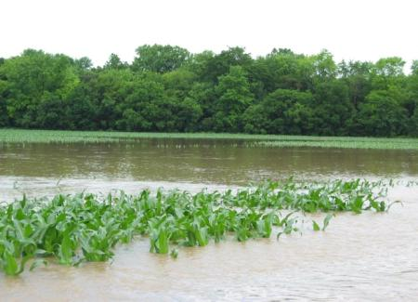
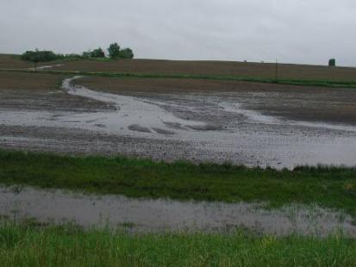
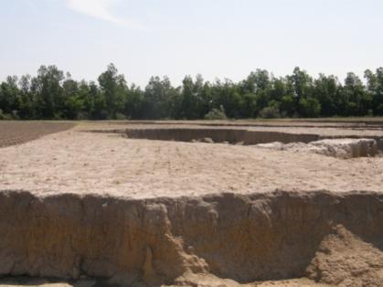
Water is a visible impact of extreme
and variable climate conditions
Notes:
A changing climate has complex multi-directional impacts
Human Impacts on Climate (mitigation)
Climate Impacts on Agricultural Production
Adaptation has potential to address both
The production problem: cultivated cropping systems are increasingly vulnerable to too much and too little precipitation, sometimes in the same growing season;
too high and low temperatures, high humidity.
An increasingly variable climate and our current systems of production place at risk
our capacity to produce food for growing populations AND
2) threaten the sustainability of our soil and water resources, and resilience of the agroecosystem to continue to produce into the future
Think N water degradation, N nitrous oxide GHG; C soil organic carbon stocks, soil erosion; water cycle-drought and quality; stakeholders-farmers, ag advisors; and inter connected systems

Slide 15
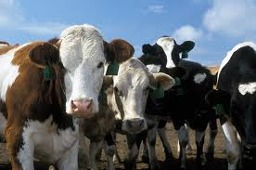
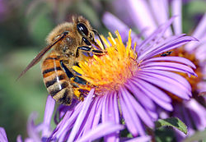
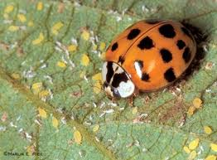
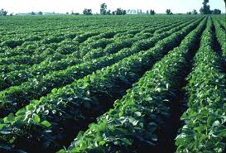
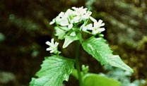
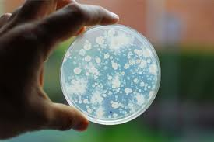
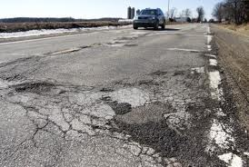
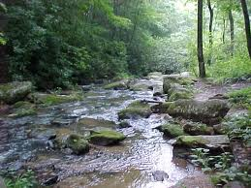
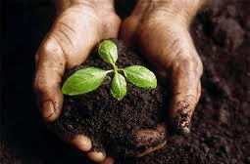
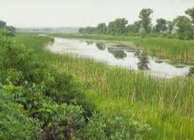
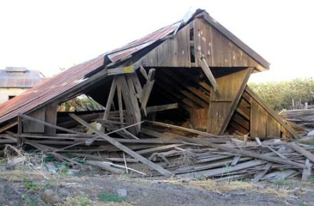
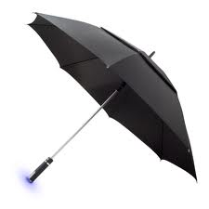
Impact the entire agroecosystem
Crops
Livestock
Pollinators
Pests
Invasives
Disease
Infrastructure
Water
Soil
Biodiversity
Insurance
Forecasting
Notes:
Some of the topics these groups will be exploring are:
Crops
Livestock
Pollinators
Pests
Invasives
Disease
Infrastructure
Water
Soil
Biodiversity
Insurance
Forecasting

Slide 16


Slide 17
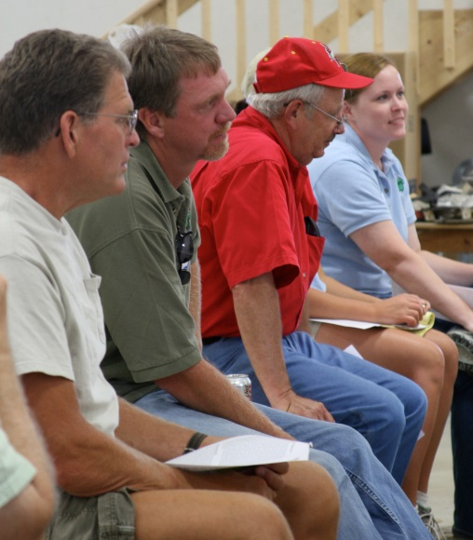
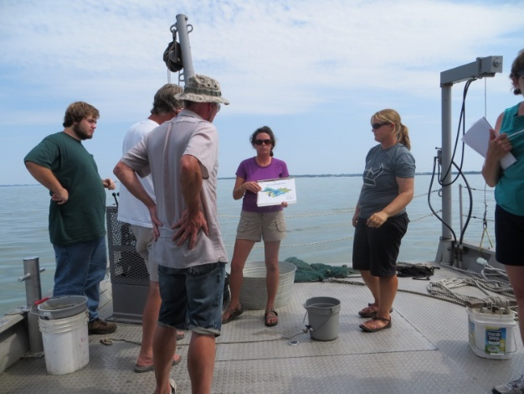
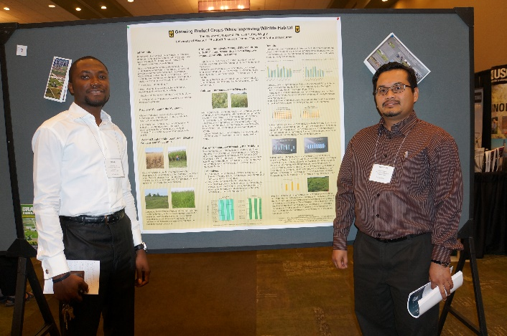
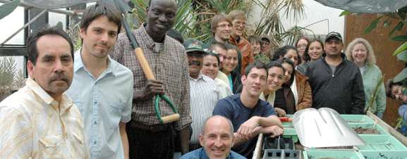
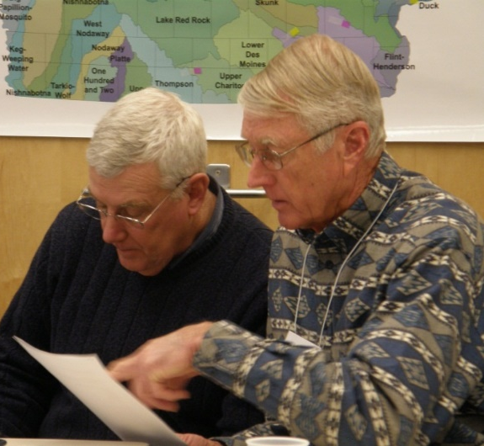
The entire continuum and knowledge of agricultural and forestry systems is needed—
to ensure robust local, national and global agricultural systems and
the integrity of healthy agroecosystems under an increasingly variable climate.

Slide 18
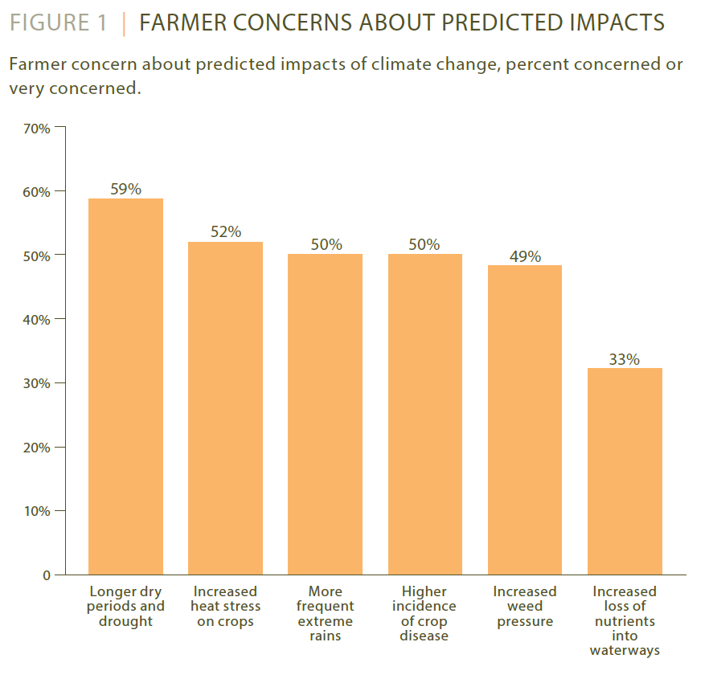


Slide 19
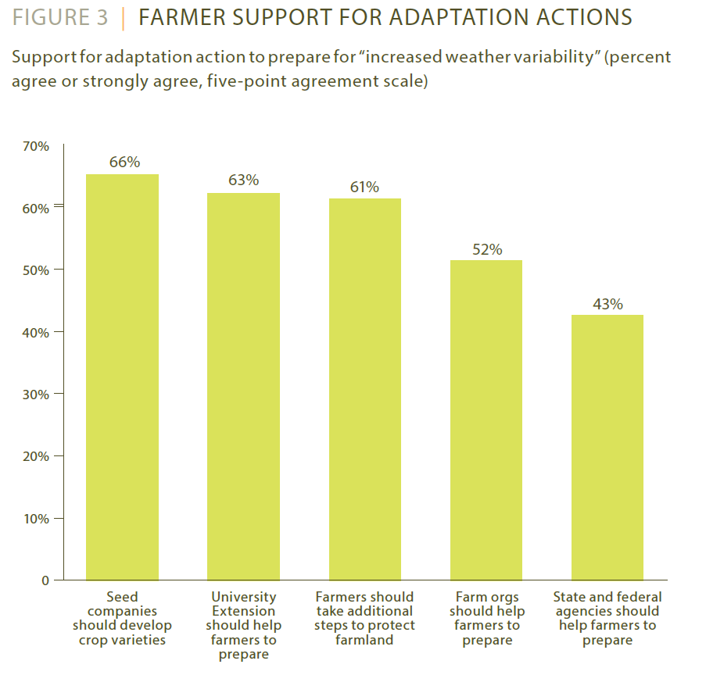

Slide 20
North America Climate Smart Agriculture Alliance
NACSAA
Producer-led implementation of CSA
Increase adaptive capacity of NA agriculture
Adaptation: minor adjustment & major changes
Sustainable intensification
Adaptive capacity & resilience
Deliver ecosystem services (e.g. water quality,
soil health, carbon sequestration, GHG)

Slide 21
NACSAA A platform for knowledge sharing and the application of climate science to agriculture
Crop & Livestock Hardiness
Erratic Weather
Mitigation of Environmental Impacts
Water Use Efficiency
Pest & Invasive Species Management
Adaptation &
Resiliency
GHG Reduction
Productivity
(sustainable
intensification)
Feed
Food
Fiber
Energy
Ecosystem
Services
Carbon
Sequestration
Clean Fuels
Methane Capture
Soil Health
Nutrient Use Efficiency
Precision Agriculture
Bio-power
Biofuels
Infrastructure
Partner Contributions
Knowledge Sharing
Communication, Outreach, and Education
Place- Based Planning
Data Collection & Aggregation
Decision Support Tools
Innovation Forum
Priority Needs Assessment
Inter-Disciplinary Stakeholder Collaboration
NACSAA Services

Slide 22

Engagement to Enable
CSA practices
1. Producer-led catalytic leadership
2. Knowledge sharing. Access & use of local
knowledge, science & technologies
3. Create policy environments to
foster & scale CSA
4. Unlock financing to implement CSA

Slide 23
Why is this work important?
Climate change will present new opportunities and challenges for agriculture and forestry
Through dialogue and the appropriate measures, producers can adapt to a changing climate
Adaptation is an investment into the future of our nation and its producers
Many adaptation actions will have added benefits such as reducing costs, increasing productivity, and expanding market access
23
Notes:
Add: “implementation of the best solutions that we have.”
23

Slide 24
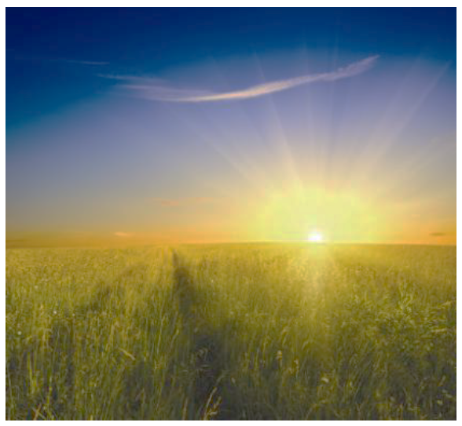
A world where agriculture moves from the source of problems to the source of solutions

Slide 25
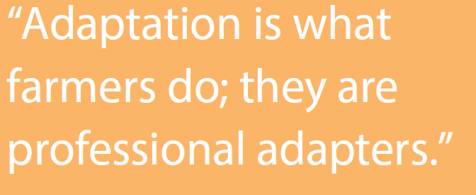
Please join us!
Midwest corn-soybean farmer 2012

